Slide 1
Analysis of Customer Behavior on E-Commerce Platform
Prashant Dhungana (30080130)
Prateek Kaushik (30229287)
Mariya Mathews (30192182)
Nisha Pillai (30158934)

Slide 2
MOTIVATION
E-commerce has redefined the way we shop over the past decades.
The objective of our project is to conduct statistical analysis to understand attributes and factors that influence customer behavior on e-commerce platforms.
Understanding customer behavior can help business to strategize on increasing customer satisfaction.

Slide 3
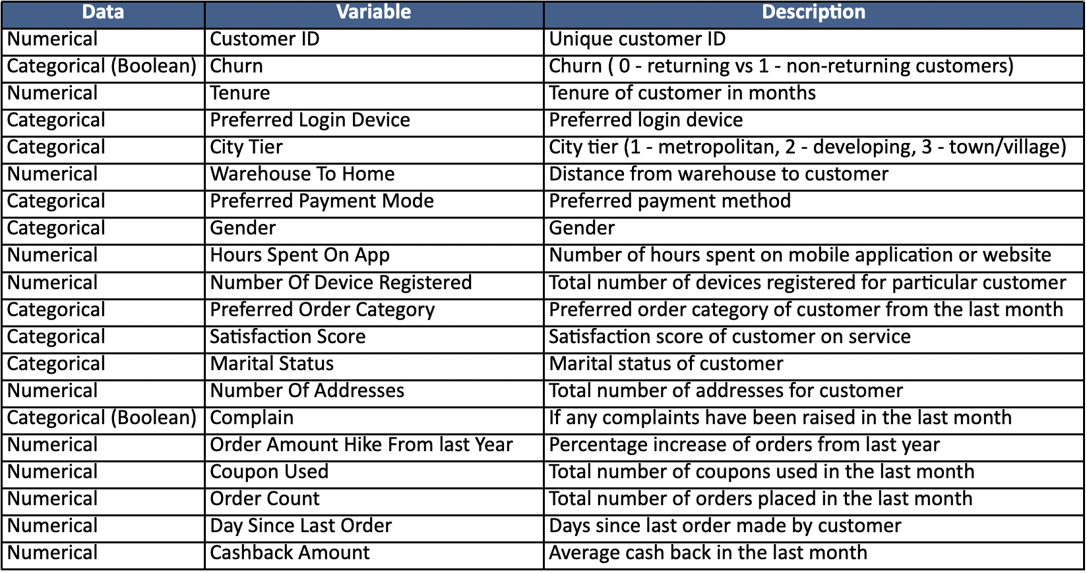
DATASET
5300+ rows
20 columns
Reference: https://www.kaggle.com/datasets/ankitverma2010/ecommerce-customer-churn-analysis-and-prediction

Slide 4
DATA
ANALYSIS

Slide 5

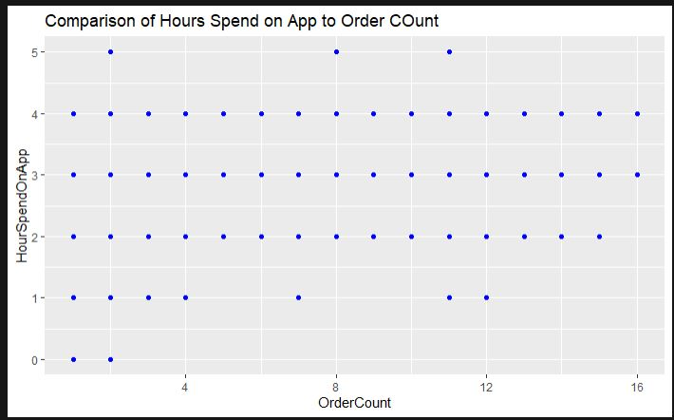

Can the number of hours spent on the app predict the purchase frequency of a user?-Linear Regression
There is no relationship between hours spent on the app and the order count.
There is a relationship between hours spent on the app and the order count.

Slide 6
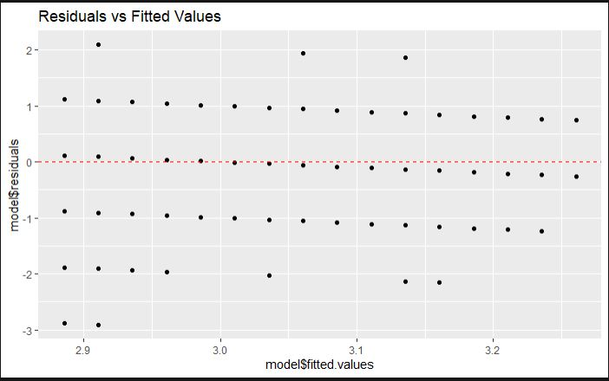
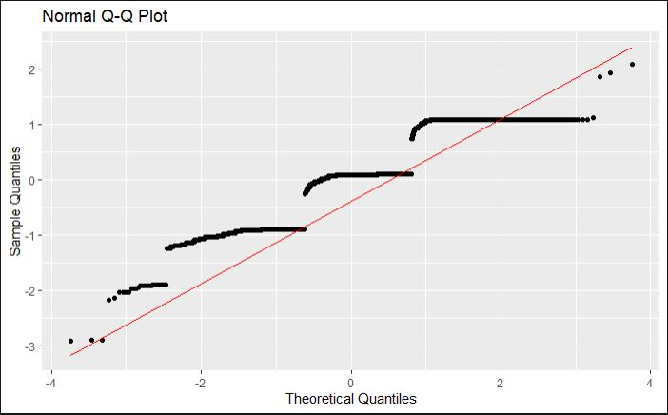
Condition Check

Slide 7
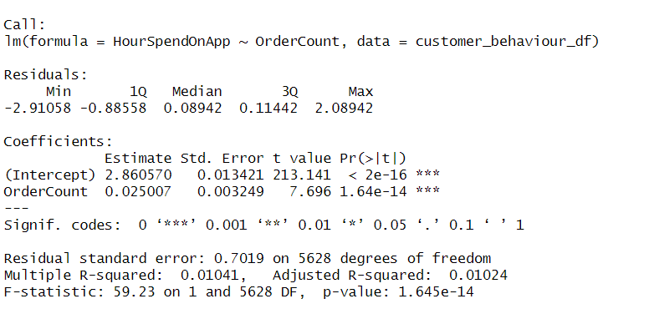
Linear Regression Summary

Slide 8
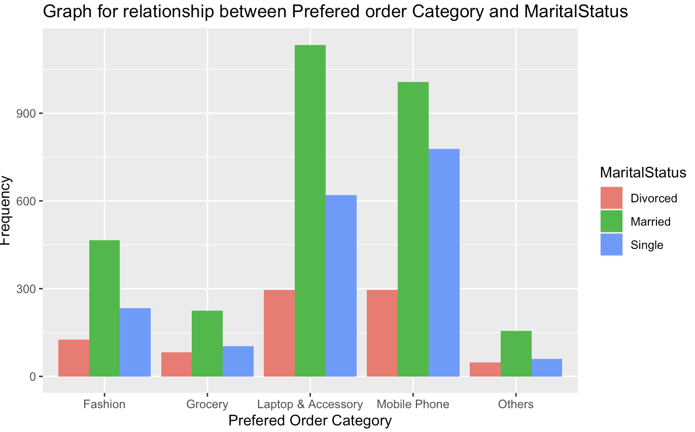
Is there enough evidence to suggest Order Category Preference is independent of Marital Status? -Chi-Squared Test
Order Category Preference is Independent of Marital Status
Order Category Preference is NOT Independent of Marital Status

Slide 9
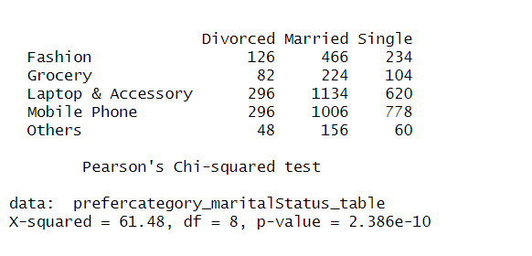
Pearson’s Chi-squared test Summary

Slide 10
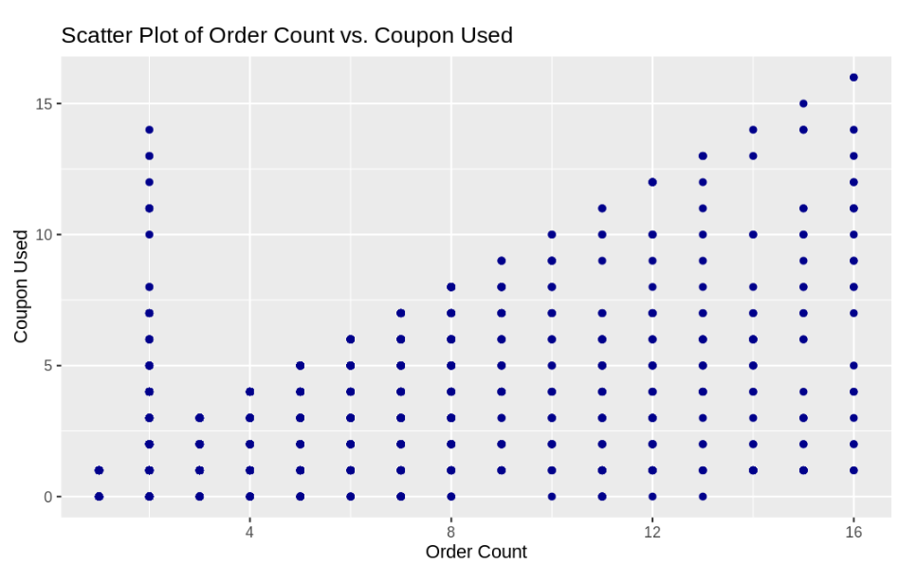
Do we have any correlation with the number of orders and number of coupons?
There is no significant correlation between the number of OrderCount and the number of CouponUsed.
There is a significant correlation between the number of OrderCount and the number of CouponUsed

Slide 11
Assumptions Before Statistical Analysis
1. The data is numeric & continuous
2. There are no extreme outliers in the data
3. Normal distribution of the data

Slide 12
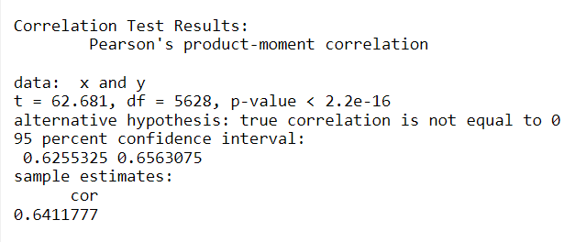
Let us check through Pearson’s Correlation Test

Slide 13
Inference
As per our Pearson's correlation test, we can confidently say that there's a very strong relationship between Order Count and Coupon Used.
With a very small p-value which is 2.2e-16, stating that we can reject the null hypothesis (we reject the null hypothesis if the significance value is smaller than 0.05) because we have high correlation between the Order Count and Coupon Used.
On the other hand, the 95 percent confidence interval for the correlation coefficient falls between approximately 0.6255 and 0.6563. This interval provides a range of values within which the true population correlation is likely to lie.

Slide 14
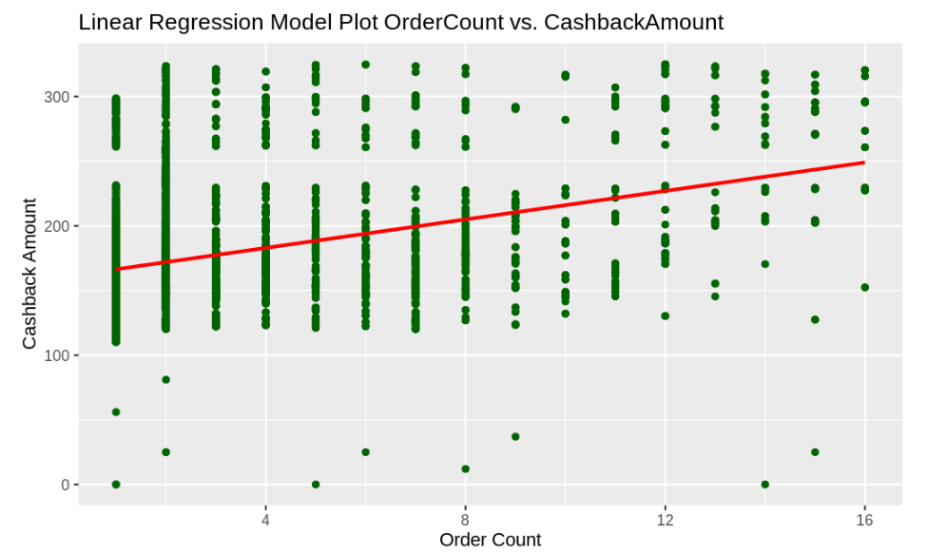
Can we find any relationship between the number of orders and cashback amount received?
There is no significant correlation between the number of orders ("OrderCount") and the cashback amount received ("CashbackAmount")
There is a significant correlation between the number of orders ("OrderCount") and the cashback amount received ("CashbackAmount")

Slide 15
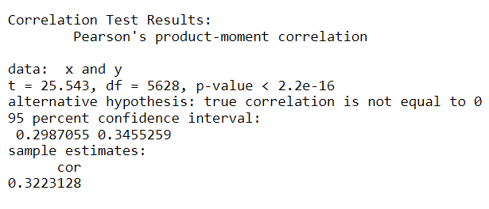
Pearson's product-moment correlation

Slide 16
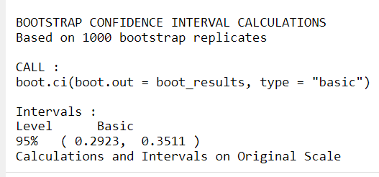
BOOTSTRAP CONFIDENCE INTERVAL CALCULATIONS

Slide 17
Inference
The bootstrap analysis indicates that the 95% confidence interval for the correlation coefficient (Pearson's r) between "OrderCount" and "CashbackAmount" is between 0.2923 and 0.3511.
This means that we can be 95% confident that the true correlation in the population falls within this interval.
In simpler terms, it suggests that there is a statistically significant positive correlation between the number of orders and the cashback amount received, and the correlation is estimated to be within the specified interval.
This information provides a measure of the relationship's strength and the uncertainty associated with the estimate.

Slide 18
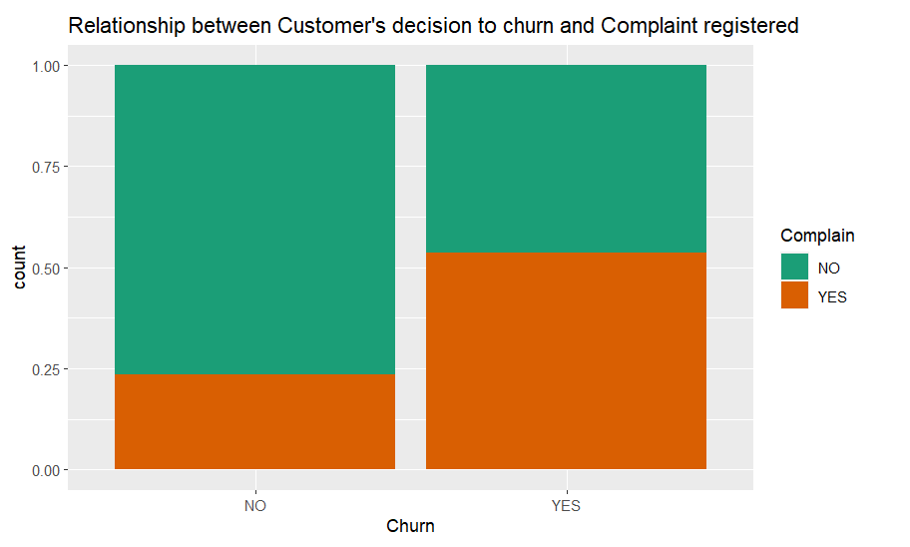
Is there enough evidence to suggest churn is independent of Complaints registered or not?
There is no relationship between customer registering complaint and Decision to churn
There is a relationship between customer registering complaint and Decision to churn

Slide 19
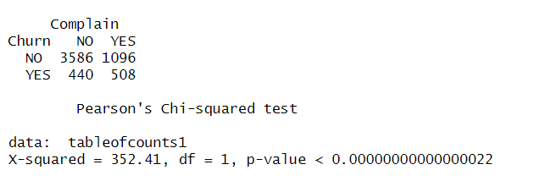
Pearson’s Chi-squared test Summary

Slide 20
Conclusion
A linear relationship exists between "Order Count" and "Hours Spent on the App."
"Preferred Order Category" is also dependent on "Marital Status."
"Order Count" depends on "Cashback Amount."
"Order Count" is influenced by "Coupons Used."
"Churn" is also associated with user "Complaints."

Slide 21
References
Verma,(2021, January 26) A. Ecommerce customer churn analysis and prediction. Kaggle. https://www.kaggle.com/datasets/ankitverma2010/ecommerce-customer-churn-analysis-and-prediction
Countants. (2020, January 5). Why consumer behavior analysis is so relevant to the ecommerce business? Medium https://medium.datadriveninvestor.com/why-consumer-behavior-analysis-is-so-relevant-to-the-ecommerce-business-8f49c250ca9c
Zanzana, Salim, and Jessica Martin. (2023, February 21). Retail e-commerce and COVID-19: How online sales evolved as in-person shopping resumed. https://www150.statcan.gc.ca/n1/pub/11-621-m/11-621-m2023002-eng.html
Verma, Ankit.(2023, July 6). “E-commerce Dataset.” (CC BY-NC-SA 4.0) creativecommon.org https://creativecommons.org/licenses/by-nc-sa/4.0/

