Slide 1

CAPTAIN ACQUISITION & SUPPLY REVIEW
Captain Onboarding &
Airport Supply
Findings and Recommendations • Data through June 30, 2026
18.0%
+90/mo
40%
of signups become
approved captains, today
more approved captains
from three fixes below
of airport rides go
unfulfilled at night

Slide 2
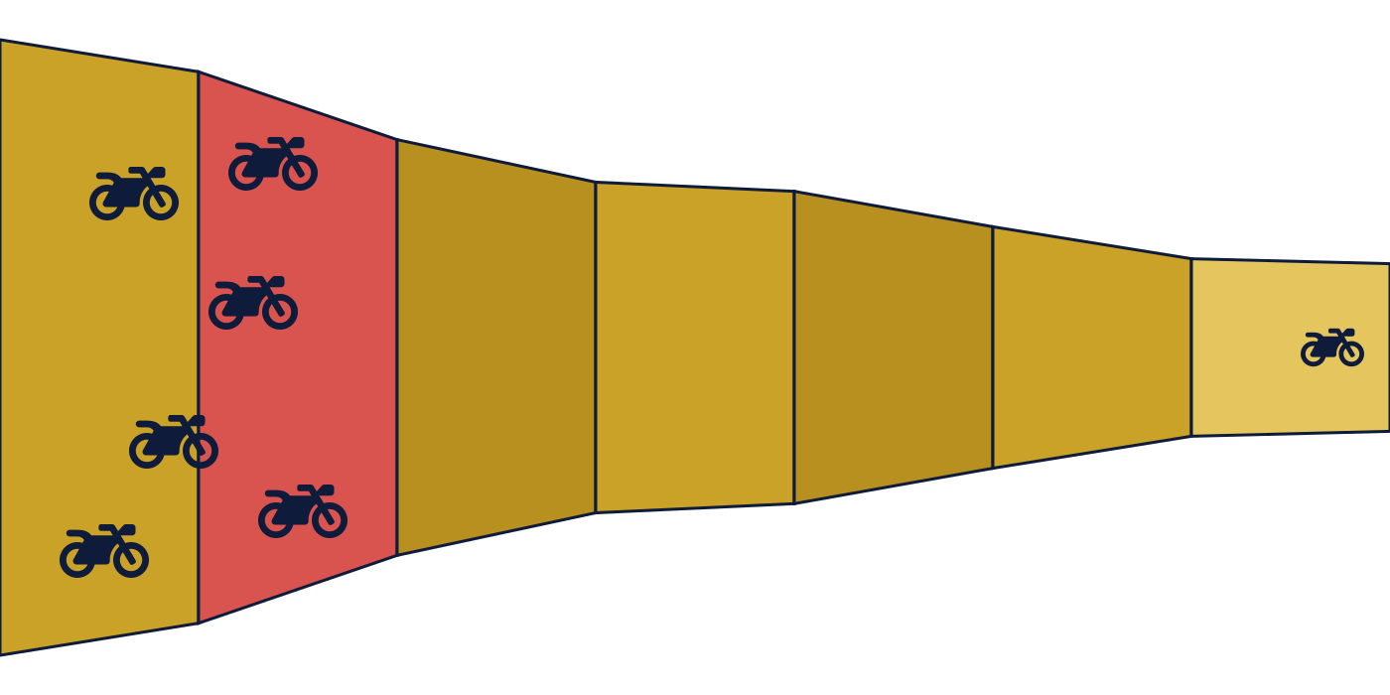
PART A — QUESTION A1
A1. The Onboarding Funnel: Where Captains Drop Off
19,662 signups
3,532 approved
STAGE-BY-STAGE
DL
17,350 / 19,662
88.2%
RC
12,463 / 17,350
71.8%
Aadhaar
11,086 / 12,463
89.0%
Permit
7,059 / 9,402
75.1%
Fitness
6,191 / 8,743
70.8%
Insurance
3,888 / 6,191
62.8%
DL
RC
Aadhaar
Permit
Fitness
Insurance
Approved
RC is flagged in red: it loses more captains than any other single step.
RC (Registration Certificate) loses 4,887 captains, more than any other single step.

Slide 3


PART A — QUESTIONS A2 & A3
A2 & A3. What’s Actually Broken at RC, and a Claim Worth Correcting
A2 — TWO FIXABLE LEAKS AT RC
A3 — THE CAMP_WA_002 CLAIM
Growth wants to scale this WhatsApp nudge 5x, citing a big completion lift.
Low-tier devices: blurry photos
34% of low-tier-device captains fail RC, vs. 21% on high-tier. Verification logs confirm blurred images and low-confidence scans as the cause.
18.8pp
4.1pp
claimed lift (unfair comparison)
real lift, matched comparison, significant
paid_digital: never upload at all
19% of paid_digital captains abandon before ever submitting an RC photo, vs. 5% of field-assisted signups. An engagement gap, not a photo problem.
Why 18.8pp is misleading: the message only sends after a captain clears RC, so recipients already passed the funnel’s hardest step. Comparing them to everyone else favors recipients unfairly.
+43/mo
+7/mo
1.8x
photo check
reminder nudge
real ceiling, not 5x. The eligible pool is only 1.8x current volume.

Slide 4

PART A — QUESTION A4
A4. Three Fixes, About 90 More Approved Captains a Month
Ranked by projected monthly impact
+46/mo
+43/mo
+7/mo
Extend the WhatsApp nudge to full coverage
Add a photo quality check before RC upload
Remind captains who stall before uploading
Currently reaches 55% of captains who cleared RC. A 5x increase is not possible; the eligible pool is only 1.8x current volume. Cover the rest instead.
Low-tier devices fail RC 34% of the time, versus 21% on high-tier, mostly from blurry photos. Catch it before submission.
19% of paid_digital captains never upload an RC document at all, versus 5% of field-assisted signups. A reminder closes the gap.
Combined impact: approximately +90 approved captains per month, about 13% above the current baseline.

Slide 5



PART B — QUESTIONS B1 & B2
B1 & B2. A Nightly Squeeze, and Why Captains Avoid It
9pm–3am, every night, both months in the data
754
unfulfilled ride requests at the airport, every single night
40%
of airport requests unfulfilled, versus 3% elsewhere in the city
2.4x
higher demand at night, while online captains drop to 35% of daytime levels
B2 — WHAT HAPPENS AFTER AN AIRPORT TRIP
31% vs 40%
get a return fare within 20 minutes at night, versus in the day. Captains who finish an airport trip are likelier to be stranded after dark.
17%
return-fare rate for suburban drop-offs, the weakest of the three destinations, and 41% of all airport trips go there.
17% vs 12%
of night airport pickups get cancelled by the captain, versus in the day. Captains already avoid the trips least likely to pay off.
Trip distance is nearly identical day and night. Captains are not avoiding longer trips, they are avoiding trips that strand them without a fare back.

Slide 6





PART B — QUESTION B3
B3. Hiring More Captains Is Not the Right First Move
The regional team’s proposal: hire captains near the airport, plus a signup bonus
Price has already been tried
Surge pricing already reaches about 2x the normal fare at night, near the highest level anywhere in the data. Most demand still goes unfulfilled.
New captains face the same odds
Being newly hired does not change the chance of getting a fare back after an airport drop-off.
The headcount math is steep
Fully closing the gap needs almost triple the current night captains online, from about 13 to about 41, every single night.
Do instead: guarantee a minimum return fare for night airport trips, especially to suburban drop-offs. Pilot a queueing system so a waiting captain is guaranteed the next fare. Re-measure, then size any remaining acquisition need against the smaller, real gap.
NEXT STEPS
Onboarding: ship the RC photo check and expand CAMP_WA_002 coverage (Product / Growth)
Airport: design the return-fare guarantee and pilot the queueing system (Ops)

