Slide 1
Cyclone Preheater Anomaly Detection
Pratikkumar Asapur
Email: kumarpratik18122000@gmail.com
Duration: 3 Years of Sensor Data (~375k records)

Slide 2
1. Data Preparation
378k sensor readings collected over 3.5 years at 5-minute intervals (Time range: Jan 1, 2017 – Aug 7, 2020)
Duplicates removed: 3,087 rows with repeated timestamps (Ensures unique records for each time step)
Missing data: 1 row with 6 NaNs (1 per sensor) (Dropped to maintain consistency for modeling)
Final dataset shape: 375,351 rows × 6 base variables
Data quality actions:
Converted all columns to numeric
Removed infinities
Re-indexed by timestamp

Slide 3
2. Feature Engineering
Rolling statistics (6h, 24h) Captures short- and long-term variability in temperature and pressure. Helps smooth out sensor noise while detecting shifts in baseline.
Z-score (24h window): Quantifies how unusual a value is compared to its recent history. Flags gradual drifts or outliers in context.
Rate of Change (1-hour % change): Highlights sudden process jumps or equipment reactions.
Domain-derived features: Temp_Diff_Inlet_Outlet, Draft_Diff_Inlet_Outlet, Temperature_Efficiency = Energy transfer health indicator

Slide 4
3. Exploratory Data Analysis (EDA)
Outliers (2–5%) detected across most variables Indicates operational extremes or sensor noise.
Multimodal Distributions: Suggest distinct operating phases (e.g., startup, shutdown, steady-state).
Strong Correlations: Inlet ↔ Outlet Temperature (r = 0.97) Outlet Temp ↔ Material Temp (r = 0.94) Reflects tight heat exchange relationships.
Rolling Mean Trends: Captures recurring shutdowns, maintenance windows & anomalies. Peaks (>1300°C) & troughs (<100°C) flagged for investigation.

Slide 5
4. Anomaly Detection Strategy
Model Used: Isolation Forest (unsupervised) Detects anomalies by isolating rare points in multidimensional space Suitable for time-series without labeled anomalies
Model Tuning: Optimized using TimeSeriesSplit (n_splits = 3) Best params: n_estimators = 200, contamination = 0.05
Statistical Baseline (for comparison): Z-score > 3 applied to mean deviation of rolling features Flags only extreme statistical anomalies
Explainability (SHAP): Top feature: Rate of change in Cyclone_Material_Temp Other important features: z-scores, temperature efficiency

Slide 6
5. Findings & Comparison
Isolation Forest detected 18,716 anomalies Captures subtle patterns and abrupt deviations Effective for transient or nonlinear behavior
Statistical Method (Z-score > 3): Flagged only 56 extreme points Acts as a conservative baseline (good for validation)
Overlap: Only 52 points were flagged by both methods These are high-confidence anomalies — extreme and structurally unusual
Key Drivers of Detection: Rate of change and z-score features dominate model explanations SHAP confirms material temp fluctuations are critical

Slide 7
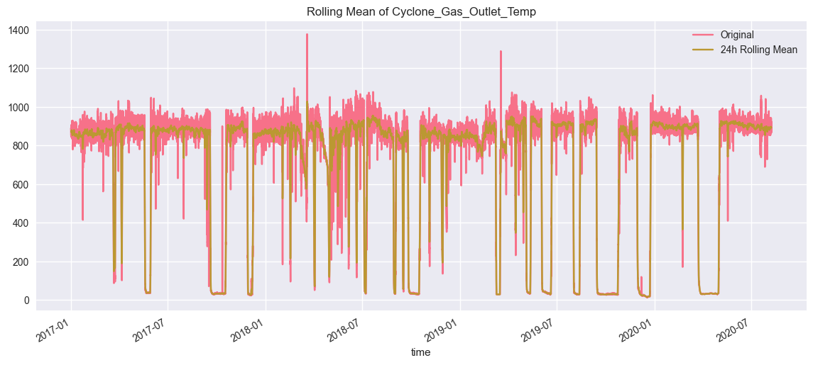
Plots
Rolling Mean of Cyclone Gas Outlet Temperature
Pink: Original readings
Brown: 24h rolling average
Insights:
Repeated drops below 100°C suggest shutdowns
Spikes >1200°C may be sensor noise or surges
Highlights operational cycles and anomalies

Slide 8
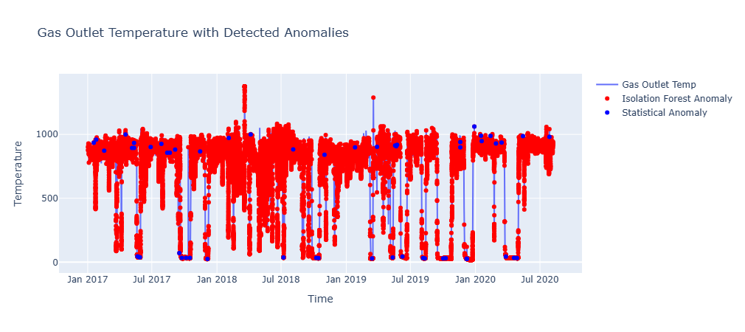
Gas Outlet Temperature with Detected Anomalies
Red dots: Anomalies detected by Isolation Forest
Blue dots: Anomalies detected by Statistical z-score method
Line: Actual gas outlet temperature over time
Insights:
Isolation Forest captures widespread subtle anomalies
Statistical method flags only extreme deviations
Overlap is minimal, showing distinct detection behaviors

Slide 9
6. Conclusion
Successfully cleaned and engineered a 3.5-year industrial time-series dataset Removed ~3,100 duplicates and handled all missing values
Applied robust anomaly detection using Isolation Forest & statistical z-scores Tuned using time-based cross-validation Detected ~18,700 anomalies, including subtle and abrupt events
Visual and statistical insights revealed patterns of downtime, spikes, and transitions Identified shutdown cycles, sensor issues, and efficiency drops
Results support safety monitoring, predictive maintenance, and process optimization

