Slide 1
Title Approval Presentation
A.Y. 2025-2026
Project Title: AI Fitness Trainer
Presented by : Pratik Lakhani C060 Priyaan Gala C051
Under the guidance of : Jesleena Gonsalves

Slide 2
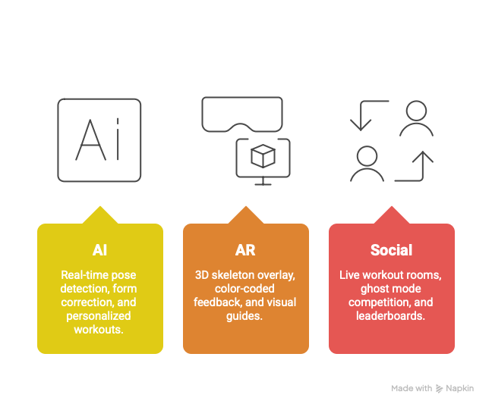
Introduction

Slide 3
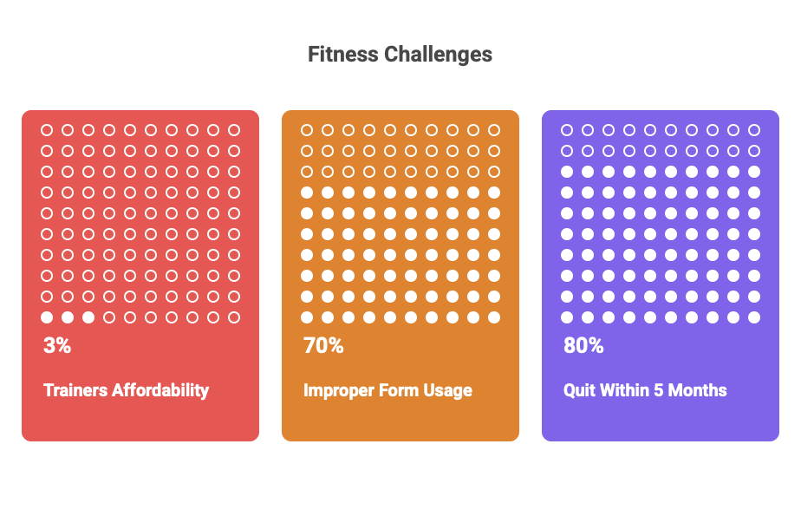
Problem statement
Why we need this

Slide 4
Aim & Objectives
Project Aim AI-powered fitness training with real-time AR feedback and social motivation
Key objectives:
Technical:
- 85%+ pose detection accuracy
- 15-20 exercises with form analysis
- Live rooms (4-6 users) - Ghost mode comparison
Learning:
- Computer vision & ML
- AR development
- Real-time systems
- Full-stack deployment

Slide 5
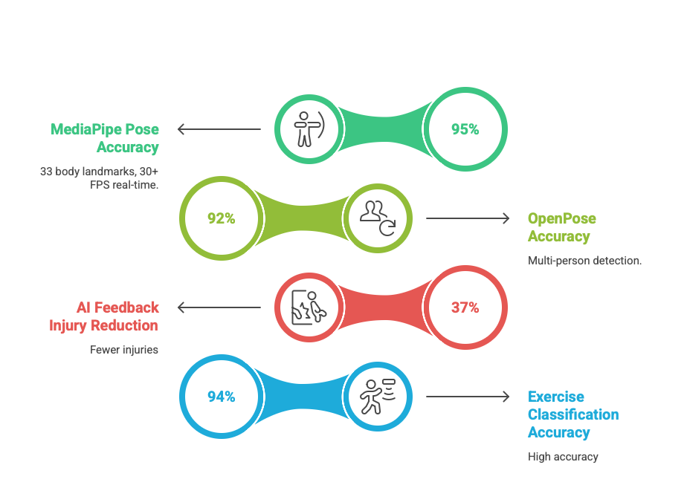
Literature Review
Research Foundation

Slide 6
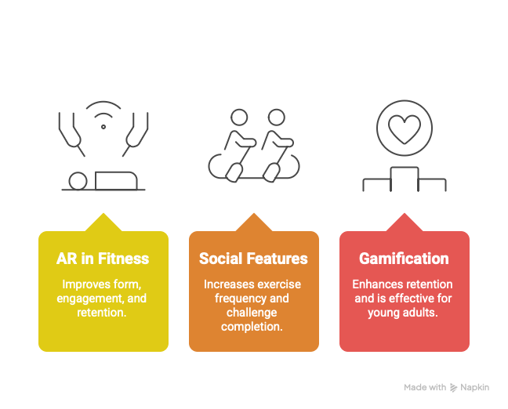
Literature Review
AR & Social Research

Slide 7
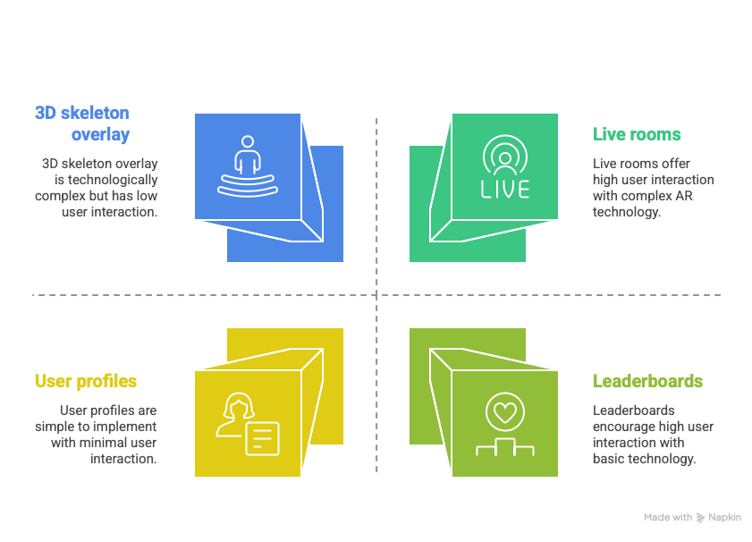
Scope

Slide 8
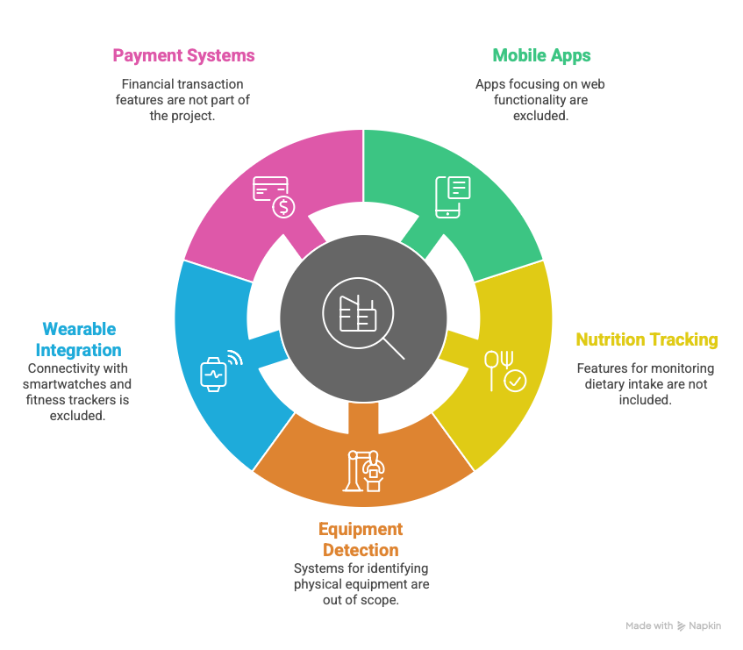
Scope

Slide 9
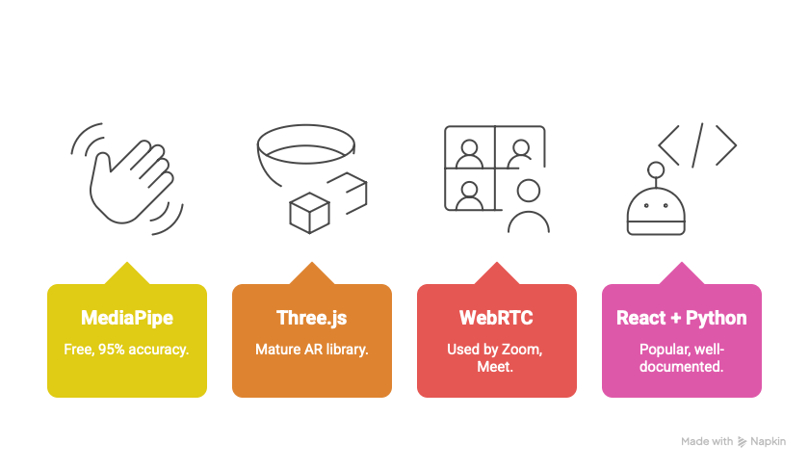
Feasibility
Technical Feasibility
2

Slide 10
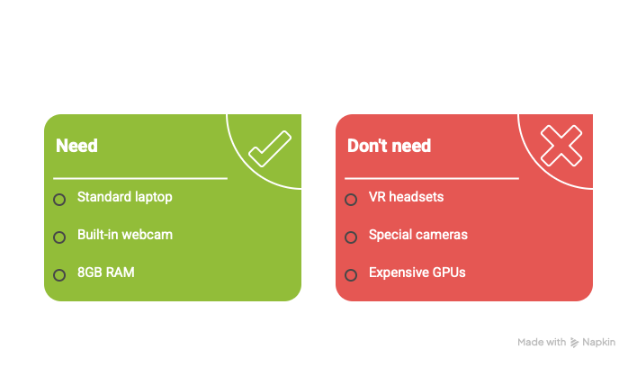
Feasibility
Hardware Feasibility
2

Slide 11
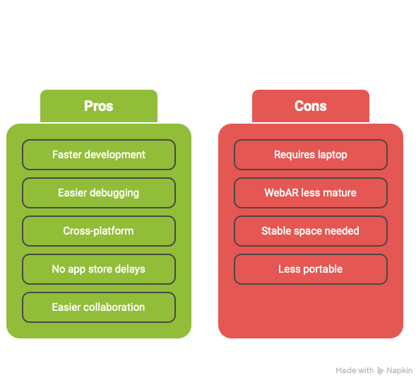
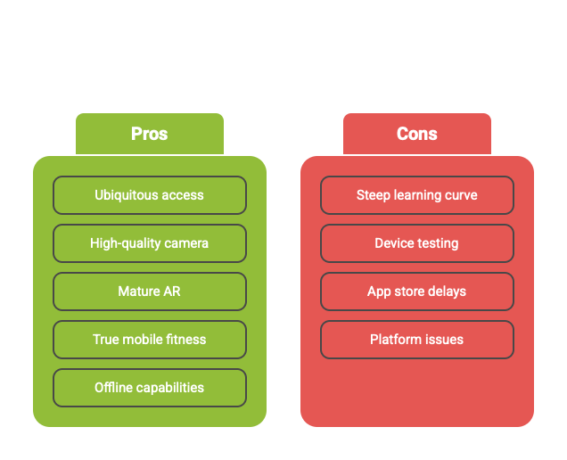
Web VS Mobile
Web
Mobile
2

Slide 12
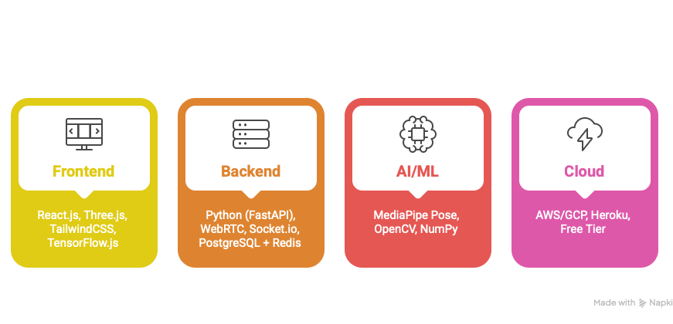
Technology Stack (Web)

Slide 13
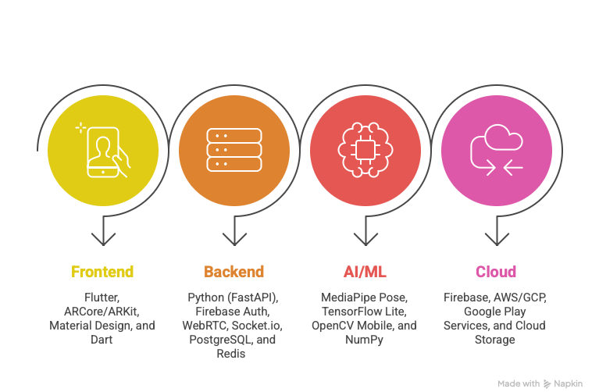
Technology Stack (mobile)

Slide 14
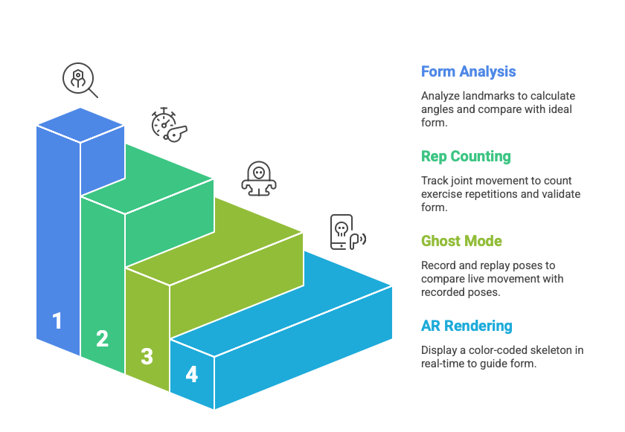
Key Algorithms

Slide 15
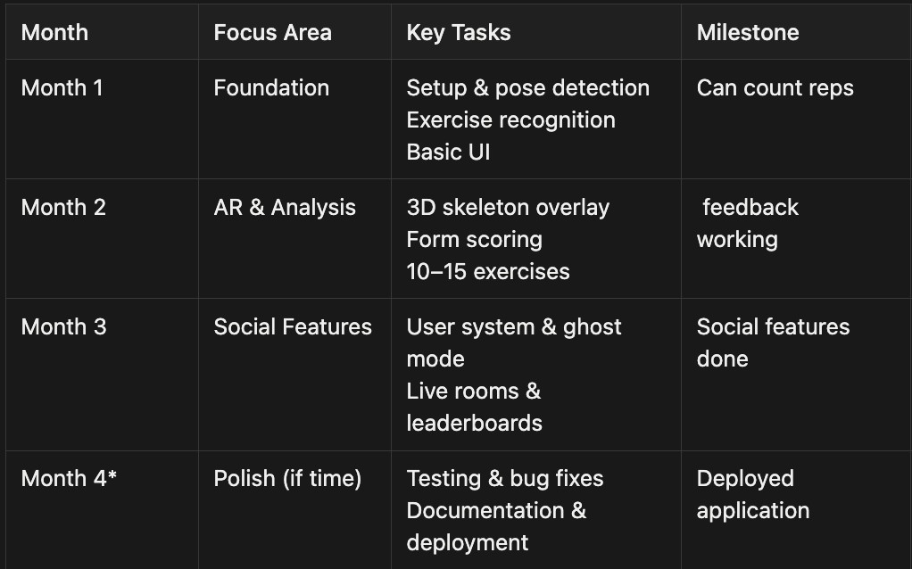
Timeline

Slide 16
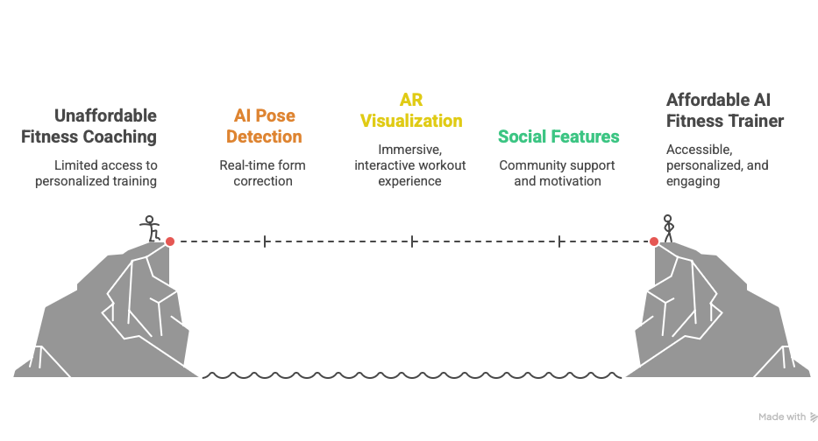
Conclusion

Slide 17
References
Computer Vision & Pose Estimation
Bazarevsky et al. (2020) - BlazePose. arXiv:2006.10204
Cao et al. (2019) - OpenPose. IEEE TPAMI
Lugaresi et al. (2019) - MediaPipe. arXiv:1906.08172
AR & Fitness
Kim et al. (2022) - AR Training Effectiveness. Int. J. HCI
Zhao et al. (2021) - AI Form Correction. J. Sports Sci & Tech
Social & Gamification
Anderson et al. (2021) - Social Features. JMIR
Johnson et al. (2016) - Gamification. Internet Interventions
ML & Recognition
Chen & Wang (2020) - Activity Recognition. IEEE Access
Velloso et al. (2013) - Exercise Recognition. ACM
American Council on Exercise (2022) - Fitness Statistics
2

