Slide 1

Mini Project – Semester VI Internal Presentation
Rice Leaf Disease Detection
Ayush Dodake 120A3008
Kirti Ekhande 120A3011
Pratik Mohite 120A3028
Under the guidance of
Prof. Smita Mane
Group 17
Department of Information Technology
SIES Graduate School Of Technology ,Nerul

Slide 2
Introduction
Of the three major crops – rice, wheat and maize – rice is by far the most important food crop for people in low- and lower-middle-income countries. Although rich and poor people alike eat rice in low-income countries, the poorest people consume relatively little wheat and are therefore deeply affected by the cost and availability of rice.
The impact of rice plant diseases has led to a 37% annual drop in rice production. It may happen basically due to the lack of knowledge in identifying and controlling rice plant diseases, but still there isn’t any proper application has been developed which is capable enough to identify these rice plant diseases accurately and control those diseases.
In order to identify rice plant disease by an application itself, Convolutional Neural Networks (CNN) can be used.
This study provides a comprehensive understanding of current rice plant illnesses as well as the Deep Learning approaches used to detect such diseases.

Slide 3
Problem Statement
Farmers who grow or cultivate rice are facing economic losses every year because of various diseases that can happen to a rice plant.
There are various common diseases known as brown spot, leaf smut, bacterial leaf blight. If a farmer can detect these diseases early and apply appropriate treatment then it can save lot of waste and prevent the economic loss.
The treatments or these diseases are little different so it’s important that you accurately identify what kind of disease is there in that rice plant.

Slide 4
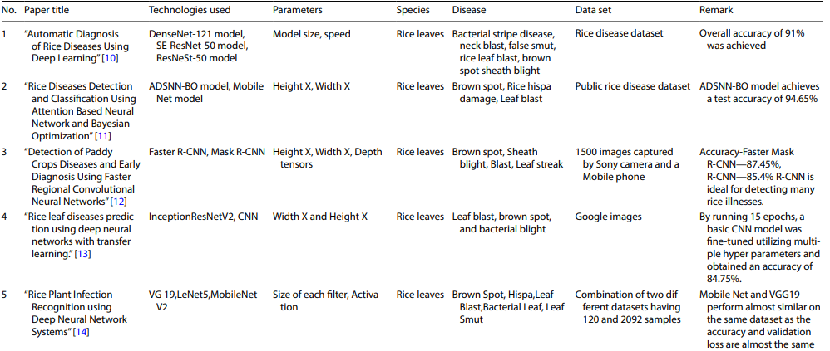
Literature survey

Slide 5
Methodology
In this work, we propose a novel model for the classification of rice leaf disease. The proposed system as shown will be able to detect and classify three distinct classes; brown spot, leaf smut and bacterial leaf blight. The proposed system is one of few in the extant literature able to classify three distinct classes.
In the proposed deep CNN transfer learning-based approach, we apply data augmentation, which simply applies minor changes to the original images to produce new distinct images.
We propose a Deep Convolutional Neural Network (DCNN) transfer learning-based approach for the accurate detection and classification of rice leaf disease.

Slide 6
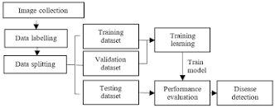
System Architecture

Slide 7
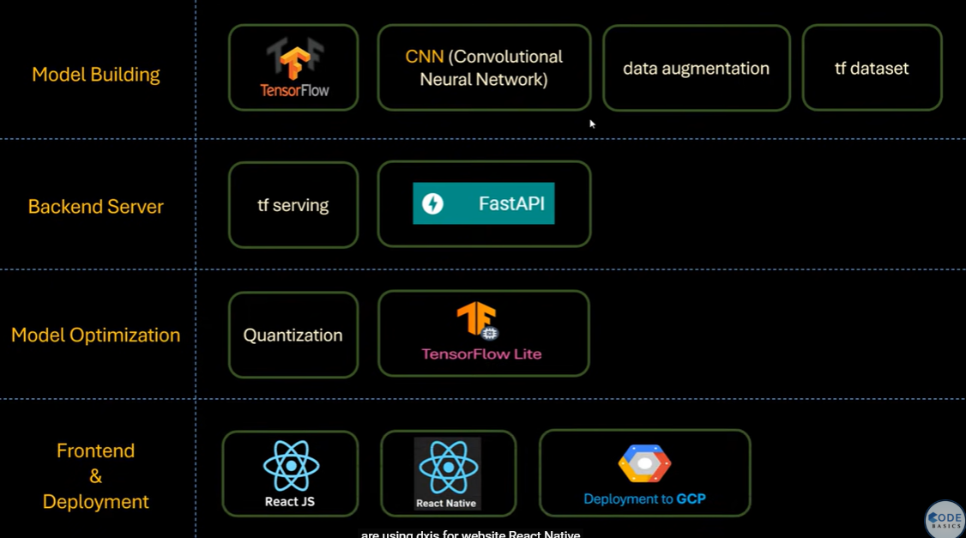

Slide 8
Software Required
Programming language: Python
Code Editor: VS Code
Algorithm used: CNN(Convolutional Neural Network
Hardware Requirements
Ram 2gb
Internet connection
OS : Windows 7 or higher
Dataset- https://www.kaggle.com/datasets/vbookshelf/rice-leaf-diseases

Slide 9
Future Scope
The proposed method can be improved by collecting a larger number of images to create much more diverse database.
The inclusion of wide-angled images captured by drones covering a more extensive field area will make the database more robust.
Dataset can be enhanced with leaf samples under more diverse conditions. Furthermore, the approach should be able to classify the leaf samples in the real world scenario as well.
The technique has the potential of application to other citrus plants species with different diseases with collaboration from domain experts.
For further improvement in results, more training is needed along with the publically available datasets, comprising of diverse images with more variations of external factors.

Slide 10
Conclusion
The advantages of an automated rice disease detection system can prove of much value to agricultural organizations and cultivators.
This work has proposed an innovative technique to detect rice diseases efficiently, and accurately classify them.
This in the best of our knowledge is the highest accuracy reported for the classification of rice leaf diseases using CNN based deep learning techniques.
This approach can be carried forward with future improvements, like integrating more categories of rice diseases and designing low-computational requirement models that can be implemented at low costs.

Slide 11
References
https://ieeexplore.ieee.org/document/9068096
https://link.springer.com/article/10.1007/s13198-020-00972
https://iopscience.iop.org/article/10.1088/1742-6596/1911/1/012004/meta
https://www.mdpi.com/2079-6374/5/3/537
https://ietresearch.onlinelibrary.wiley.com/doi/10.1049/iet-ipr.2018.6210

Slide 12
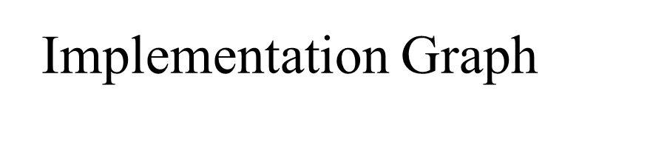
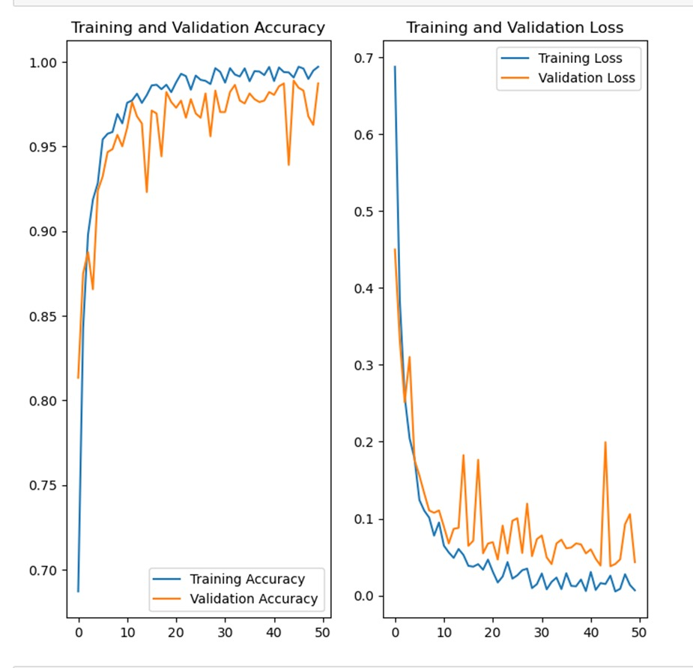

Slide 13
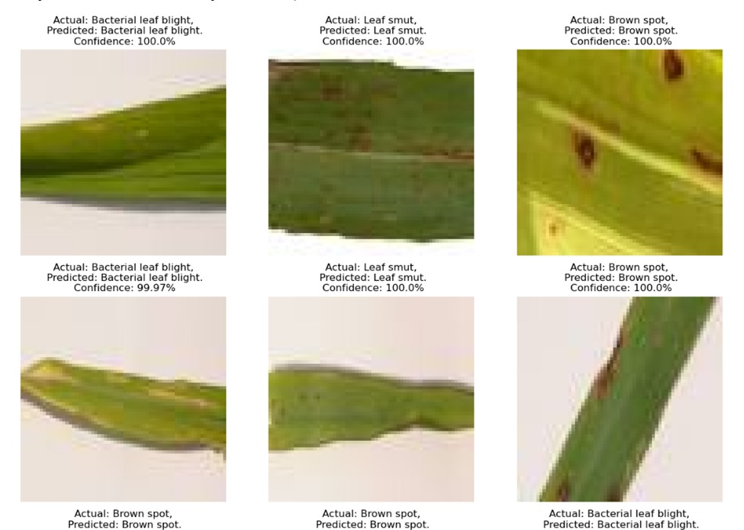

Slide 14
Thank You

