Slide 1
Virtualization
By - Pratik Mukharu Raut
PRN – 2019BTECS00050

Slide 2
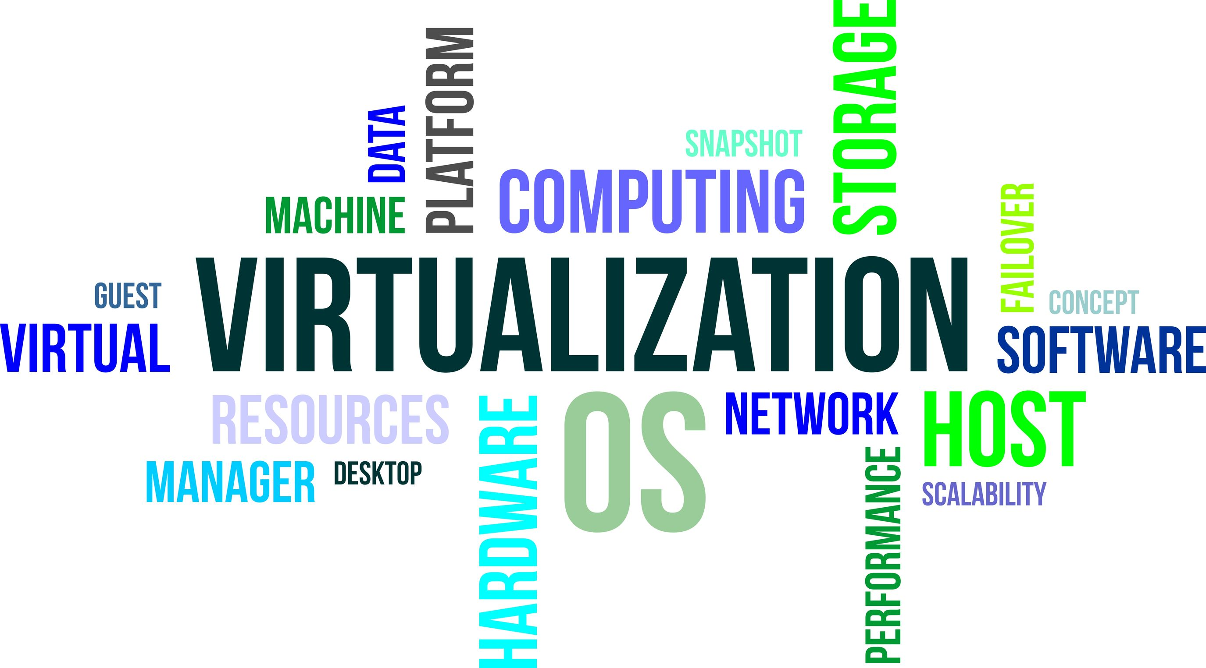

Slide 3

What is Virtualization ?

Slide 4
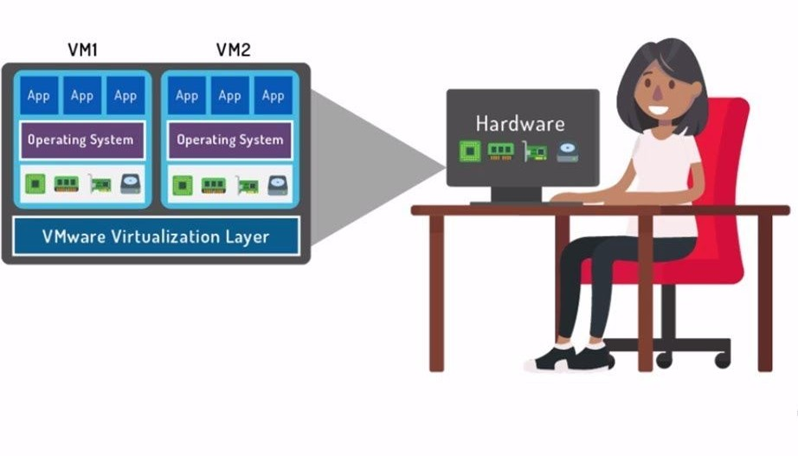
Virtualization :
Virtualization means to create a virtual version of a device such as a server or computer system using software instead of hardware.
It is a technique of splitting or adding of Physical resource into as many as Logical resource as we want.

Slide 5



Why Virtualization ?
Proper use of resources
Effective CPU utilization
Decreases administrative cost
Migration

Slide 6
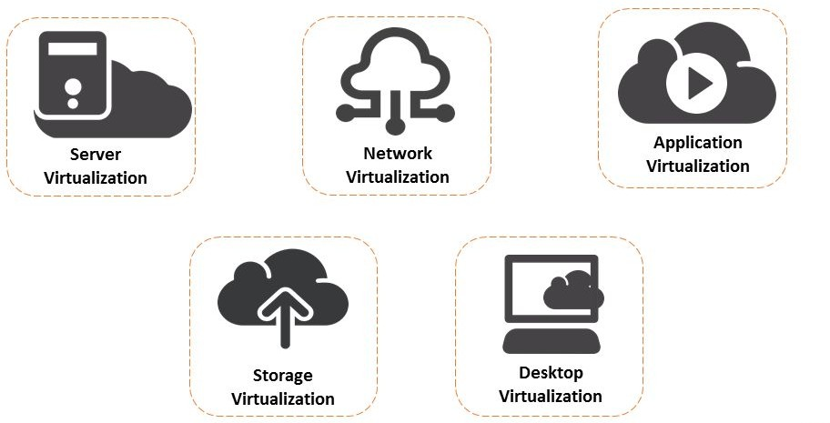
Types of Virtualization :
Application Level
Network Level
Desktop Level
Storage Level
Server Level

Slide 7
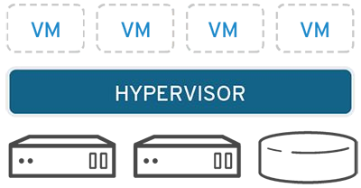
Hypervisor :
Hypervisor or Virtual Machine Manager (VMM) :
A Hypervisor is a software that manages the resources between host and virtual instances.

Slide 8
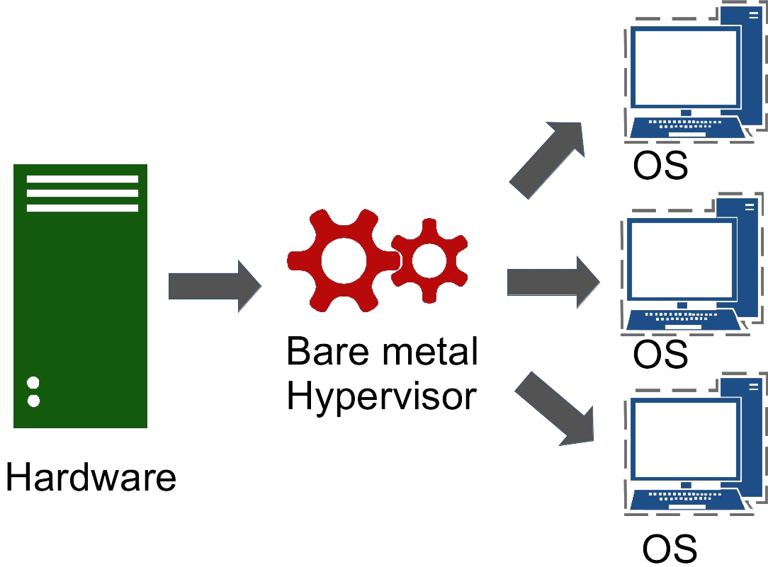
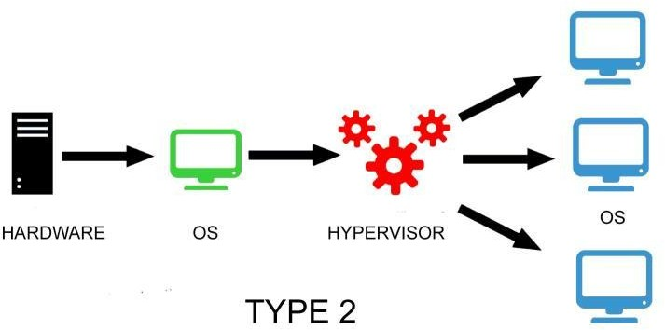
Types of Virtualization : Based on Hypervisor
TYPE 1

Slide 9
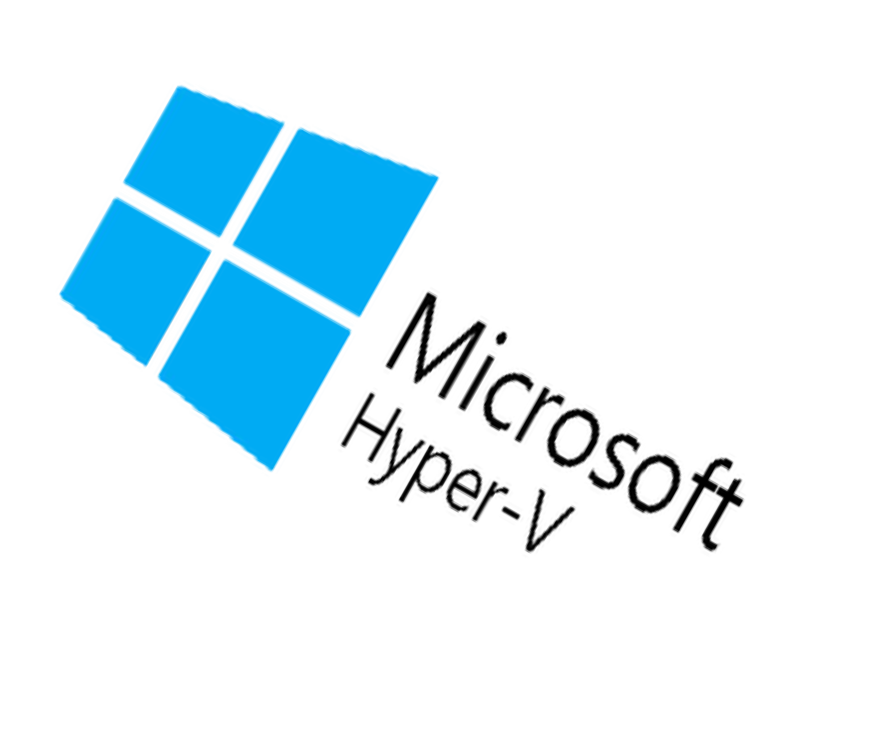
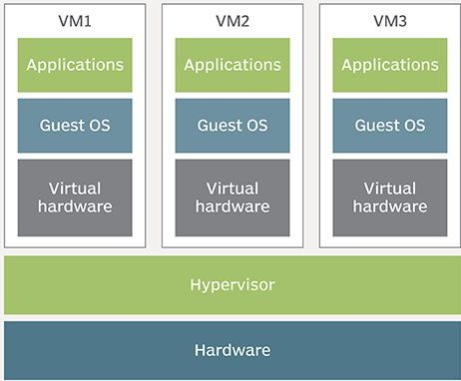

Type 1: Bare Metal Hypervisor

Slide 10
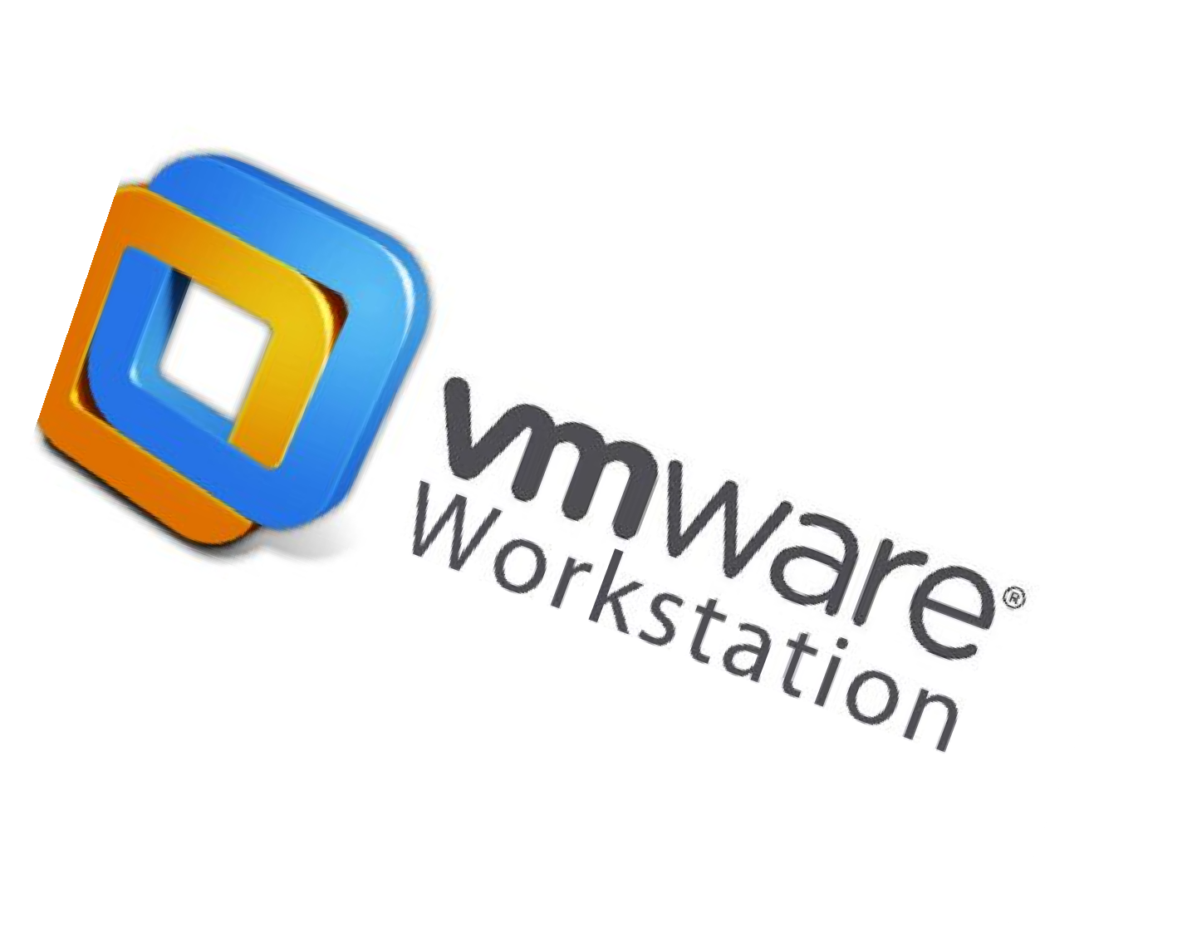
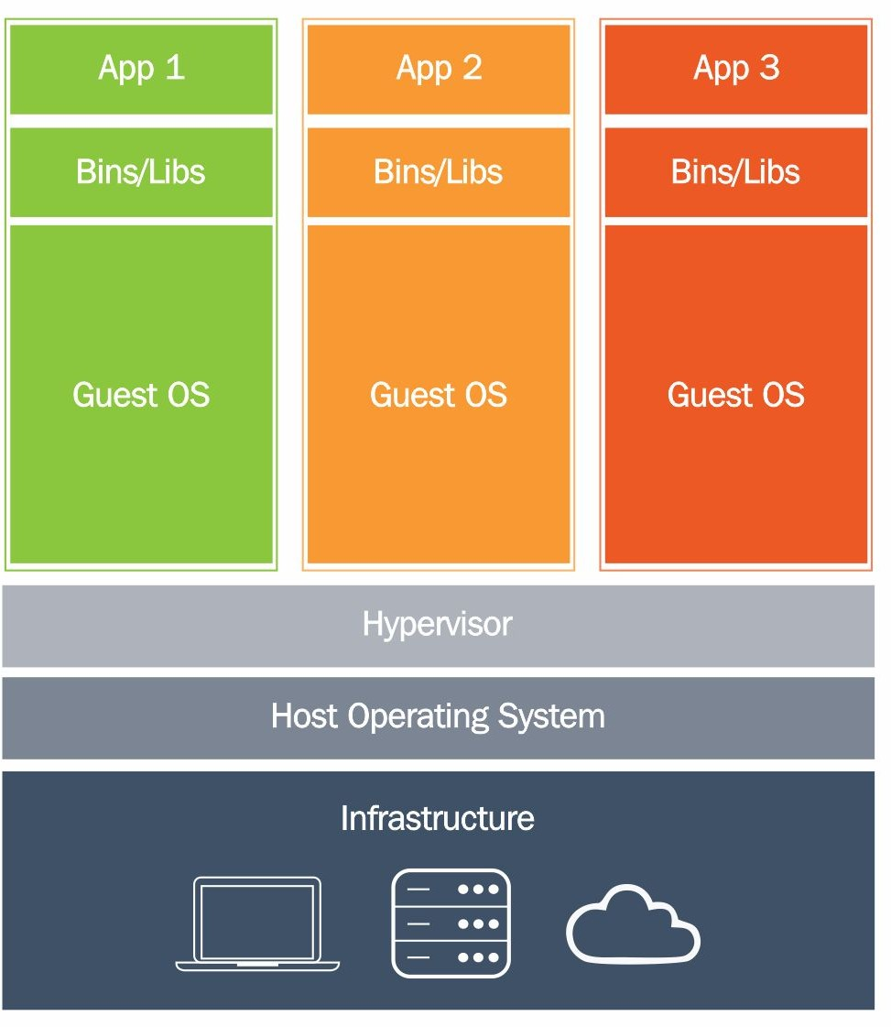

Type 2: Hosted Hypervisor

Slide 11
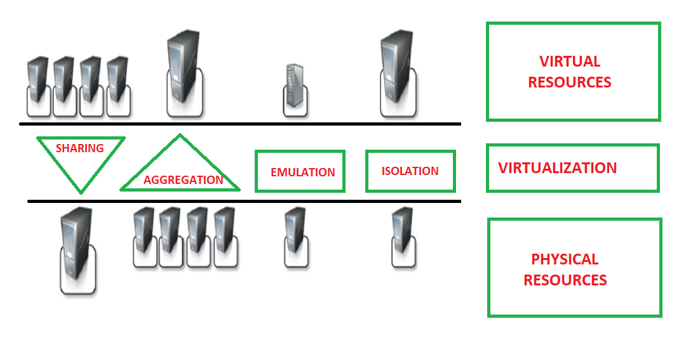
Advantages of Virtualization :
Economical
Sharing
Aggregation
Emulation
Isolation
Security

Slide 12
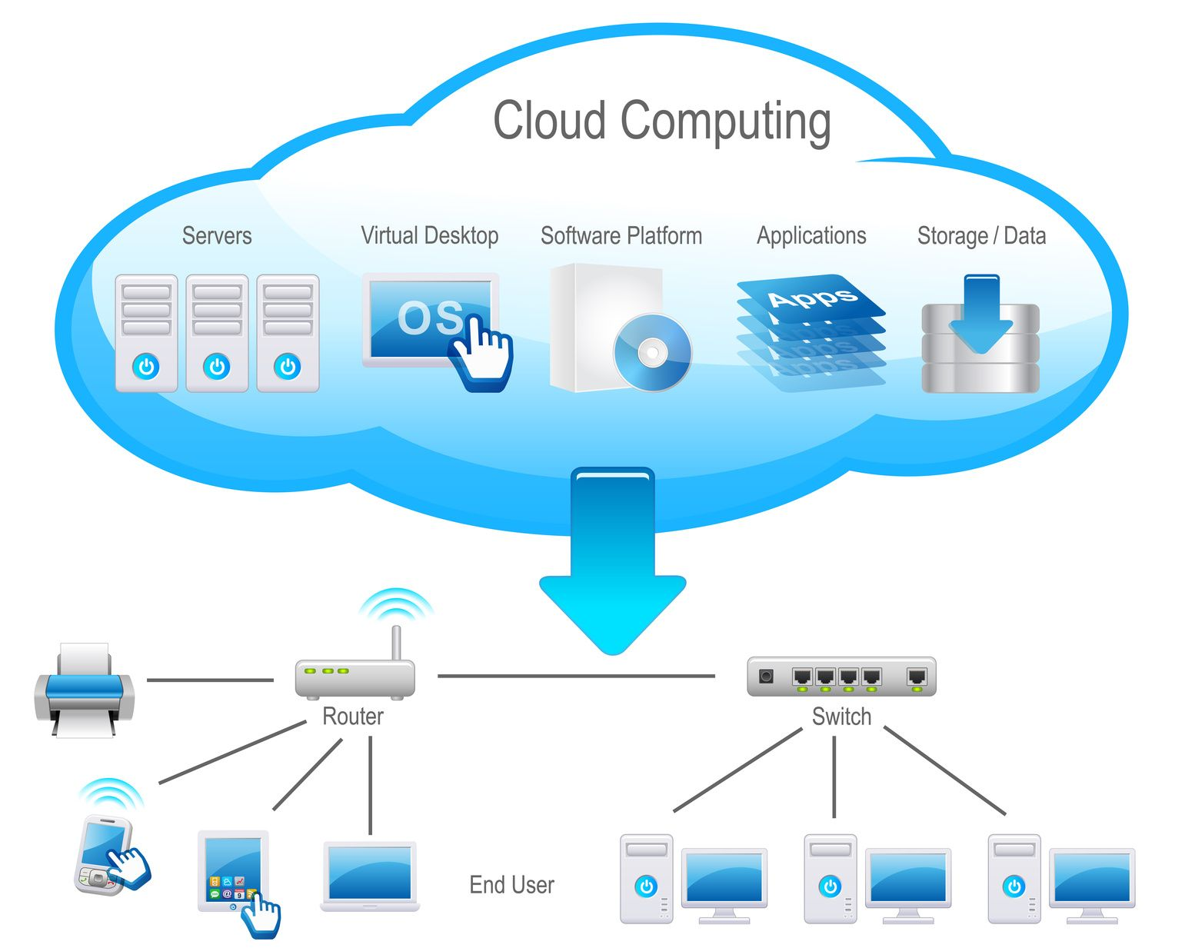
Virtualization in Cloud Computing :

Slide 13
Disadvantages :
Implementation
Limitations
Security
Availability
Scalability

Slide 14
Referances :
https://www.paessler.com/it-explained/virtualization
https://www.hitechwhizz.com/2020/05/advantages-and-disadvantages-drawbacks-and-benefits-of-virtualization.html
https://phoenixnap.com/kb/what-is-hypervisor-type-1-2#ftoc-heading-2
https://www.geeksforgeeks.org/characteristics-of-virtualization/
https://www.youtube.com/playlist?list=PLBGx66SQNZ8aiuWzEFavDMpQ1RRWsZLZV

Slide 15
Thank You..!!

