Slide 1


Store Management System
Presented By-
Pratik Tukaram Mulik(239174)
Shubham Namdev Belhekar(239207)

Slide 2
Project Introduction
The Store Management System (SMS) is a comprehensive software solution designed to revolutionize retail operations by automating and optimizing various processes involved in managing a store. Developed within the realm of computer science, this project aims to address the challenges faced by traditional brick-and-mortar stores in efficiently handling inventory, sales, customer data, and employee management

Slide 3
Objective (Purpose):
Inventory Management: Develop a system to efficiently track and manage inventory levels, including stock updates, product additions, and removals.
Sales Tracking: Implement a feature to record sales transactions, including items sold, quantities, prices, and total revenue.
Customer Management: Create a module for managing customer information, including profiles, purchase history, and loyalty programs if applicable.
Reporting: Generate various reports such as sales reports, inventory status reports, profit analysis, etc., to provide insights for decision-making.

Slide 4
Scope:
We believe that Online Store Management System will become even more popular in the future for the obvious reason that they save users, time and money by allowing purchase goods from anywhere, anytime.

Slide 5
Technology Used:
Front End: ReactJS
Back End: Java Spring Boot API.
Database: MySQL

Slide 6
S/W and H/W Requirements
Server Side:
Processor: Intel core i5 or above
HDD: 500 GB or above
RAM: 4GB or above
Database: MySQL
Client Side (minimum requirement):
Processor: Intel Dual Core
HDD: Minimum 80GB Disk Space
RAM: Minimum 2GB
OS: Windows 7, Linux

Slide 7
Functionalities - Module wise /user wise
Store Management System consists of two modules named below
1. Admin
2. Customer
3. Employee

Slide 8
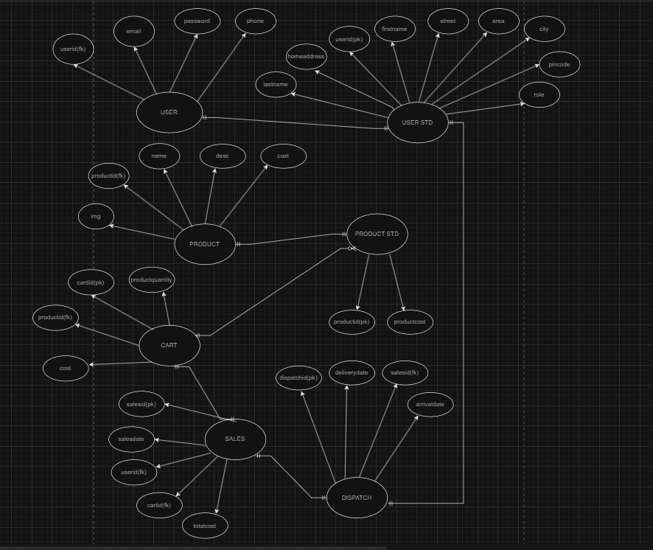
UML Diagrams: E-R Diagram

Slide 9
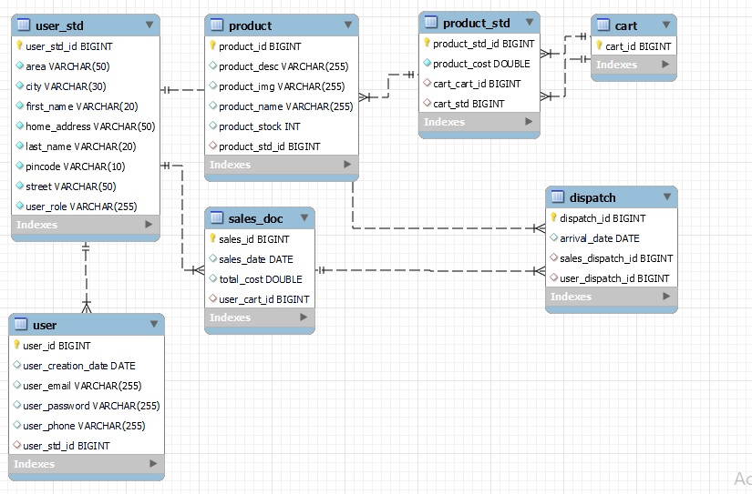
E-R Diagram

Slide 10
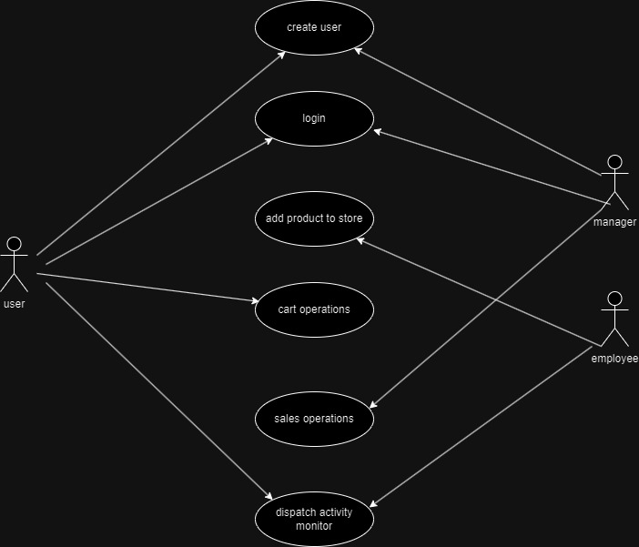
Use Case

Slide 11
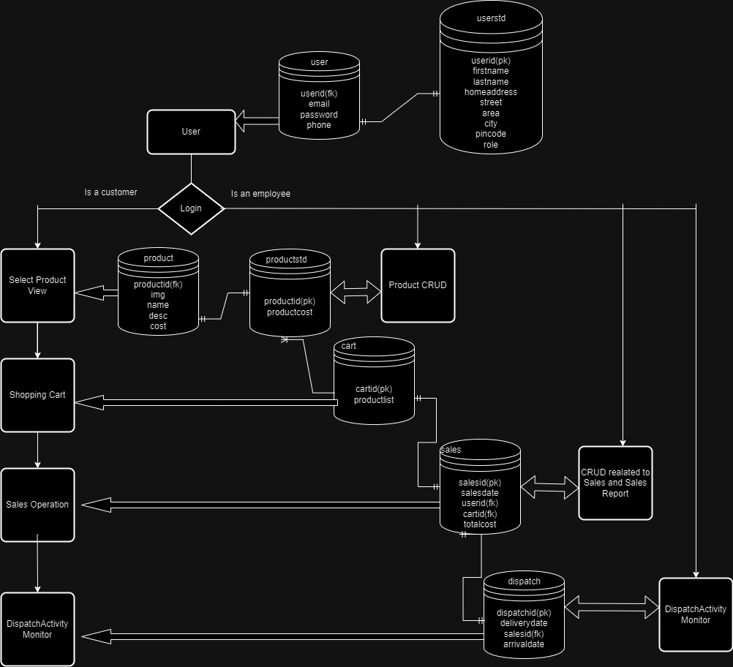
DFD diagrams

Slide 12
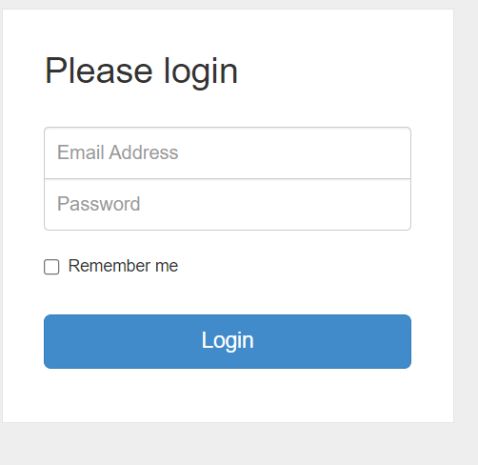
UI
Screen Shots

Slide 13
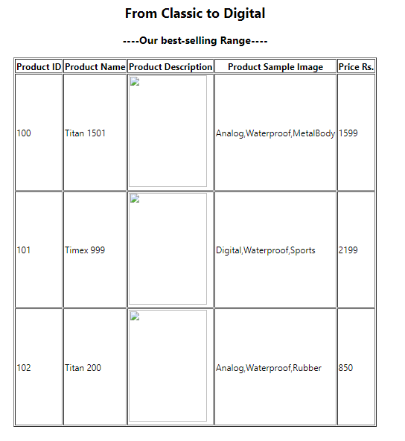
UI
Screen Shots

Slide 14
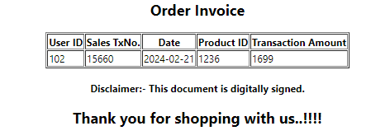
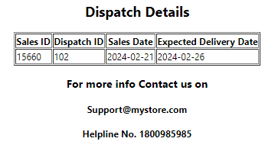
UI
Screen Shots

Slide 15
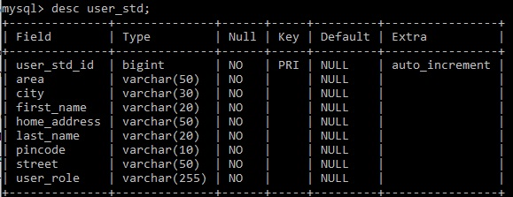
Database Screenshots
Table1:UserStd

Slide 16
Table2:User

Slide 17
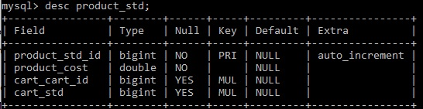
Table3:ProductStd

Slide 18
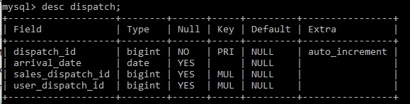
Table4:Product

Slide 19
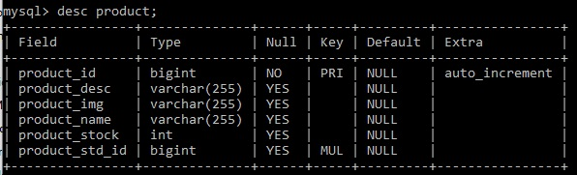
Table5:Cart

Slide 20
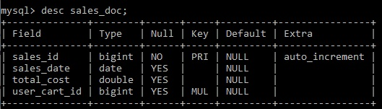
Table6:Sales

Slide 21
Table7:Dispatch

Slide 22
Futures Scope
This project will be useful in small scaled online businesses.
With the option of managing products, variety of products can be added/ removed from showcase
Also we can extend this service providing facility over wide area network .

Slide 23
Conclusion
With the rise of online businesses, this Store Management System is viable option for online business.
With customer management options, the trends in market can be easily adopted and employed
With sales tracking, appropriate corrective actions can be implemented to boost business

Slide 24
References
http://www.javatpoint.com/java-tutorial
http://www.w3.org
http://www.wikipedia.org
https://www.tutorialspoint.com/java

Slide 25
THANK YOU

