Slide 1
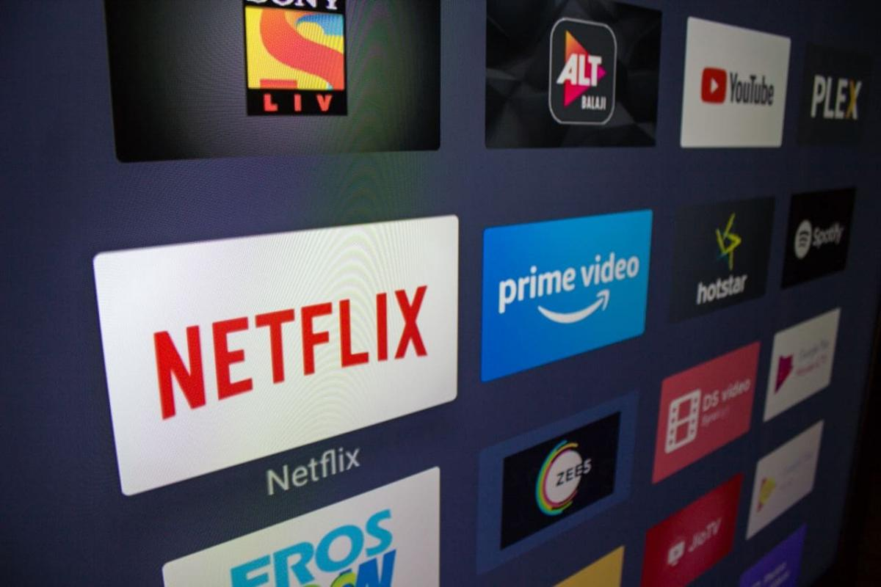
Exploratory Data Analysis on OTT Platforms
(Effects of OTT Platforms on the mindset of Indian Youth)
Project by-
Pratik Patil
Amisha Sahu

Slide 2

Introduction:
What is OTT?
OTT stands for ‘Over-the-top’ and refers to any streaming service that delivers content over the internet.
The growing range of OTT Services include:
Youtube
Netflix
Amazon Prime
Hotstar
MX Player
etc

Slide 3
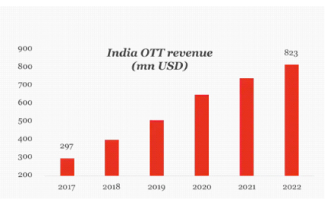
Introduction:
Why this topic?
Rapidly growing sector
Popular among youth
Easy to access
Addiction of binge watching
Student Perspective - Negative Effects

Slide 4

Introduction:
Importance of this analysis
Real life problem faced by Youth
Effects on mental health
Effects on Study
Influence of OTT on day-to-day life
Perception about the changing culture

Slide 5

Data Collection:
The data was collected using questionnaire via Google Forms
Type of questions included:
Basic demographic details like age, gender, Income, educational levels, etc.
Preferences regarding OTT Platform and Genres watched by the respondents.
Time spend by the respondents while watching OTT content.
Preferred type of content.
Negative effects of binge watching
Effect on aggression levels of the respondents.
Openness to changing culture.

Slide 6
Data Cleaning:
A total data of 151 individuals was collected.
This data was then cleaned and sorted using MS Excel and Python.
MS Excel:
Qualitative data was converted to Quantitative
Aggression Levels
Not at all
Slightly
Moderately
Very Much
Extremely
Aggression Level
1
2
3
4
5

Slide 7
Python:
Data was converted to dummy variables
Python Command used:
pd.get_dummies() – from Python Pandas Library
What genre of Movies/Web Series/Tv Shows do you watch the most?
Adventure, Thriller/Horror
Crime, Drama
Romance, Drama
Adventure, Sci-Fi/Fantasy
Romance, Comedy
Romance, Comedy
Thriller/Horror, Romance
Adventure, Crime
Thriller/Horror, Crime
Romance, Sci-Fi/Fantasy
Adventure | Thriller/Horror | Crime | Romance | Sci-fi/Fantasy | Drama | Comedy
1 | 1 | 0 | 0 | 0 | 0 | 0
0 | 0 | 1 | 0 | 0 | 1 | 0
0 | 0 | 0 | 1 | 0 | 1 | 0
1 | 0 | 0 | 0 | 1 | 0 | 0
0 | 0 | 0 | 1 | 0 | 0 | 1
0 | 0 | 0 | 1 | 0 | 0 | 1
0 | 1 | 0 | 1 | 0 | 0 | 0
1 | 0 | 1 | 0 | 0 | 0 | 0
0 | 1 | 1 | 0 | 0 | 0 | 0
0 | 0 | 0 | 1 | 1 | 0 | 0

Slide 8
Data Overview:
Age distribution in the data
Gender Ratio in the collected data

Slide 9
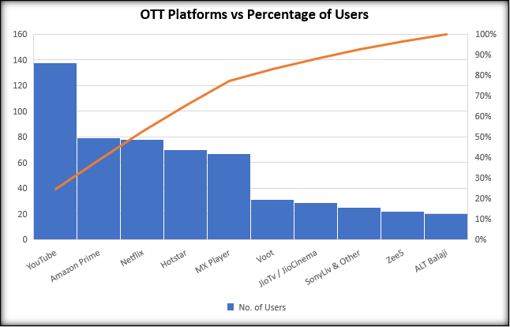
Pareto chart for most preferred OTT Platforms:
Platform | No. of Users
YouTube | 138
Netflix | 78
Amazon Prime | 79
Hotstar | 70
Zee5 | 22
MX Player | 67
ALT Balaji | 20
JioTv / JioCinema | 29
Voot | 31
SonyLiv & Other | 25

Slide 10
Analysis:
Four problem statements were formed based on the different aspects of our objective
Analysis
Psychological Effects
Academic Performance and Important work
Social Interaction
Preference of content
Watching Time
Watching Time
Watching Time
Gender
Aggression Levels
Gender
Gender
Appealing Content
Depression/Anxiety Levels
Effect on exam or work
Physical Activity
Abusive Content
Genre Watched
Family & Friends
Censored Content
Variables

Slide 11
Psychological Effects:
Findings
Mean Aggression Levels of respondents are different for different Watching time of OTT content. (Result of ANOVA Test)
Mean Depression/Anxiety Levels of respondents are different for different Watching time of OTT content. (Result of ANOVA Test)
Males and Females prefer to watch different Genres of content. (Result of Chi-Square Test)

Slide 12
Academic Performance and Important work:
Findings
Watching online content can affect any person equally irrespective of their gender. (Result of Chi-Square test)
Watching time of online content increases, it is more likely to affect exams and other important work of youth, thus affecting their working and learning efficiency. (Result of Correlation)

Slide 13
Social Interaction:
Findings
Lack of Physical Activity is not related to the Watching Time. (Result of Non-Parametric – Kruskal-Wallis Test)
Interaction with Friends and Family is not related to Watching Time. Which means that avoiding social interaction is independent of watching time of OTT content. (Result of Non-Parametric – Kruskal-Wallis Test)
People with different data connection types (Mobile Data and Broadband/Wi-Fi) have different watching patterns of online content.
(Result of Chi-Square Test)

Slide 14
Preference of Content:

Slide 15
Preference of Content:

Slide 16
Conclusion:
Direct or Indirect Psychological effects
High number of people showed interest in Western content
Binge watching causes effects like insomnia and insecurity
Effects of OTT
Most of the negative effects are Gender Independent
Majority of people don’t have any problem with uncensored or abusive content
People with Broadband/Wifi tend to watch for more number of hours compared to people with mobile data

Slide 17
Thank You

