Slide 1

USA Housing listings price Prediction
Pratik Patil - 202118023
Devanshi Shah - 202118042

Slide 2
Index:
Introduction
Data Description
Data Exploration
Model Implementation
Linear Regression
Random Forest
Model Evaluation
Conclusion
Data Pre-Processing

Slide 3
Introduction:
Why are Housing Prices important?
Buying a house can be considered as one of the most crucial step in a person’s life.
But, there are a lot of factors affecting this decision like, the locality, furnishing of the property, living space, and most importantly the ‘Price’ along with many more other parameters.
So, what are the solutions? - Consult a broker? No!
If we have all the relevant information, we can easily apply Machine Learning Algorithms and accurately predict the results.

Slide 4
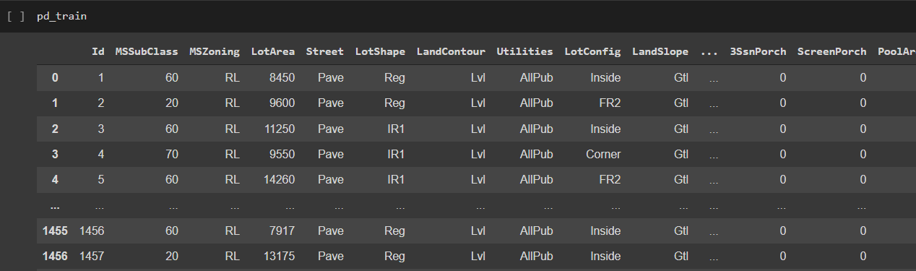
Data Description:
We have used ‘USA Housing dataset’ from Kaggle.
Data consists of Test and Train CSV files which were used to train the model and further predict house prices based on relevant features.
There are around 1500 rows and 80 columns per file.

Slide 5

Data Pre-Processing:
The following processes were performed:
Checking Outliers using scatter plot
Handling Missing Data:
Removing features consisting of more then 15% missing values (Thumb rule)
Filling missing values with “None”/0 wherever required
Filling missing values with ‘Mode’
Handling Outliers:
Dropping values outside a particular range
String Indexing
Vector Assembling

Slide 6
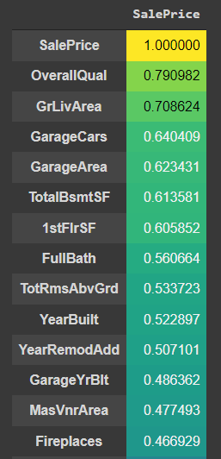
Correlation of Features with SalePrice:
Here, we have plotted a Correlation Matrix of SalePrice with all the Features.
As we can see OverallQuality of the house has the highest correlation with SalePrice.
And it is followed by factors like Ground_Living_Area, Car_Garage, Garage_Area, etc.

Slide 7
Model Implementation:
We performed the prediction of a single target variable and hence used the relevant models.
Linear Regression:
It is a basic regression model and can be easily used to predict a single variable.
It is a way of calculating direct relationship between two variables by using direct correlation.
Random Forest:
It is a widely used Suprevised ML Algorithm for classification and regression problems.
It builds numerous decision trees on different samples and takes their average vote to predict a response variable.

Slide 8
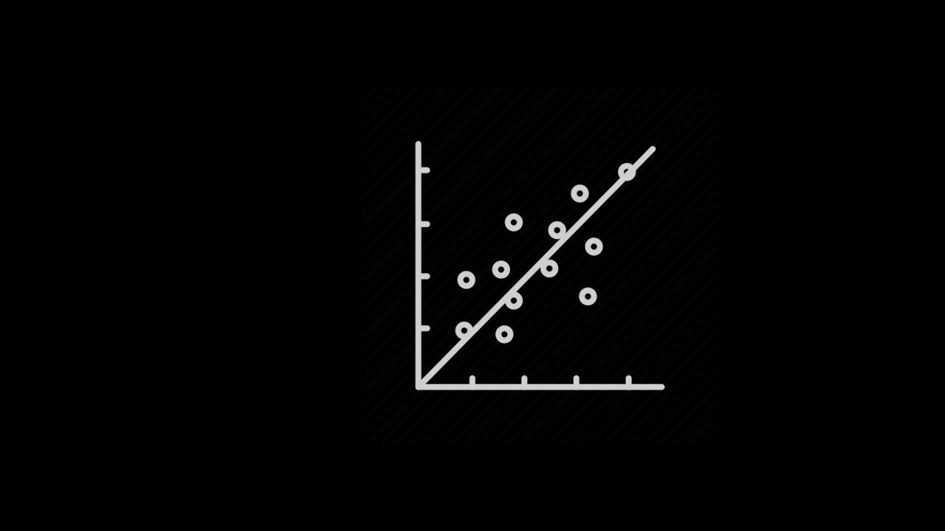
Linear Regression

Slide 9
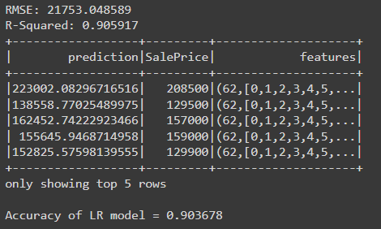
Result of Linear Regression:
Here, we can see the result after applying Linear Regression.
The model gives 90% Accuracy score.

Slide 10

Random Forest

Slide 11
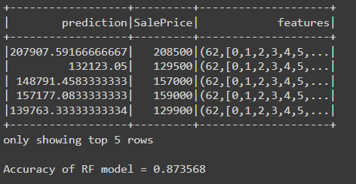
Result of Random Forest:
Here, we can see the result after applying Random Forest.
The model gives 87% Accuracy score.

Slide 12
Conclusion:
Price prediction is a Regression problem and after implementing both the models we can see that Linear Regression outperformed Random Forest regression.
The reason this happened is, even though for general cases of independent categorical variables Random Forest gives higher accuracy than any other model, but in this case there are a large number of Features having less data-set(with low noise), which gives Linear Regression an upper hand over Random Forest.
Hence, we conclude that Linear Regression is better predicting model for this dataset.

Slide 13
Thank You!

