Slide 1

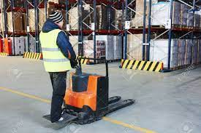
kls GOGTE INSTITUTE OF TECHNOLOGY belagavi
DEPARTMENT OF MECHANICAL
2022-2023
“DESIGN & DEVELOPMENT Of
E-FORKLIFT FOR INDUSTRY WAREHOUSES & DOMESTIC PURPOSE”
Under the guidance of
Prof: B .S. JAGATHI
SUBMITTED BY
SL NO | NAME | USN
1 | PRATIK P PATIL | 2GI19ME106
2 | MADHAV D B | 2GI19ME070
3 | KIRAN ADIN | 2GI19ME062
4 | KIRAN VASTRAD | 2GI18ME056

Slide 2
OUTLINE
Brief introduction
Product Design Phases
Components
Working
Design of Elements
Prototype part Dimensions
Fabrication
Cost Estimations
Product Specs
Future scope & Conclusion
References

Slide 3
BRIEF INTRO
E-FORKLIFT is used for the industrial applications which Cargo can be moved from one place to other and hence the work such as carrying goods or any other is done within the time schedule and the particular cycle time for that operation is saved .
Existing forklifts design has its limitation in rotation and structures has potential safety & risk .
The 360 Degree Turning Electrical Forklift are Inplant goods carrier system which rely on batteries for operating,
User friendly and eco-friendly.
360 degrees rotating forks attached lift mechanism which will lift the load of 1 to 50 kg the device is compact in size which may move in very less space and serve the requirement,

Slide 4
PRODUCT DESIGN PHASES
Study of various machine used now a days and survey
Study of different Type of mechanism / material
Designing the equipment with comforts and feasibility
Sketching /drawings approximates measurements
Purchasing the material as per the requirements
Fabrication with standers components and equipment
Testing for all the positive output
Painting and demo of the machine

Slide 5
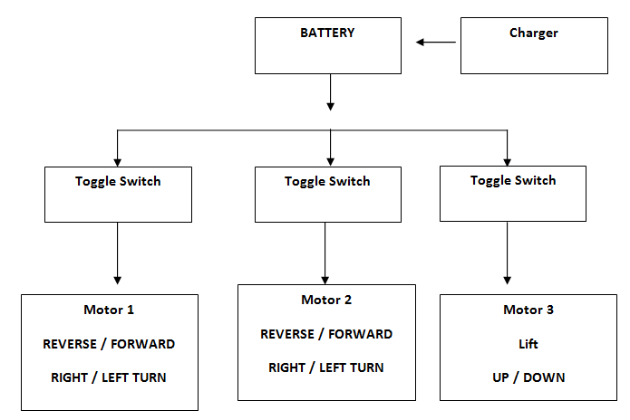
Basic Driving Mechanism of a forklift

Slide 6
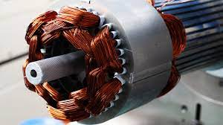
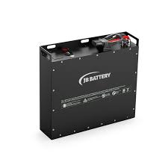
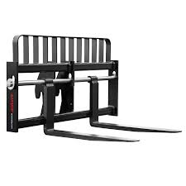
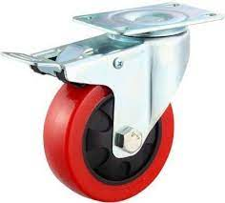
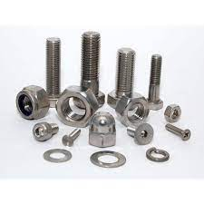
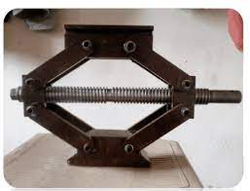
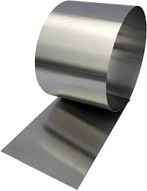
COMPONENTS
1) Motors
2) Cylindrical bearing
3) Guide rod
4) Tube frame
5) Battery
6) Charging
7) Fasteners (nut, bolt, washer)
8) Castal wheels
9) Wheels
10) Toggle switch
11) Toggle Jack
12) Shaft
13) Sheet metal
14) Bearing bush

Slide 7
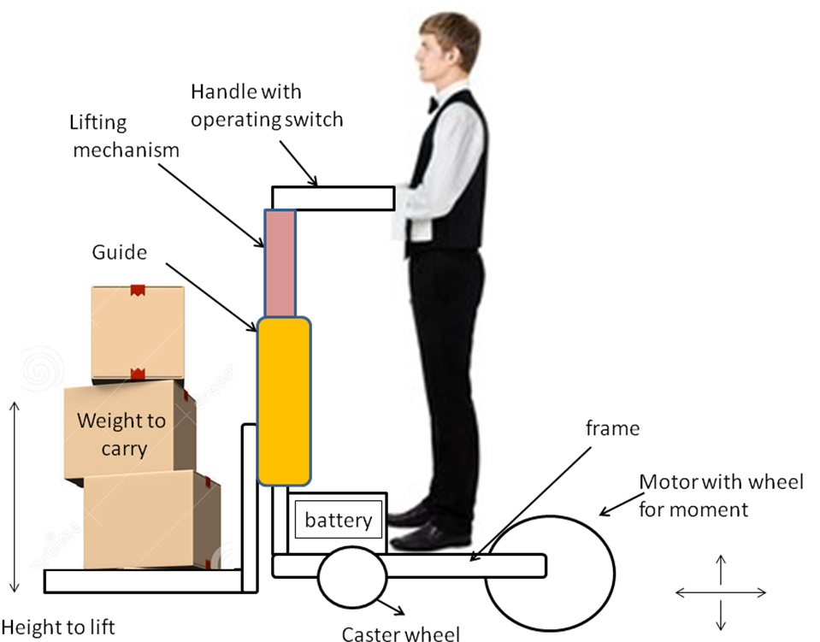
WORKING
Usually a fully functional forklift would consist of the following major system. 1. The power system, 2. Driving system, 3. Loading system
But in our design we only concerned with the loading system, since we are not going to focus on the power,

Slide 8







Design Of Machine elements
To make a Feasible Mechanical Machine which is [ Electically driven + 360º Turning] &
Design Considerations:-
Material selection based on strength properties, weldability , Machinability, cost & availability
Type of load , Stress acting
Kinematics of parts
Stiffness or rigidity and Wear resistance
Manufacturing
Input conventional process out put
Assembly and fabrications
Reliability & life cycle
Cost Estimation

Slide 9
SELECTION OF MATERIALS
Square and rectangular pipes are extensively used in welded steel frames which experience heavy loads from multiple directions. The shape os pipes suit multiple axis loading with having uniform geometry along with two or more cross section axes. This enhances the uniform strength of these pipes, making them better choice of columns. These are manufactured through the process where flat steel plate is slowly changed in shape to achieve round where the edges are presented to weld. Then the edges are welded together to form the master tube.
The square sections enhance the reliability of the structure. These are manufactured using graded steel in compliance with set international standards. The square sections are used as support in automotive industry, transmission tower plants, machinery industry, construction industry and many others. These sections are made using high grade steel metal in compliance with international standards. The square section holds superb tensile strength and is rust resistant with ability to offer long working life. The sections are tested on various parameters, which are tensile, bending, flattening and other strengths.
Features of the tube
• Supreme resistance to torsion.
• High impact strength
• Corrosion resistant
• Easier to transport.
• Good weldability.
• Supreme tensile strength.
• Dimensional accuracy.

Slide 10
Forklift Part design

Slide 14
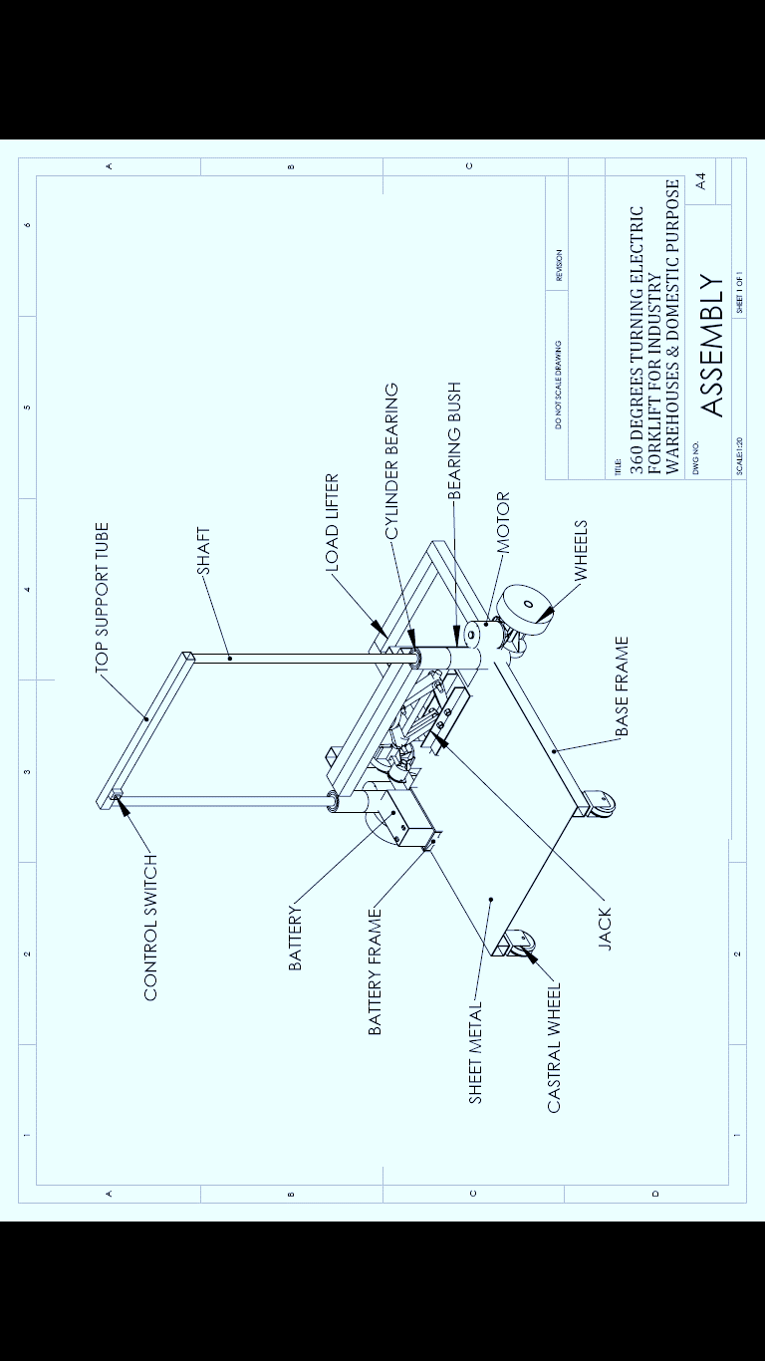
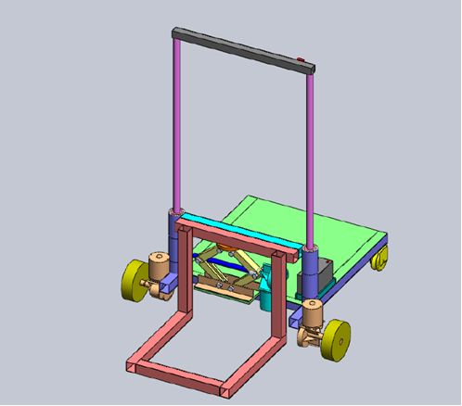
ASSEMBLED VIEW WITH ALL COMPONENTS

Slide 15
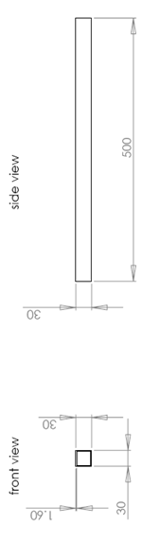
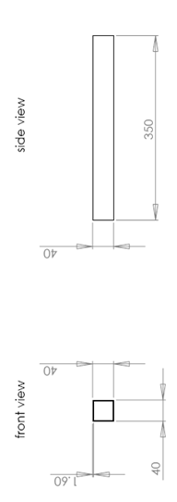
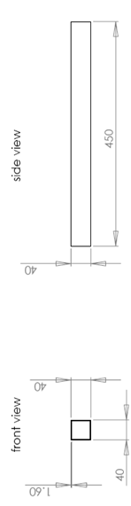
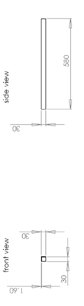
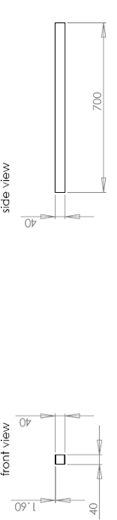
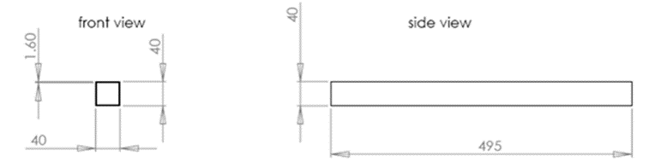
DIMENSIONS OF PARTS
1.Tubeframe dimensions in milimeter
Tube frame 1
Tubeframe 2
Tube Frame 3
Tubeframe 4
Support tube
Tubeframe 5

Slide 16
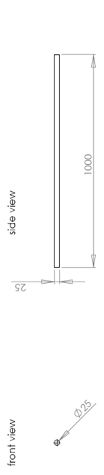
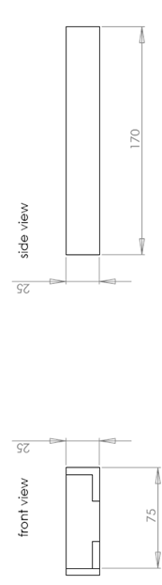
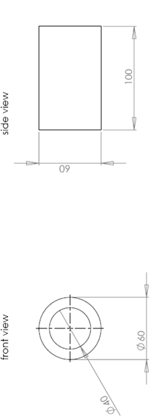
2.Shaft Dimension:-
3.Battery frame Dimension:-
4.Bush Dimension:-

Slide 17
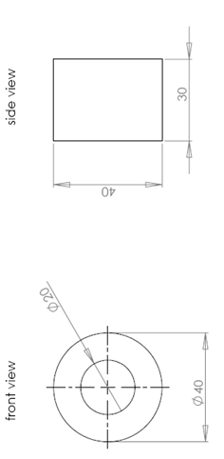
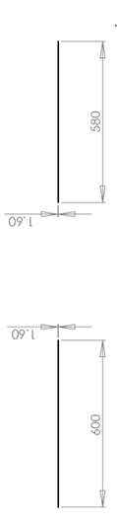
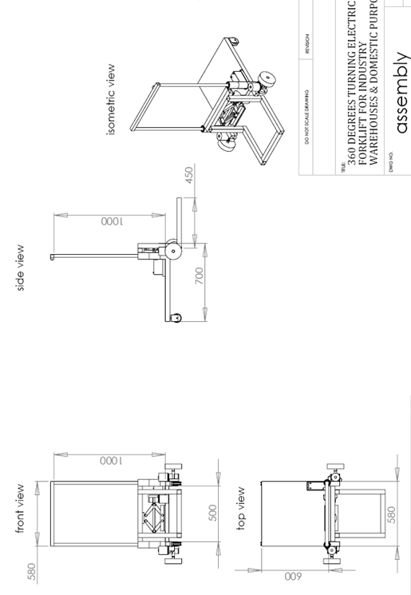
5.Motor bush Dimension:-
6.Sheet Metal Dimension:-
7.Assemby:-

Slide 18
FABRICATION
1. Motor
Operation: fitting, wiring
2. Shaft
Material: Mild steel
Operation: Marking, cutting, facing, and turning.
3. Tube Frame
Material: Mild steel
Operation: Marking, cutting, welding, drilling, grinding
4. Fasteners
Material: Mild steel
Operation: fitting
5. Battery
Operation: Charging, fitting
6. Wheel
Material: Mild steel/rubber
Operation: fitting
7. Castral wheels
Material: Mild steel/rubber
Operation: Fitting

Slide 19
FABRICATION
8. Sheet metal
Material: Mild steel
Operation: marking, cutting, facing, boring, welding, fitting
9. Bearing bush
Material: Mild steel
Operation: marking, cutting, facing, boring, welding, fitting
10. toggle jack
Material: Mild steel ( assembly)
Operation: fitting
11. toggle switch
Material: Mild steel ( assembly)
Operation: fitting
12. Guide rod
Material: Mild steel
Operation: Marking, cutting, facing, and turning, fitting

Slide 20
COST ESTIMATIONS
Materials Cost
SL No | Particulars | Cost in Rs
1 | Motor | 2200
2 | Toggle switch | 300
3 | bearing | 1800
4 | tube | 120
5 | Shaft | 450
6 | Bush | 150
7 | Nut, Bolts & Washer | 200
8 | Sheet metal | 300
9 | Toggle switch | 100
10 | Other attachments | 365
Processing Cost
1 | Machining | 220
2 | Drilling | 180
3 | Grinding/Filling | 50
4 | Welding | 650
5 | Greasing | 50
6 | Painting | 350
Other Cost
1 | Miscellaneous | 300
Total |  | ~ 8000/-

Slide 21

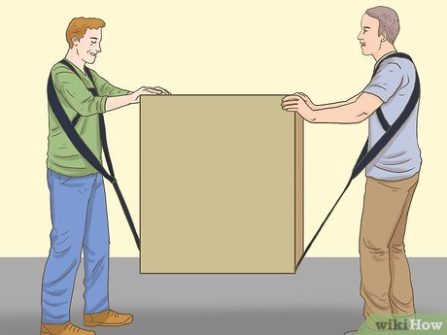



PRODUCT SPECIFICATIONS
Key Features:
Compact Design: Occupies minimal space, ideal for congested industrial environments and library aisles.
User-Friendly Operation: Intuitive controls for easy maneuverability and operation, suitable for operators of all skill levels.
Affordability: Cost-effective solution utilizing locally available materials, ensuring accessibility for small to medium-scale industries and libraries.
Portability: Lightweight construction facilitates easy transportation and deployment across various settings.
Simple Construction: Fabricated using common tools and materials, ensuring ease of maintenance and repair.
Versatility: Adaptable for stationary or portable use, catering to the diverse needs of warehouses and libraries.
Enhanced Performance: Exceeds manual counterparts in terms of efficiency and lifting capabilities, enhancing overall productivity.
Quick Setup: Simple assembly process for swift deployment and operational readiness.
Safety: Comprehensive safety features integrated to ensure operator and workplace safety in all aspects.
portable

Slide 22


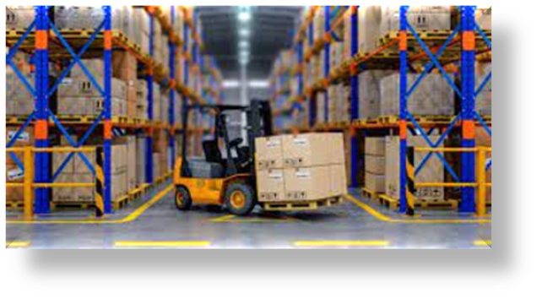
FUTURE SCOPE & CONCLUSION
The E-forklift project demonstrates promising potential with ample scope for modifications and enhancements to optimize operational efficiency. Its adaptability and affordability make it a viable candidate for commercial production and widespread market adoption. Embracing electric-powered solutions signifies our commitment to sustainability, technological innovation, and customer satisfaction. This project represents a significant stride towards a greener, quieter, and more efficient future in material handling operations.

Slide 23
REFERENCE
H. G. Patil - Design Data Hand Book –ShriShashiprakashan, Belgaum,4th Edition 2007
K Mahadevan and Balaveera Reddy- Design Data Hand Book- CBS Publication,3rd Edition, 2010
R. S. Khurmi & J. K. Gupta - Machine Design- Eurasia publishing house New Delhi,14th Edition, 2008
T.R. Banga & S. C.Sharma – Industrial Organization and Engineering Economic (Estimation & Costing) Published by Romesh Chander Khanna, New Delhi 24th Edition 2006
Theory of Machine –Rattan S.S Tata - McGraw Hill Publishing Company New Delhi,2nd Edition,2006

Slide 24
Thank you

