Slide 1

Smart Dumpster :
A smart city is a technologically modern urban area that uses different types of electronic methods and sensors to collect specific data and make it available on cloud.
Information gained from that data is used to manage assets, resources and services efficiently; in return, that data is used to improve operations across the city. It makes cities more Secure, Livable and Sustainable.
Sensors, IOT Devices, Cloud based solutions helps Communities to improve energy distribution, streamline trash collection, decrease traffic congestion, and improve air quality etc.

Slide 2

Problem Statement :
In cities/ Smart Cities, trash is collected on a regular basis by community wise dedicated trash collector companies or service providers. Usually, they follow a routine to collect trash.
Let's consider a county that has 100 communities and around 1000 dumpsters. Trash is collected every other day and had to travel a total of 1000 miles to collect it and dump it in the dump yard.
This costs around 3000$ every other day and around 45,500$ monthly only for the Gas. Operational costs such as vehicle maintenance, and labor changes will make it a huge amount for a small county.
If the dumpster is empty then this travel will be a waste for the trash collector and if it’s too full for so many days, it causes a huge inconvenience for the residents.

Slide 3

Problem Resolution :
To avoid all this mess, a simple solution will be to monitor the dumpster data, provide that information to the trash collectors and keep our communities clean.
But with the help of Sensors, IoT devices, cloud services, AI, and blockchain technology, we can make convert this simple solution into a revolutionary, transparent, and efficient solution.
This can be achieved through our project “Smart Dumpster”.
To achieve this, we have divided our projects into 4 parts. Smart Dumpster with sensors and IoT devices, Serverless and secure cloud services to collect dumpster data, Chainlink functions to collect Any API data and provide it to the decentralized oracle network and Finally send this data on the blockchain and make it transparent so that various companies can bid for the trash collection.

Slide 4
Problem Resolution contd..
By this Solution, IOT sensors will provide accurate dumpster data, so if the dumpster is empty, the collector can cancel that trip, Which will save gas and labor costs.
IOT sensors will also provide real-time data so if the dumpster is full, the collector will be able to travel immediately, keeping our communities clean and avoiding inconvenience to the residents.
Once dumpster status is available, city councils will be able to conduct online-transparent bidding so that various trash collector companies will have equal opportunities to participate.
Bidding winner trash collector will now have all the data available. He will be able to see the Locations of the full dumpsters, we can provide an optimum travel route to collect the trash which will save the gas fees and time.
Once the collected trash is reached to dump yard, the city council will have the data of the total trash collected and be able to conduct further bidding to the recycling companies. So councils will be able to make money while collecting trash as well as by recycling. With

Slide 5
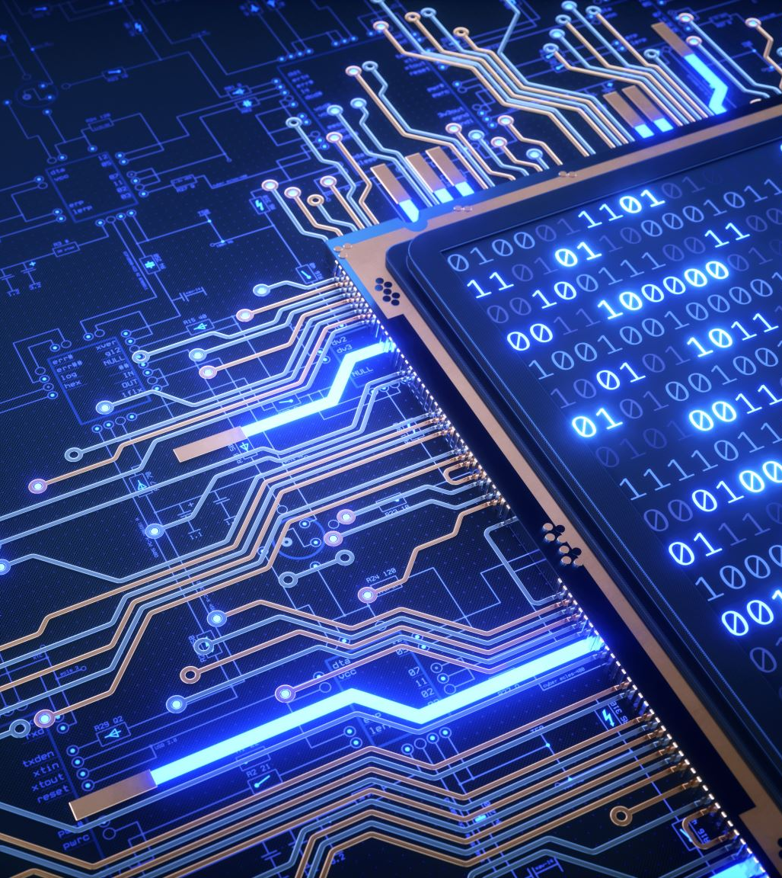
Technologies Used
IOT devices will have internet connectivity, either by WiFi (ESP32), Amazon SideWalk – LORA (Semtech/ quectel modules) or NbIot devices (Tmobile Dev Kit or Nordic NRF91).
It will be equipped with various sensors. Camera, Infrared and ultrasonic sensors will be used to calculate dumpster status (Full/Empty). Temperature sensors can be used to measure temperature so that if any inflammable material catches fire, the IOT device will be able to inform immediately that corrective actions can be taken. This makes it very Secure for residents.
Once Data is available, the IOT device will send HTTP Post command to the Amazon AWS cloud service. On cloud service, we have API gateway to provide HTTP Get and HTTP POST API. These APIs will be connected to Amazon Lambda which will be running a serverless computing service. It will save or retrieve data from Amazon DynamoDB.
Interface between AWS services and IOT data will be HTTP POST.

Slide 6
Technologies Used contd..
Once Data is available on AWS cloud services, we will be using Chainlink functions to send this data to Decentralized Oracle Network (DON). Using ChainLink Functions Hardhat Starter Kit, we will be sending HTTP GET requests to AWS. Retrieved AWS data will be sent on Oracle networks and eventually on the Blockchain.

Slide 7
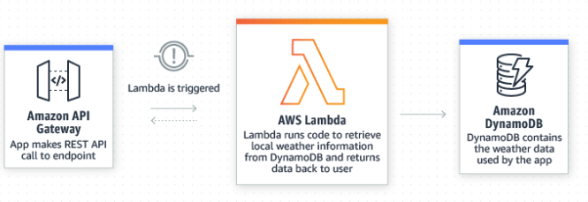
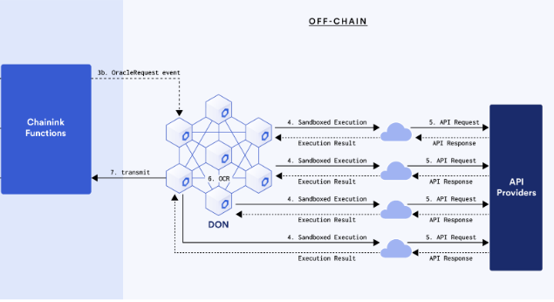
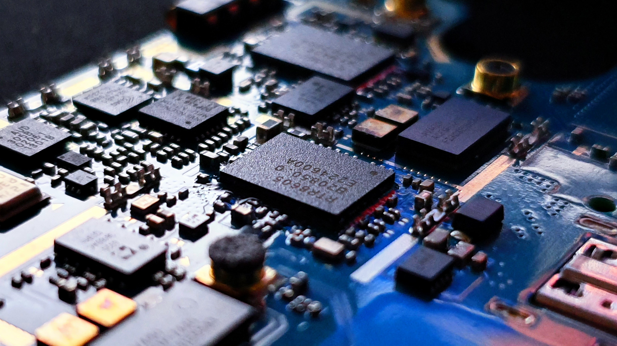
Technologies: Architecture
HTTP POST
HTTP GET
IoT Device

Slide 8
Chainlink Function
Chainlink Functions provides your smart contracts with access to a trust-minimized compute infrastructure.
Your smart contract sends your code to a Decentralized Oracle Network (DON), and each DON's oracle runs the same code in a serverless environment
Chainlink Functions provides access to off-chain computation without running and configuring your own Chainlink Node. To pay for requests, you fund a subscription account with LINK. Your subscription is billed only when the DON fulfills your request.
Chainlink Functions Fetch data from almost any Web2 system such as AWS
Chainlink function is configured for HTTP query parameters to request different sensor values

Slide 9
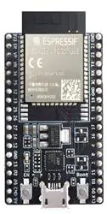
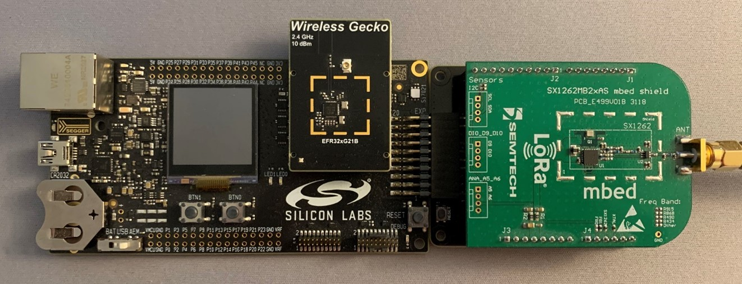
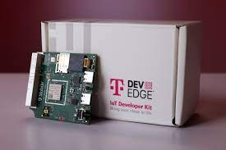
IOT Device’s :
ESP32 is used here as an embedded IOT device to send the sensor data seamlessly to AWS lambda and to blockchain using Chainlink Functions.
It uses near by Wifi to connect to the internet. Sensors like Camera, Ultrasonic sensor, InfraRed LED, Temperature, humidity, Weight etc can be easily integrated with this device to measure and send data on blockchain.
Incase of nearby WiFi is not available then Amazon Sidewalk Devices will be the great option.
Amazon Sidewalk is a secure and free-to-connect community network which connects to SideWalk Bridges such as Echo and Ring devices.
It uses LoRa communication technology to send data from over 10 miles while consuming very Low Power.
If Wi-Fi or Nearby Amazon Sidewalk Bridge is not available, then We can use T-Mobile DevEdge IoT Developer Kit.
It uses T-Mobile LTE CAT-M IoT Network, a leading LPWA Network technology to send various sensor Data to internet with very low power consumption.

Slide 10
AWS Lambda is a serverless, event-driven compute service that lets you run code for virtually any type of application or backend service without provisioning or managing servers.
You can trigger Lambda from over 200 AWS services and software as a service (SaaS) applications and only pay for what you use.
AWS Lambda automatically runs code in response to multiple events, such as HTTP requests via Amazon API Gateway.
Amazon DynamoDB is a key-value NoSQL database that is used to store real-time sensor data.
AWS Lambda

