Slide 1

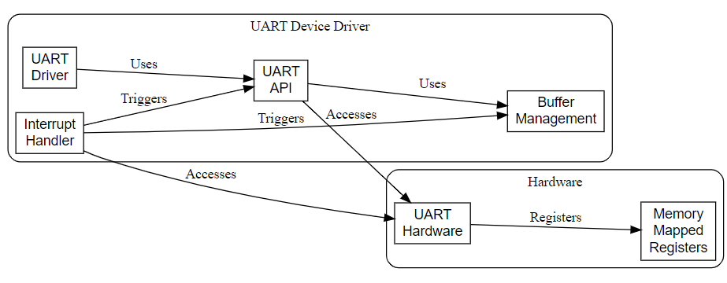
Develop a Device Driver for UART
Context: Developing a UART device driver for LPC2148 involves creating software that enables the microcontroller to communicate with external devices via the UART interface. This driver handles data transmission, reception, and UART configuration, ensuring seamless integration of serial communication capabilities into embedded systems based on the LPC2148 microcontroller.
Problem Statement: Developing a Device Driver for the UART using LPC2148 microcontroller interface.
Deliverables:
Source code of the UART device driver tailored for the LPC2148 microcontroller.
Test cases and validation results to ensure the driver's reliability and compatibility with various UART peripherals.
Integration support and assistance for incorporating the driver into specific embedded systems or applications.
Training/Pre-Requisites:
Knowledge about UART protocol.
Training over the LPC2148 microcontroller.
Basic knowledge about the Device Driver’s.
Timeline
Kick Off < 1st Month >
Milestone 1 < 2nd Month >
Milestone 2 < 3rd & 4th Month>
References:
Dong, Yunwei, Yuanyuan He, Yin Lu, and Hong Ye. "A model driven approach for device driver development." In 2017 IEEE International Conference on Software Quality, Reliability and Security Companion (QRS-C), pp. 122-129. IEEE, 2017.
Kumar, Prashant, and Shashank Singh. "Multi sensor system using LPC2148 microcontroller." PhD diss., 2014.
Hands on learning with Raspberry pi.
Research paper collection and Literature survey.
Prototyping & Testing.
Optimization of the system.
Generation of project report.
Technical development & programming of the system
Interfacing the micro controller with external devices via UART interface.

