Slide 1

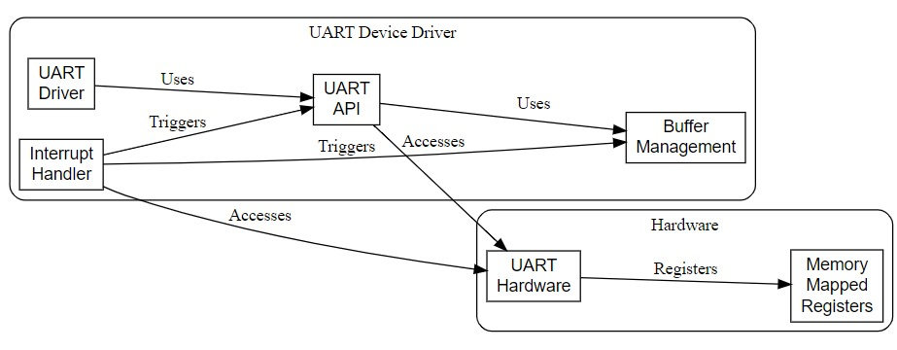
To Develop a Device Driver for UART using LPC1768
Guide name: Prof. Ashwini Desai
Problem Statement : Design and implement a robust and efficient UART device driver for the LPC1768 microcontroller. This driver must enable seamless and reliable serial communication with external devices, supporting various configurations and operational modes.
Block Diagram:
Introduction: Developing a device driver for the UART peripheral on the LPC1768 microcontroller will enable efficient and reliable serial communication with external devices. This driver aims to support various configurations and modes of operation, enhancing the microcontroller's versatility in embedded applications.
Specification Table:
Sl. No. | Requirements | Objective | Specification
 |  |  | Hardware | Software | Sensors | Actuators | Communication Protocol
1. | LPC1768 | The LPC1768 microcontroller aims to deliver a high-performance, cost-effective solution with extensive peripherals and memory for versatile embedded applications.. | Baud rates, Data bits, Stop bits, and Parity, GPIO | Keil uVision4
2. | UART | UART enables simple, asynchronous serial communication with configurable parameters for data integrity and low hardware requirements, making it cost-effective and versatile for various devices. |  | Keil uVision4
Drivable
Results: Developing a UART device driver for LPC1768 involves configuring UART registers for baud rate, parity, and interrupts, and implementing functions for initializing, transmitting, and receiving data, ensuring compatibility with the LPC1768's hardware specifications and communication protocols.

