Slide 1

Department of Electronics and Communication Engineering
MINOR PROJECT 2
DESIGN AND OPTIMIZATION OF HIGH PERFORMANCE SRAM
SL.NO. | NAME | USN | ROLL. NO
01 | ALEENA MULLA | 02FE21BEC006 | 05
02 | BASAVESH PATIL | 02FE21BEC018 | 15
03 | HARSH PATIL | 02FE21BEC035 | 32
04 | PRATIK PATIL | 02FE21BEC063 | 58
Under the Guidance of
Prof. Ashwini Desai

Slide 2
PROBLEM STATEMENT
The design and optimization of SRAM cells are critical for achieving low power consumption and high stability in modern electronic devices. Traditional 6T SRAM cells face challenges such as high leakage current and instability at lower voltages. The 8T SRAM architecture offers a potential solution, but its performance needs to be evaluated and optimized for practical applications.

Slide 3
BLOCK DIAGRAM
DESIGNING OF SRAM
IMPLEMENTATION OF SRAM USING 8T
SIMULATION AND ANALYSIS
TRANSISTOR LEVEL OPTIMIZATION

Slide 4
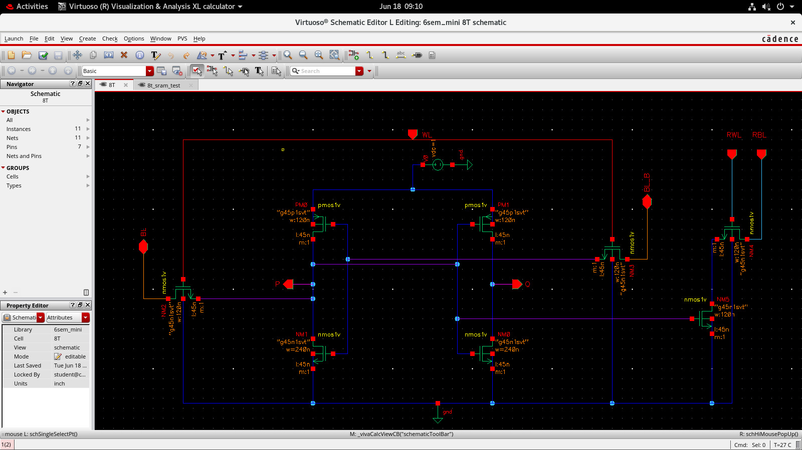
DESIGN AND IMPLEMENTATION
8T

Slide 5
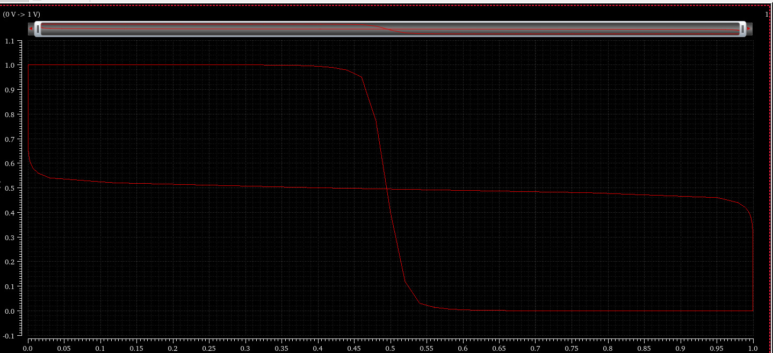
SNM

Slide 6
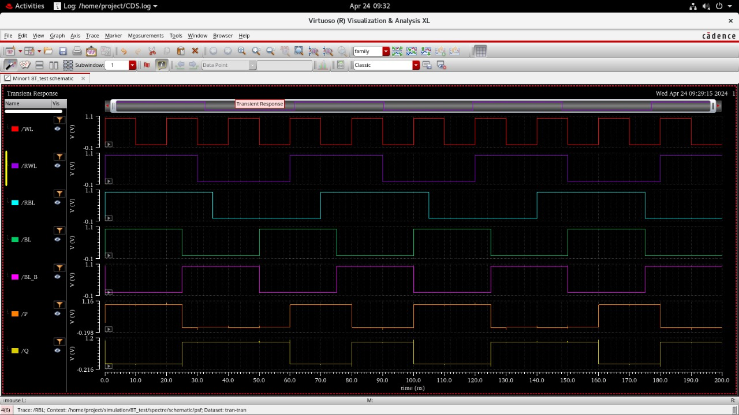
WAVEFORMS

Slide 7
RESULTS/OPTIMIZATION
WIDTH | POWER
All 120 nm | 1.638 e^-6
All 120(pull up transistor 240nm) | 2.247 e^-6
All 120(pull down transistor 240 nm) | 1.642 e^-6
All 120(pass transistors 2 inverters 240 nm) | 1.741 e^-6
All 120(pass transistors 2 inverters 360 nm) | 1.789 e^-6
All 120 (pull down transistor 360 nm) | 1.649 e^-6
All 120 (pull up inverter 360 nm) | 2.365 e^-6
All 120 (pull down inverter 480 nm) | 1.655 e^-6
All 120 (pass transistors 480 nm) | 1.82 e^-6

Slide 8
PARAMETRS | DELAY
WRITE 1 | Rising to falling 35 .01e-9 Falling to rising 25.02 e-9
READ 0 | Rising to Falling 25.01e-9 Falling to rising 35.02 e-9

