Slide 1
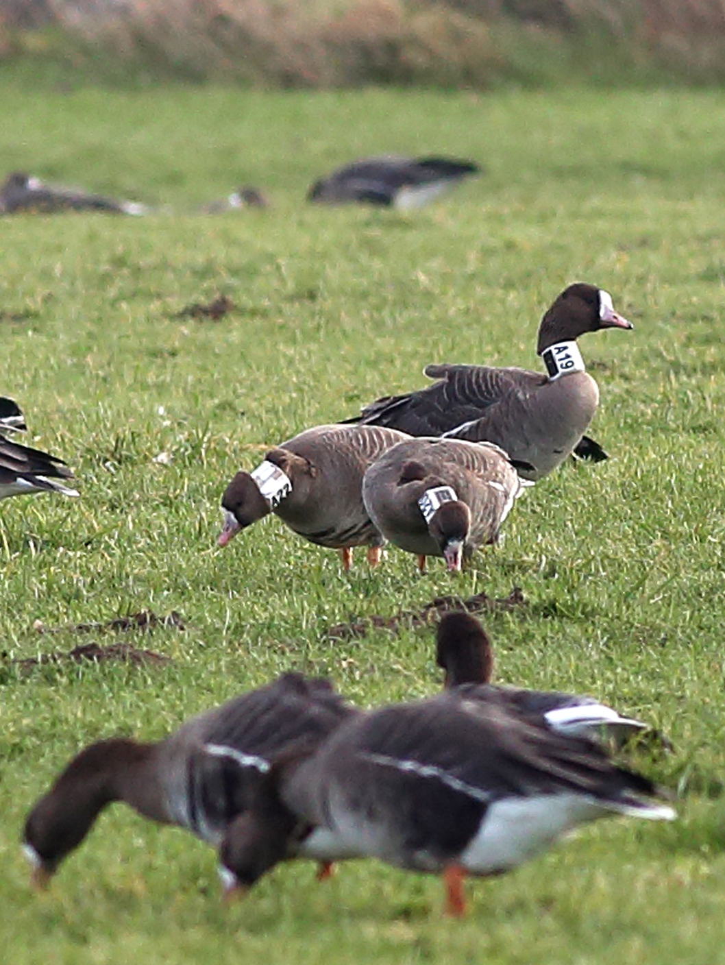
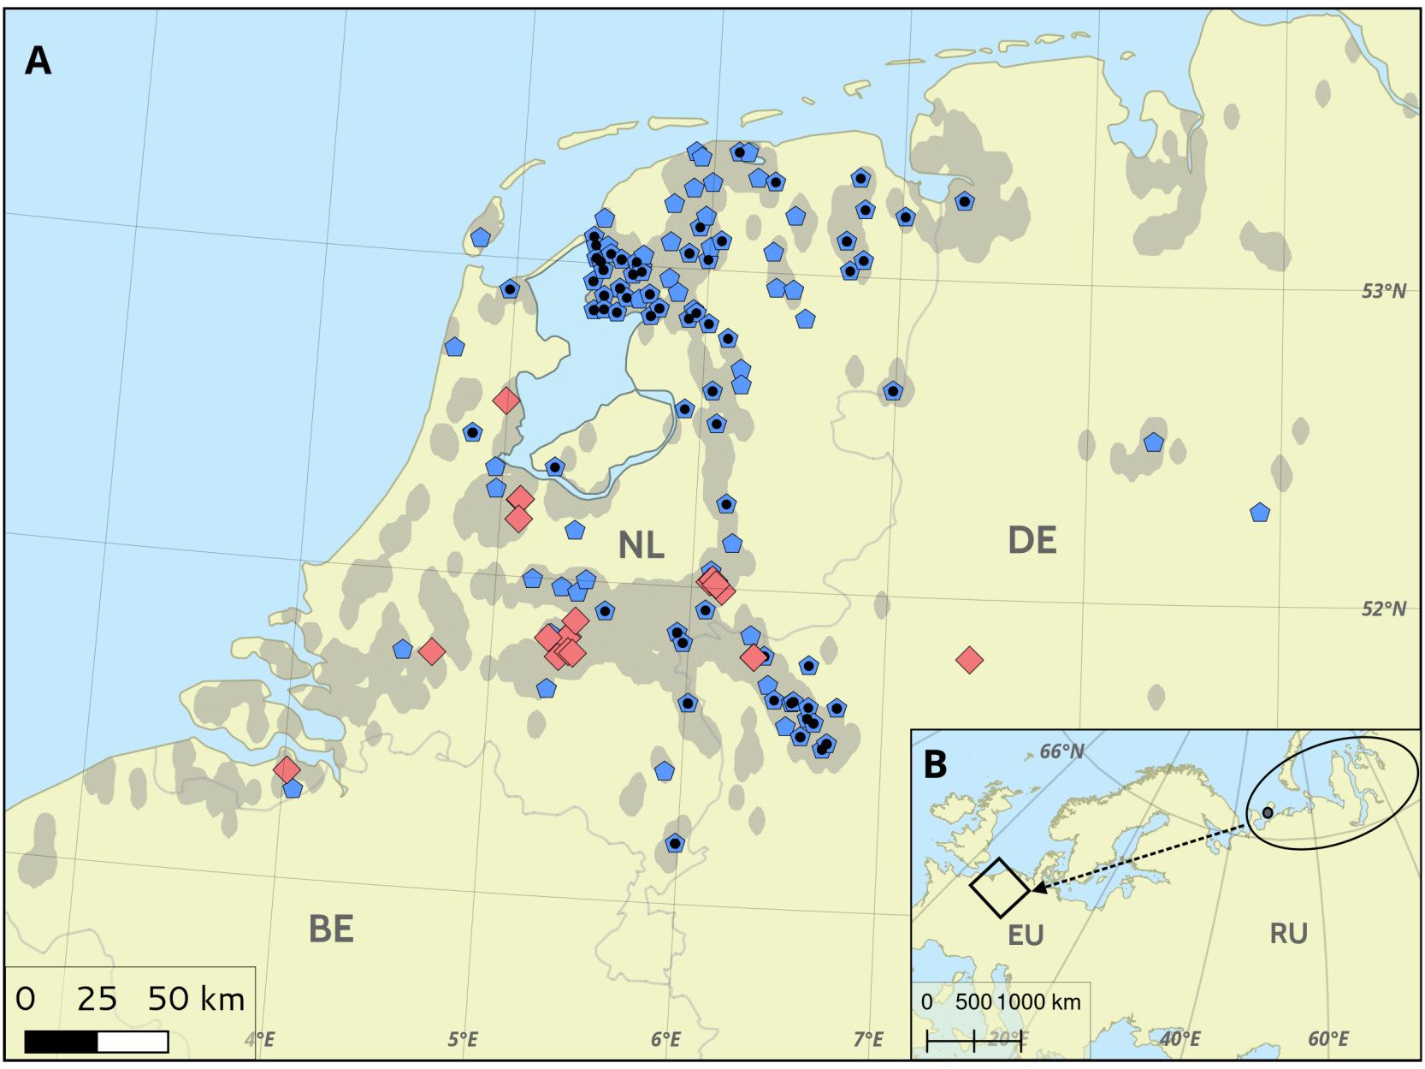
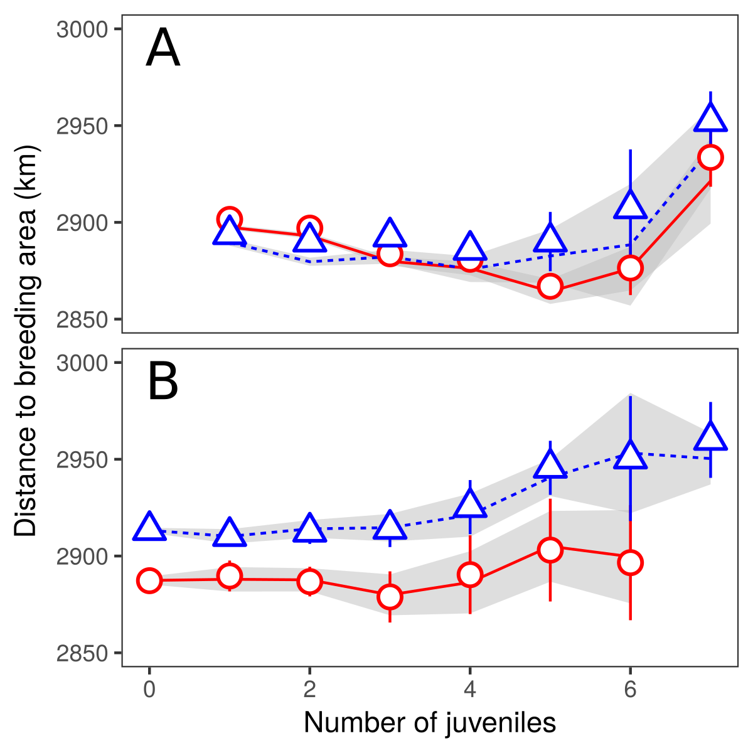
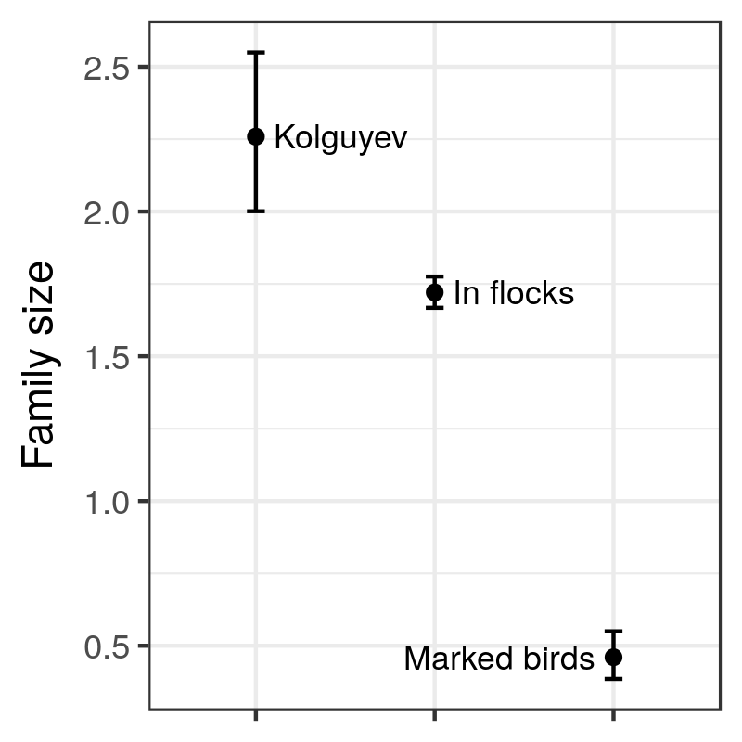
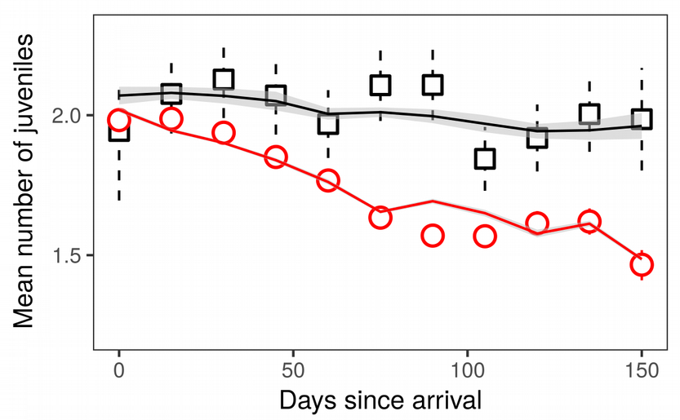
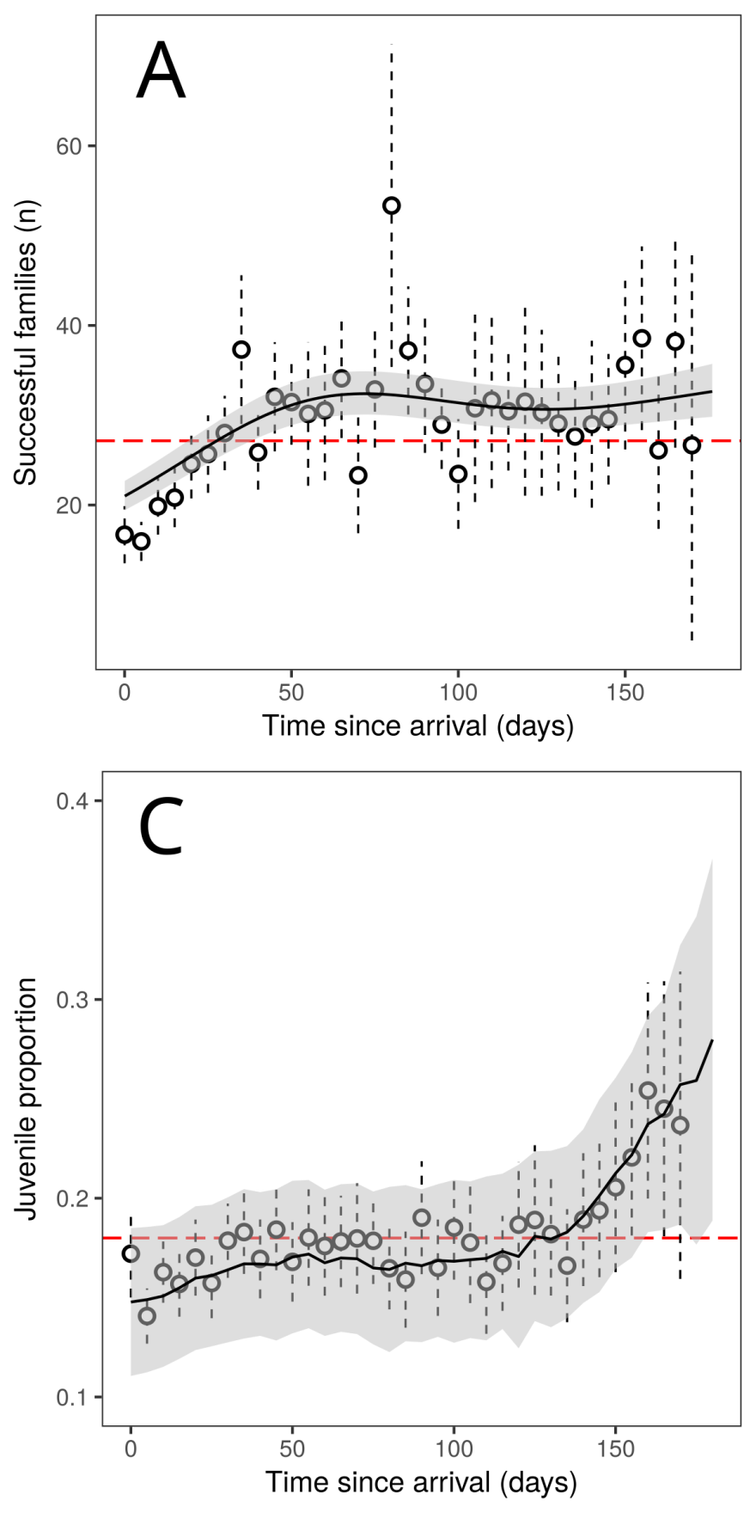
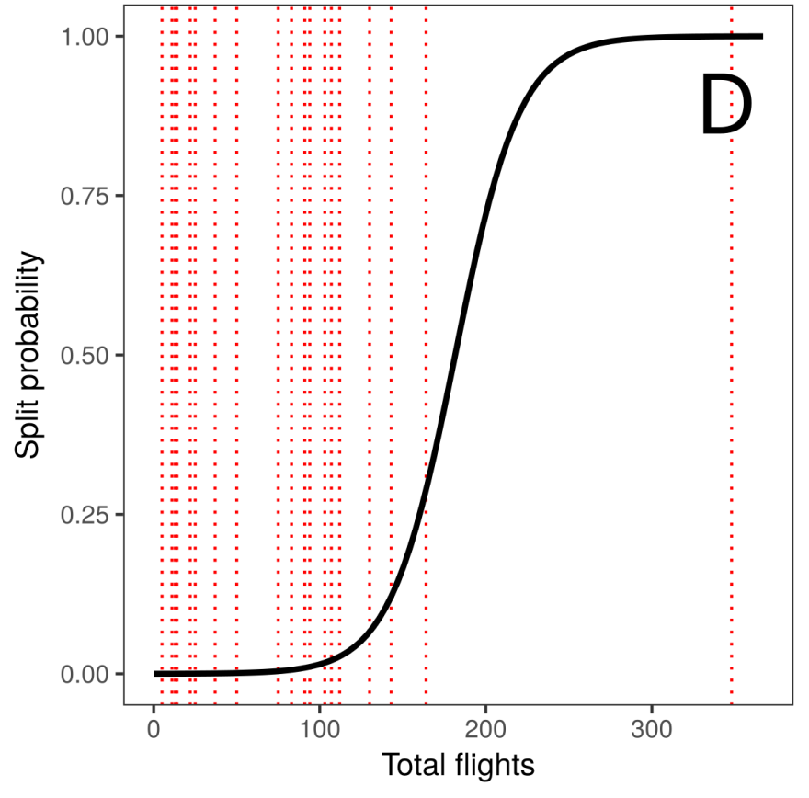





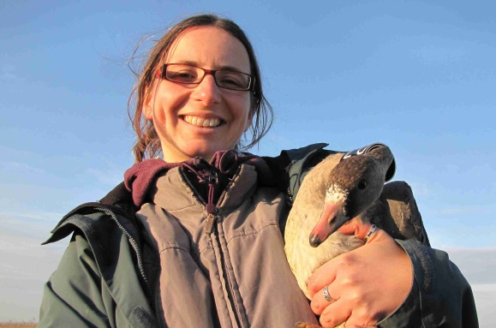
Family size Dynamics in Wintering Geese
Pratik R. Gupte, Kees Koffijberg, Gerhard J.D.M. Müskens, Martin Wikelski, Andrea Kölzsch
Max Planck Institute for Ornithology, Christian Albrechts University Kiel, SOVON Dutch Centre for Field Ornithology, Wageningen Environmental Research (Alterra)
Summary
Families of geese and swans often stay together through one or more migration events. How their social status influences migration timing, winter movements and space-use is not well understood.
We explored family size dynamics of wintering greater white-fronted geese (Anser a. albifrons) using 17 years of observation data on foraging flocks and GPS tracks of 13 complete families.
Our results suggest that white-fronted geese are differentially migratory by age and social class in both autumn and spring. This is important for consideration of the effects of climate and habitat change on large migrants that subsist in families long after hatching and their conservation and management.
Family separation in numbers
Large families winter further from breeding area
We found that only between December and February, families with more juveniles wintered farther from the breeding grounds, where flocks were smaller.
Differential migration of families, juveniles and adults without young
Families likely got separated by disturbance in winter
Contact:
akoelzsch@orn.mpg.de

