Slide 1
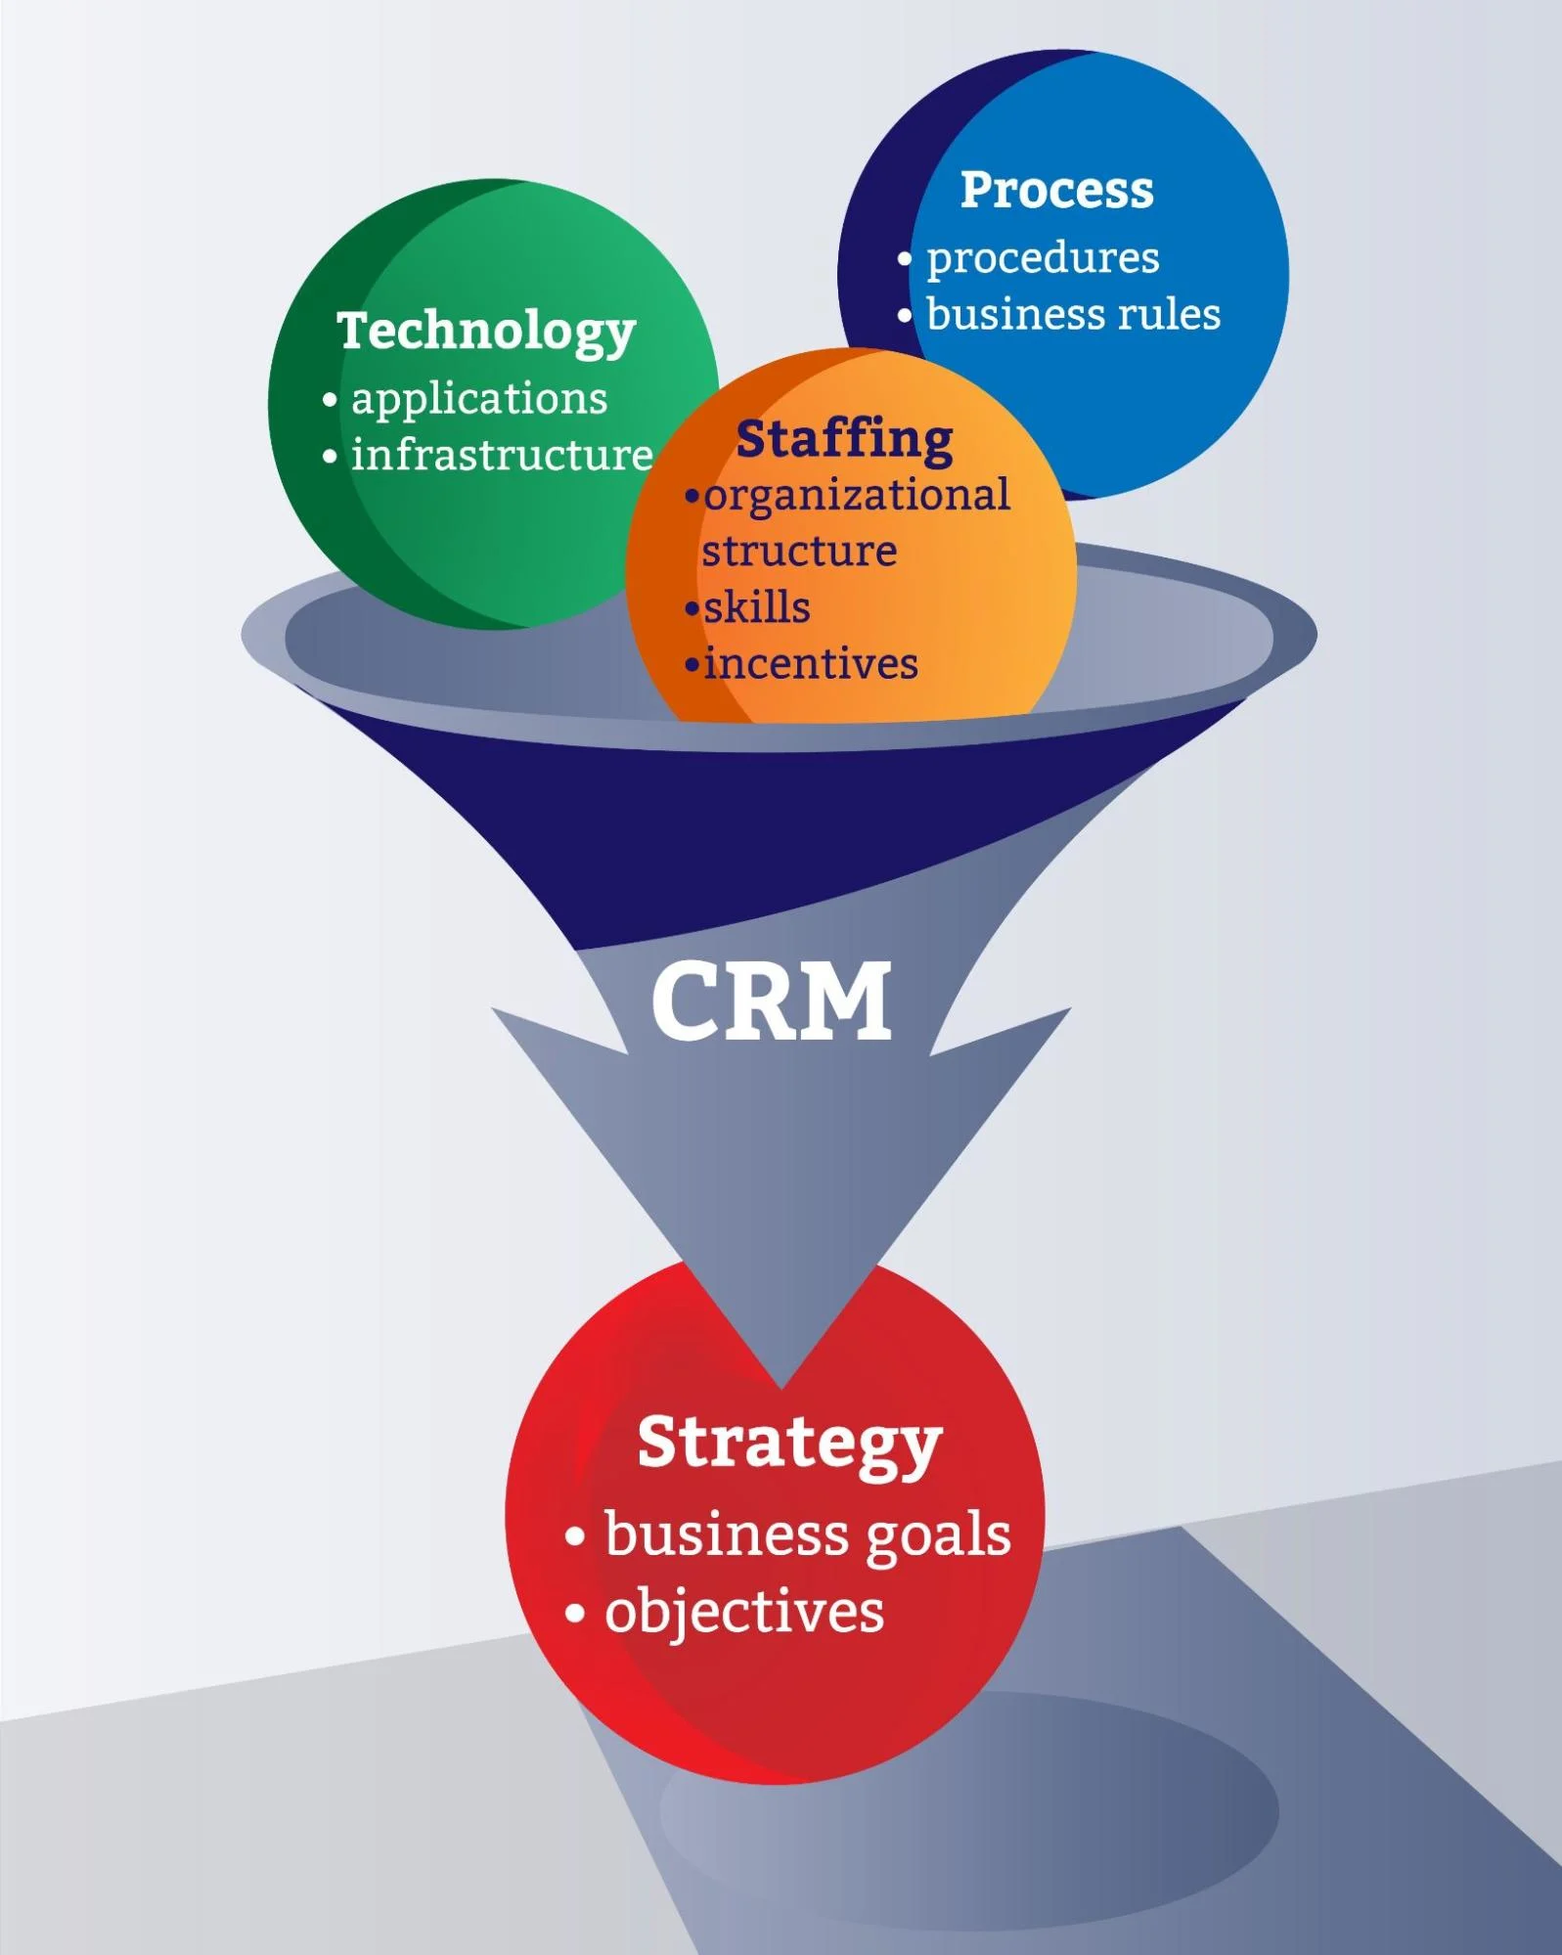
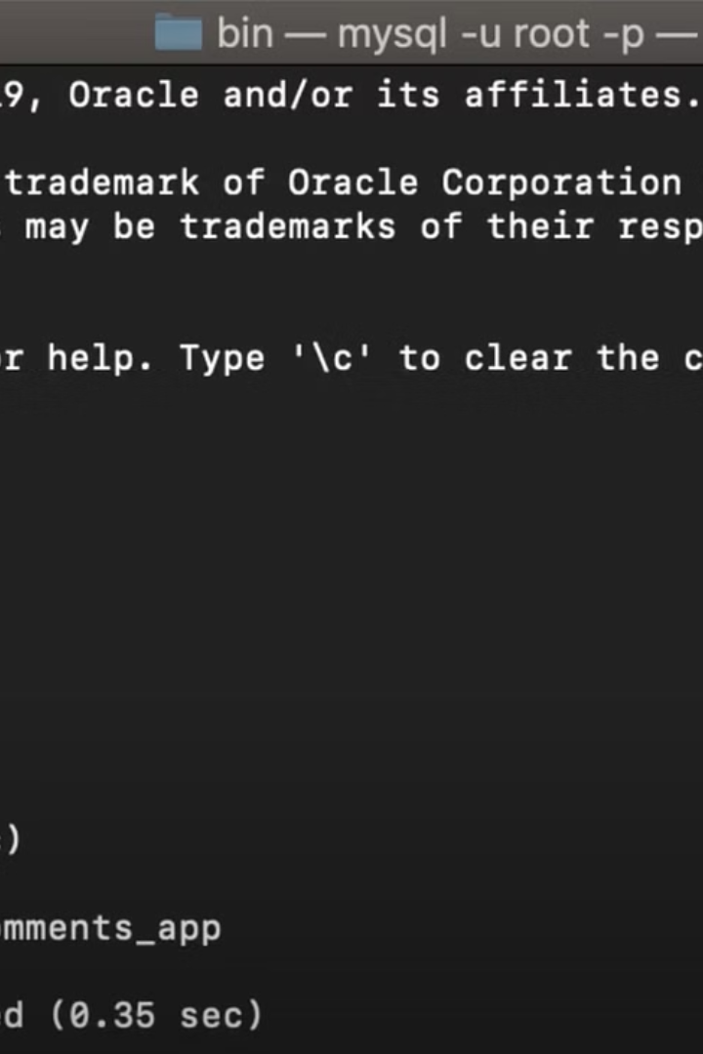

Introduction to the Project
CRM, or Customer Relationship Management, is a software system designed to manage interactions with customers, prospects, and leads. It helps businesses streamline their sales, marketing, and customer service processes.
Benefits of CRM
Improved customer satisfaction and loyalty
Increased sales and revenue
Enhanced marketing effectiveness
Streamlined customer service
Better data management and analysis

Slide 2
Overview of CRM system
Customer Relationship Management (CRM)
Key Components
Includes functionalities for sales management, marketing, customer service, and support.
A system designed to manage customer interactions and data throughout the customer lifecycle.
Benefits
CRM Integration
Streamlines processes, improves customer relationships, and increases profitability.
Seamless integration with existing systems for a unified and efficient business operation.

Slide 3


Technologies used: Spring Boot and MySQL
Spring Boot: A powerful and streamlined framework for building enterprise-level applications in Java, providing a fast way to set up standalone Spring-based applications.
MySQL: An open-source relational database management system that allows efficient management of data, ensuring reliability and scalability for the CRM application.

Slide 4
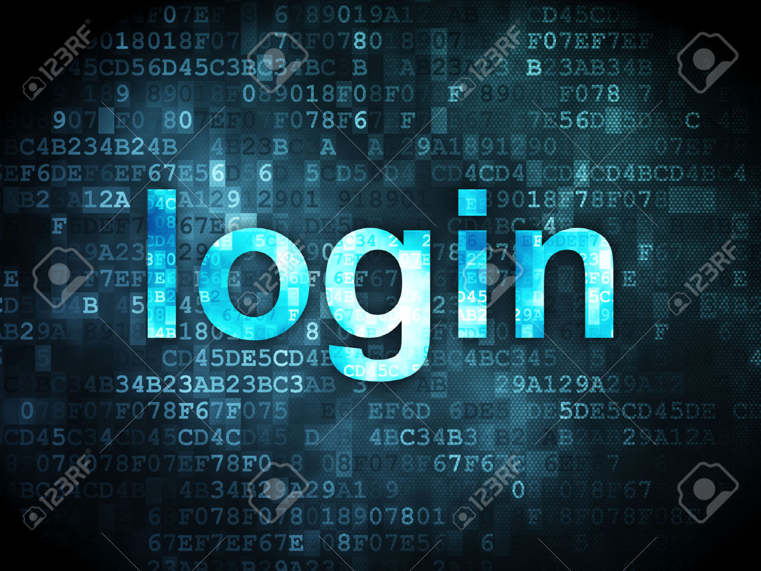
User Authentication and Authorization
This Photo by Unknown Author is licensed under CC BY
1
User Login
Users enter their credentials to access the system.
2
Token Generation
Upon successful login, a secure token is generated.
3
Access Control
Permissions are assigned based on user roles and privileges.

Slide 5
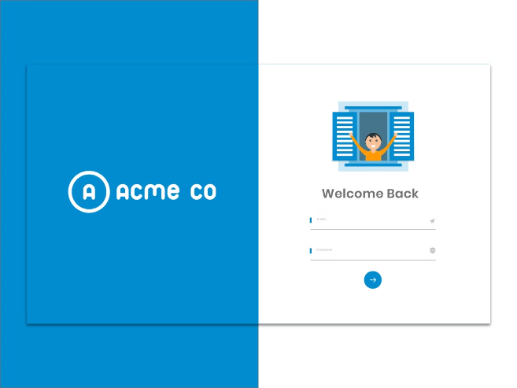
Admin functionalities: sign in, login, and dashboard
Admins can securely sign in and access the system.
They can then proceed to login to their account.
Upon successful login, admins are directed to the dashboard.

Slide 6
User Functionalities: Sign In, Login, and Profile
Sign In
Login
Profile
Users can easily sign in using their credentials for access to their accounts.
Once signed in, users can login securely to access the system's features.
Users can view and manage their profiles, including personal details and preferences.
A secure authentication process ensures the protection of user data.
The login process includes multi-factor authentication for enhanced security.
Profile customization options provide a personalized experience for users.

Slide 7

Collecting and Storing Information in the Database
When collecting information in the database, it's important to define clear data schemas and use efficient storage techniques. Utilizing normalized tables and proper indexing can enhance database performance.
Storing data securely is crucial. Implementing encryption for sensitive information and regular database backups are essential for data protection.

Slide 8
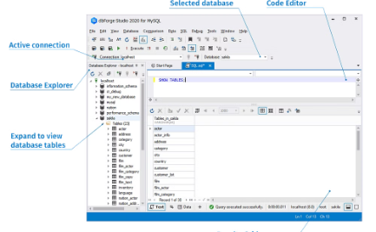
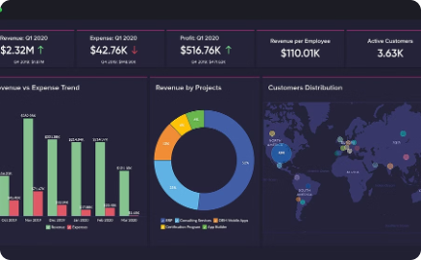
Data Retrieval and Display
Data Retrieval
Dynamic Data Display
Data Presentation
Efficiently retrieve and organize data from the MySQL database using Spring Boot.
Display the retrieved data dynamically in the CRM system with intuitive user interfaces.
Present the retrieved data in a visually appealing manner through the CRM dashboard.

Slide 9



Security Measures Implemented
Cybersecurity
Data Encryption
Multi-factor Authentication
Implementing robust cybersecurity measures to protect the system from cyber threats and attacks.
Utilizing strong encryption methods to safeguard sensitive user and admin data.
Enabling multi-factor authentication to enhance login security and prevent unauthorized access.

Slide 10
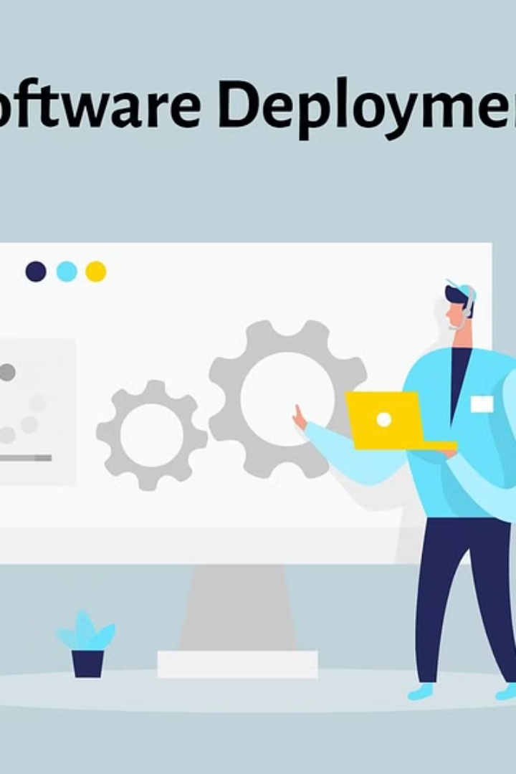
Conclusion and Next Steps
As we conclude, the project's next steps involve thorough testing and deployment.
Following that, continuous monitoring and refinement will ensure seamless user experience and data security.

