Slide 1
Fall Detection Mechanism By Application of Piezo Tiles For Elderly People
Version 1.0
Team: GUCCI-GANG
CNC 3.0

Slide 2


Some Infamous Statistics:
According to the Home Safety Council an American Non-Profit Organization, falling in bathrooms is the leading cause of unintentional home injury deaths and around 6,000 lives are lost every year.

Slide 3



Reasons
1. Bathroom Is a Private Area
2. Fall Results Majorly in Head Injury
3.Time Delay Results

Slide 4
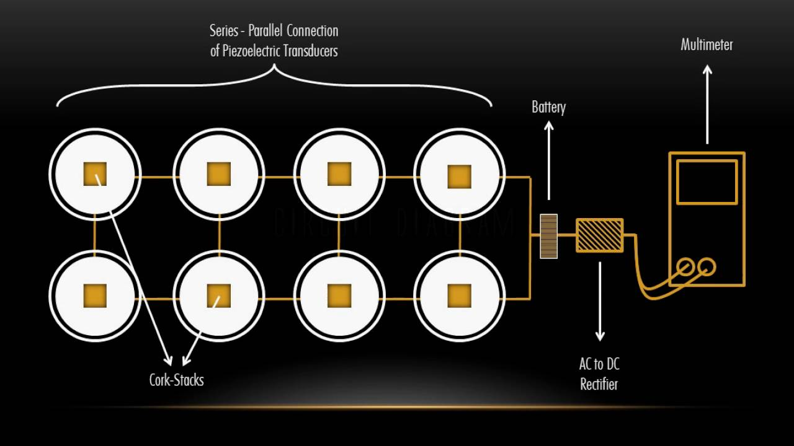
Our Solution
Peizo Tiles: The Piezo tiles are tiles made of Piezoelectric materials. These are materials that produce an electric current when they are placed under mechanical stress.
The piezoelectric process is also reversible, so if you apply an electric current to these materials, they will actually change shape slightly.

Slide 5






APPLICATION
Rings Alarm
Send SMS
Piezo Tiles(To Detect Fall)

Slide 6
Requirements
Piezo Sensors
Micro Controllers Or Micro Processor(Raspberry Pi, Arduino etc.)
GSM Module
Buzzer Alarm
Capacitor

Slide 7
Threshold Selection
The threshold selection will be based on the analyzed results of the various experiments conducted by taking into account the following parameters:
Are of the bathroom
Size of the person
Size of the tiles with pezo sensors

Slide 8
References:
https://www.instructables.com/id/Piezo-Tiles-Generate-Electricity-by-Walking/
https://learn.sparkfun.com/tutorials/piezo-vibration-sensor-hookup-guide
https://www.arduino.cc/en/Tutorial/KnockSensor
https://money.usnews.com/money/blogs/the-home-front/2009/08/31/the-top-5-causes-of-accidental-home-injury-deathsand-how-to-prevent-them

Slide 9


