Slide 1
ENEE150 Discussion #6
Pratik Rathore
3/11/21

Slide 2
Agenda
Structs
Dynamic memory allocation (malloc, calloc, free)

Slide 3
Structs – Motivation
Say we wanted to track all the books in a library
For every book, we want to store the title, author, genre, year of publication, edition number, # of pages
We might naturally think to use an array, but the fields correspond to different data types – title (char*), author (char*), genre (char*), year of publication (int), edition number (int), # of pages (int) – so this is not possible
Structs can be used to solve this problem

Slide 4
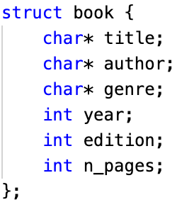
Structs – Declarations
keyword
name
Structs are composite data types that allow us to store different types of variables in the same block of memory
”struct” is the keyword used to tell the compiler that you are defining a struct
The name is what you will use to refer to the struct in your code
Fields are the variables that will be stored in your struct
Disadvantage of structs over arrays: pointer arithmetic breaks down, so struct fields cannot be accessed in an elegant manner
The best place for defining structs is in header files
fields

Slide 5
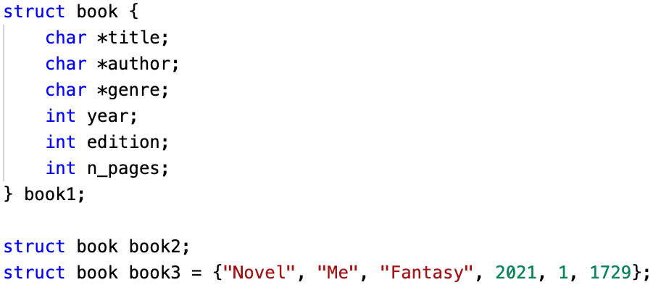
Structs – Declarations
Now that we know how to define a struct, how do we actually use it?
Three different approaches:
Create an instance right after the struct definition
Create an instance without providing any fields
Create an instance while providing fields

Slide 6
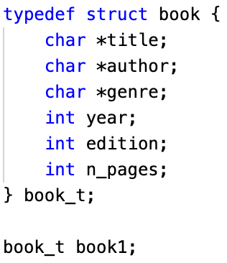
Structs – Typedef
Writing out “struct book” every time can be tedious, but C gives us a way around this
We use typedef to give “struct book” a new name, “book_t”
Then we can simply use “book_t” to create new instances of the struct

Slide 7
Structs – Accessing Fields
We use the . operator to access elements in the struct
For example, book1.year will be equal to 2021
book1.n_pages will be 1729
book1.genre will be a pointer to the first character in “Fantasy”, i.e. book1.genre[0] = ‘F’

Slide 8

Structs – Pointers
Just like other data types in C, we can define a pointer to a struct using the & operator
With pointers, fields are accessed using the -> operator
So p1->n_pages is the same as book1.n_pages
p1->year is the same as book1.year
p1->genre is the same as book1.genre

Slide 9

Structs – Arrays
Similar to other data types in C, we can declare arrays of structs
If we wanted to represent all the books in the library in a single data structure, we could declare an array of book_t structs
We can reference individual structs using [] notation, e.g. book_db[0] refers to the first book_t in the array
We can still access fields using ., e.g. book_db[0].year is the publication year of the first book_t contained in book_db
We can also use pointer arithmetic to jump between structs within the array

Slide 10
Dynamic Memory Management (DMM)
In the assignments we have seen so far, we had constraints on the amount of input data, which let us pre-allocate memory for data storage
For example, in project 2, we are given a max size (5 MB) for every database, which we can use to pre-allocate a char buffer to store the entire database
Issue 1: This is a wasteful approach, since the data is unlikely to reach 5 MB in size, despite us having allocated that much memory
Issue 2: In the real world, we will not usually know the amount of data beforehand. If the database is over 5 MB in size, we have no way to read in all the data.
To avoid these two problems, we can use dynamic memory management (DMM)

Slide 11
Dynamic Memory Management (DMM)
In DMM, instead of allocating memory at compile time, we allocate memory at run time
By doing so, we can exactly size our arrays/data structures to fit the correct amount of data, avoiding the problems of using too little or too much memory
Unlike global and local variables which are managed by the compiler, memory allocated using DMM must be managed by the programmer, which creates an additional layer of complexity
DMM functions are contained in <stdlib.h>

Slide 12
DMM – malloc
void * malloc(int)
The argument to malloc is the size of the memory that you want to allocate (in bytes)
This size is almost always calculated using the sizeof() function
Never use a hardcoded value as the argument for malloc – different machines may allocate different numbers of bytes to different data types (i.e. int could be 8 or 4 bytes), which has the potential to cause issues in your program!
malloc returns a void* to the first byte in the allocated memory, and we must cast to get the desired pointer type
malloc may return NULL if there is not enough memory to allocate – this is something you must check for

Slide 13
DMM – malloc
Ex: float* ptr = (float*) malloc(sizeof(float)), will allocate a block of memory to accommodate a single float
We can even use malloc with structs!
Ex: book_t* ptr = (book_t*) malloc(sizeof(book_t)), will allocate a block of memory to accommodate a single book_t
We can also use malloc to create arrays!
Ex: book_t *ptr = (book_t*) malloc(sizeof(book_t) * N) will allocate memory for an N-element book_t array

Slide 14
DMM – calloc
void * calloc(int, int)
calloc is a fancy version of malloc that you can use to allocate memory for arrays
First argument is the size of an element, while the second argument is the number of elements
Ex: book_t *ptr = (book_t*) calloc(sizeof(book_t), N) will allocate an N-element book_t array
The main difference between malloc and calloc is that calloc will set the allocated memory to 0, but malloc does not

Slide 15

DMM – free
void free(void *)
Argument is a pointer that was obtained from a call to malloc/calloc
When free is called upon a pointer, it frees the memory at that location and returns it to the heap for later use
When you are done with memory that has been malloc’d, you must call free, otherwise you will end up with a memory leak
The amount of memory that is available on the heap varies between architectures – not freeing memory could mean that your program will have enough memory on one system but not on another one, which can cause crashes/strange behavior
We don’t want our program’s memory to look like this!

Slide 16

Tips/Suggestions
Structs could be helpful for project 2 – you can define a recipe struct to store recipe data
Always use free when you are done with malloc’d/calloc’d memory
Enjoy your break!

