Slide 1
ENEE150 Discussion #13
Pratik Rathore
5/6/21

Slide 2
Agenda
Two’s Complement
Bitwise operators

Slide 3
Two’s Complement
Two’s complement is the most common way of representing signed integers
An n-bit integer in two’s complement can take on values between -2^(n-1) to 2^(n-1) – 1
All numbers >= 0 are represented using standard binary conventions
Negative numbers are trickier
First, we flip the sign to get a positive value
Second, we find the binary representation of the positive value
Third, we flip the bits of the binary representation
Fourth, we add 1 to the binary representation
Math operations work nicely with two’s complement (assuming no overflow)
Example: -13 with 8 bits
00001101
Binary representation of 13
11110010
Flip bits
11110011
Add 1 to binary representation

Slide 4
Bitwise Operators
We have seen and used logical operators in C (&&, ||, !), which would operate on various data types
Bitwise operators are typically used to operate on ints at a bit level (although they can be used on float/double)
6 different bitwise operators: &, |, ^, ~, <<, >>
Bitwise operators are very useful for manipulating data that is not of “standard” size (e.g. not 32 or 64 bits)

Slide 5
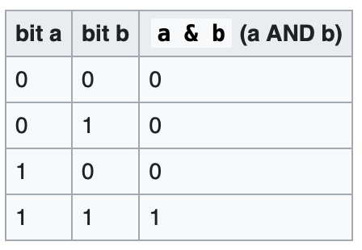
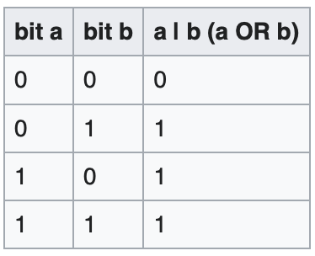
& and |
& – bitwise AND operator
| – bitwise OR operator
a & b will traverse through the bits of a and b and perform the AND operation at each position
a | b will traverse through the bits of a and b and perform the OR operation at each position
Example: a = 12, b = 22 (8 bits)
So a = 00001100, b = 00010110
Therefore a & b = 4, a | b = 30
00001100
& 00010110
00000100
00001100
| 00010110
00011110

Slide 6
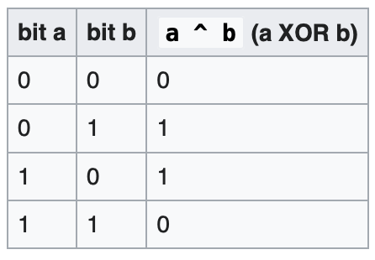
^ and ~
^ – bitwise XOR operator
~ – bitwise NOT operator
a ^ b will traverse through the bits of a and b and perform the XOR operation at each position
~a will traverse through the bits of a and flip them at each position
Example: a = 12, b = 22 (8 bits)
So a = 00001100, b = 00010110
Therefore a ^ b = 26, ~a = -13
00001100
^ 00010110
00011010
~ 00001100
11110011

Slide 7
<< and >>
<< – left shift operator
>> – right shift operator (logical right shift)
a << n will shift a to the left by n bits (blank spaces are filled by 0’s)
a << n is equivalent to multiplying a by 2^n
a >> n will shift a to the right by n bits
The logical right shift will fill empty spaces with 0’s, the arithmetic right shift (not in C) will fill empty spaces with the first bit of the number
Arithmetic right shift divides a by 2^n (rounding down); logical right shift does not perform division properly for negative numbers
Ex. a = 52
a << 1 = 104, a << 2 = 208, a >> 1 = 26, a >> 2 = 13, a >> 3 = 6

Slide 8

Tips
Submit project 4 on time
Start studying for the final as soon as possible
Have a great summer!

