Slide 1
ENEE150 Discussion #9
Pratik Rathore
4/8/21

Slide 2
Agenda
Review for Midterm 2

Slide 3
Questions about Project 3?

Slide 4
Midterm 2 Topics
Strings (Lecture 10)
Pointer Arrays (Lecture 11)
Structs (Discussion 6, Lectures 11-12)
Dynamic memory allocation (Discussion 6, Lectures 13-14)
Linked lists (Discussion 7, Lectures 14-17)
Hash tables (Lecture 17)
Trees (Lecture 18)
Recursion will not be on midterm 2
The midterm will emphasize dynamic memory allocation and linked lists
Trees will not be emphasized much on the exam

Slide 5
Dynamic Memory Management (DMM) Review
In DMM, instead of allocating memory at compile time, we allocate memory at run time
By doing so, we can exactly size our arrays/data structures to fit the correct amount of data, avoiding the problems of using too little or too much memory
Unlike global and local variables which are managed by the compiler, memory allocated using DMM must be managed by the programmer, which creates an additional layer of complexity
DMM functions are contained in <stdlib.h>

Slide 6
DMM Review – malloc
void * malloc(int)
The argument to malloc is the size of the memory that you want to allocate (in bytes)
This size is almost always calculated using the sizeof() function
Never use a hardcoded value as the argument for malloc – different machines may allocate different numbers of bytes to different data types (i.e. int could be 8 or 4 bytes), which has the potential to cause issues in your program!
malloc returns a void* to the first byte in the allocated memory, and we must cast to get the desired pointer type
malloc may return NULL if there is not enough memory to allocate – this is something you must check for

Slide 7
DMM Review – malloc
Ex: float* ptr = (float*) malloc(sizeof(float)), will allocate a block of memory to accommodate a single float
We can even use malloc with structs!
Say we have a struct that is typedef’d to be book_t
Ex: book_t* ptr = (book_t*) malloc(sizeof(book_t)), will allocate a block of memory to accommodate a single book_t
We can also use malloc to create arrays!
Ex: book_t *ptr = (book_t*) malloc(sizeof(book_t) * N) will allocate memory for an N-element book_t array

Slide 8
DMM Review – calloc
void * calloc(int, int)
calloc is a fancy version of malloc that you can use to allocate memory for arrays
First argument is the size of an element, while the second argument is the number of elements
Ex: book_t *ptr = (book_t*) calloc(sizeof(book_t), N) will allocate an N-element book_t array
The main difference between malloc and calloc is that calloc will set the allocated memory to 0, but malloc does not

Slide 9

DMM Review – free
void free(void *)
Argument is a pointer that was obtained from a call to malloc/calloc
When free is called upon a pointer, it frees the memory at that location and returns it to the heap for later use
When you are done with memory that has been malloc’d, you must call free, otherwise you will end up with a memory leak
The amount of memory that is available on the heap varies between architectures – not freeing memory could mean that your program will have enough memory on one system but not on another one, which can cause crashes/strange behavior
We don’t want our program’s memory to look like this!

Slide 10
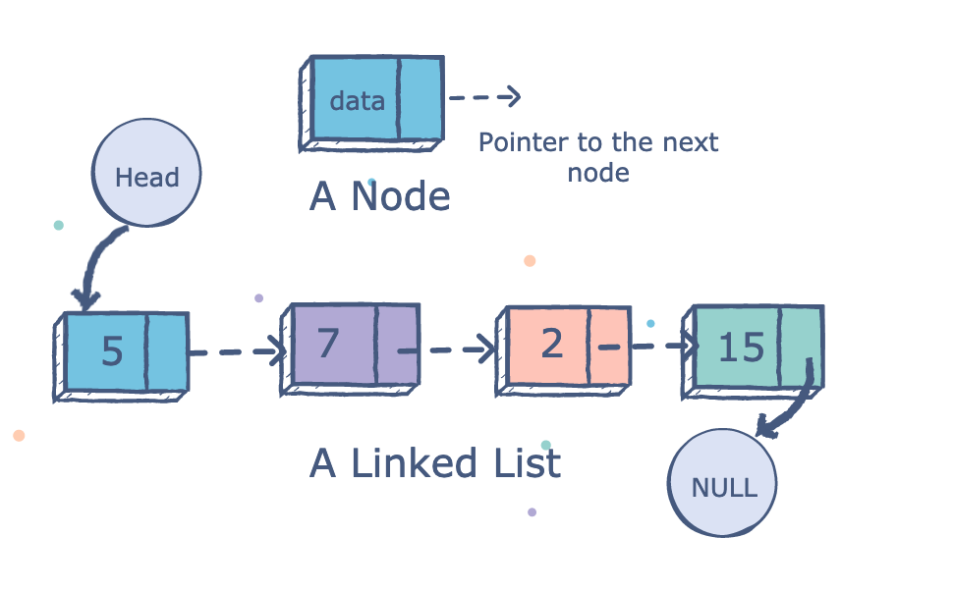
Linked List Review – Structure
Linked lists are an application of DMM and structs
A linked list is a chain of nodes
Each node is a struct that contains data, and a pointer to the next node
The node at the end (aka the tail) of the linked list will always point to NULL
There is also a head pointer that contains the address of the first node
Since nodes are not contiguous in memory, insertion and deletion are easier than for an array
https://medium.com/@konduruharish/linked-list-in-typescript-and-c-be96732b9854

Slide 11
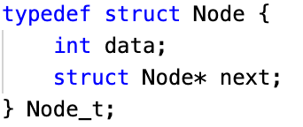
Linked List Review – Nodes
Nodes simply hold data (as many fields as you like), and a pointer to the next Node in the linked list
In C, the best way to define nodes for a linked list is by defining a struct, as shown on the right
When creating nodes, we will use malloc
Always check whether malloc returns NULL!

Slide 12
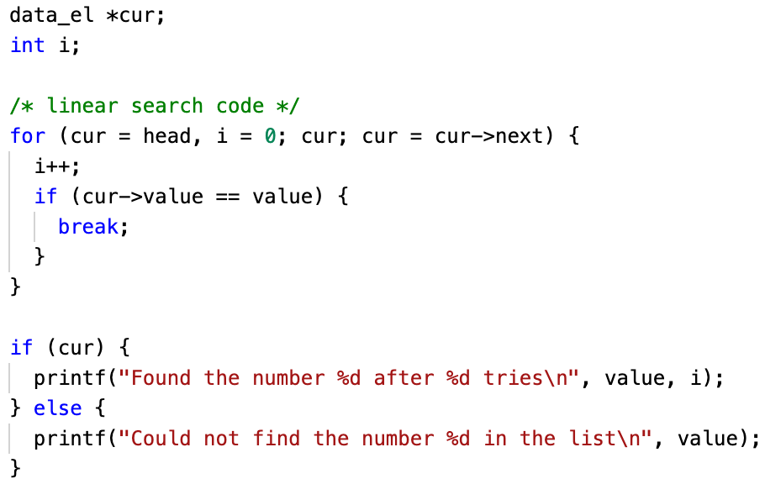
Linked List Review – Traversal
To traverse through the entire linked list, start at the head pointer, and repeatedly use ->next to move through all the nodes
Going through the node pointers by using ->next is called pointer chasing
Traversal is commonly used for searching for elements in a linked list
In the example on the right, we iterate through the linked list, looking for value, and breaking if we find value in the list
list_search.c on ELMS

Slide 13
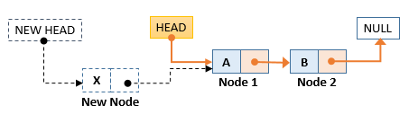
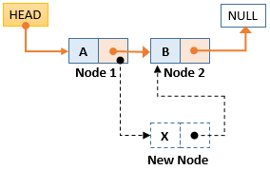
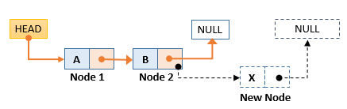
Linked List Review – Insertion
Three places to insert a node: at the head, in the middle, and at the end
Inserting at the head:
new_node -> next = head
head = new_node
Inserting in the middle:
new_node -> next = cur_node -> next
cur_node -> next = new_node
Inserting at the tail:
new_node -> next = NULL
tail_node -> next = new_node
At the head
In the middle
At the tail
https://www.opentechguides.com/how-to/article/c/142/linked-list-insert.html

Slide 14
Linked List Review – Deletion
Similar to insertion, we can delete nodes at the head, middle, and end
Deleting the head:
head = head -> next
Deleting in the middle (we use prev and cur, cur is the node we want to delete, prev is the preceding node):
prev -> next = cur -> next
In reality, this is a bit more complicated – we will have to check if the list is empty, or if we are deleting the head for example
Deleting at the tail (we use prev and cur as before):
prev -> next = NULL
If we are not using the node that we delete, we have to use free to avoid memory leaks

Slide 15

Tips/Useful Resources
Start studying ASAP
For more specific details, look at midterm2-review.pdf on ELMS
Make sure you understand Dr. Yeung’s code examples on ELMS
Study (or try to improve) the code you have written for homeworks/projects related to midterm 2 topics – doing so will help you prepare for writing code on the exam
If you are unsure about a concept, take a look at Dr. Yeung’s lectures
Reach out to me, Dr. Yeung, or the other TAs via email if you have further questions

Slide 16
Questions?

