Slide 1
ENEE150 Discussion #4
Pratik Rathore
2/25/21

Slide 2
Agenda
Pointers
& and * operators
Pass by Reference
Pointer Arithmetic
Tips for using Pointers

Slide 3
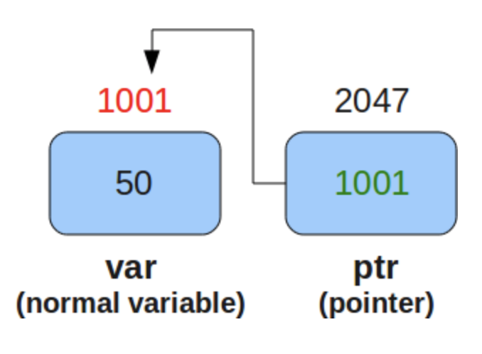
Pointers
A pointer is a variable that stores the address of another variable
Pointers can be initialized for different data types in C:
Pointer to an int: int *i
Pointer to a char: char *c
General pointer declaration: <pointer type> *<pointer name>
Pointers allow for pass by reference, which speeds up code
Instead of passing entire arrays or entire structs, one can simply pass the location in memory
https://www.thegeekstuff.com/2011/12/c-pointers-fundamentals/

Slide 4
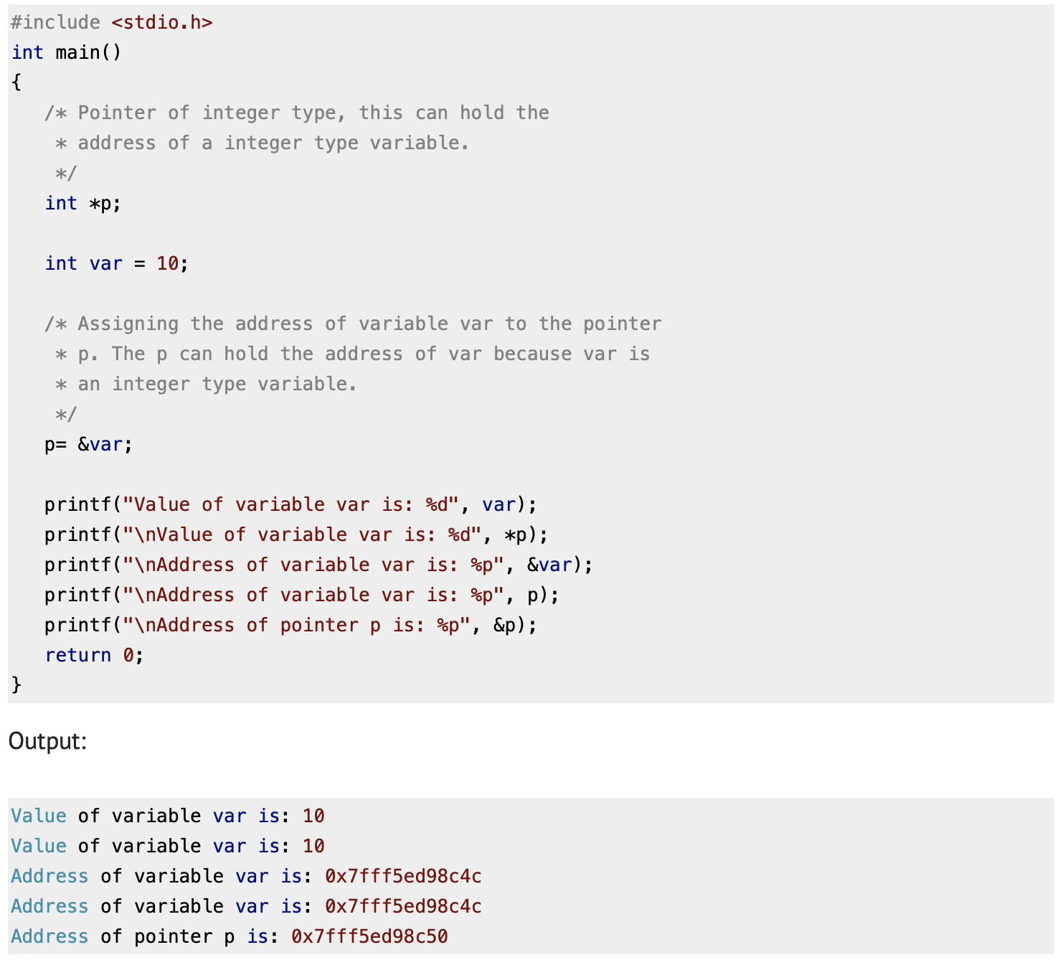
& and * operators
& -- used to obtain the address of the variable
Ex. If we have int d, then &d is the address in memory where d is being stored
* -- use to dereference a pointer and obtain the value of a variable
Ex. *d would be the value assigned to the variable int d
https://beginnersbook.com/2014/01/c-pointers/

Slide 5
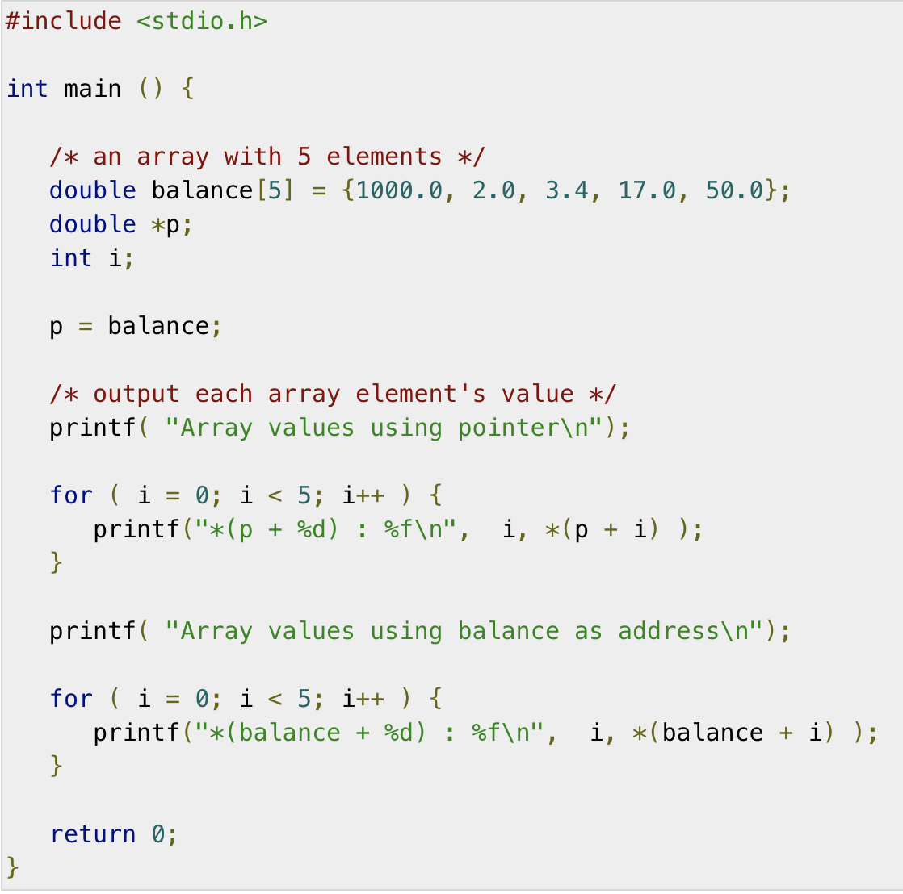
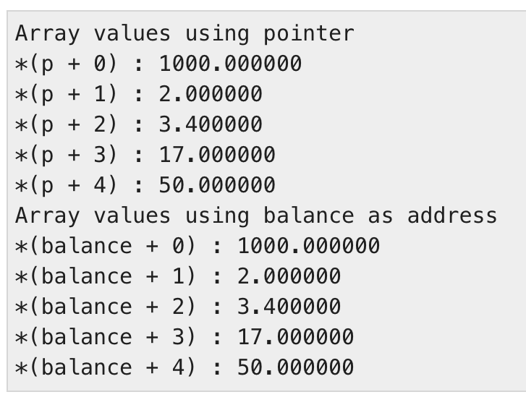
Array Pointers
Pointers are especially useful for handling arrays in C
The name of an array (balance) is a pointer to the address of the first element
In other words, address being stored in p/balance is the same as &address[0]
https://www.tutorialspoint.com/cprogramming/c_pointer_to_an_array.htm

Slide 6
Pass by Reference
So far, we have been using pass by value, where each parameter’s value is copied in memory and then passed into a function
However, we cannot pass more complicated data structures, such as arrays, directly as function arguments
This is why we defined the_board as a global variable in Project 1
In pass by reference, we use the address of the variable as a parameter, which is accomplished using pointers
Pass by reference allows us to avoid using global variables

Slide 7
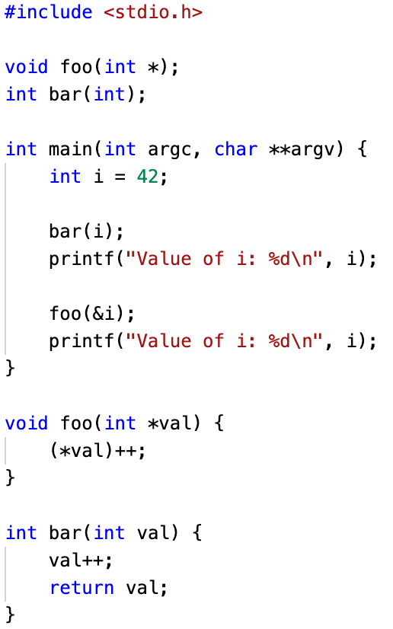
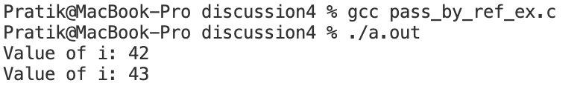
Pass by Reference Example
Pass address of i to foo
Dereference and increment the variable i
foo modifies i because we pass by reference, bar does not modify i because we pass by value

Slide 8
Pointer Arithmetic
Pointer arithmetic can be used to easily move around and manipulate memory
Pointer arithmetic is especially useful for accessing and manipulating arrays
3 pointer arithmetic operations:
Adding an integer to a pointer
Subtracting an integer from a pointer
Subtracting two pointers from each other

Slide 9
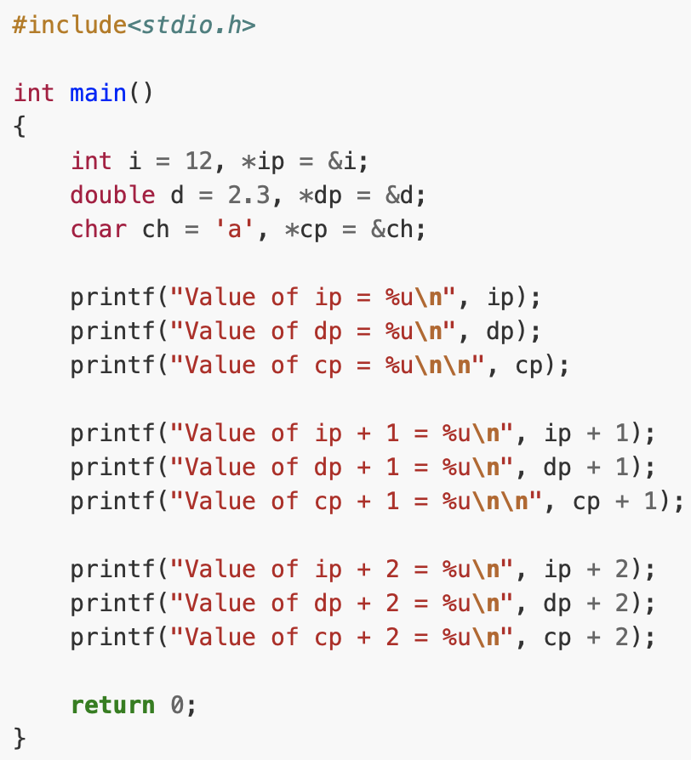
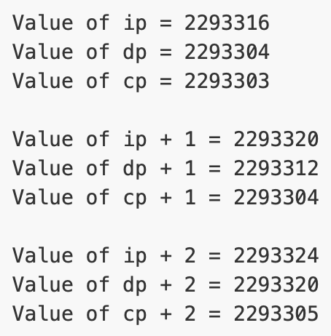
Pointer Addition/Subtraction
Both pointer addition and subtraction are done with respect to the base type of the pointer
For example, let’s say we have int *p set to 1000
Then p + 1 is 1000 + 4 * 1 = 1004, since ints are 4 bytes long
Similarly, p – 1 is 1000 – 4 * 1 = 996
The code on the Array Pointers slide shows how pointer arithmetic can be used to access array elements
https://overiq.com/c-programming-101/pointer-arithmetic-in-c/

Slide 10
Tips/Final Thoughts
We will be using pointers on all future assignments, so it is very important that you understand them!
Tips:
Avoid confusing pointers with “normal” variables – you should be careful not to mix up addresses with actual data
The dereference operator (*) can be confusing since it is also used when initiating pointers – this is something to always keep in mind
Always initialize your pointers when creating them, otherwise you may write to some random location in memory and cause a crash – these errors can be very hard to find

Slide 11
Questions?

