Slide 1
ENEE150 Discussion #5
Pratik Rathore
3/4/21

Slide 2
Agenda
Project 2

Slide 3
Project 2 – Overview
You will be developing a recipe database
pr2.pdf on ELMS contains the project specifications
Project is due on 3/24 at 11:59 pm
Please submit both assignments using assignment number 20

Slide 4
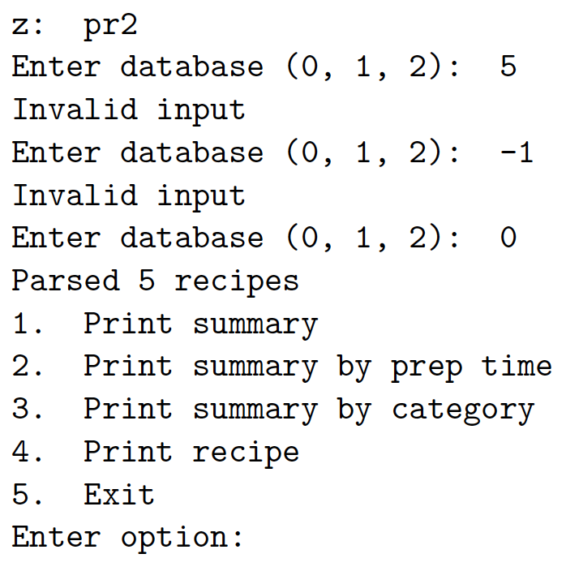
Project 2 – Required Functionality
At startup:
Allow the user to select a database file, and load this database into memory
Afterwards:
Print summary lines (Option 1)
Print summary lines by preparation time (Option 2)
Print summary lines by category descriptors (Option 3)
Display full recipes (Option 4)
Exit (Option 5)
Options 1, 2, 3, 4, 5 should be selectable at a common menu

Slide 5
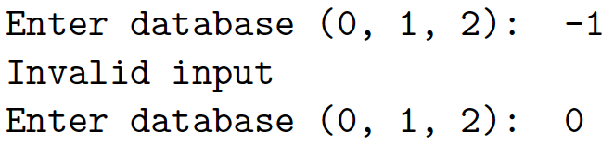
Startup
There are 3 database files: recipes0.data, recipes1.data, recipes2.data
Upon startup, give the user the option to select one of the databases
You may assume the user will always enter an integer, but it may not be one of the valid responses (0, 1, or 2)
If an invalid input is entered, print ”Invalid input” and re-prompt

Slide 6
Recipe Database File – Detecting Individual Recipes
The beginning of each recipe is marked by a ”marker line” consisting of 29 spaces and 24 asterisks
The marker line itself is not part of the recipe; recipes start immediately below the marker line
There is no marker line for the final recipe, only an end of file character
Your program should sequentially assign ID numbers to each recipe

Slide 7
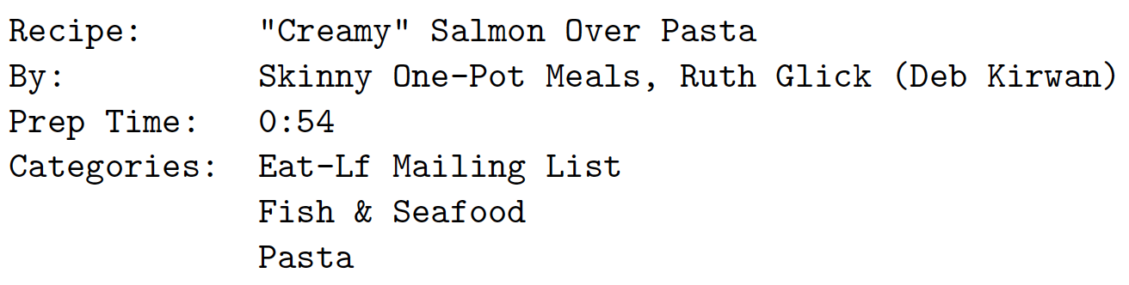
Recipe Database File – Parsing Headers
Each marker line is followed by a newline (‘\n’)
The recipe header follows this newline
Your program must parse the header for the recipe name, author, prep time, and category descriptors
The Recipe portion of the header consists of “Recipe:” followed by whitespace, the recipe name, and ‘\n’
By, Prep Time, and Categories are formatted similarly
Number of categories can vary between recipes

Slide 8
Recipe Database File – Parsing Recipe Bodies/Constraints
The recipe header is followed by “Ingredients:\n”
The first character following this string until ”Instructions:\n” consists of all the ingredients
The instructions begin at the first character following “Instructions:\n” and terminate at the next marker line
You may assume the following when parsing:
The entire file never excess 5 MB
< 10000 recipes
At most 8 categories per recipe
At most 500 categories throughout the entire database
Every string in the recipe header is under 100 characters

Slide 9
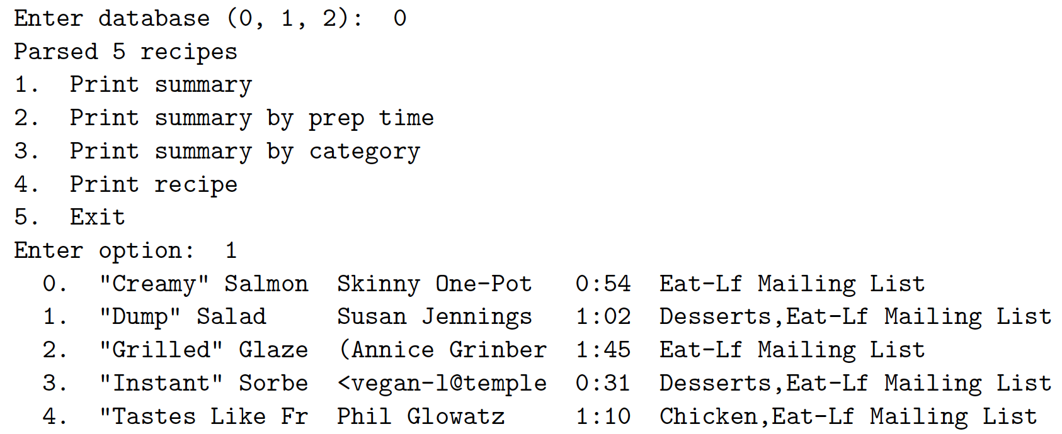
User Option 1 – Printing Summary Lines
Print a summary line of every recipe in the database
Summary line format: recipe ID, name, author, prep time, categories
For readability:
ID: Exactly 3 characters (excluding ‘.’)
Name: Exactly 15 characters
Author: Exactly 15 characters
Prep time: Exactly 4 characters
Categories: Exactly 30 characters
You should only print as many categories as will fit in the field, i.e. categories should not get truncated
Print categories in the order they appear in the recipe header
2 whitespace characters between each field
You may have to truncate or print extra whitespace to satisfy the length requirements

Slide 10
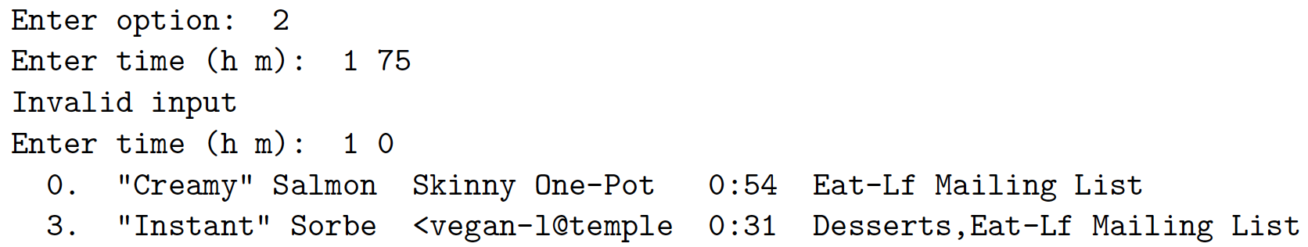
User Option 2 – Print by Prep Time
Prompt user for a prep time, and print all recipes that do not exceed the specified prep time
If the prep time entered is invalid, print “Invalid input” and re-prompt
Line formatting is the same as in option 1

Slide 11
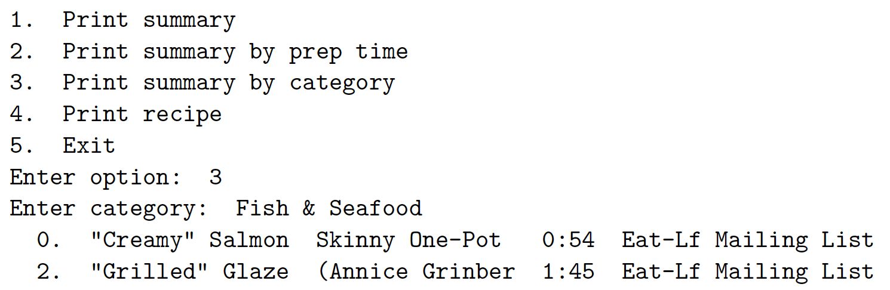
User Option 3 – Print by category
Prompt the user for a category name
If the category is invalid, print “Invalid input” and re-prompt
Once a valid input is entered, print summary lines (same format as before) for all recipes that has a matching category descriptor

Slide 12
User Option 4 – Display Full Recipes
Prompt the user for a recipe ID; if invalid, print “Invalid input” and re-prompt
Print the requested recipe exactly the same way as it appears in the database file

Slide 13
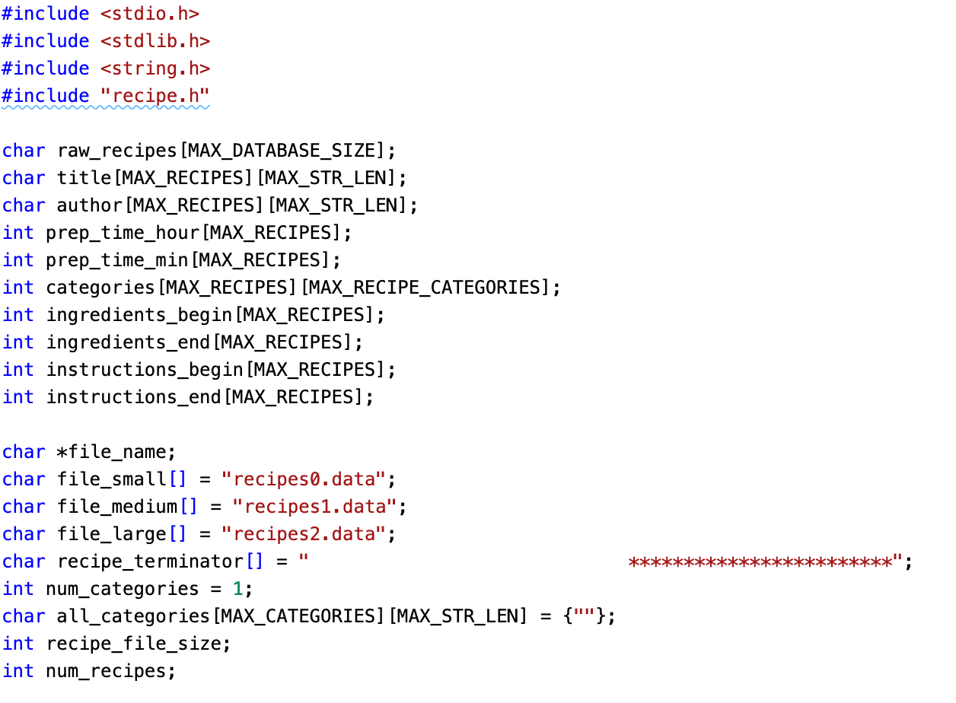
Starting Point
Used for storing database information – notice the use of the constraints mentioned in slide 8
Marker line
Category names

Slide 14
Functional Decomposition
You get to decide how to decompose your program into functions
Before coding, come up with a decomposition of your project, and identify the functions you plan to create
You will have to hand in a description of these functions by 11:59 pm on 3/10
Recommendation: When doing your decomposition, start with high-level functions (maybe one for parsing, one for printing recipe lines, one for printing full recipes, one for printing the menu, etc…), and then try to break up those functions into simpler low-level functions
The more effort you put into creating the decomposition, the easier it will be for you to write your program

Slide 15
Project 2 Demo

Slide 16
Grading Policy
Similar to project 1: 80% testcases, 10% style, 10% compilation
Your output formatting must exactly match that of the test vectors! We were lenient about the formatting on project 1, but we will take more points off for formatting this time.

Slide 17
Tips
Create your own header file for the project once you have a functional decomposition – doing so will help structure your code
Take a look at the .data files to understand how the recipe databases are structured
As always, attend office hours
Start ASAP! – Three weeks will go by faster than you think

Slide 18
Questions?

