Slide 1
ENEE150 – Discussion 2
Pratik Rathore
2/4/21

Slide 2
Agenda
Overview of project 1 (description, checkers.h, required functions)
How to run testcases
Grading policy for project 1
Project 1 demo

Slide 3
Project 1 – Overview
You will be developing a 2-player Checkers game in C
Start by looking at pr1.pdf and checkers.h on ELMS
Due on 2/17 at 11:59 PM
Please submit as a .zip file, using assignment number 10

Slide 4
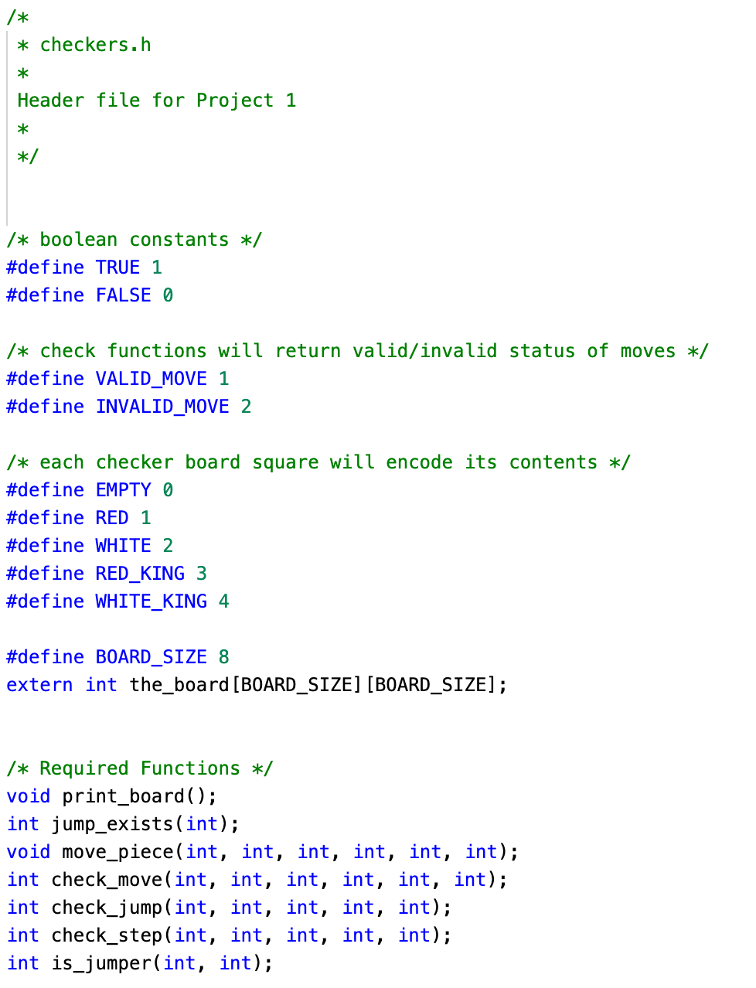
checkers.h
Predefined constants – using these will make your code easier to understand
You will have to fill out these functions in the program. You can create more functions if you like.

Slide 5
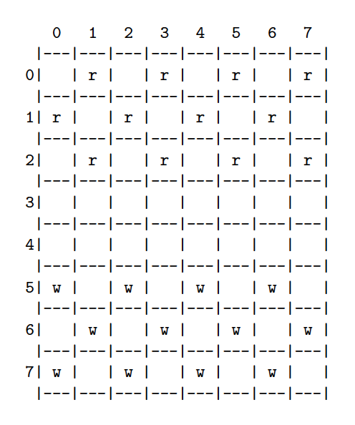
Required functions – print_board
Declaration: void print_board()
The print_board function is the same as the print_board function written in HW1
The board at the start of the game is shown on the left
The board is updated and printed after every valid move

Slide 6
Required functions – jump_exists
Declaration: int jump_exists(int color)
color: either RED or WHITE
For the given color, if a jumping move can be made, the function returns TRUE, otherwise it returns FALSE
Call this function before prompting a player for a move and checking its validity – a player cannot avoid a jumping move if such a move exists

Slide 7
Required functions – check_move
Declaration: int check_move(int color, int x_from, int y_from, int x_to, int y_to, int jump)
color: either RED or WHITE
x_from, y_from: current position of piece
x_to, y_to: intended position of piece
jump: Flag that indicates whether the move must be a jump (either TRUE or FALSE)
If the move is valid, return VALID_MOVE, else return INVALID_MOVE

Slide 8
Required functions – move_piece
Declaration: void move_piece(int color, int x_from, int x_to, int y_to, int jump)
Identical parameters to check_move
Call this function only if check_move returns VALID_MOVE
If jump is TRUE, then move both the player’s piece and remove the opponent’s piece
If jump is FALSE, only move the player’s piece

Slide 9
Required functions – check_step
Declaration: int check_step(int x_from, int y_from, int x_to, int y_to, int dir)
x_from, y_from: current position of piece
x_to, y_to: intended position of piece
dir: +1 if move is in positive y-direction, -1 if move is in negative y-direction
We use this function to check whether a given move is a valid stepping move
If valid, return VALID_MOVE, if invalid return INVALID_MOVE
Use this function as a helper to check_move

Slide 10
Required functions – check_jump
Declaration: int check_jump(int x_from, int y_from, int x_to, int y_to, int dir)
x_from, y_from: current position of piece
x_to, y_to: intended position of piece
dir: +1 if move is in positive y-direction, -1 if move is in negative y-direction
We use this function to check whether a given move is a valid jumping move
If valid, return VALID_MOVE, if invalid return INVALID_MOVE
Use this function as a helper to check_move

Slide 11
Required functions – is_jumper
Declaration: int is_jumper(int x, int y)
x, y: A location on the board
Takes into consideration: the color of the piece; whether or not the piece is a king
Returns TRUE is the piece can jump, FALSE if the piece cannot jump
Multiple applications:
check_move: Use is_jumper to verify that a jumping move is in fact being performed when the jump argument is true
jump_exists: Use is_jumper to determine jumping status of the pieces on the board
Use to determine whether a player can make multiple jumps (“multiple-jump move”)

Slide 12
How to Run Testcases
checkers is the executable file
< testcases/test1.in tells the command line to use testcases/test1.in as input to checkers
> test1.out tells the command line to place output in test1.out
diff test1.out testcases/test1.out checks for differences between the actual and expected output
Since diff does not print anything, the output of the executable is a perfect match to the expected output!

Slide 13
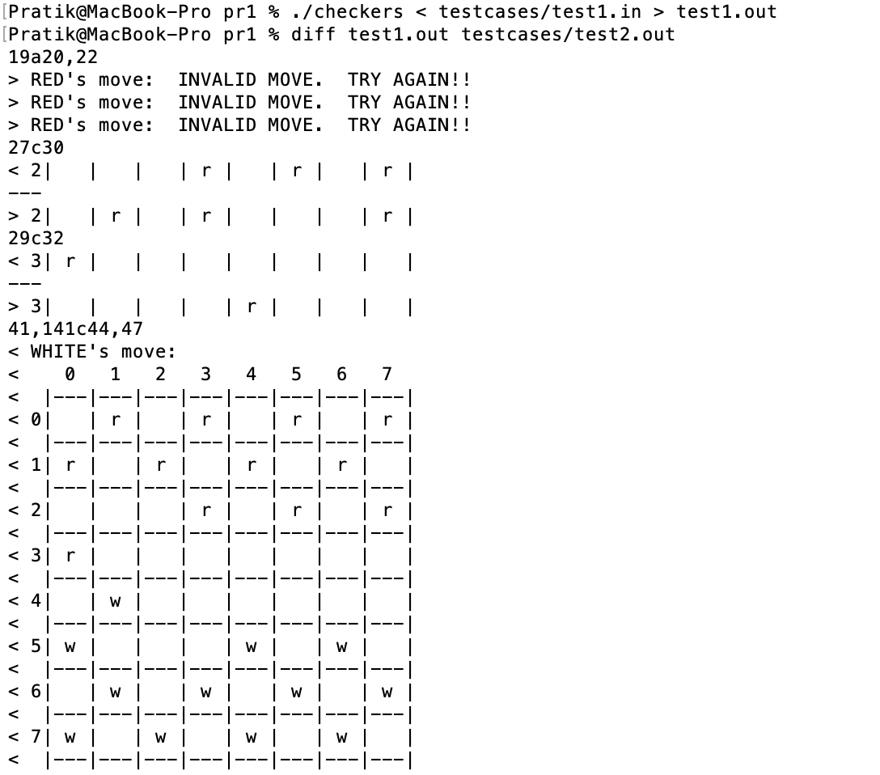
How to Run Testcases
This time we use testcases/test2.out as the expected output
diff now produces output, since the actual and expected output are no longer the same
If diff had produced output when we used testcases/test1.out, this would mean that something is wrong with our code!
In general, make sure that the output from the executable exactly matches the expected output!

Slide 14
Grading Policy
Most of the points (80%) will be awarded based on how your program performs on both public and private testcases
For a given testcase:
If outputs match exactly using diff, you will receive full credit
If outputs do not match, partial points may be awarded
10% will be awarded based on program compilation (this is all or none)
10% will be awarded based on style (I will be looking for readability, indentation, variable names, and commenting)

Slide 15
Tips
Start as soon as possible!
Attend office hours and ask questions via email
Before coding, consider sketching out the connections between the functions and seeing how they all fit together. Having this “big picture” can be helpful as you write your program.

Slide 16
Checkers Demo

