Slide 1
ENEE150 Discussion #11
Pratik Rathore
4/22/21

Slide 2
Agenda
ADTs
Polymorphism

Slide 3
ADTs – Motivation
C has a lot of standard data types – ints, floats, chars, etc…, but these have limited functionality
What if we wanted to implement rational numbers, or complex numbers?
Abstract data types (ADTs) are user-defined data types that can be used to solve this problem

Slide 4
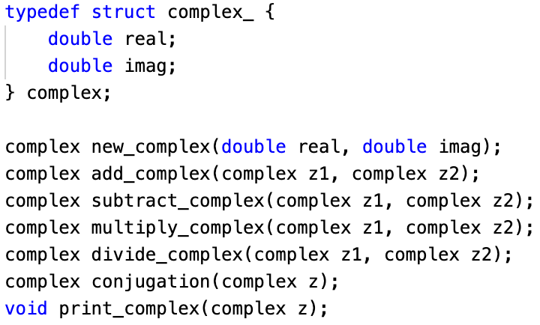
ADTs – Interfaces
Interface for complex numbers ADT
ADTs in C are defined as structs
In other languages, such as Java and C++, ADTs are defined as classes, and used for object-oriented programming
C is not naturally designed for ADTs, but we can implement ADTs using file conventions
We define a struct corresponding to the data type in a .h file (known as an interface), and then define the functions associated with the data type in a .c file
The struct must contain enough fields to define the data type (in this case, we need the real and imaginary part)
Note that we could have defined complex numbers in a different way – we could use the magnitude and angle (i.e. exponential form)
Struct definition of complex numbers

Slide 5
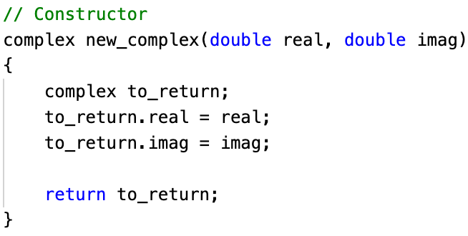
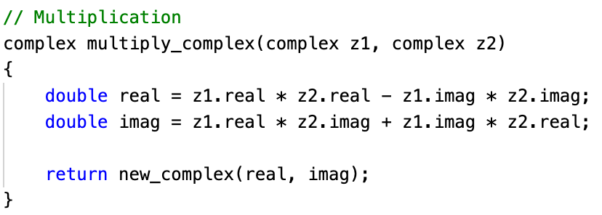
ADTs – Functions
Constructor for complex numbers ADT
The functions associated with ADTs perform operations on the user-created data type
Examples for complex numbers: Addition, subtraction, multiplication, division, conjugation
Every ADT has an associated constructor function, which will create an instance of the ADT
Multiplication for complex numbers ADT
Call constructor to make new complex number

Slide 6
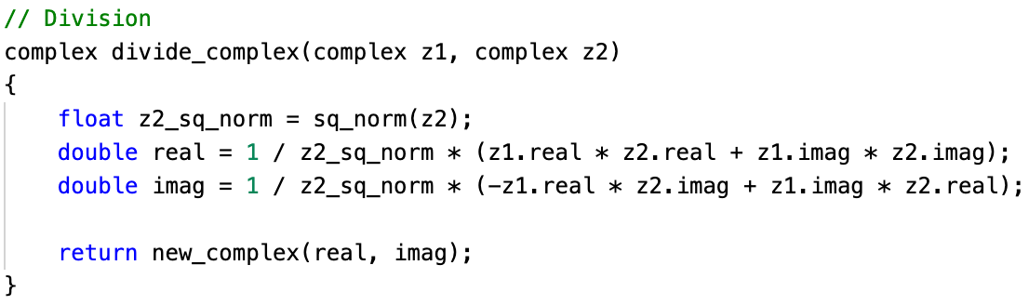
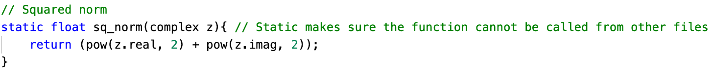
ADTs – Functions
Division for complex numbers ADT
By default, functions written for ADTs are public, i.e. they can be called outside of the file they are written in
However, we may want to make some functions private, i.e. they can only be called inside of the file they are written in
In general, it’s a good idea to make helper functions private – you don’t want other users to explicitly rely on them
To make a function private in C, use the “static” keyword
Note: languages like Java and C++ have “public” and “private” as keywords to designate functions appropriately
Call private helper function
Squared norm

Slide 7
Polymorphism – Motivation
In project 3, there were two different types of linked list nodes – one for accounts, and the other for playlists
Since the lists were of different data types, we had to define separate insertion, deletion, and traversal functions
Polymorphism lets us bypass this problem – we can now have a single function each for insertion, deletion, and traversal

Slide 8
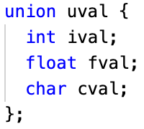
Polymorphism – Unions
Polymorphism is implemented in C using unions
The definition of a union is very similar to that of a struct
Like structs, unions contain members of different types
Unlike structs, the members of a union are stored in the same location of memory, so only one can be “active” at a given time
For example, if ival is assigned to 2, and fval is assigned to be 4.2, ival will no longer be accessible, because it has been overwritten
The size of the union is the size of its largest field (in this case, 8 bytes due to the float)
poly-list.c on ELMS

Slide 9
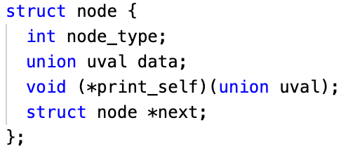
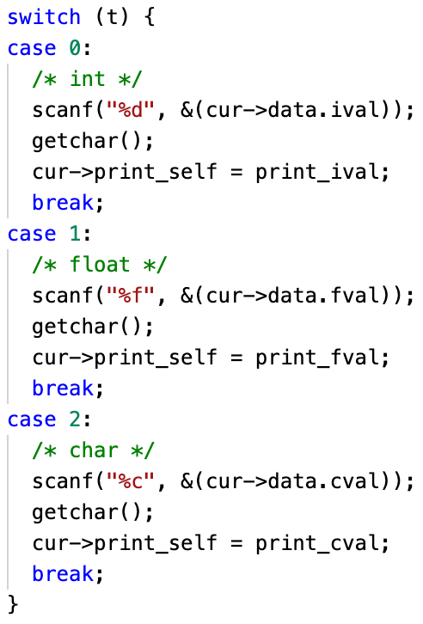
Polymorphism – Unions
Polymorphic data field
In linked lists, unions can be used as fields within nodes to enable polymorphism
In this case, t is an input that tells the program whether the node should store an int, float, or char
Not only does polymorphism allow us to reduce the number of linked list functions, polymorphism also lets us store different types of data within a single linked list
poly-list.c on ELMS
Use appropriate union member (int, float, or char)
poly-list.c on ELMS

Slide 10
Tips
ADTs don’t just have to be used for math – they can be used to implement data structures like lists, trees, or hash tables
Project 4 will involve ADTs, so reach out to the TAs or Dr. Yeung if you have any questions about the material

Slide 11
Questions?

