Slide 1
ENEE150 Discussion #3
Pratik Rathore
2/10/21

Slide 2
Agenda
Unit Testing with drivers
Debugging with gdb + Demo
Questions about Project 1 (if time)

Slide 3
Unit Testing
When programming complex projects, you should test throughout the build process to make sure that your code is working
Waiting until the end can make it difficult to root out bugs in code
One way to test code throughout the dev process is unit testing
Unit testing is usually used to test individual functions in the code

Slide 4
Unit Testing – with checkers
Unit testing file
Input
driver.c
Actual Output
Test one of these functions
“Hijack” main()
Compare
print_board
jump_exists
check_move
move_piece
check_step
check_jump
is_jumper
checkers.c
Expected Output

Slide 5
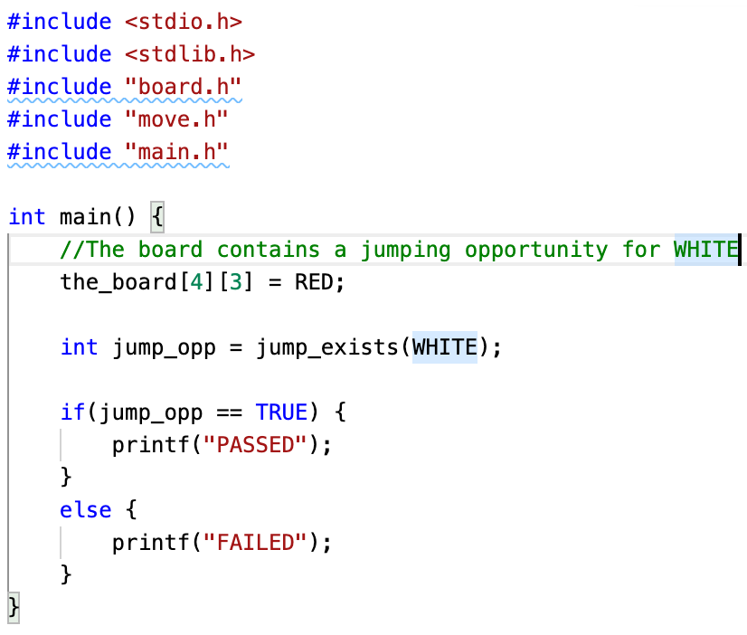
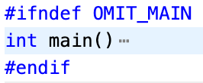
Driver files
Used to test a single function in the code (checkers.c)
Contains a main() function that “hijacks” the main function in checkers.c
#ifndef OMIT_MAIN … #endif around main() in checkers.c enables hijacking
gcc –DOMIT_MAIN –o checkers_test driver.c checkers.c defines OMIT_MAIN to the preprocessor, triggering the #ifndef in checkers.c
Modify global variable to create jumping opportunity
Call jump_exists function from checkers.c
Compare actual and expected outputs

Slide 6
Test suites
As you make more unit tests, you should test all of them together by forming a test suite
You want to be sure that new changes to your code are not breaking older tests
Shell scripts make running test suites easier – just run the shell script at the command line!

Slide 7
gdb – GNU Debugger
printf is a common way to debug, but doing so can be tedious
We want a more organized way to see what can be causing bugs in code – i.e., we want a proper debugger
gdb is the default debugger for C files on Glue

Slide 8
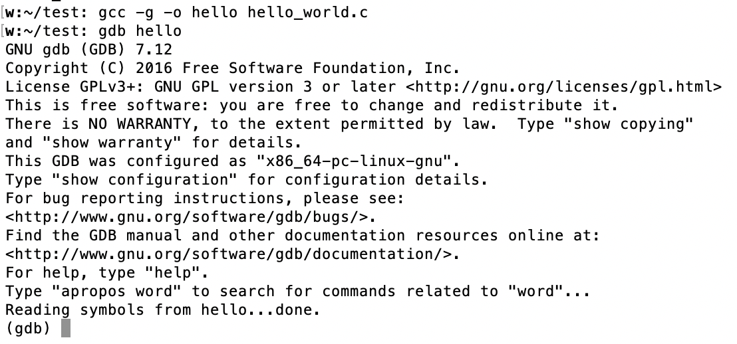
Running gdb
Use –g flag when compiling the executable
gcc –g –o hello hello_world.c
Run gdb using gdb <executable>
gdb hello

Slide 9
gdb Commands
run (runs the executable)
print (print out values of variables)
break (set a breakpoint)
break foo (breakpoint at a function foo(…))
break code.c:7 (breakpoint at line 7 of file code.c)
continue (run until the next breakpoint is reached)
step (execute the next line of code)
list (show code near the current line)
delete (opens prompt to delete all breakpoints)
quit (quit debugger)

Slide 10
Demo – seg_fault_ex
If you ever encounter a segmentation fault, using run in gdb is an excellent way to root out the cause!

Slide 11
Demo – factorial
The executable outputs the wrong value – break, step, and print can be used in gdb to figure out why this is occurring

