Slide 1
ENEE150 Discussion #10
Pratik Rathore
4/15/21

Slide 2
Agenda
Overview of Recursion
Recursion example with Euclidean algorithm
Recursion example with quicksort

Slide 3
Recursion – Intro
In recursion, we seek to solve a problem by dividing and solving sub-problems of the same type
Examples (from lecture):
Fibonacci
Factorial
Linked List Traversal
Binary Search Tree Traversal
Every recursion must contain base case(s), which terminate the function, and recursive case(s), where the function calls itself
For Fibonacci, the base case is Fib(0) = 0 and Fib(1) = 1, recursive case is computing Fib(n – 1) + Fib(n – 2) to get F(n) for n >= 2
For Factorial, the base case is fact(0) = 1, recursive case is computing n * fact(n – 1) to get fact(n) for n >= 1
For binary tree traversal, the base case occurs at leaf nodes, recursive cases involve calling the traversal function on the left and right child nodes
All of the listed problems can be solved easily and more efficiently with loops (except for binary tree traversal), but recursion makes the solutions more elegant

Slide 4
Euclidean Algorithm – Intro
Let’s say we want to find the greatest common divisor (GCD) of two non-negative integers, x and y, denoted by gcd(x,y)
Condition: x and y are not both 0
The Euclidean Algorithm, invented by Euclid around 300 B.C., can be used for this task
Surprisingly, even though this technique is over 2000 years old, it is still one of the best for computing GCDs today
The key insight is that gcd(x,y) = gcd(y, x % y) ➔ the arguments become smaller, making a new subproblem
This is a well-known fact from number theory
The base case is when y = 0, i.e. gcd(x,0) = x

Slide 5
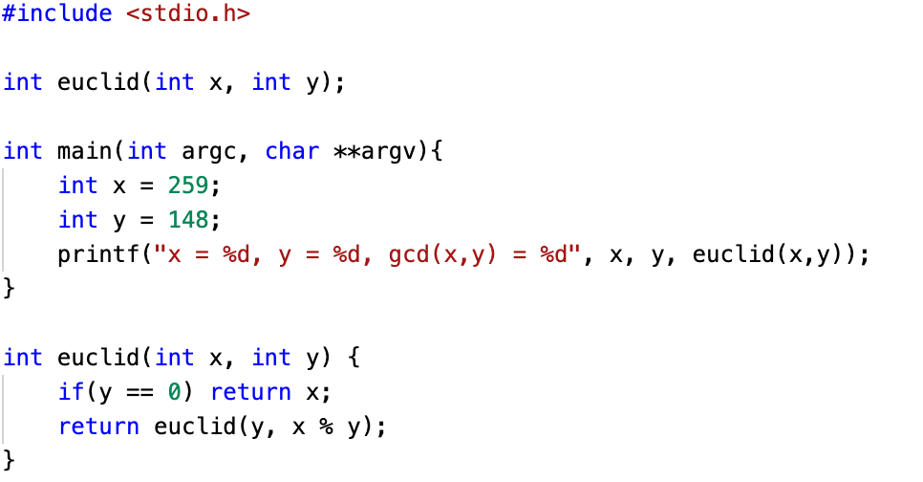
Euclidean Algorithm – Recursive Implementation
The implementation is very elegant using recursion
The first step is to check the base case of y == 0
If we pass through the base case, we want to compute gcd(y, x % y), and we do so by calling euclid() in the next line

Slide 6
Euclidean Algorithm – Full Trace
37
euclid(259, 148)
euclid(148, 111)
37
euclid(111, 37)
37
euclid(37, 0)
Base case

Slide 7
Quicksort – Intro
Invented by British computer scientist Tony Hoare in 1959
The objective of the quicksort algorithm is to sort an array in increasing (or decreasing) order
You may have heard of other sorting algorithms in the past, such as bubblesort, which repeatedly swaps elements until they are in the correct order
However, bubblesort is inefficient, with an efficiency of O(n²) on average
On the other hand, quicksort is far more efficient, with an average efficiency of O(n log n)
Quicksort’s efficiency makes it one of the most popular sorting algorithms today
Importantly for us, the quicksort algorithm is an excellent example of recursion

Slide 8
Quicksort – Algorithm Overview
First, we choose an element of the array, which we call a pivot
We will assume that the pivot is always the right-most array element (although this can slow down the algorithm in certain cases)
We then “partition” the array so that all elements to the left of the pivot are less than or equal to the pivot
Partitioning involves swaps between elements in the array (see quicksort.c for full detail)
This means that everything to the right of the pivot is now greater than or equal to the pivot
Key insight: After the partition, we can apply quicksort to the subarray to the left of the pivot, and to the right of the pivot ➔ we have a recursive approach!
Base case: Subarrays that are one element in length don’t need further partitioning
9 | 32 | 4 | 56 | 84 | 56 | 73 | 92 | 69 | 65
Partition
Pivot
9 | 32 | 4 | 56 | 56 | 65 | 73 | 92 | 69 | 84
Pivot
<= Pivot
>= Pivot
Apply partitioning to these halves again!

Slide 9
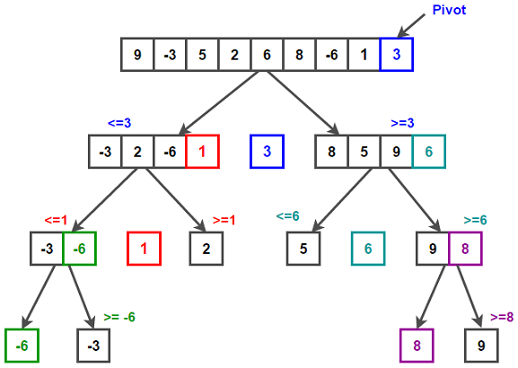
Quicksort – Full Trace
Looking at a trace of quicksort reveals its underlying tree structure
The binary tree structure is what gives rise to the log n term in the algorithm efficiency
http://algohub.me/algo/quick-sort.html

Slide 10
Questions?

