Slide 1
ENEE150 Discussion #8
Pratik Rathore
4/1/21

Slide 2
Agenda
Project 3

Slide 3
Project 3 – Overview
For this project, you will be building a “music server” in C
Program will startup in initialization mode and read in albums
Program will then go to transaction mode, where the user will request the server to perform different operations (opening/closing accounts, adding playlists, printing album and account information)
Program will handle initialization/transaction through input files to the executable
All information to the user will be provided through standard output

Slide 4
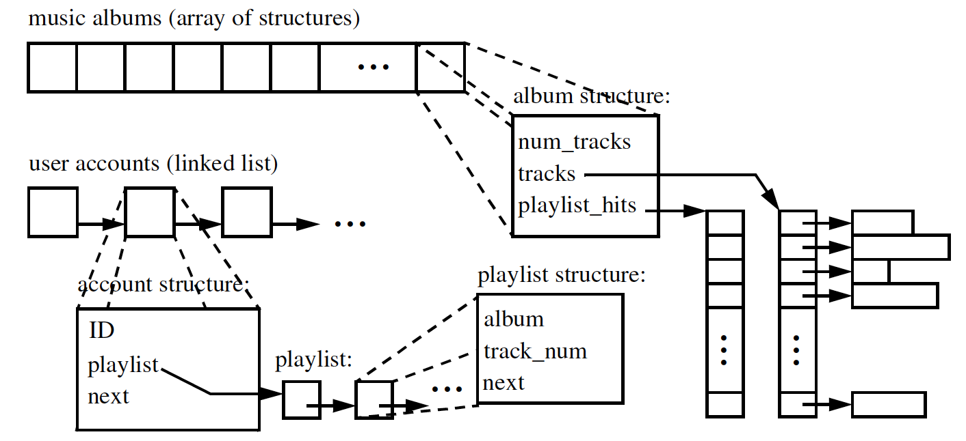
Data Structures
Your program will store music albums, user accounts, and playlists
Albums will be stored as an array of structs, user accounts and playlists will be stored as a linked list of structs
All of these data structures must be allocated dynamically

Slide 5
Data Structures – Music Albums
Stored as a dynamically allocated array of structures
A given structure will associate the information associated with a single album
Three fields:
num_tracks (int) – number of tracks in the album
track (char**) – pointer to a pointer array that holds the title of each track
playlist_hits (int*) – a pointer to an array of integers that contains the number of users that have included the corresponding track in their playlists
The pointer array that is pointed to by track will have num_tracks entries, since there are num_tracks songs on the entire album
Similarly, playlist_hits will also have num_tracks entries
track and playlist_hits must both be dynamically allocated
The pointers within track will also have to be dynamically allocated

Slide 6
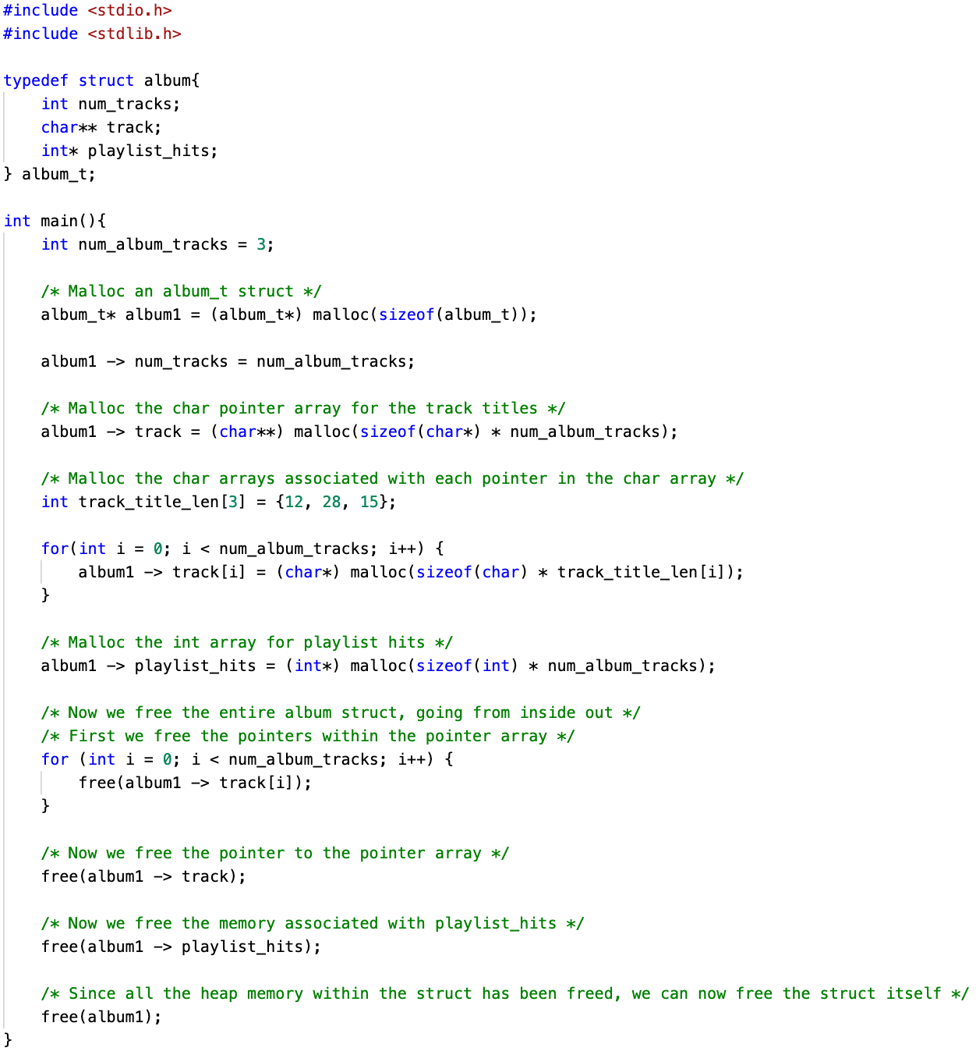
Album Malloc Example

Slide 7
Data Structures – User Accounts
Stored as a linked list
Contains the information associated with a single user
Three fields:
ID (int) – unique user ID
playlist (node*) – head pointer to linked list containing playlist info
next (account*) – next account in the linked list

Slide 8
Data Structures – Playlists
Also stored as a linked list
Three fields in a playlist node:
album (int) – album ID corresponding to playlist entry
track_num (int) – corresponding track number in album
next (node*) – pointer to next song in the linked list

Slide 9

Input Files
The executable will take a .album (album data) and .xact file (user transactions) as command line inputs
Five testcases will be provided for the purposes of this project
To run the first testcase (using executable ‘pr3’):

Slide 10
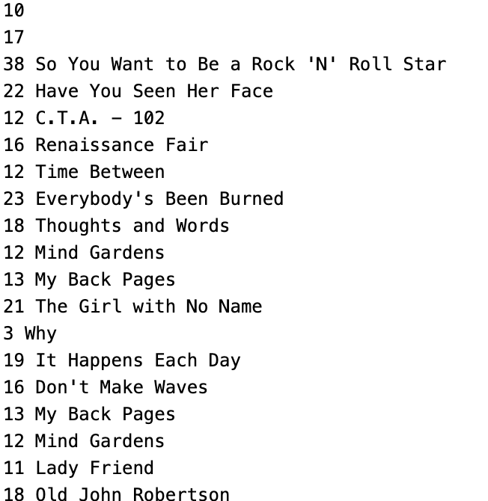
Server Operation – Initialization
Number of Albums
Number of Tracks
When the program starts up, it should read in all the album data into the appropriate data structure
The .album files contain information to help you dynamically allocate the memory for the album data structure
First line: The number of albums
This line is followed by the actual album information:
First line: Number of tracks (N)
Following N lines: The length of the song title (excluding ‘\0’), followed by the song title itself
When creating playlist_hits, initialize all values to 0 (calloc has this functionality)
Song Titles w/ Length

Slide 11
Server Operation – Transaction Handling
After initialization, the server will enter transaction mode
There are 6 different transaction types:
Print album (1)
Open account (2)
Print account (3)
Add playlist (4)
Close account (5)
Terminate (6)
Print album, print account, and terminate are fairly straightforward – I won’t cover them here

Slide 12
Server Operation – Open Account
Triggered by “2” in .xact file
The following line in the .xact file will contain the user ID; the program should create a new user account with that ID
Create the new user account as follows:
malloc an account structure
Initialize the ID field with the specified ID
Initialize playlist field to NULL
Insert the new account at the head of the user account linked list

Slide 13
Server Operation – Add Playlist
Triggered by “4” in .xact file
The following lines in the .xact file will contain a user ID, album ID, and track number
The program should find the corresponding user account and add a new playlist entry for the user based on the album ID and track number
We do so as follows:
malloc a playlist structure
Initialize the album and track_num fields with the specified values
Insert the new playlist structure at the tail of the playlist linked list
Increment the playlist_hits value for the corresponding track in the correct album structure

Slide 14
Server Operation – Close Account
Triggered by “5” in .xact file
The following line in the .xact file will contain the user ID corresponding to the account we want to remove
Remove the user account as follows:
Find the specified account in the accounts linked list
Remove the account node from the accounts linked list
Traverse the playlist linked list and remove every node
For every node in the playlist, find the album and track specified by that node and decrement the corresponding playlist_hits value
Make sure to free the associated playlist and account structures from memory!

Slide 15
Tips
Make a functional decomposition of the project before writing any code
Consider creating your own unit tests to test functionality as you develop your project – don’t write your entire project and then test at the very end
Once you implement linked lists, I highly encourage you to test out the linked list functionality separately
The project description gives advice on how to run test cases as you develop your code
Get started early!
Feel free to reach out to TAs or Dr. Yeung through email/office hours

Slide 16
Questions?

