Slide 1
ENEE150 Discussion #7
Pratik Rathore
3/25/21

Slide 2
Agenda
Linked Lists

Slide 3
Linked Lists – Motivation
So far, we have mainly used arrays to store large blocks of data
However, depending on the algorithm/use of the data structure, arrays are not always convenient
For example, say we want to read numbers from a text file, but:
We don’t know how many numbers are present in the file
We want to keep the numbers sorted as we read them in
Since we don’t know how many numbers there are, we can’t just allocate an array
Since we want to sort at the same time, we will have to insert elements in the middle of the array, which requires the shifting of array elements (inconvenient)
A linked list can help us bypass these issues

Slide 4
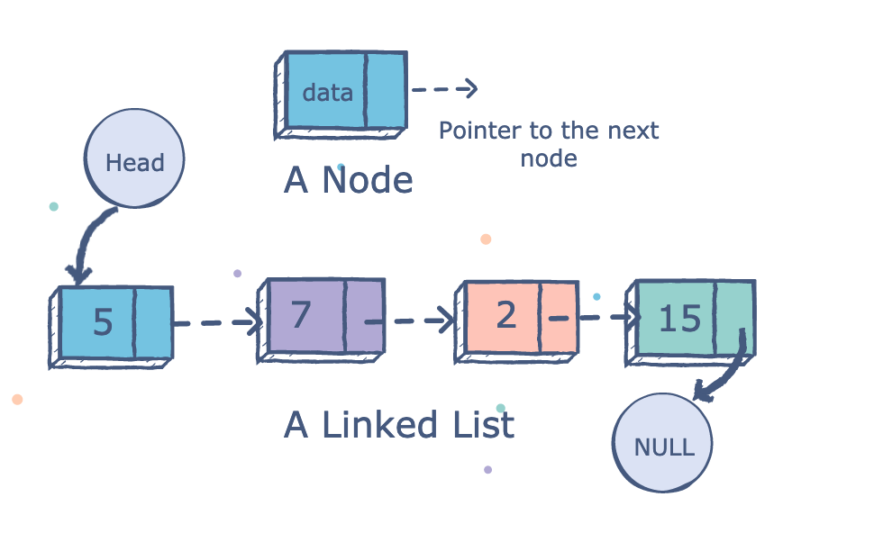
Linked List – Structure
A linked list is a chain of nodes
Each node contains data, and a pointer to the next node
The node at the end of the linked list will always point to NULL
There is also a head pointer that contains the address of the first node
Key difference: The nodes themselves are not contiguous in memory, but arrays are contiguous in memory
Since the nodes are not contiguous in memory, insertion and deletion are easier than for an array
https://medium.com/@konduruharish/linked-list-in-typescript-and-c-be96732b9854

Slide 5
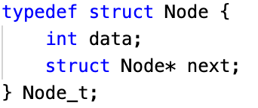
Linked List Nodes
Nodes simply hold data (as many fields as you like), and a pointer to the next Node in the linked list
In C, the best way to define nodes for a linked list is by defining a struct, as shown on the right
When creating nodes, we will use malloc
Always check whether malloc returns NULL!

Slide 6
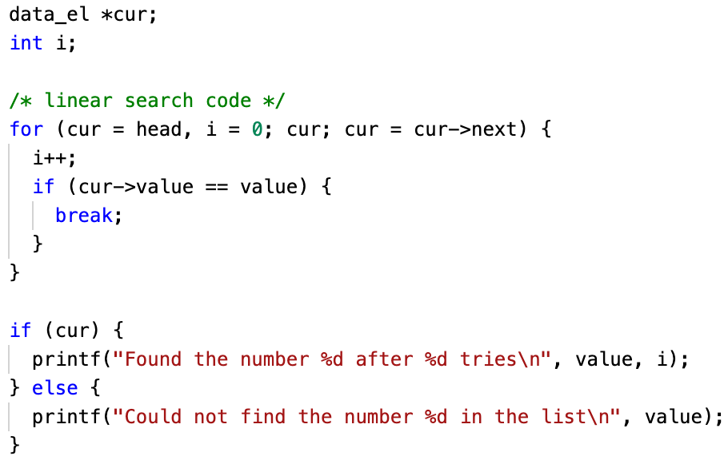
Linked List – Traversal
To traverse through the entire linked list, start at the head pointer, and repeatedly use ->next to move through all the nodes
Going through the node pointers by using ->next is called pointer chasing
Traversal is commonly used for searching for elements in a linked list
In the example on the right, we iterate through the linked list, looking for value, and breaking if we find value in the list
list_search.c on ELMS

Slide 7
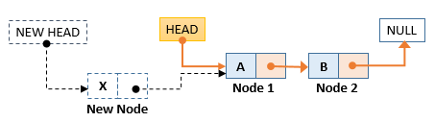
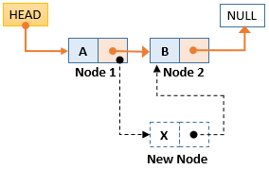
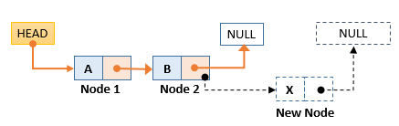
Linked List – Insertion
Three places to insert a node: at the head, in the middle, and at the end
Inserting at the head:
new_node -> next = head
head = new_node
Inserting in the middle:
new_node -> next = cur_node -> next
cur_node -> next = new_node
Inserting at the tail:
new_node -> next = NULL
tail_node -> next = new_node
At the head
In the middle
At the tail
https://www.opentechguides.com/how-to/article/c/142/linked-list-insert.html

Slide 8
Linked List – Deletion
Similar to insertion, we can delete nodes at the head, middle, and end
Deleting the head:
head = head -> next
Deleting in the middle (we use prev and cur, cur is the node we want to delete, prev is the preceding node):
prev -> next = cur -> next
In reality, this is a bit more complicated – we will have to check if the list is empty, or if we are deleting the head for example
Deleting at the tail (we use prev and cur as before):
prev -> next = NULL
If we are not using the node that we delete, we have to use free to avoid memory leaks

Slide 9
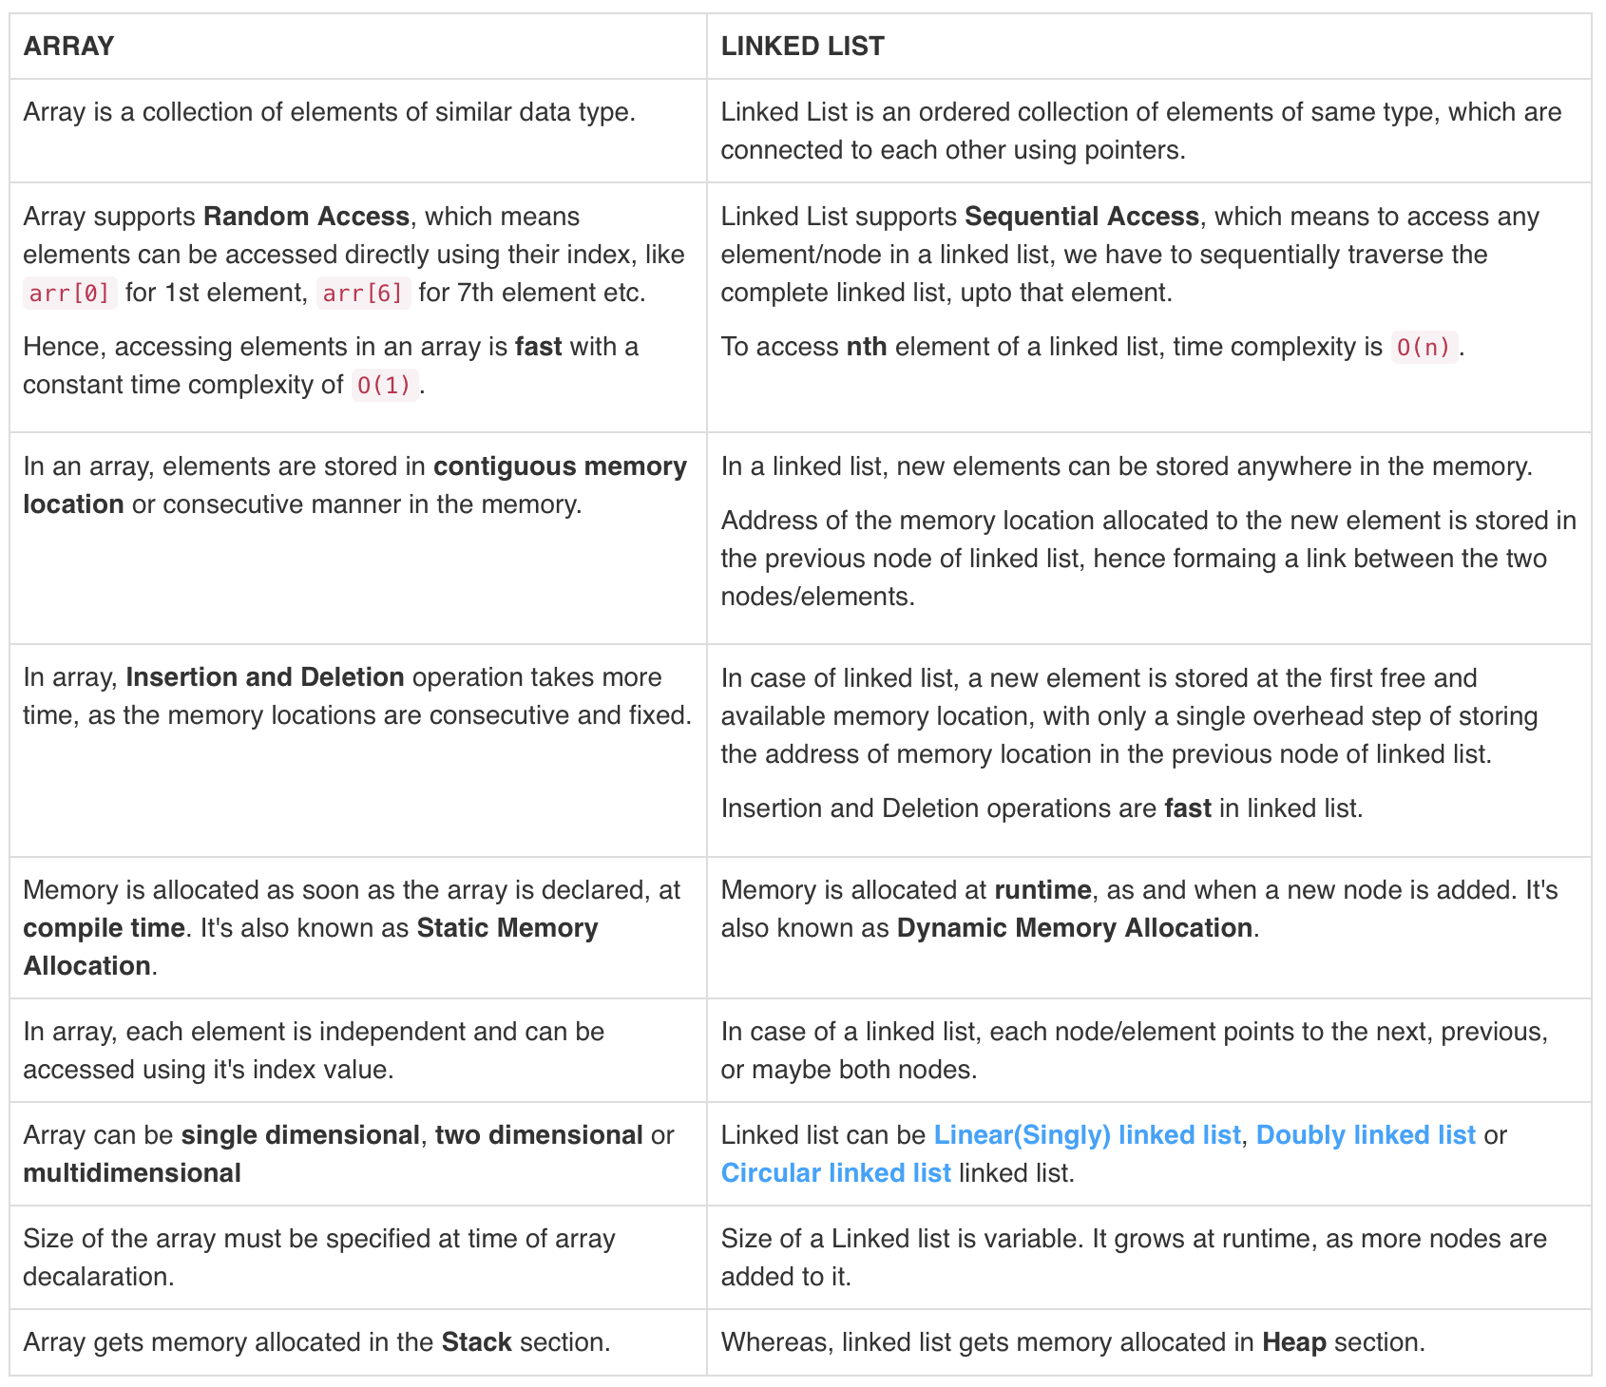
Linked List vs. Arrays
https://www.studytonight.com/data-structures/linked-list-vs-array

Slide 10
Tips
With linked lists, we will be using pointers everywhere, so try your best to not confuse pointers and normal data types
As always, when you are done using a node, use free()
When deciding on data structures to use in your code, weigh the pros and cons of each before deciding which one to use

