Slide 1
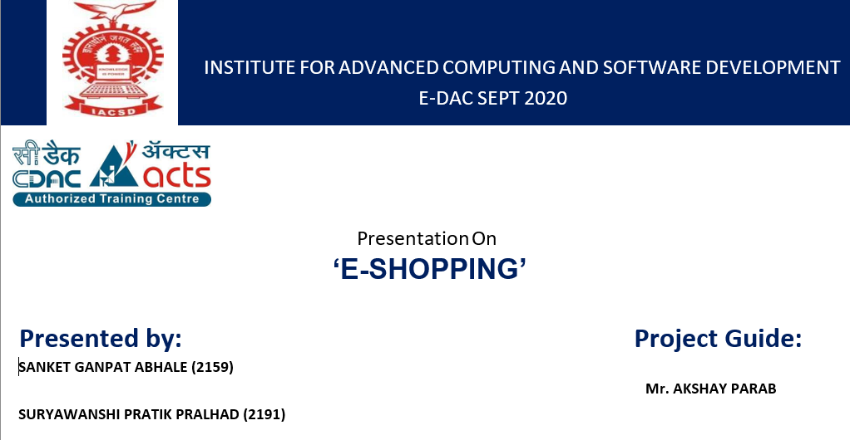

Slide 2
Introduction :
E-commerce is a web based application or mobile application implemented for easy to access product or services around the corner of world, buy, sell, chat, transact, get service and maintains records. Using record we can trIntroduction:
E-commerce is a web based application or mobile application implemented for easy to access product or services around the corner of world, buy, sell, chat, transact, get service and maintains records. Using record we can track customer and inform customize and future offers and discounts. Legal contract department prepare policy contract and sends to customer after payment has received from the customer.

Slide 3
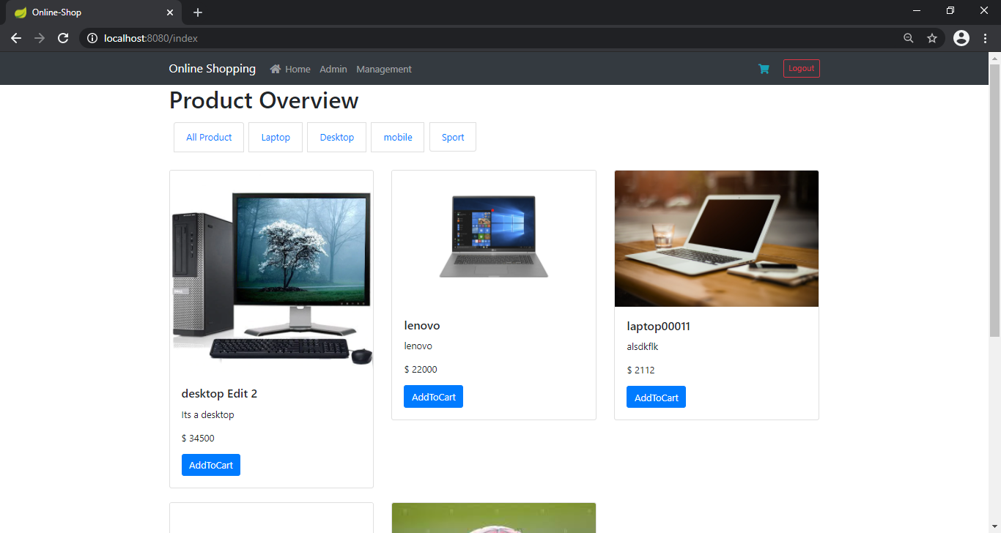
Home Page:

Slide 4
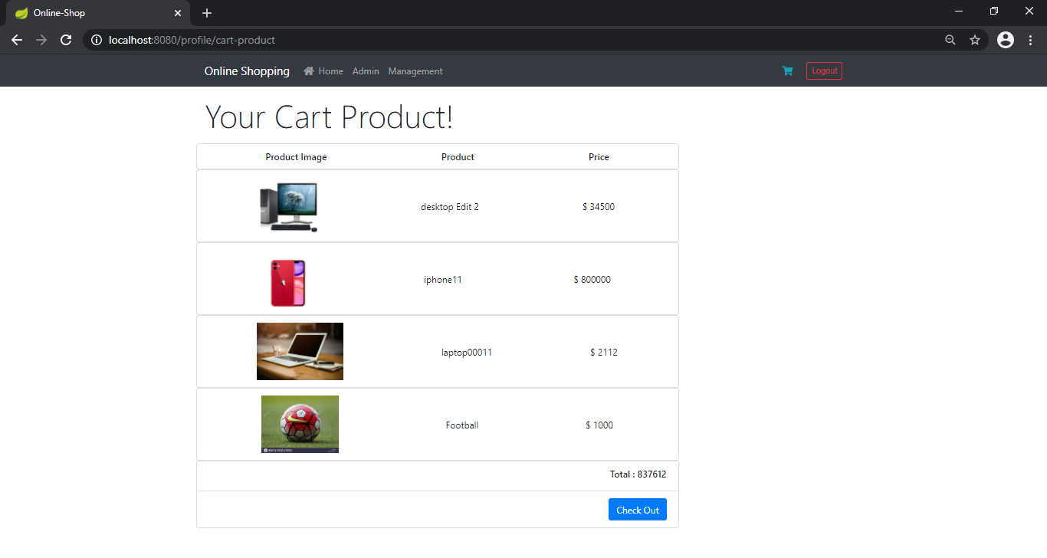
Cart details:

Slide 5
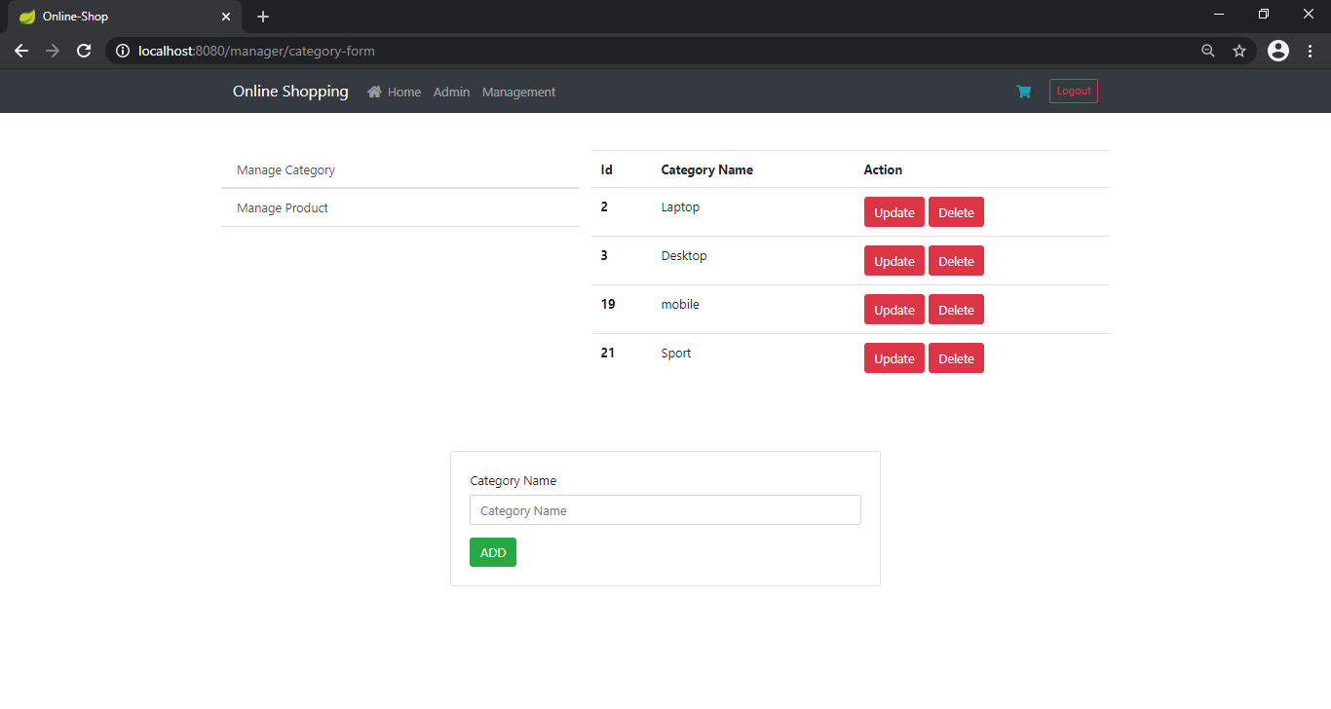
Manage categories and products:

Slide 6
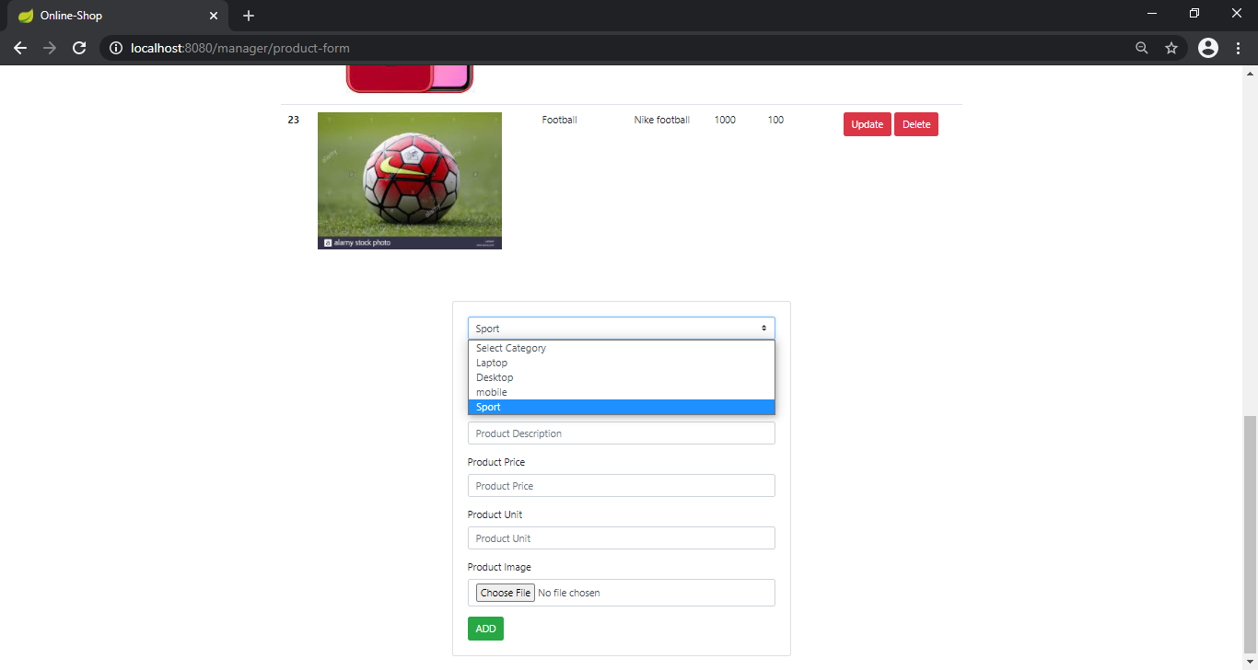
Add product to a category:

Slide 7
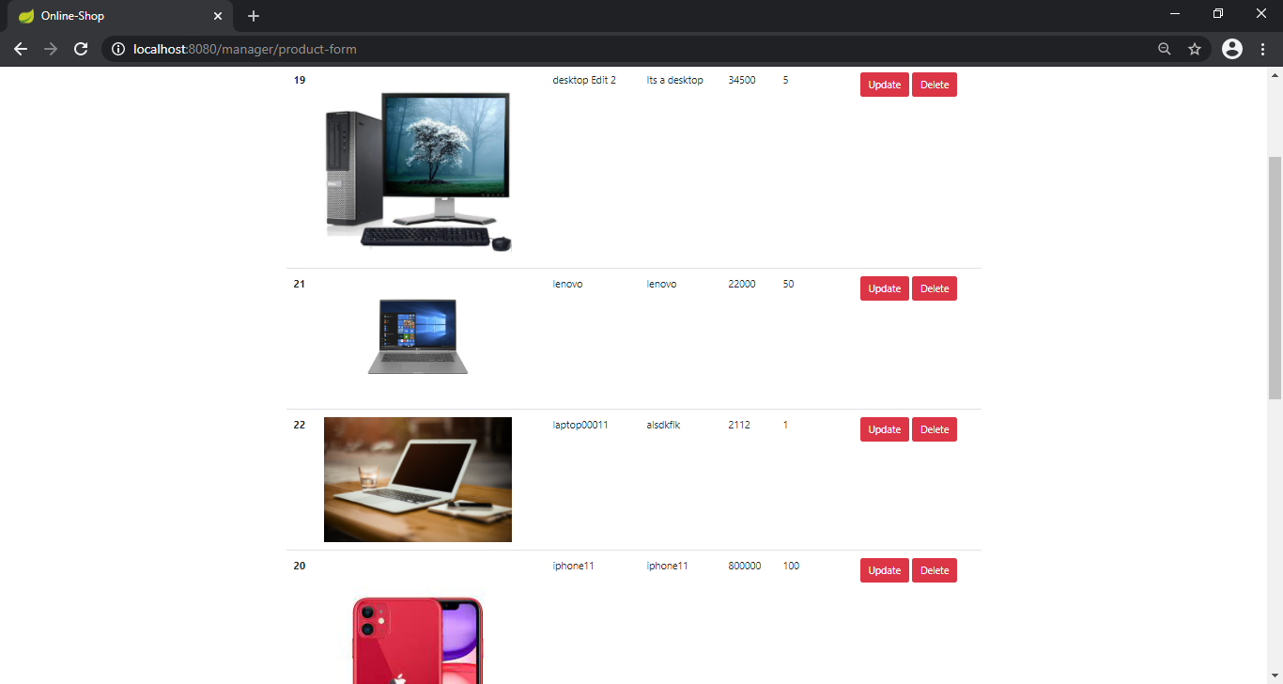
Products list :

Slide 8
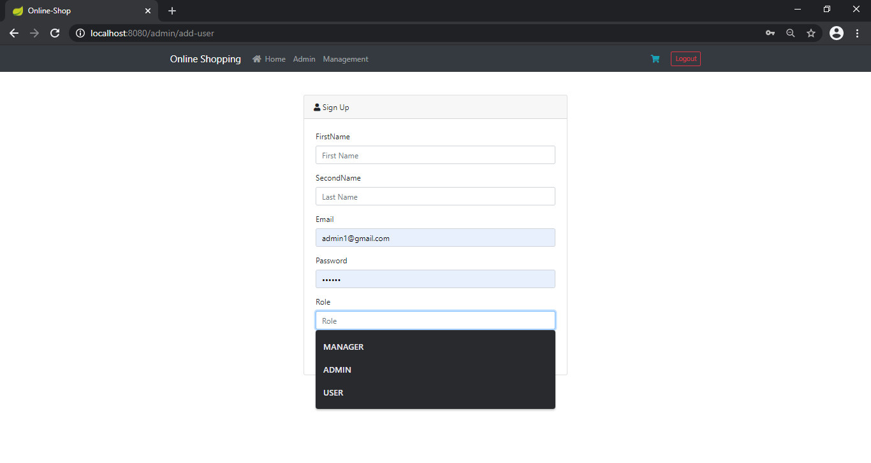
Add admin, manager and user :

Slide 9
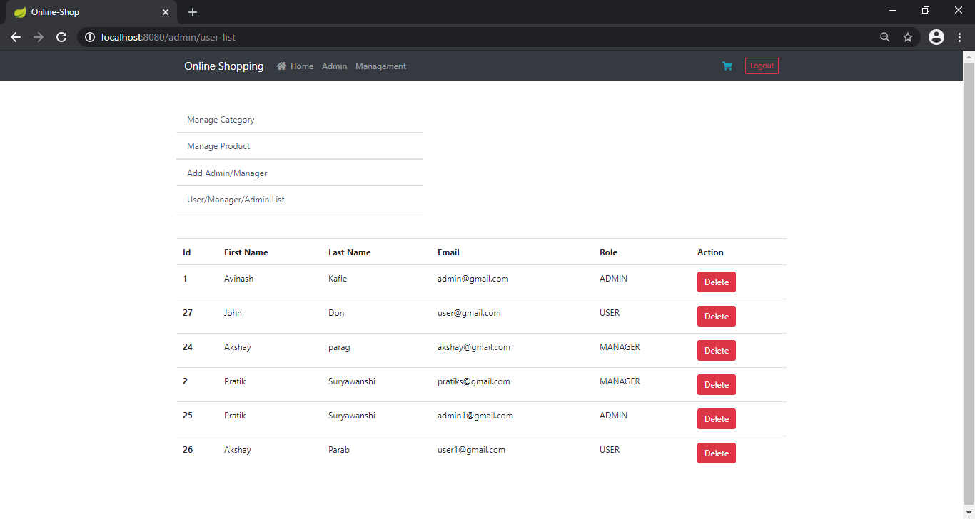
View user’s list (admin, manager and users) :

Slide 10
Conclusion :
E-commerce is continuously progressing and is becoming more and more important to businesses as technology continue. Every day more people connect to the Internet and grow increasingly comfortable with digital transactions.

Slide 11
References :
• Dorer and Forrms, Inc. v. Arel, 60 F. Supp. 2d 558 (E.D. Va. 2017), http://lw.bna.com/lw/98266.htm.
• ICANN, Business Dealings, Including with SLD Holders, ICANN Registrar
Accreditation Agreement, http://www.icann.org/registrars/ra-agreement12may99.htm
• ICANN, Seven New TLD Proposals Accepted, ICANN New TLD
Program, http://www.icann.org/tlds.
ONLINE REFERENCE
• n.wikipedia.org/wiki/E-commerce

Slide 12


