Slide 1
Local Multi-Head Channel Self-Attention for Facial Expression Recognition
Pratik Shetty
Guide : Prof. C. Krishna Mohan
TA : Khin Cho Win

Slide 2
Outline
Problem Statement
Importance
Related Works
Approach
Advantages
Experimental Analysis
Conclusion
Future Work
References

Slide 3
Problem statement
Novel self-attention module that can be easily integrated into virtually every Convolutional Neural Network (CNN).
That is specifically designed for computer vision, the Local (multi) Head Channel (Self-Attention) (LHC Self-Attention).

Slide 4
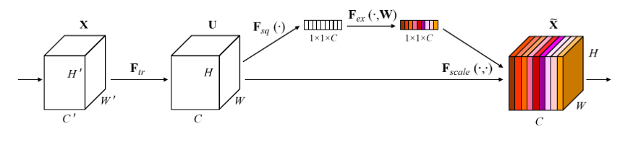
Related Works
Squeeze-And-Excitation-Networks
Includes global information in the decision process of the network
Same channel approach
No self attention

Slide 5
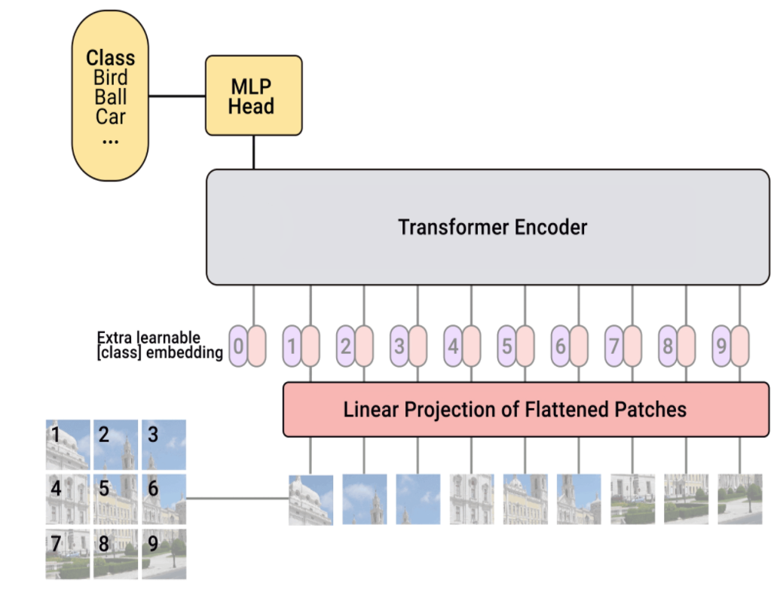
Related Works (Cont’d)
Vision Transformer(Vit)
Stand-alone spatial self-attention attention
The transformer’s encoder inputs are patches extracted from the tensor image.
Outperforms EfficientNet by a small margin.
Training requires lots of data (3 Billion)

Slide 6
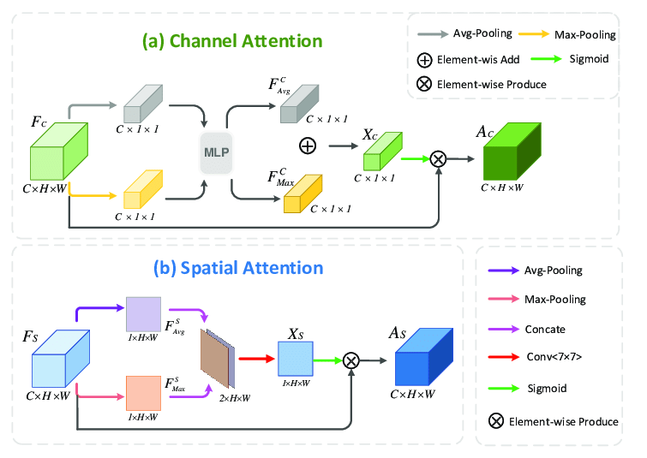
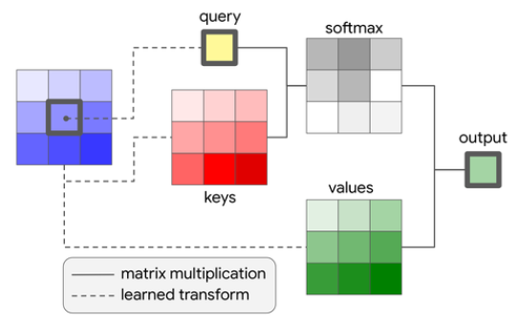
Importance
Channel-wise self-attention is better than spatial attention.
Figure: Self-Attention

Slide 7
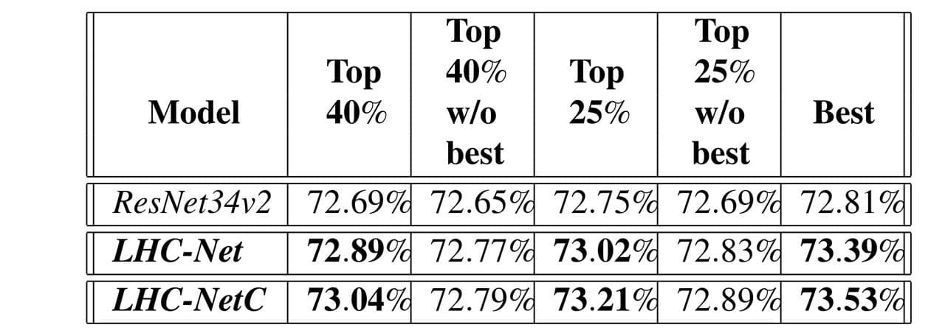
Comparison of ResNet Vs. LHC-Net
Significant performance improvement in comparison to the existing convolutional architecture.

Slide 8
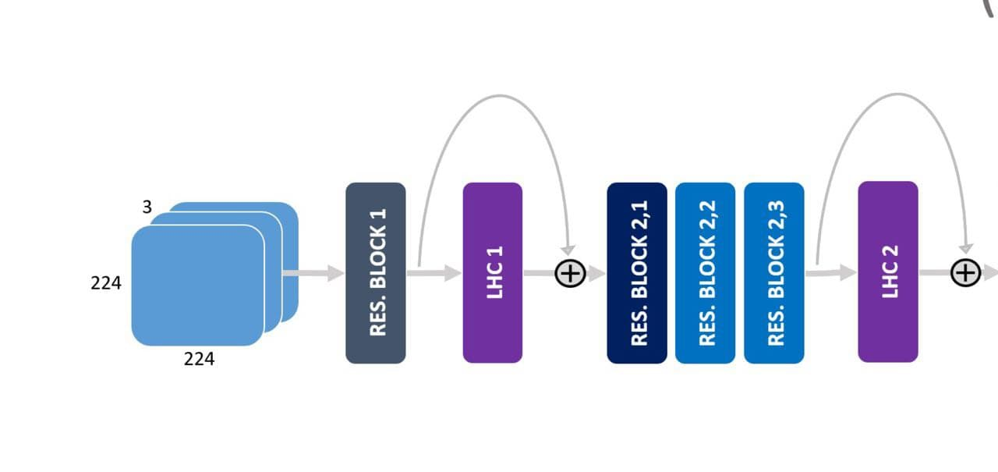
Approach
LHC-net modules are integrated with existing neural network architecture having backbone as convolutional neural network.
Figure: LHC-net integration with ResNet34v2 architecture.

Slide 9
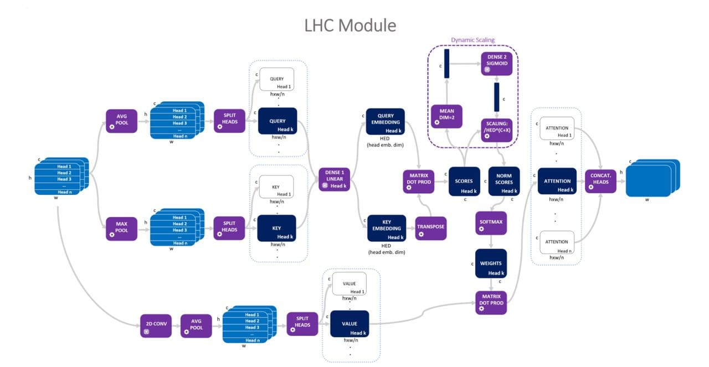
LHC Module Architecture

Slide 10
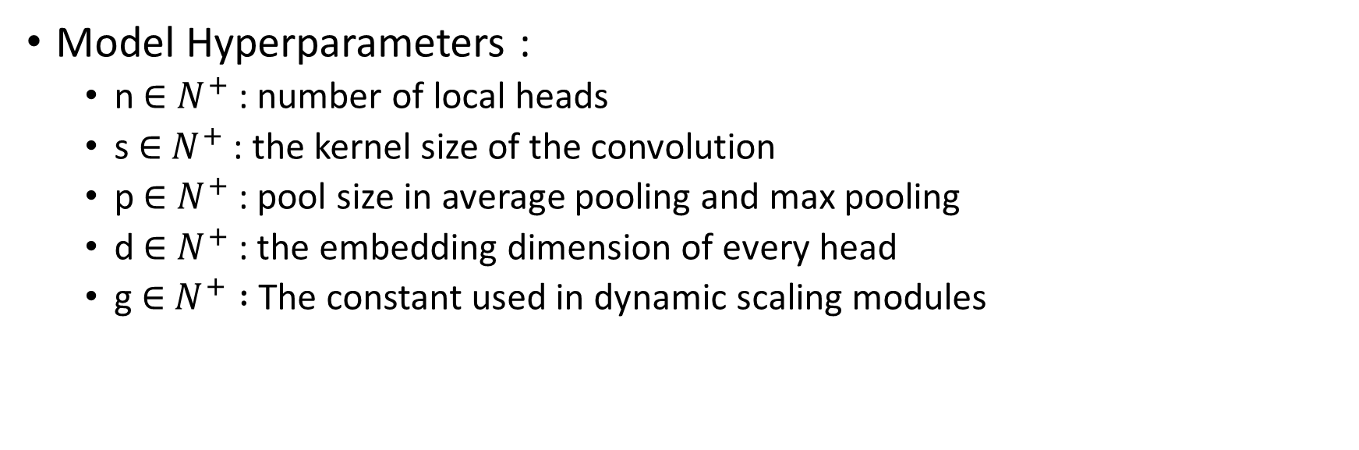
LHC Module Architecture (Cont’d)

Slide 11
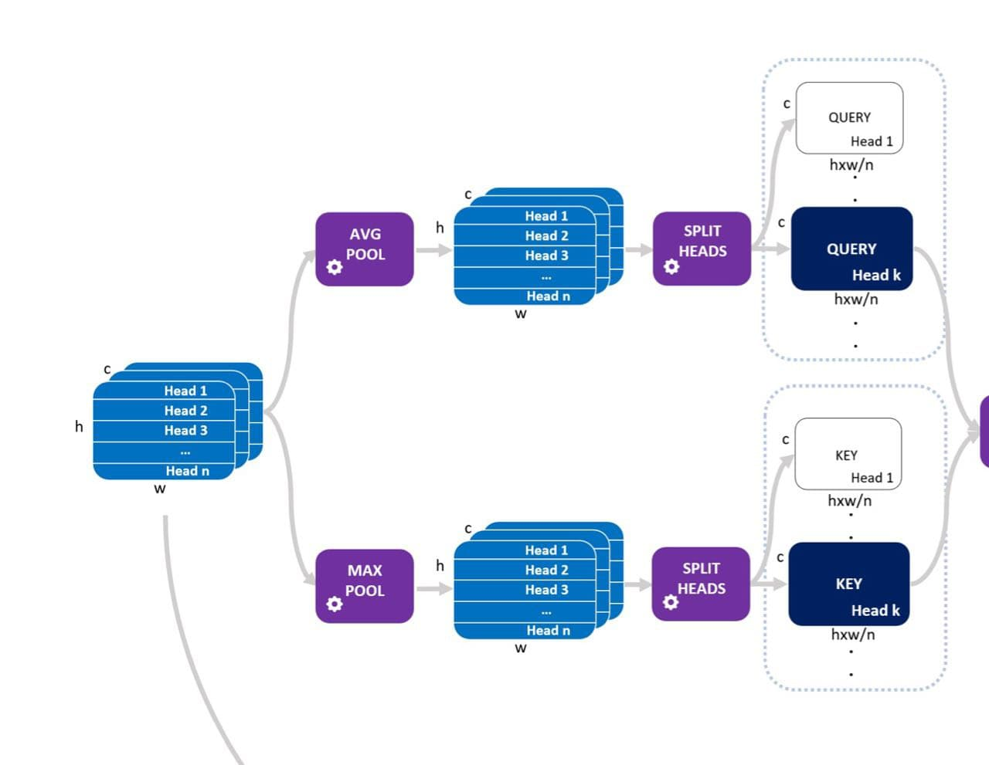
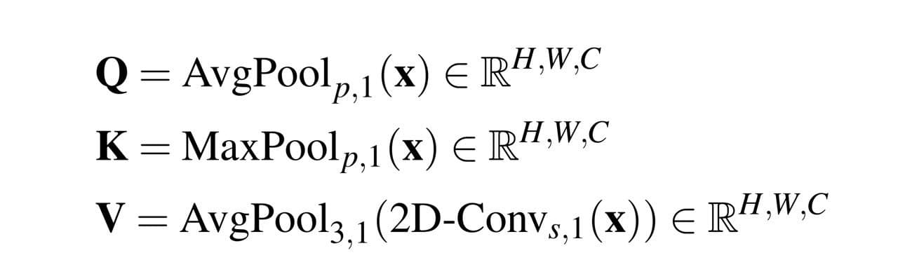
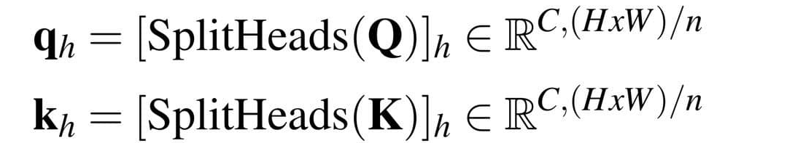
LHC Module Architecture (Cont’d)
A generic input tensor is processed to get Q(query) and K(key) tensors.
The tensors Q and K are splitted into n horizontal slices.
The resulting tensors are reshaped.

Slide 12
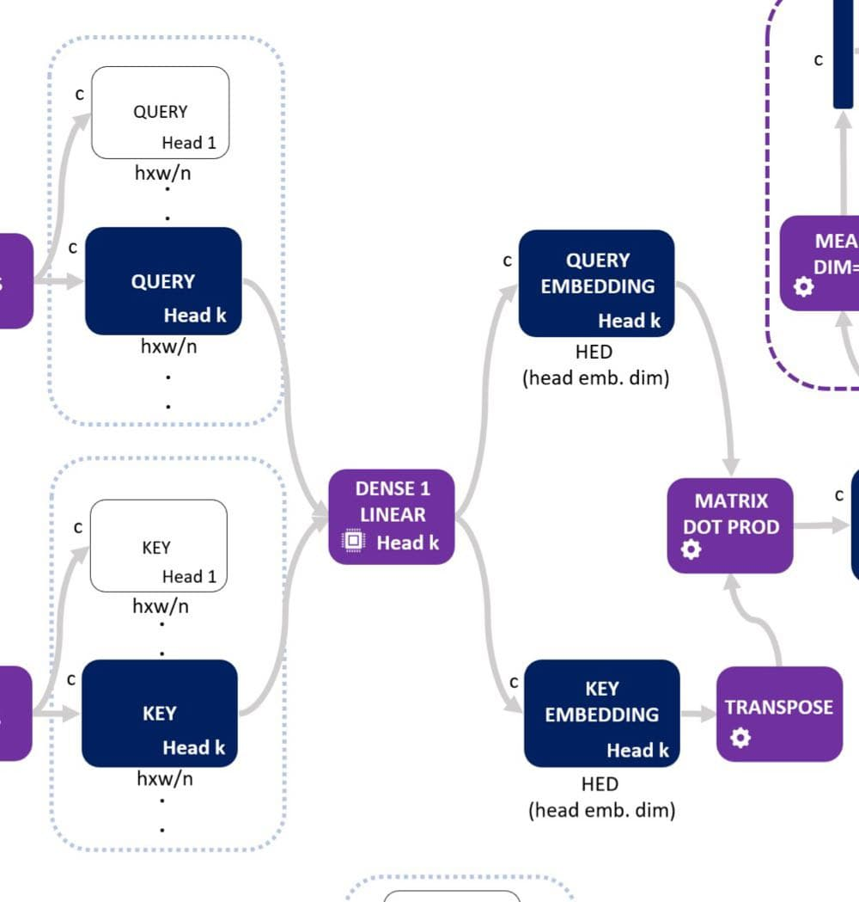
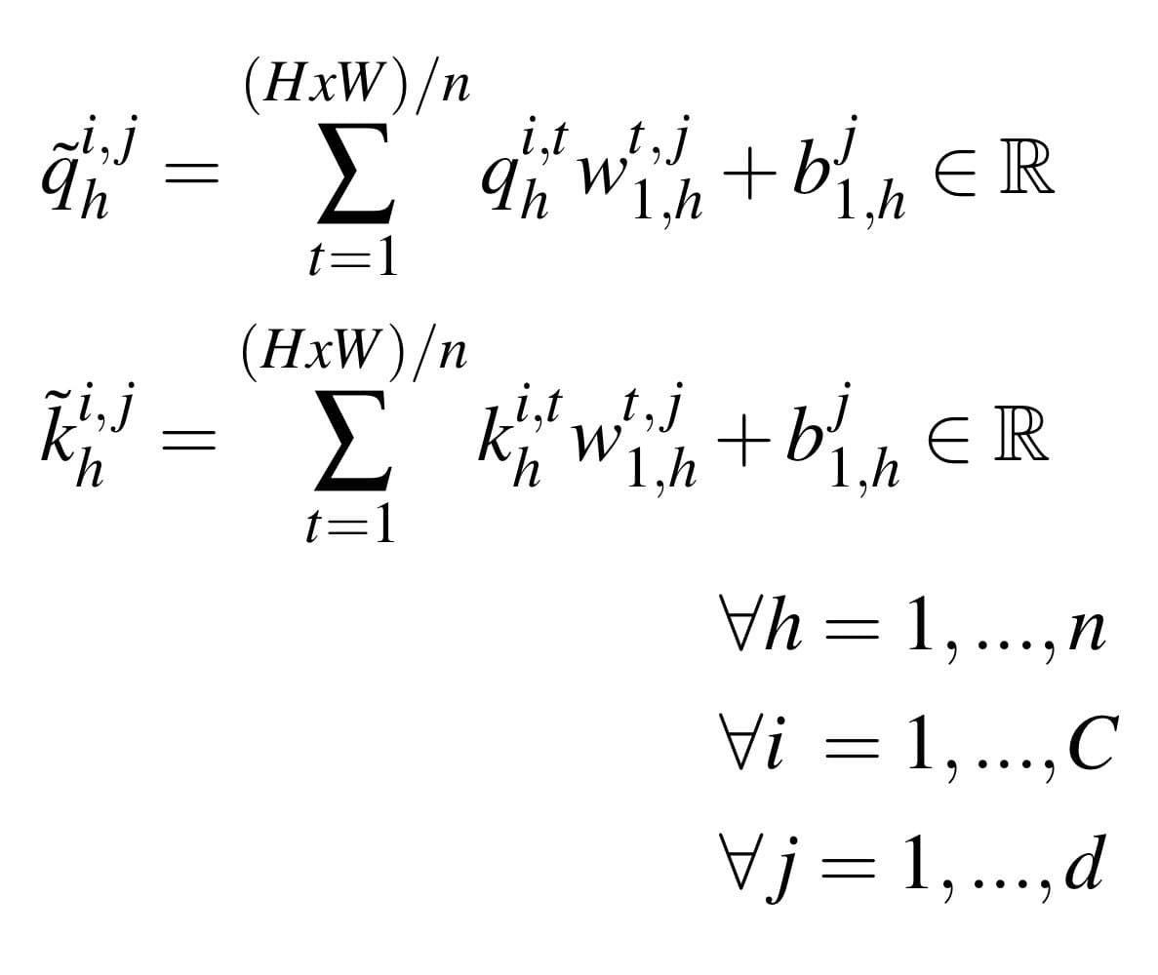
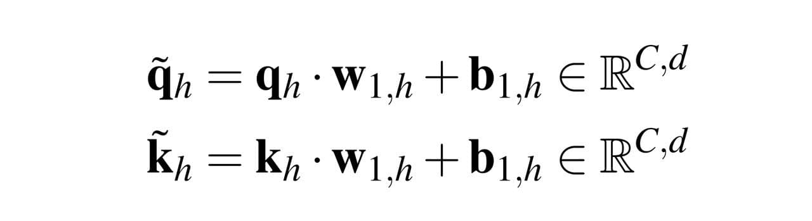
LHC Module Architecture (Cont’d)
Query and key will share the same dense blocks resulting in n embeddings as follows:

Slide 13
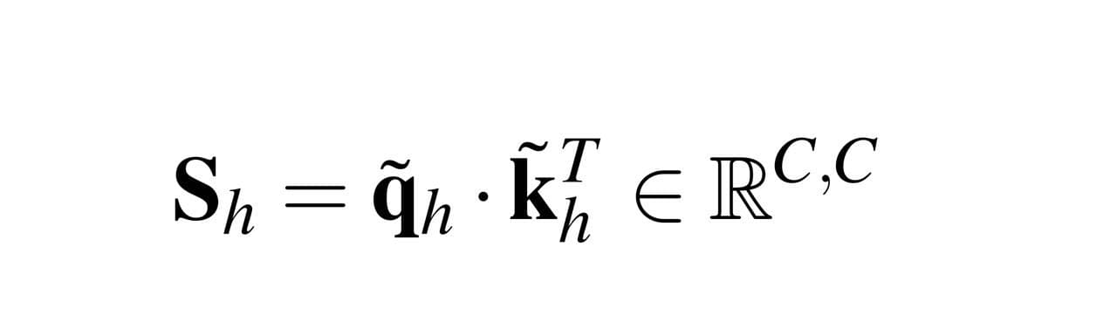
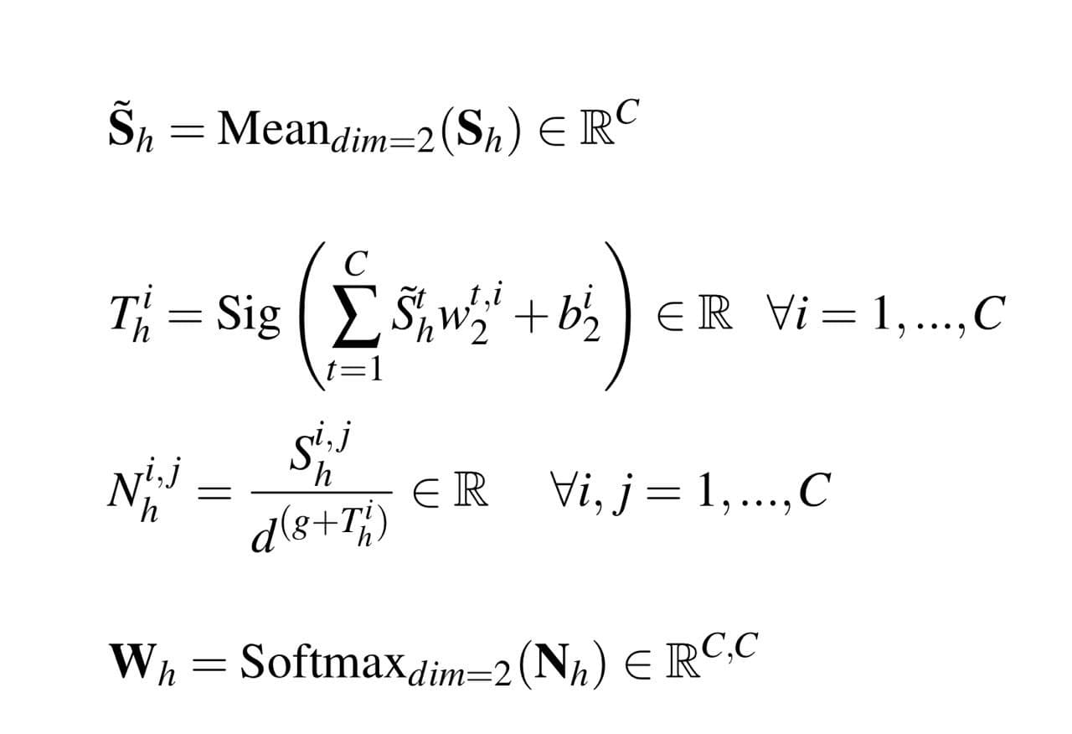
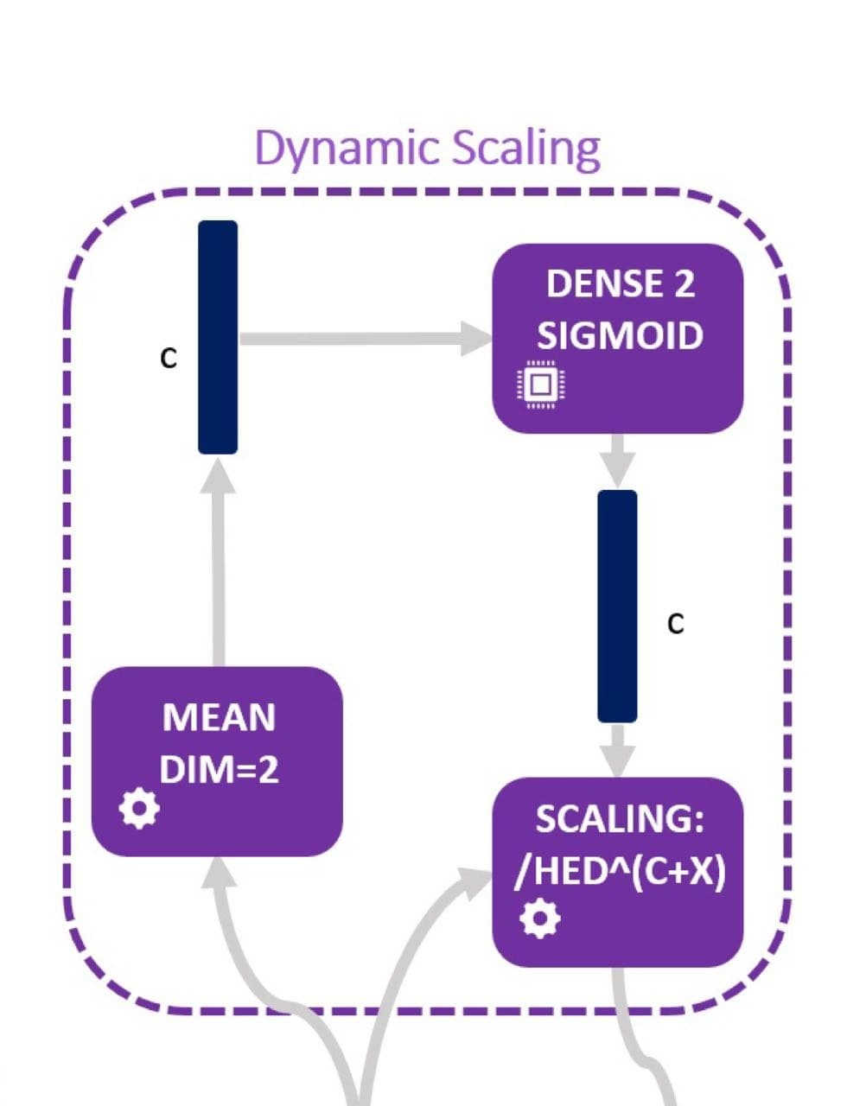
LHC Module Architecture (Cont’d)
The attention scores (S_{h}) are calculated.
Dynamic Scaling : It produces a channel-wise learned scaling (not dependent on heads) by averaging the scores and passing them through another fully connected layer with sigmoid activation and weights/biases.

Slide 14
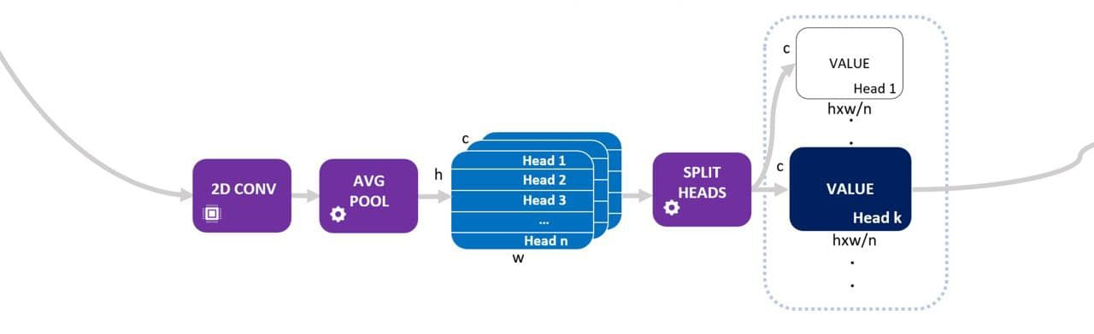
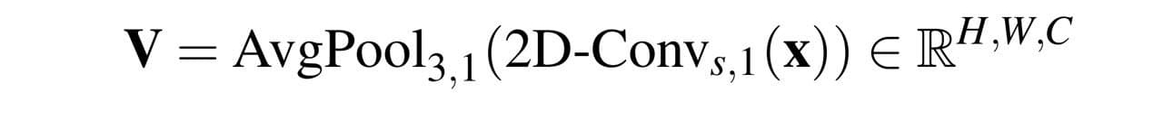
LHC Module Architecture (Cont’d)
Generating V(value) tensor :

Slide 15
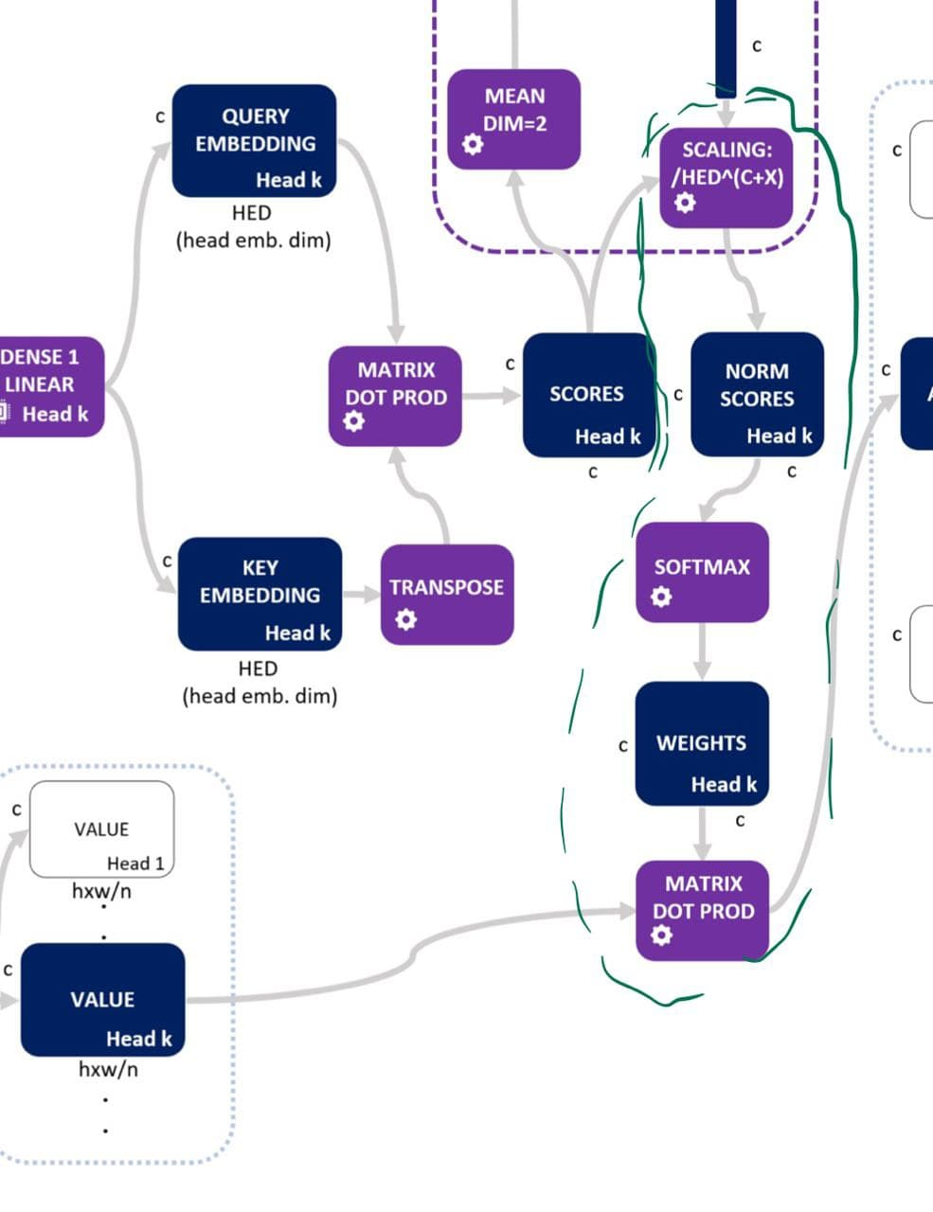
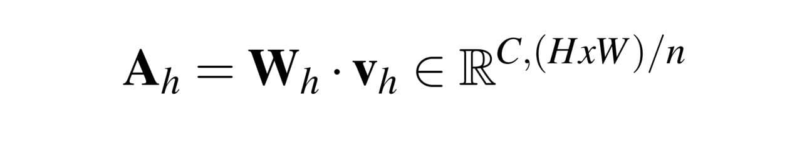
LHC Module Architecture (Cont’d)
The final attention vector for head h :

Slide 16
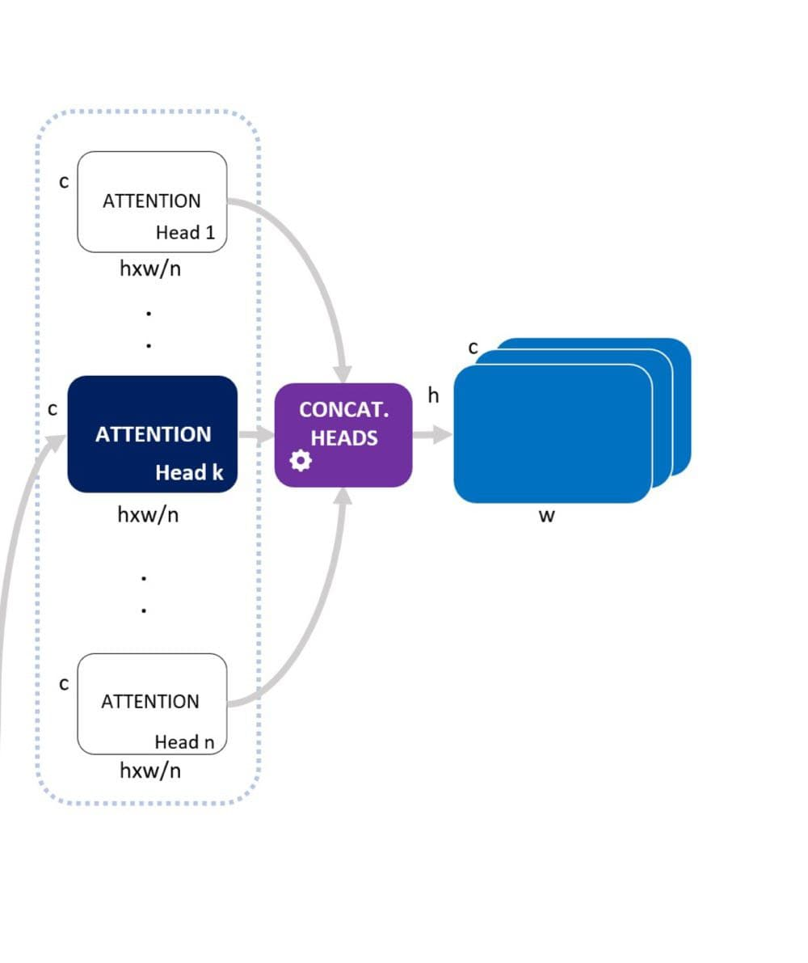
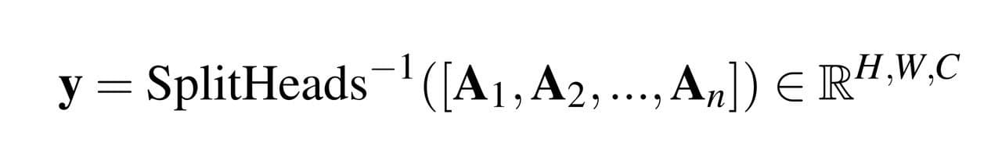
LHC Module Architecture (Cont’d)
Finally, we assemble then heads to get the final output y :

Slide 17
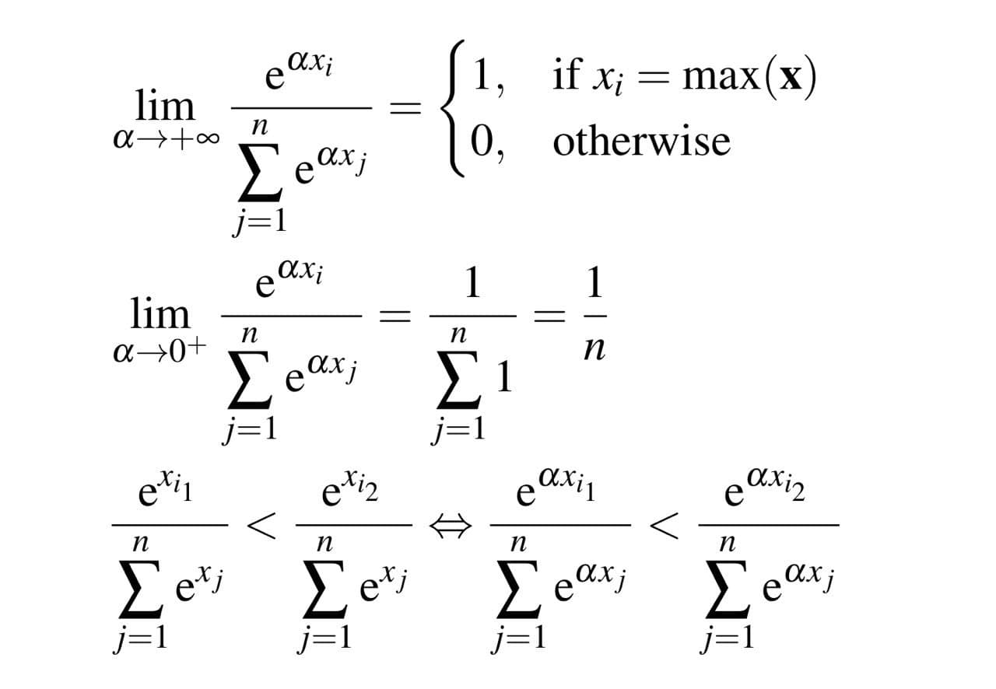
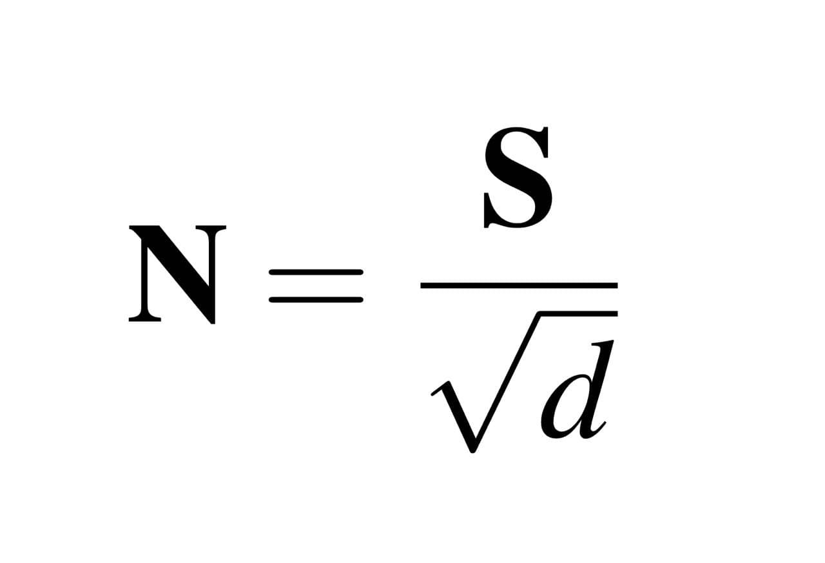
Advantages
Channel Self-attention : Improves on spatial attention which assumes the relationship pixels or areas of image exists.
Dynamic Scaling : Dynamic scaling module learns how complex the new feature maps must be.

Slide 18
Advantages (Cont’d)
Local Multi-head
  Detecting a pattern of a few pixels is harder if the input includes the entire feature map.
  Splitting the images into smaller parts gives local heads the ability to build new feature maps considering only the important parts of the old maps.

Slide 19
Experimental Analysis

Slide 20
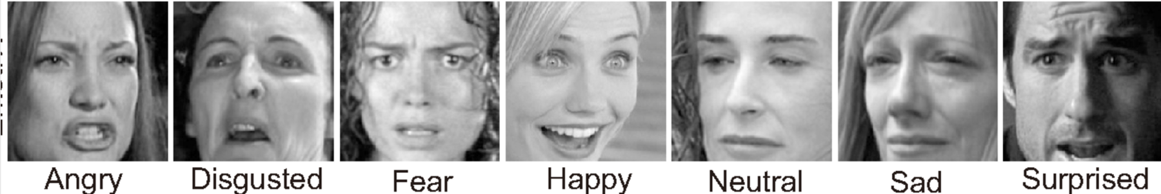
Dataset Description
FER 2013
  The object of a 2013 Kaggle competition
  35587 grey-scale 48x48 images of faces
  7 categories: anger, disgust, fear, happiness, sadness, surprise, neutral.
  a challenging dataset: noisy data with a relatively large number of non-face images and misclassifications and strongly unbalanced

Slide 21
Performance measures

Slide 22
Finding
LHC-Net was able to consistently outperform our best performing ResNet34v2, both on average and on peak result.
LHC-Net has the top accuracy both with and without testing time augmentation (TTA).
LHC-NetC outperforms LHC-Net but is outperformed when TTA is used.

Slide 23
Conclusion
The LHC-net module has proved channel self-attention in synergy with convolution could be a functioning paradigm by setting a new SOTA on well known dataset FER2013.
It has been shown that self-attention works well as a small attention module intended as a booster for pre-existing architectures.

Slide 24
Future Work
The existing module will be evaluated on the more computational intensive scenarios. eg. Imagenet dataset.
A better head splitting technique could be key in the future research. For example, learning the optimal areas through spatial attention.

Slide 25
References
Pecoraro, Roberto, et al. "Local Multi-Head Channel Self-Attention for Facial Expression Recognition." arXiv preprint arXiv:2111.07224 (2021).
https://towardsdatascience.com/transformers-explained-visually-part-3-multi-head-attention-deep-dive-1c1ff1024853
https://www.kaggle.com/residentmario/transformer-architecture-self-attention
http://jalammar.github.io/illustrated-transformer/
https://www.kaggle.com/msambare/fer2013
https://www.researchgate.net/figure/The-Attention-module-a-Channel-attention-module-MLP-Multilayer-perceptron-b_fig3_342725128
https://towardsdatascience.com/self-attention-in-computer-vision-2782727021f6

Slide 26
Thank You!

