Slide 1
STATISTICS CASE STUDY SUBMISSION
Group Name:
Mukesh Jha : DDA1610110
Anirban Dwibedi : DDA1610212
Pratik Sanghvi : DDA1610244
Shanmugapriya Venkatachalapathy : DDA1610194

Slide 2
Abstract
A detailed study performed to understand the driver variables contributing to the loan default. The study includes classification of sample into different groups based on interest rate and loan status, Univariate analysis to check the skewness of data , Multivariable analysis to understand the correlation between two or more continuous variables, deriving the null hypothesis and hypothesis testing to conclude which variables are the key drivers.
When a loan application is submitted, the outcome of the analysis will help in taking right decision based on five key drivers namely annual income, loan amount, funded amount, DTI, and interest rate. This would make approving authority’s task easier in order to take decision to approve the loan for the right customer and reject for others.

Slide 3
Problem solving methodology

Slide 4
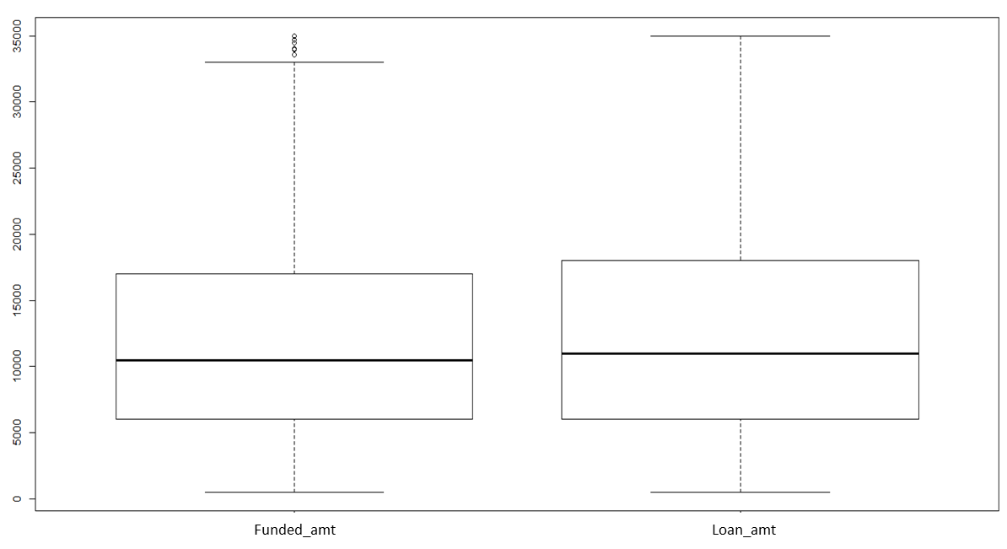
Analysis: Outlier study
Summary table
Boxplot to check outlier
 | Min | 1st Qu. | Median | Mean | 3rd Qu. | Max.
annual_inc | 2000 | 40000 | 55000 | 66100 | 78800 | 1250000
funded_amt | 500 | 6000 | 10500 | 12380 | 17000 | 35000
loan_amt | 500 | 6000 | 11000 | 12770 | 18000 | 35000
loan_dti | 0.00 | 9.16 | 14.43 | 14.13 | 19.44 | 29.96
The boxplot and summary table shows
Outliers lies within annual_inc.
Haven’t performed outlier treatment on this variable considering the importance of this variable. Higher range is obvious for this
Funded_amt has maximum outliers. Performing outlier treatment on this variable cleans up the sample. Didn’t fine any more outlier across continuous variables

Slide 5
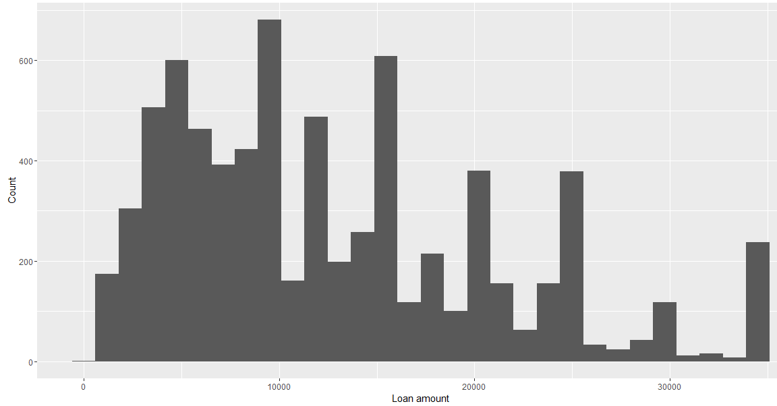
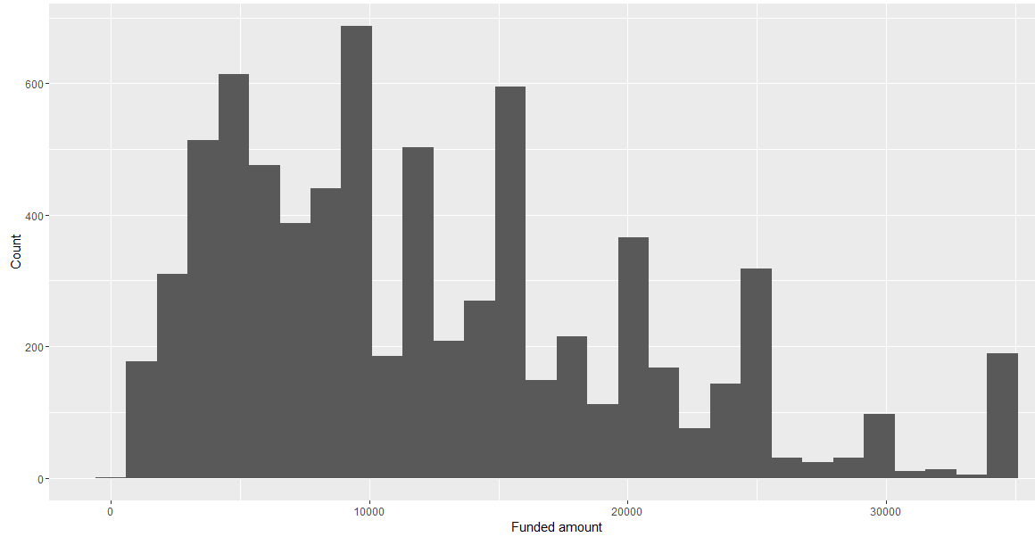
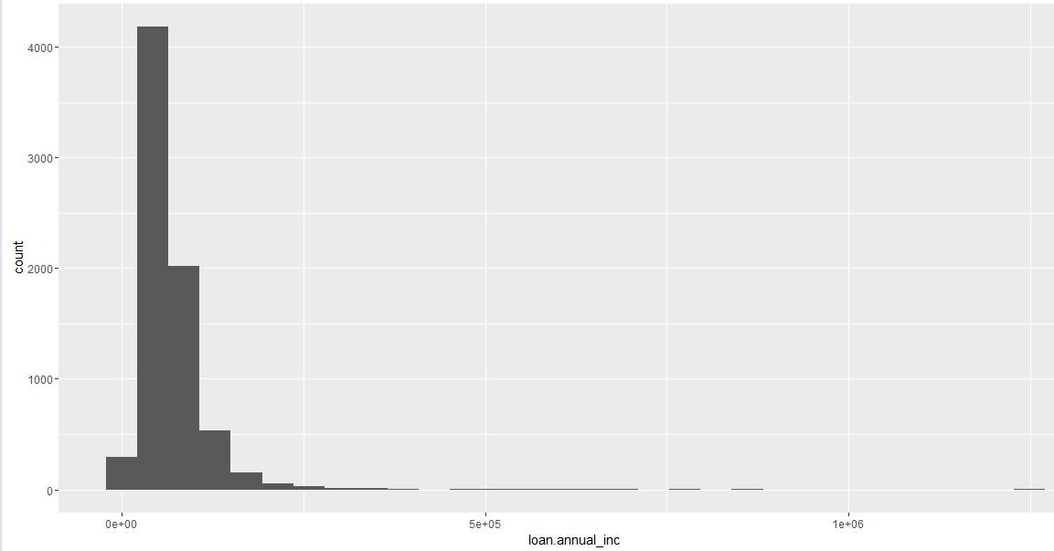
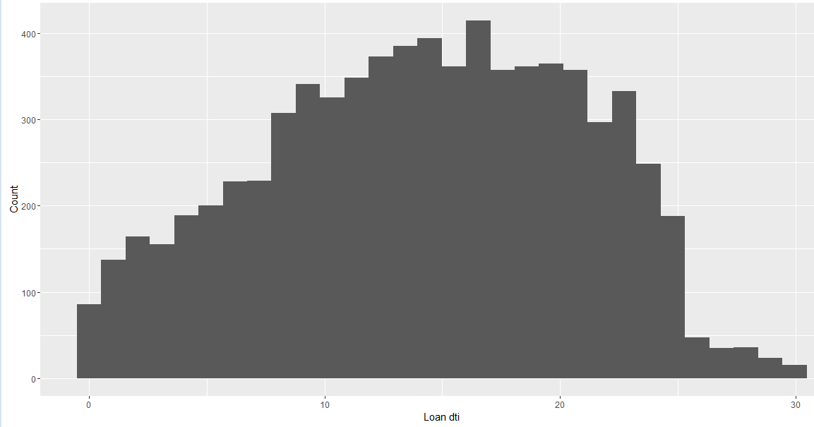
Analysis: Data distribution (Continuous variables)
Loan_amnt (Skewness: 0.83)
Funded_amt (Skewness: 0.85)
Annual income (Skewness: 6.3)
Loan DTI (Skewness: -0.15
Distribution of annual_inc

Slide 6
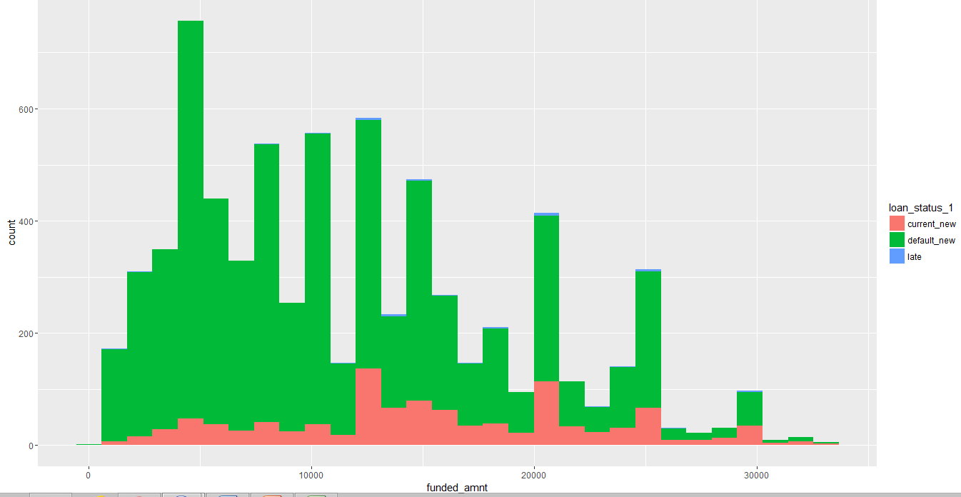
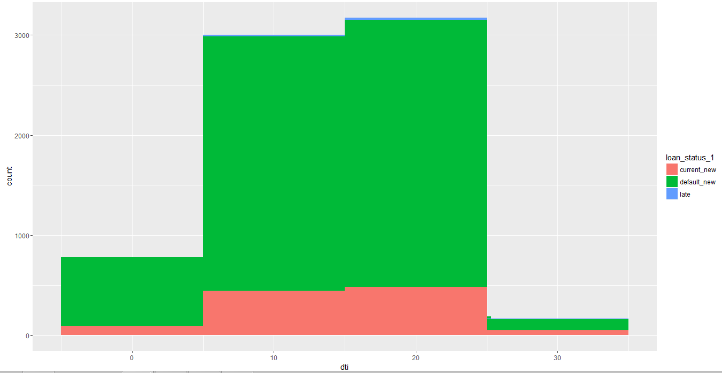
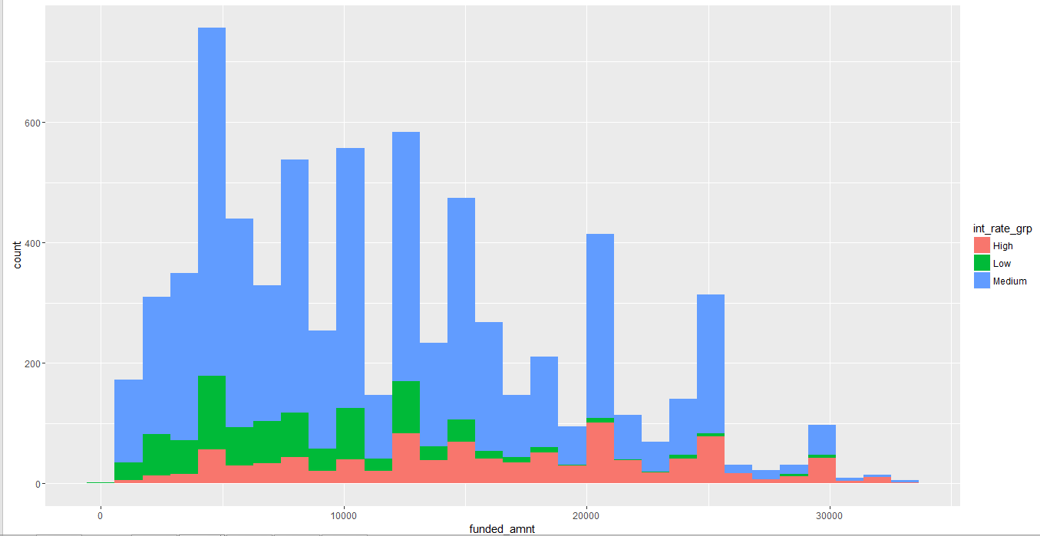
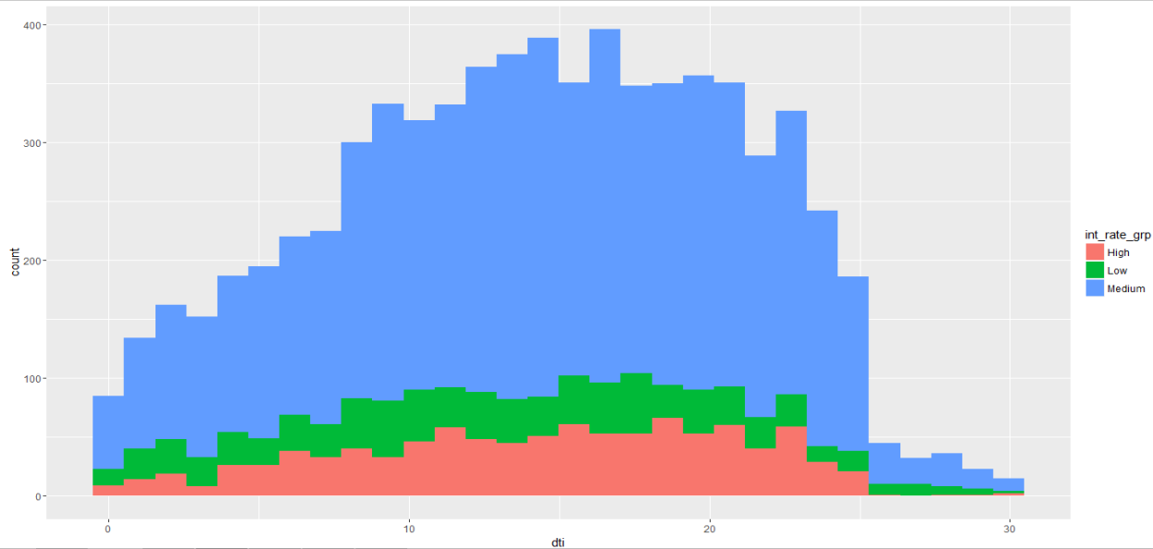
Analysis: Univariate and Multivariate
Funded Amount - Loan Status
DTI - Loan Status
Funded Amount – Interest Rate Group
DTI– Interest Rate Group

Slide 7
Results: Members with DTI from 5 to 25 are defaulting the most
DTI

Slide 8
Results: Mostly, defaults are happening for funded amount between 4 and 15 K

Slide 9
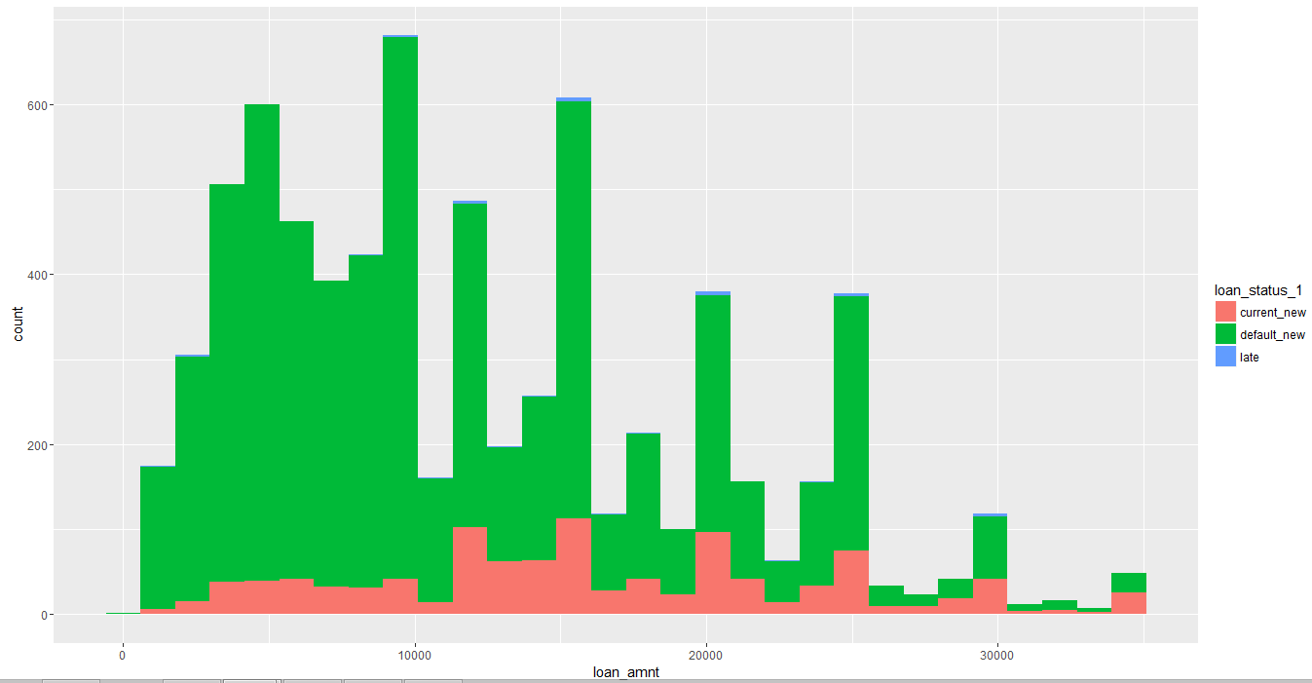
Results: Mostly, defaults are happening for loan amount between 4 and 15 K

Slide 10
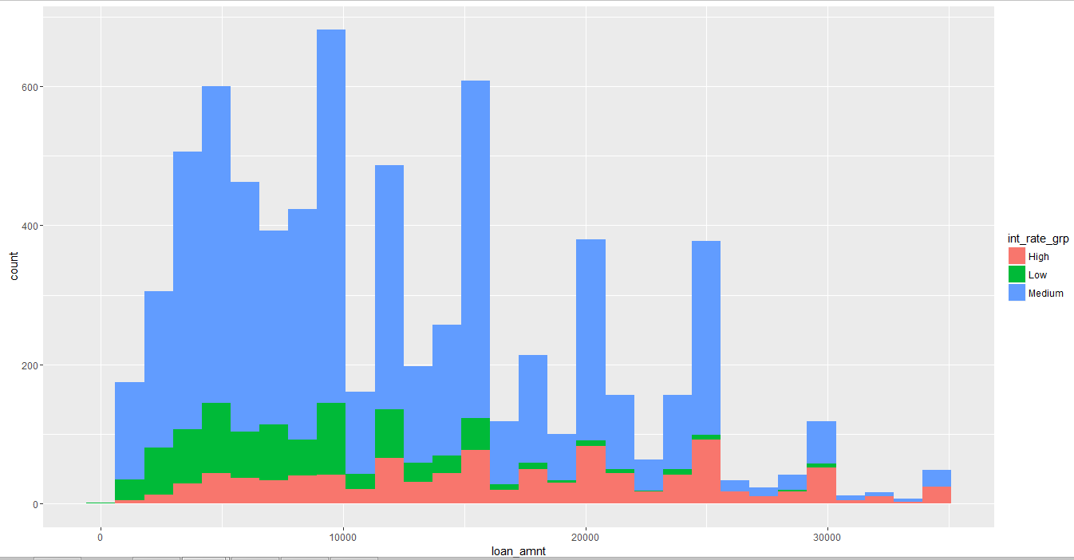
Results: Defaults are observed in Medium interest rate group

Slide 11
Conclusions
Key drivers leading to loan defaults are -
Loan Amount
Funded Amount
DTI
Interest rate
Loan defaults are happening mostly when -
DTI range in 5 to 25
Funded amount range between 4k and 15 k
Loan amount range between 4k and 15 k
Interest rate is Medium

