Slide 1
INVESTMENT CASE STUDY SUBMISSION
Group Name:
Mukesh Jha : APFE1680314
Anirban Dwibedi : APFE1680672
Shanmugapriya Venkatachalapathy : APFE1680609
Pratik Sanghvi : APFE1680625

Slide 2
Abstract : Investment Study for Spark Fund
Spark Funds Investments wanted to have a solid strategy for the investment funding across countries and sectors with the most suitable type of investment that can give them high return. A study of the investment data has helped to identify investment opportunities for Spark Funds that are available across different sectors and countries along with suitable investment type. The analysis shows a trend which highlights countries and sectors where maximum investments are currently made and the type of investments (venture, private equity, seed).

Slide 3
Problem solving methodology : CRISP-DM Framework
Understand Business Objective
What is the business objective?
What are the goals ?
Understand Data
Identify Outliers, duplicate values, missing data
Identify attributes having semi-structured data
Check mixed date format, unique key attributes, homonyms, synonyms
Prepare Data
Outlier treatment, missing value treatment
Merge data frames
Create subset required for analysis
Summarize
No
Is data ready for analysis?
Getting accurate results?
Yes
Deploy (Submit the case study slide deck)
No
Yes
Analyze Data
Evaluate Output
Plot charts to find out pattern, trend, inference
Connect dots to bring out story

Slide 4
Funding Type Analysis : Most suitable investment type
Questions | Answer
Average funding amount of venture type | 11,748,949
Average funding amount of angel type | 958,695
Average funding amount of seed type | 719,818
Average funding amount of private equity type | 73,308,593
Considering that Spark Funds wants to invest between 5 to 15 million USD per investment round, which investment type is the most suitable for them? | Venture Type
Given the investment constraint between 5 and 15 USD, Venture type investment is the most suitable for Spark Funds

Slide 5
Country Analysis : Top investment friendly countries
Top 3 English speaking countries which have received highest funding across all sectors for the chosen investment type
Top English speaking country | USA
Second English speaking country | GBR
Third English speaking country | IND
Top 3 investment friendly countries where Spark Funds should focus are United States, Great Britain and India.

Slide 6
Sector Analysis : Top sectors for investment
 | USA | GBR | IND
Total number of Investments (count) | 11286 | 582 | 315
Total amount of investment (USD) | 101,000,666,779 | 5,053,293,406 | 2,820,673,602
Top Sector name (no. of investment-wise) | Others | Others | Others
Second Sector name (no. of investment-wise) | Social, Finance, Analytics, Advertising | Social, Finance, Analytics, Advertising | Social, Finance, Analytics, Advertising
Third Sector name (no. of investment-wise) | Cleantech / Semiconductors | Cleantech / Semiconductors | News, Search and Messaging
Number of investments in top sector (3) | 2758 | 140 | 103
Number of investments in second sector (4) | 2590 | 128 | 59
Number of investments in third sector (5) | 2192 | 116 | 49
For point 3 (top sector count-wise), which company received the highest investment? | Virtustream | Electric Cloud | FirstCry.com
For point 4 (second best sector count-wise), which company received the highest investment? | SST Inc. (Formerly ShotSpotter) | Celltick Technologies | Manthan Systems
Top 3 sectors where most of the investors are investing across top 3 countries are-
Others
Social, Finance, Analytics, Advertising
Cleantech / Semiconductors

Slide 7
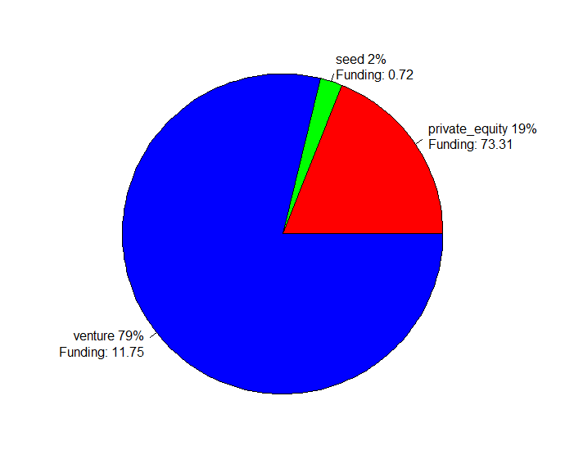
Results : Investments Contribution by Funding Type
Across sectors maximum funding are done into Venture

Slide 8
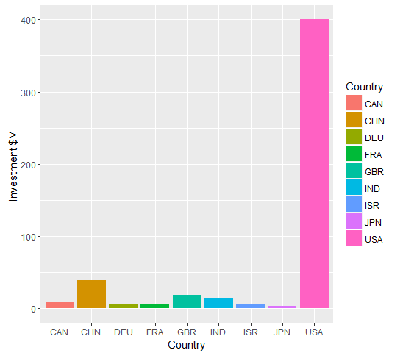
Results : United States is the most preferred country by investors
United States is the most preferred country by investors followed by Great Britain & India

Slide 9
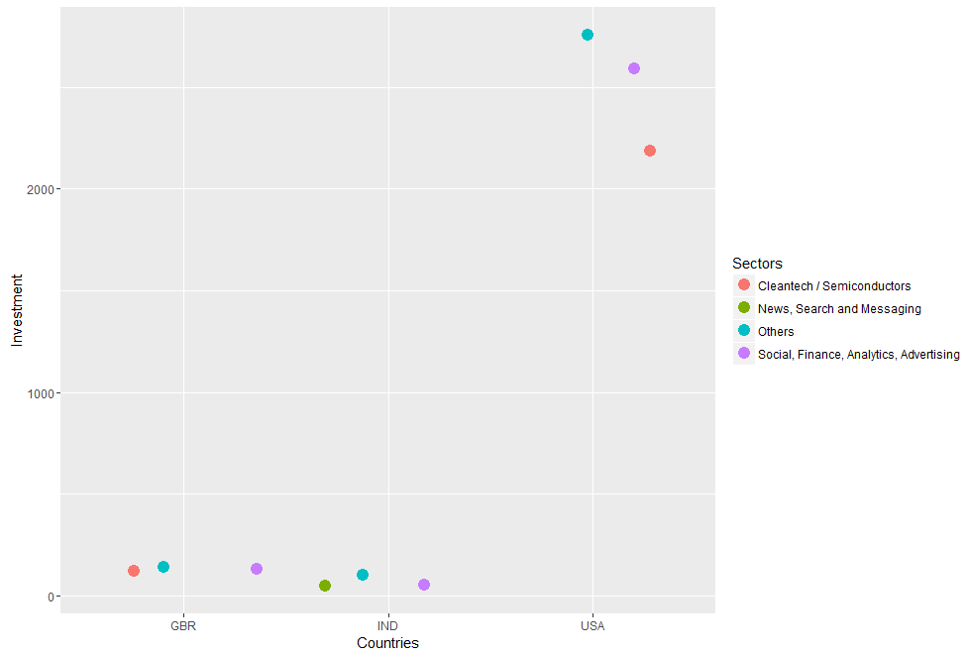
Results : Others sector fall in the top invested category across
Top 3 sectors where most of the investors are investing across top 3 countries are-
Others
Social, Finance, Analytics, Advertising
Cleantech / Semiconductors

Slide 10
Conclusion
The Spark Funds Management should focus on Venture Type investment predominantly in countries like United States, Great Britain & India. The most suitable investment sectors for Spark Fund are “Others” , “Social, Finance, Analytics, Advertising” and “ Cleantech / Semiconductors “

