Slide 2
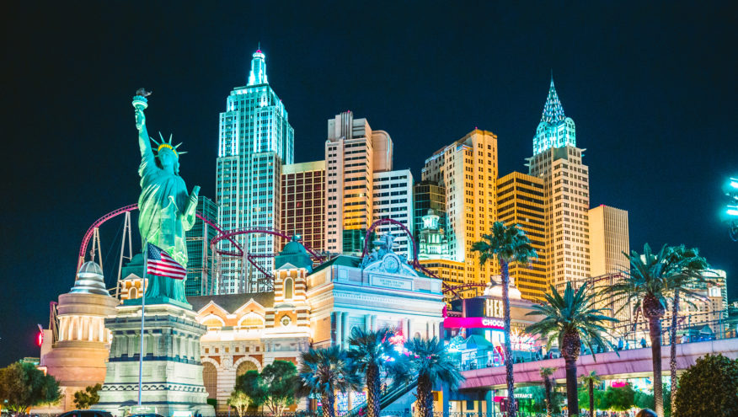
Notes:
vegas

Slide 3
HELLO INDIA
Notes:
SYSDNEY

Slide 4
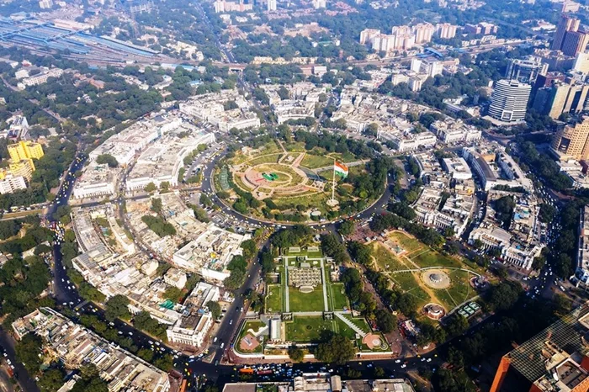
Notes:
SYSDNEY

Slide 5
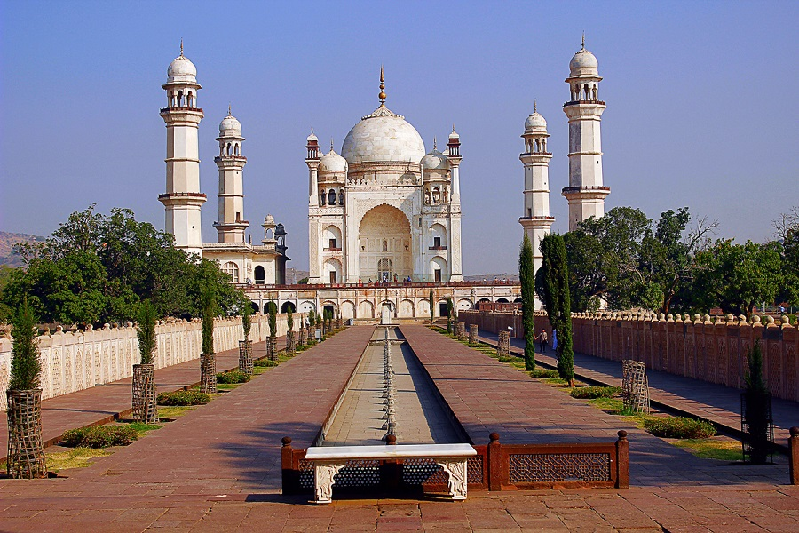
Notes:
SYSDNEY

Slide 6
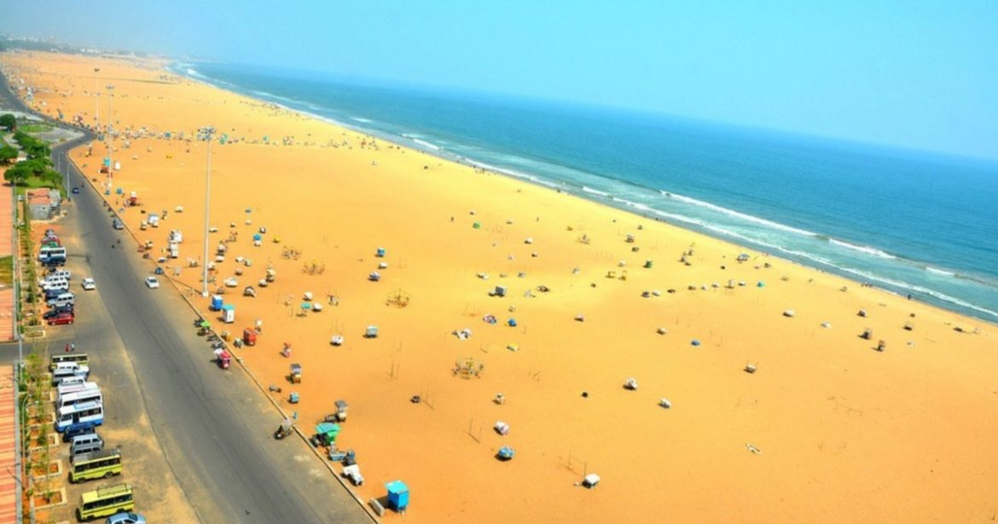
Notes:
SYSDNEY

Slide 7
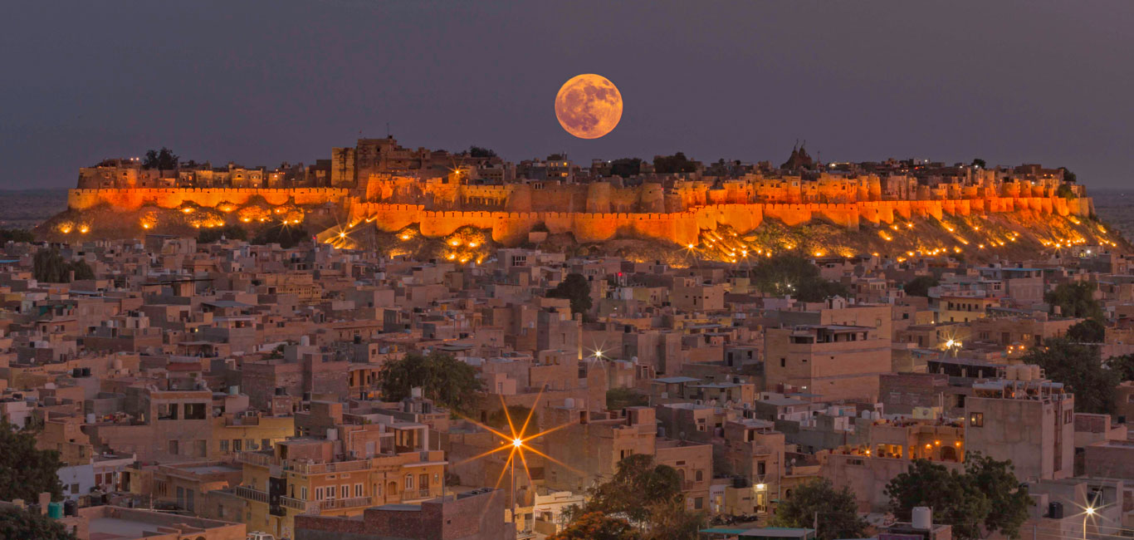
Notes:
SYSDNEY

Slide 8
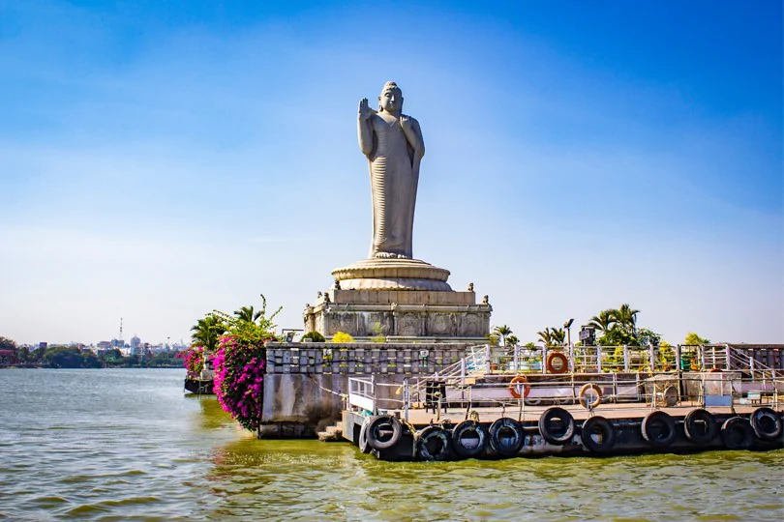
Notes:
SYSDNEY

Slide 9
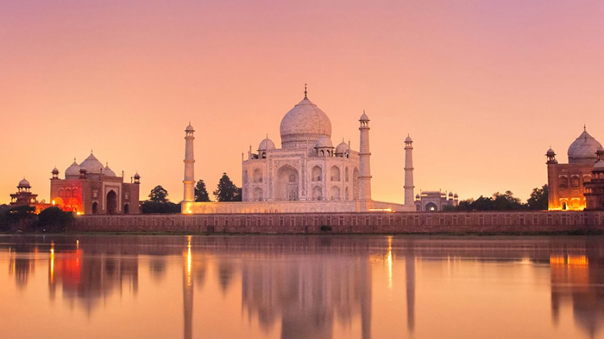
Notes:
SYSDNEY

Slide 10
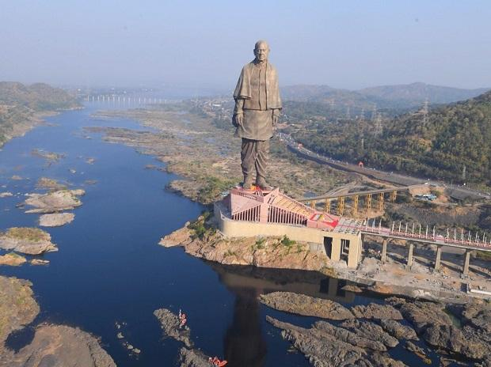
Notes:
KEVADIA

Slide 11
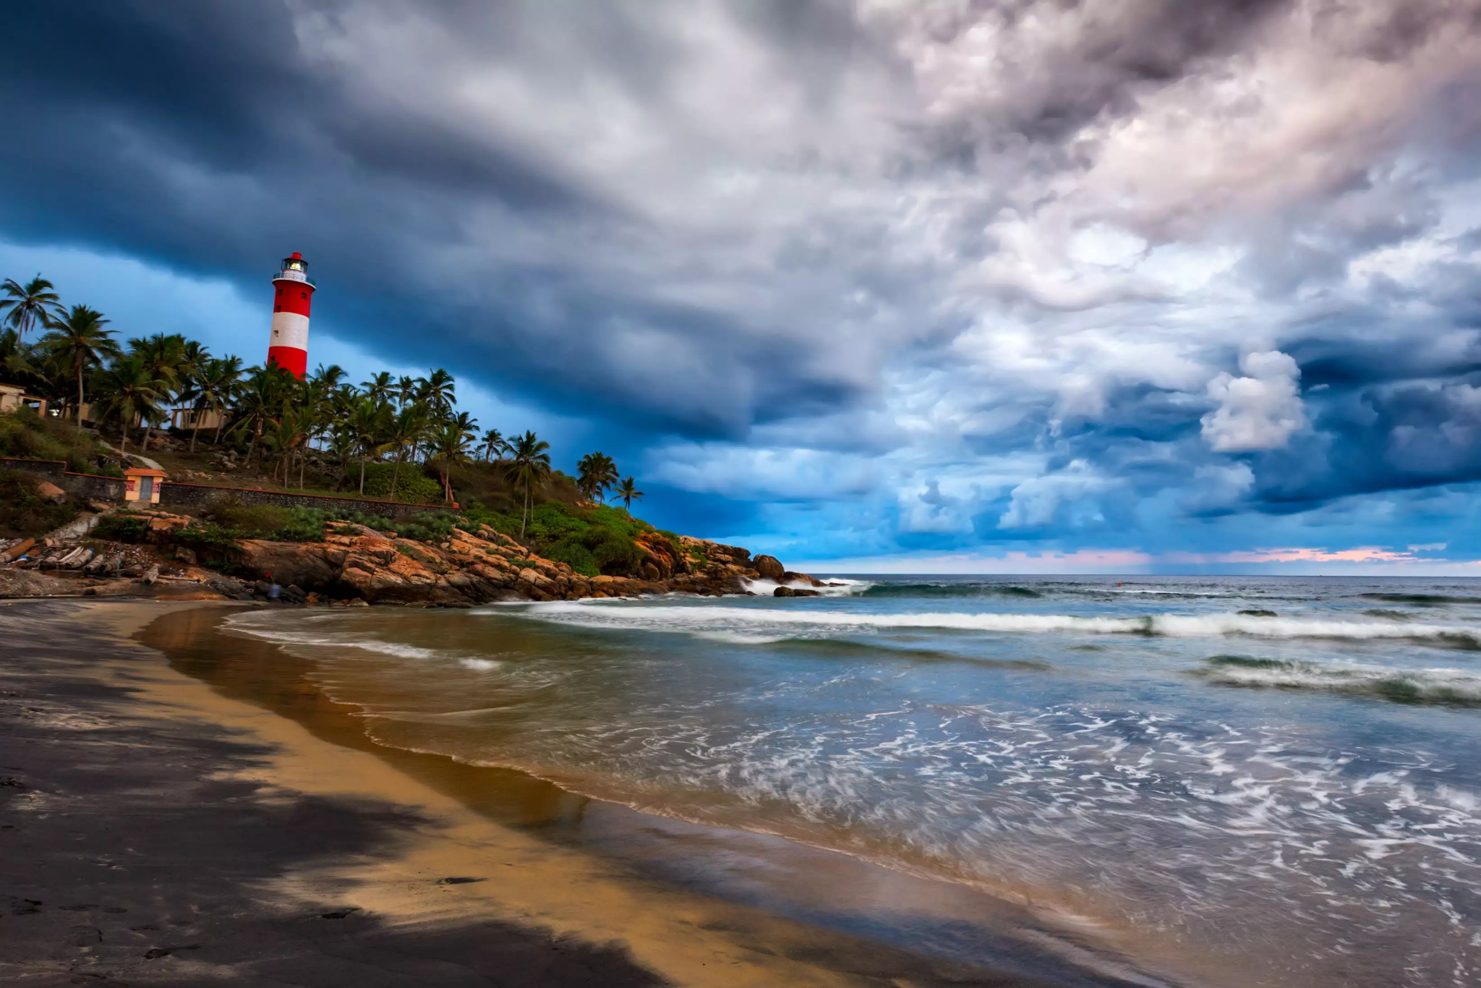
Notes:
KOVALAM

Slide 12
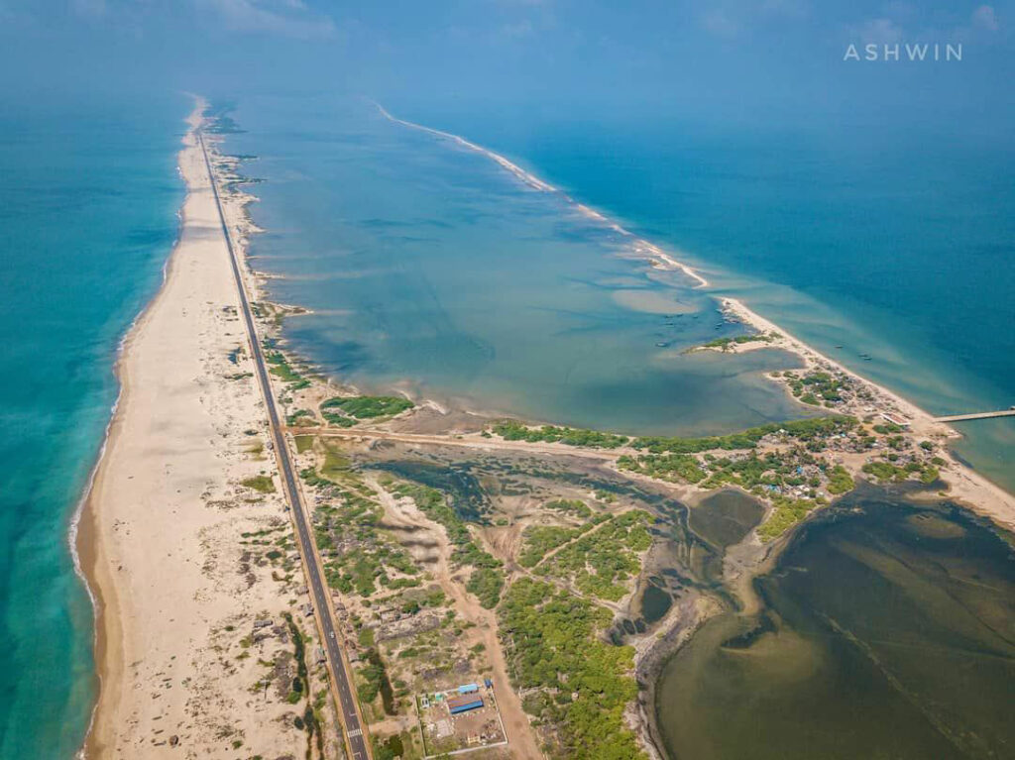

Slide 13
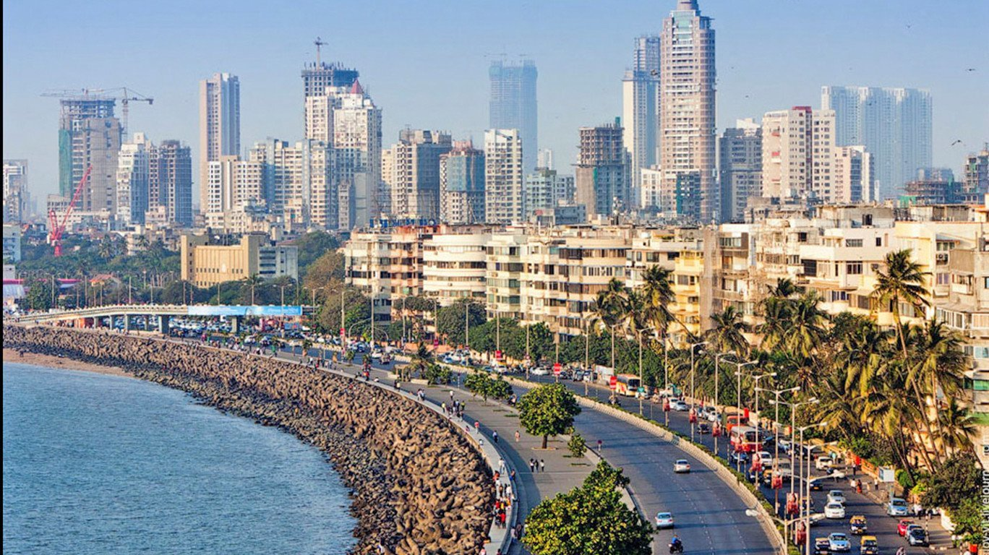

Slide 14
HELLO BANGALORE
Notes:
SYSDNEY

Slide 15

Notes:
SYSDNEY

Slide 16
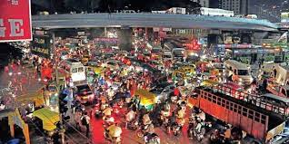
Notes:
SYSDNEY

Slide 17
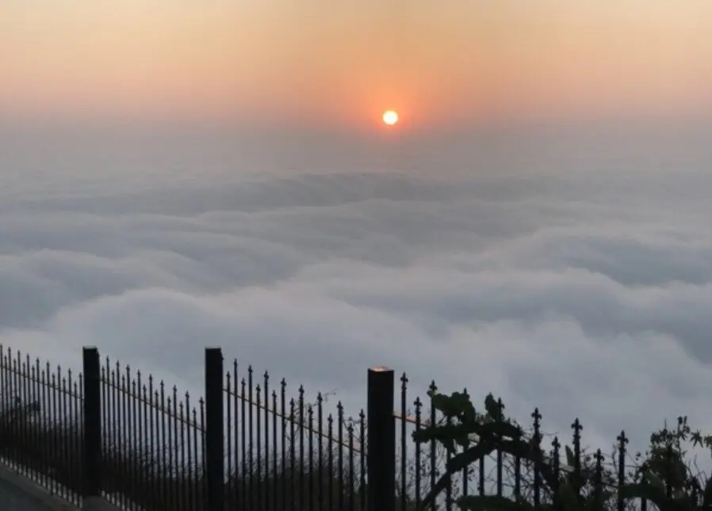
Notes:
SYSDNEY

Slide 18
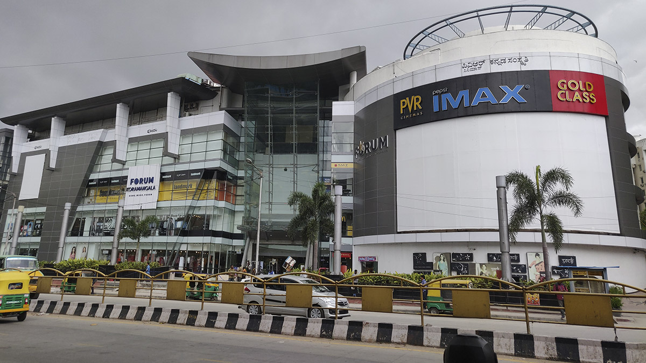
Notes:
SYSDNEY

Slide 19
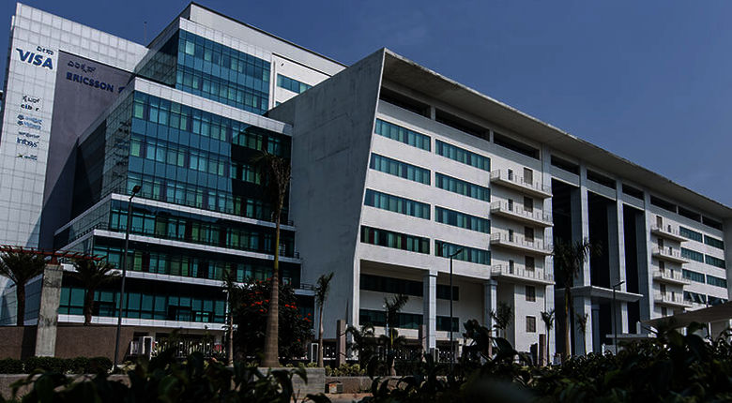
Notes:
SYSDNEY

Slide 20
Notes:
SYSDNEY

