Slide 1
LARAVEL

Slide 2
What is laravel ?
Laravel is a free, open-source PHP web framework, created by Taylor Otwell and intended for the development of web applications following the model–view–controller architectural pattern and based on Symfony.

Slide 3
Based on symphony ?
Symfony is an open source PHP framework with MVC architecture. It is one of the most popular application frameworks among the open source developers' community. It is used to build high-performance complex web applications.
Laravel is made on top of symphony.

Slide 4
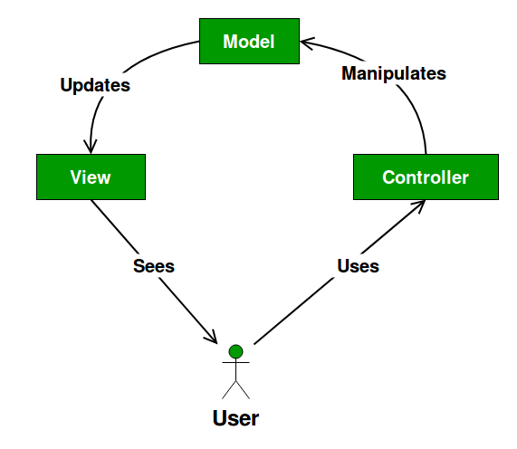
So what is MVC pattern ?

Slide 5
The Model contains only the pure application data, it contains no logic describing how to present the data to a user.
The View presents the model’s data to the user. The view knows how to access the model’s data, but it does not know what this data means or what the user can do to manipulate it.
The Controller exists between the view and the model. It listens to events triggered by the view (or another external source) and executes the appropriate reaction to these events. In most cases, the reaction is to call a method on the model. Since the view and the model are connected through a notification mechanism, the result of this action is then automatically reflected in the view.

Slide 6
Why use laravel ?
What made Laravel a better choice for my latest project:
Quick and functional core that can be extended
Clean and simple routing
Effective ORM and database layer
Easy integration with third-party libraries (AWS, export libs, etc.). You can use Composer or Packagist to include libraries in your project
Active and growing community that can provide quick support and answers
Supporting unit tests out of the box
Async queue and background jobs for the long running tasks

Slide 7
How to get started with laravel
Apache Server
Mysql Server
Composer
Laravel Framework Itself

Slide 8
Mysql Server ?? Apache Server ??
Mysql Server
Apache Server
Its RDBMS system
MySQL is a freely available open source Relational Database Management System (RDBMS) that uses Structured Query Language (SQL). SQL is the most popular language for adding, accessing and managing content in a database
Its job is to establish a connection between a server and the browsers of website visitors (Firefox, Google Chrome, Safari, etc.) while delivering files back and forth between them (client-server structure).

Slide 9
Composer (PHP Package Manager)
Composer is an application-level package manager for the PHP programming language that provides a standard format for managing dependencies of PHP software and required libraries

Slide 10
Did you know ??
Did you know laravel itself is a package ??
That’s why we can install via calling
composer create-project laravel/laravel example-app
See the keyword composer it denotes laravel is framework that can be shipped as a package.

Slide 11
Installation ...
Can be installed by 3 methods
Composer way
Laravel Installer Way
Laravel Sail

Slide 12
Composer Way ..
composer create-project laravel/laravel example-app

Slide 13
Laravel installer way
composer global require laravel/installer
laravel new example-app

Slide 14
Laravel Sail Way
cURL -s https://laravel.build/example-app

