Slide 1


^{OOPS -Concepts in PHP}
Call US : 011-65164822
CPD TECHNOLOGIES
Add:- Block C 9/8, Sector-7, Rohini, Delhi -110085
www.cpd-india.com
www.blog.cpd-india.com

Slide 2
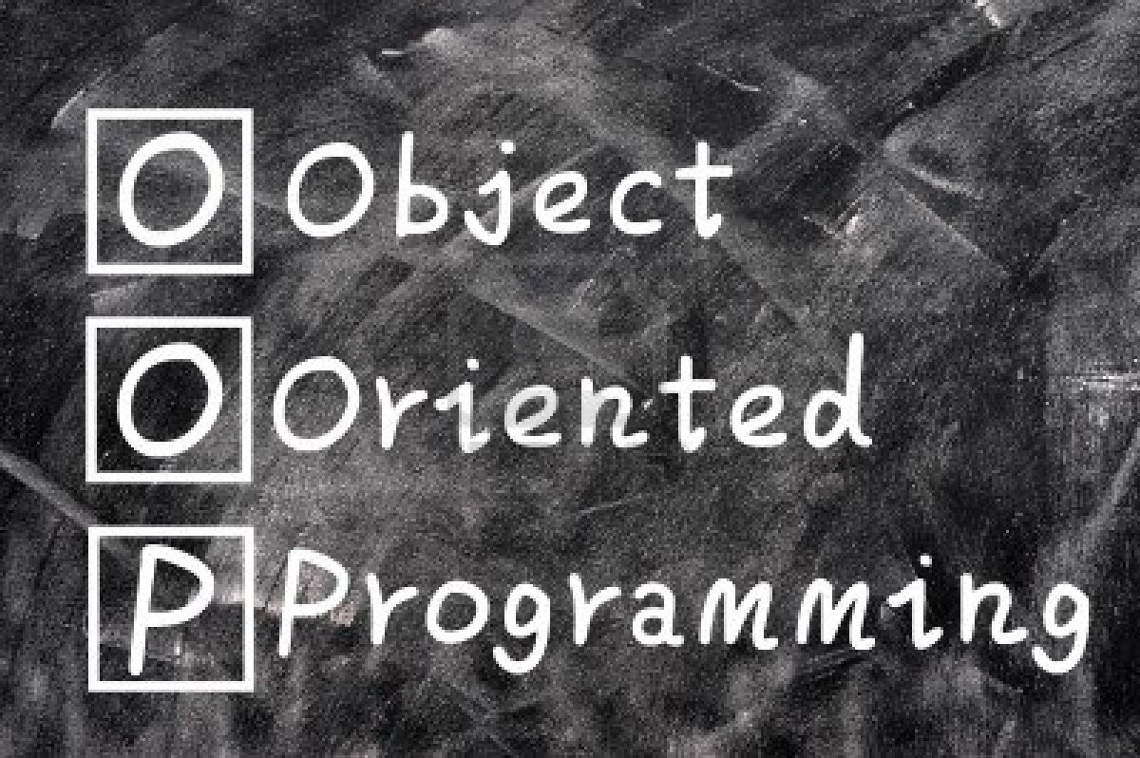

Slide 3


Topics to be covered
What is OOPS
Class & Objects
Modifier
Constructor
Deconstructor
Class Constants
Inheritance In Php
Magic Function
Polymorphism
Interfaces
Abstract Classes
Static Methods And Properties
Accessor Methods
Determining A Object's Class

Slide 4
What Is Oop ?
Object Oriented Programming (OOP) is the programming method that involves the use of the data , structure and organize classes of an application. The data structure becomes an objects that includes both functions and data. A relationship between one object and other object is created by the programmer
www.cpd-india.com

Slide 5
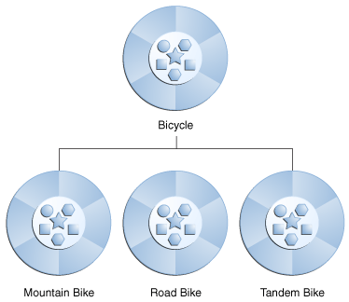
Classes
A class is a programmer defined datatype which include local fuctions as well as local data.
Like a pattern or a blueprint a oops class has exact specifications. The specification is the class' s contract.

Slide 6

Object
An object is a like a container that contains methods and properties which are require to make a certain data types useful. An object’s methods are what it can do and its properties are what it knows.

Slide 7
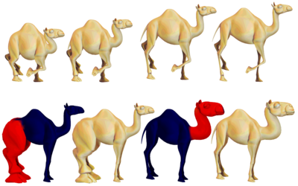
Modifier

Slide 8
Modifier
In object oriented programming, some Keywords are private and some are public in class. These keyword are known as modifier. These keywords help you to define how these variables and properties will be accessed by the user of this class.
www.cpd-india.com

Slide 9
Modifier
Private: Properties or methods declared as private are not allowed to be called from outside the class. However any method inside the same class can access them without a problem. In our Emailer class we have all these properties declared as private, so if we execute the following code we will find an error.
www.cpd-india.com

Slide 10
Modifier
<?
include_once("class.emailer.php");
$emobject = new Emailer("hasin@somewherein.net");
$emobject->subject = "Hello world";
?>
The above code upon execution gives a fatal error as shown below:
<b>Faprivate property emailer::$subject
in <b>C:\OOP with PHP5\Codes\ch1\class.emailer.php</b> on line
<b>43</><br />
tal error</b>: Cannot access That means you can't access
www.cpd-india.com

Slide 11
Modifier
Public: Any property or method which is not explicitly declared as private or protected is a public method. You can access a public method from inside or outside the class.
Protected: This is another modifier which has a special meaning in OOP. If any property or method is declared as protected, you can only access the method from its subclass. To see how a protected method or property actually works, we'll use the following example:

Slide 12
Modifier
To start, let's open class.emailer.php file (the Emailer class) and change the declaration of the $sender variable. Make it as follows:
protected $sender
Now create another file name class.extendedemailer.php with the following code:
www.cpd-india.com

Slide 13
Modifier
<?
class ExtendedEmailer extends emailer
{
function __construct(){}
public function setSender($sender)
{
$this->sender = $sender;
}
}
?>
www.cpd-india.com

Slide 14
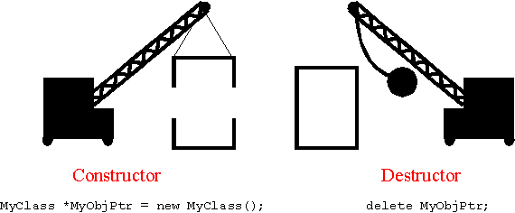
Constructor & Destructor
Constructor is Acclimated to Initialize the Object.
Arguments can be taken by constructor.
A class name has same name as Constructor.
Memory allocation is done by Constructor.
www.cpd-india.com

Slide 15
Constructor & Destructor
The objects that are created in memory, are destroyed by the destructor.
Arguments can be taken by the destructor.
Overloading is possible in destructor.
It has same name as class name with tiled operator.

Slide 16
Interesting, right?
This is just a sneak preview of the full presentation. We hope you like it! To see the rest of it, just click here to view it in full on PowerShow.com. Then, if you’d like, you can also log in to PowerShow.com to download the entire presentation for free.

