Slide 1
DATA ANALYST PORTFOLIO PROJECT
ONLINE RETAIL RETURN RISK & PROFITABILITY ANALYSIS
Using Excel, SQL and Power BI
BY
Pratiksha L Rohankar

Slide 2

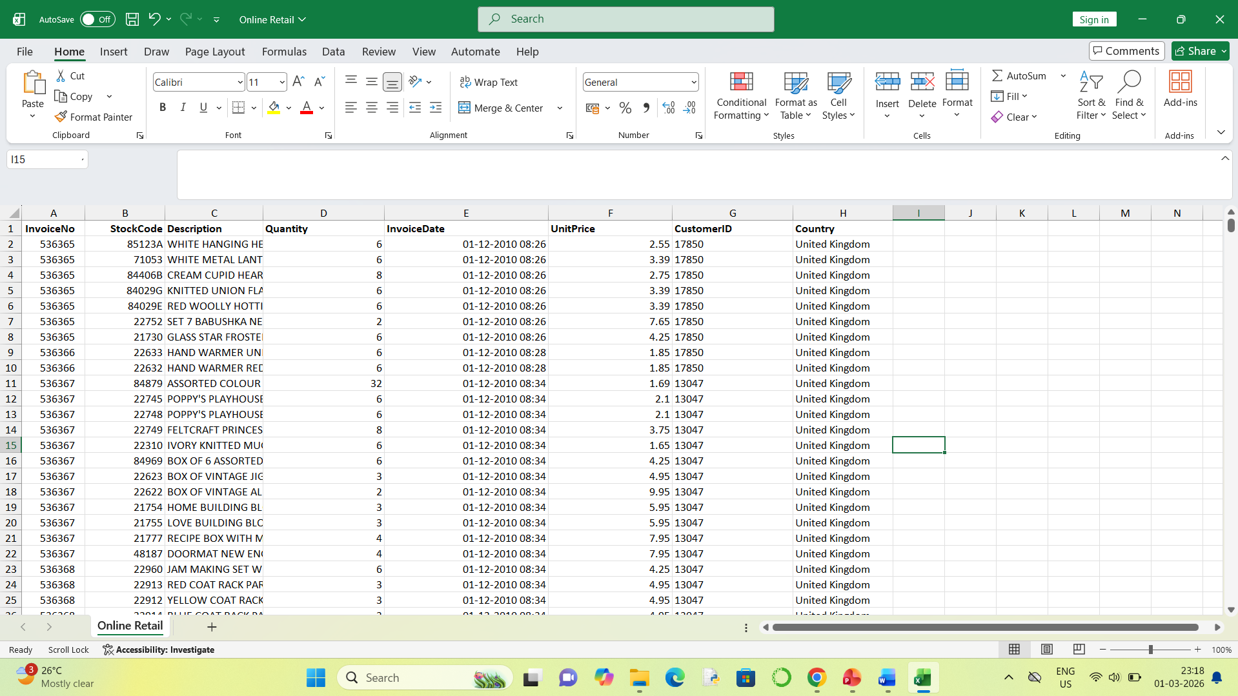

EXCEL
OPEN RAW DATA

Slide 3
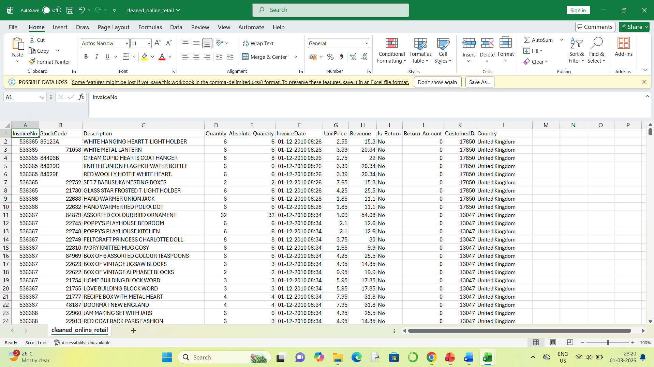
EXCEL
DATA PREPARATION

Slide 4

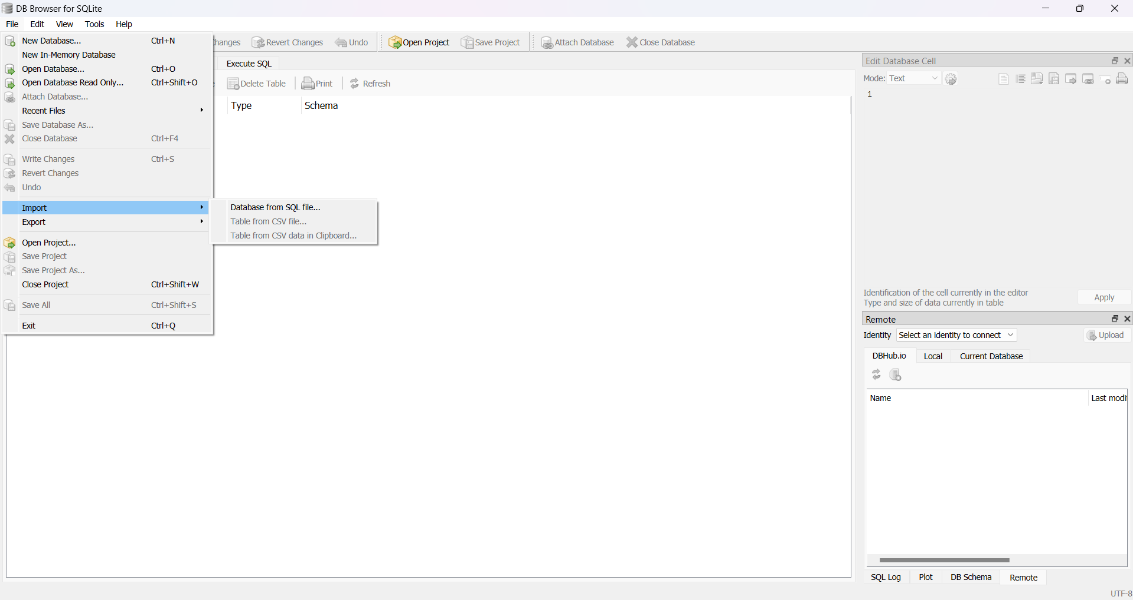

DB Browser for SQLite
IMPORT DATA

Slide 5
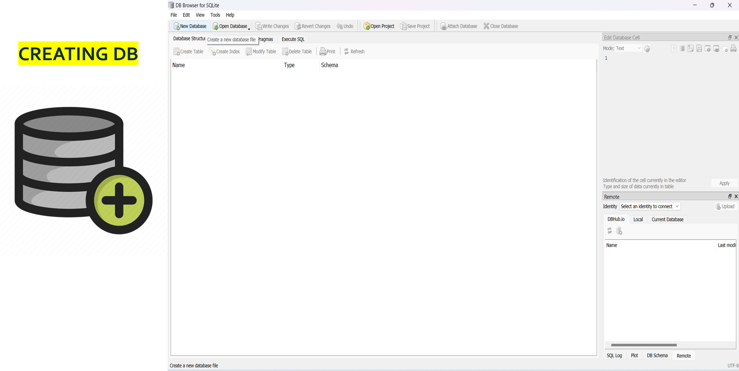
DB Browser for SQLite

Slide 6
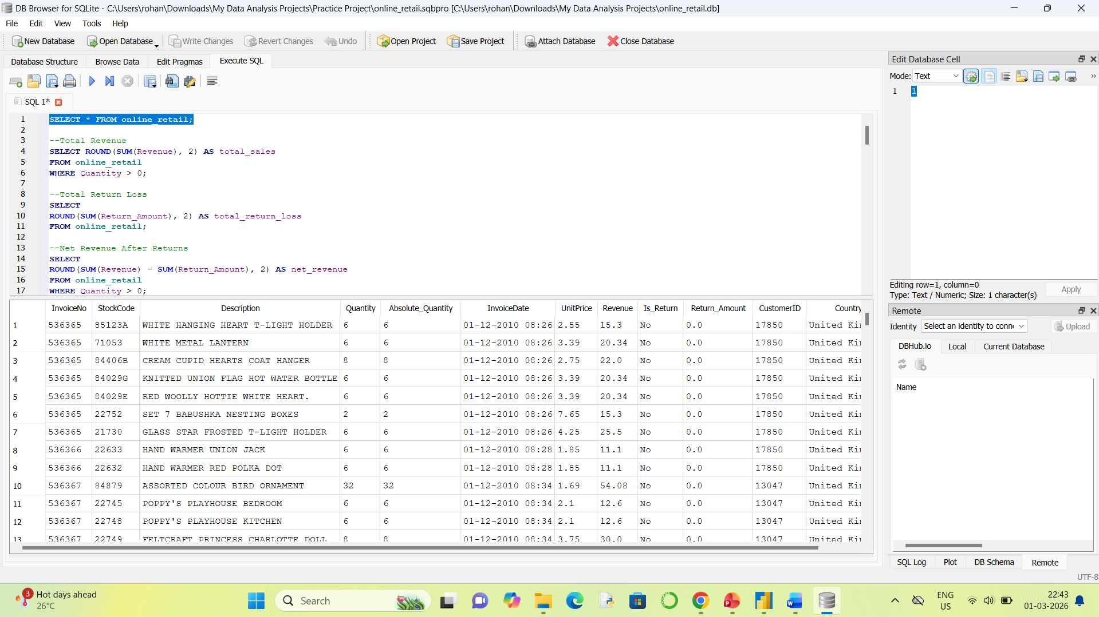
DB Browser for SQLite
WRITING QUERIE

Slide 7


POWER BI
CONNECTING Power BI To DB Browser for SQLite
DATA PROCESSING
DATA VISUALIZATION

Slide 8
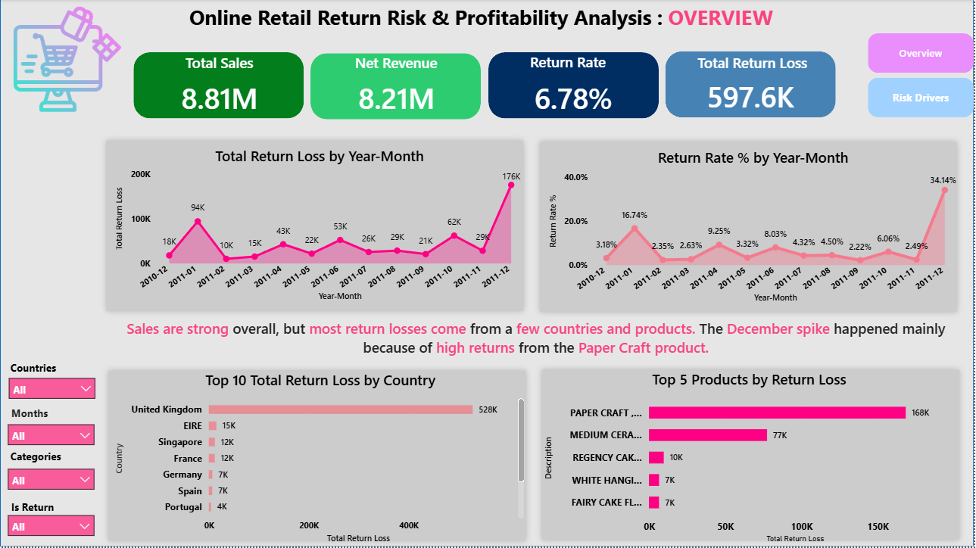
POWER BI

Slide 9
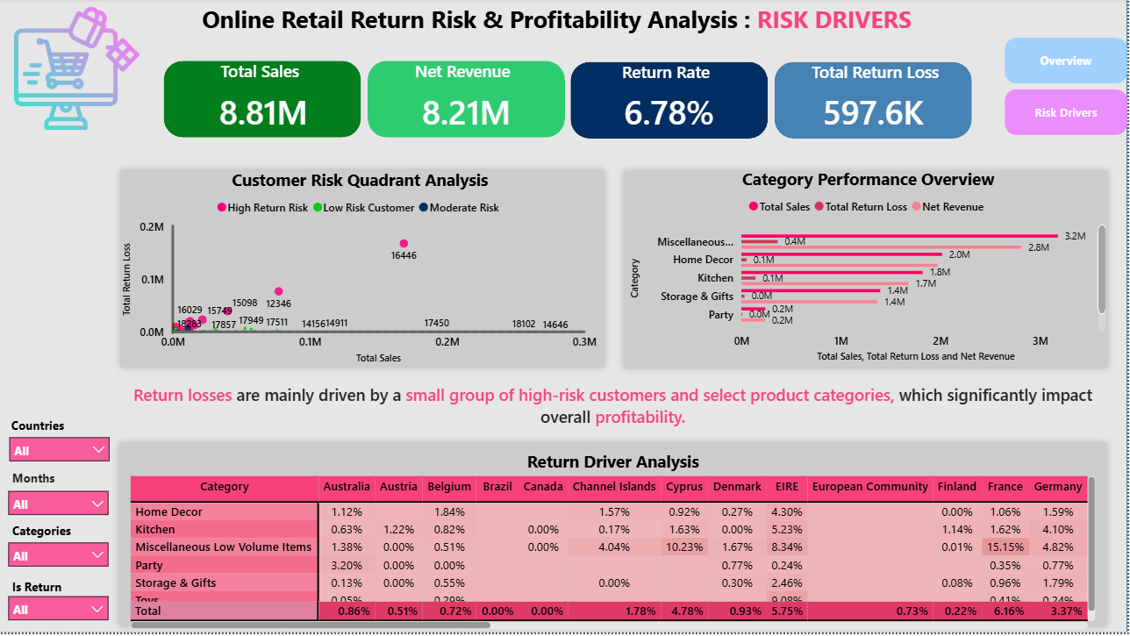
POWER BI

Slide 10
PROBLEM STATEMENT
Despite generating strong total sales of 8.81M, the company is facing significant profit reduction due to high product return losses (597.6K).
The overall return rate of 6.78% appears moderate, but deeper analysis shows that return losses are:
Concentrated in specific months, especially a major spike in December
Driven by a few high-return products, particularly Paper Craft
Highly impacted by one major country (United Kingdom)
Influenced by a small group of high-risk customers
Associated with certain product categories

Slide 11
DASHBOARD 1: SUMMARY
Key Performance Indicators(KPI’s) Requirement
Total Sales: Track overall sales revenue with MTD (Month-To-Date) and MoM (Month-over-Month) growth to monitor business performance trends.
Net Revenue: Measure actual revenue after deducting return losses and analyze monthly profitability trends.
Return Rate: Calculate the percentage of returned items out of total sales and track monthly fluctuations to identify return risk patterns.
Total Return Loss: Monitor total financial loss caused by product returns and analyze month-wise spikes (especially seasonal impacts like December).
Monthly Return Loss Trend: Analyze Year-Month return loss trends to detect seasonal spikes and abnormal return behavior.
Monthly Return Rate Trend: Track monthly return rate percentage to identify high-risk periods.
Country-Level Return Loss: Measure total return loss by country to identify geographical risk concentration.
Product-Level Return Loss: Track top products contributing to return loss to identify high-risk items (e.g., Paper Craft).

Slide 12
DASHBOARD 1: SUMMARY
Key Performance Indicators(KPI’s) Requirement
Total Sales: Track overall sales to measure revenue exposure across customers and categories.
Net Revenue: Monitor profit after returns to evaluate financial impact.
Return Rate %: Measure return percentage to identify overall risk levels.
Total Return Loss: Trak total loss from returns to understand cost impact.
Customer Risk Segmentation: Classify customers into High, Moderate, and Low risk based on return behavior.
Customer Risk Quadrant Analysis: Compare Sales vs Return Loss to identify high-risk and profitable customers.
Category Performance Overview: Analyze Sales, Return Loss, and Net Revenue by category.
Return Driver Heatmap: Identify high-return countries and categories driving risk

Slide 13
THANK YOU

