Slide 1
DATA ANALYST PORTFOLIO PROJECT
Telco Customer Churn Analysis
SQL + Excel Based Analysis
PRESENTED BY:
Pratiksha L Rohankar

Slide 2

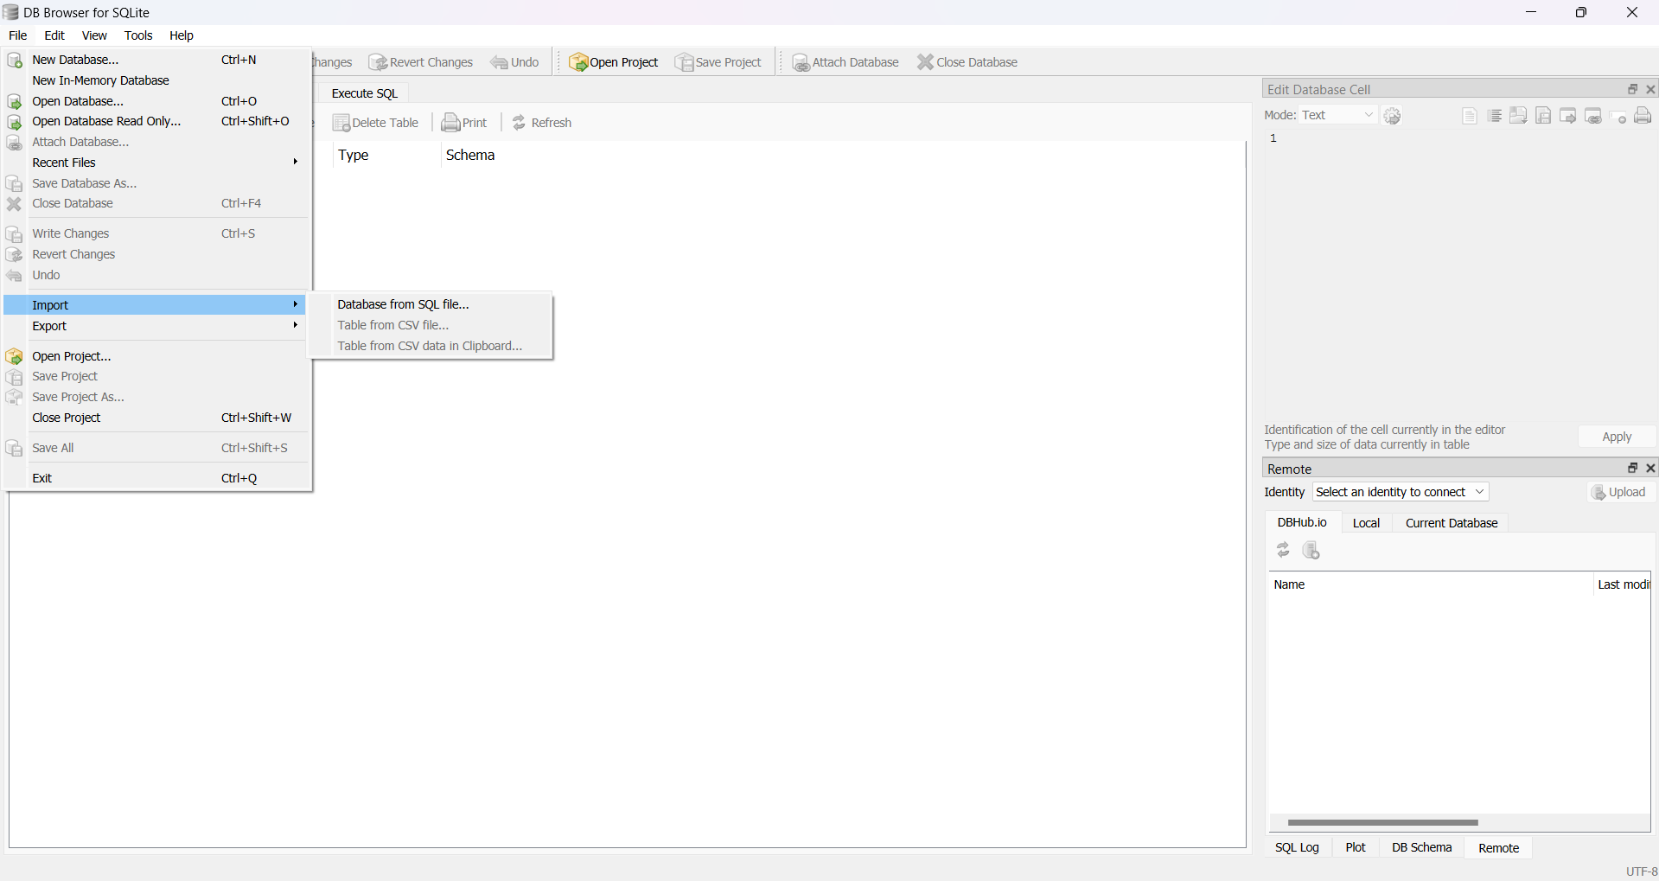

DB Browser for SQLite
IMPORT DATA

Slide 3
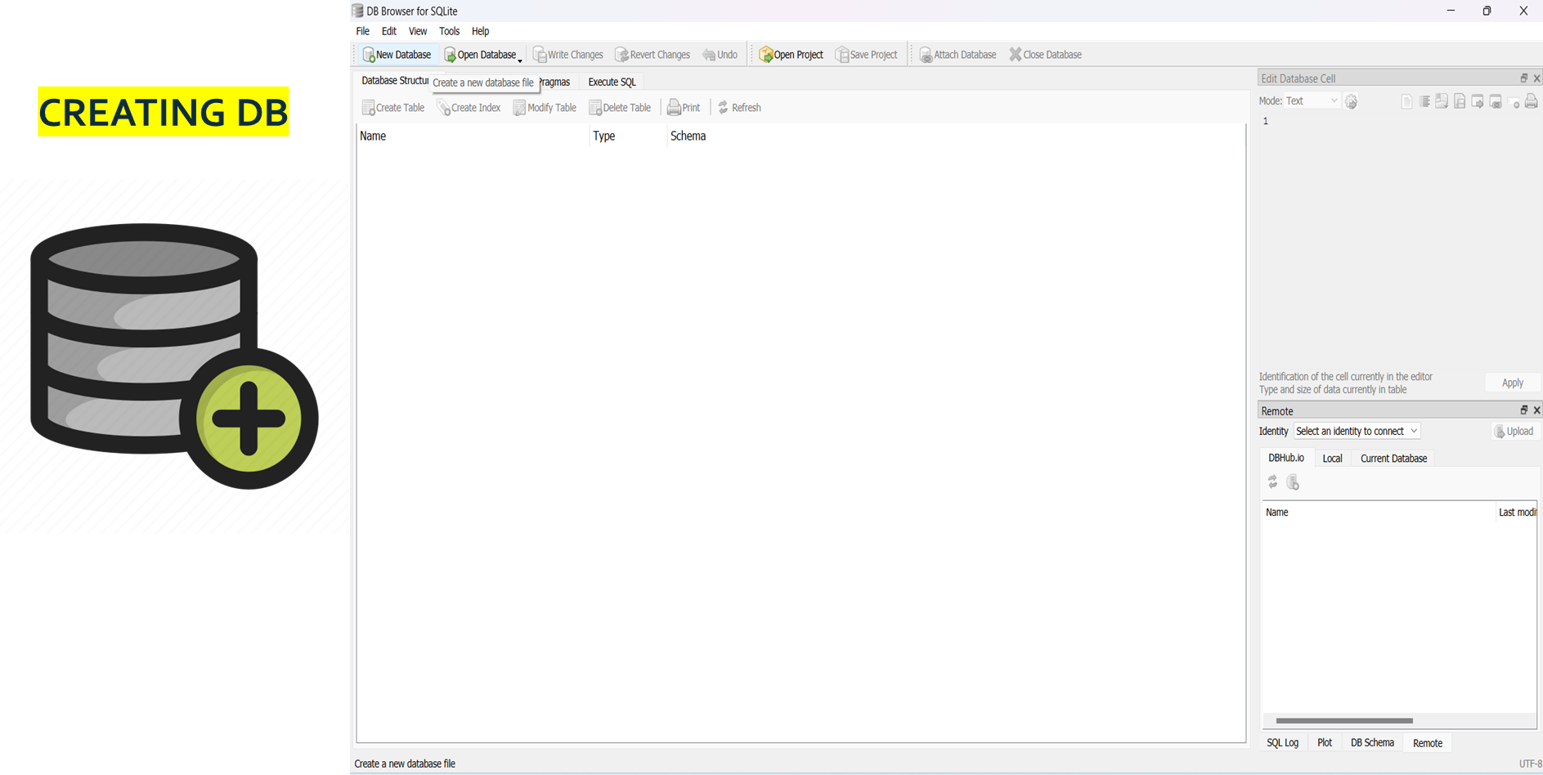
DB Browser for SQLite
DB Browser for SQLite

Slide 4
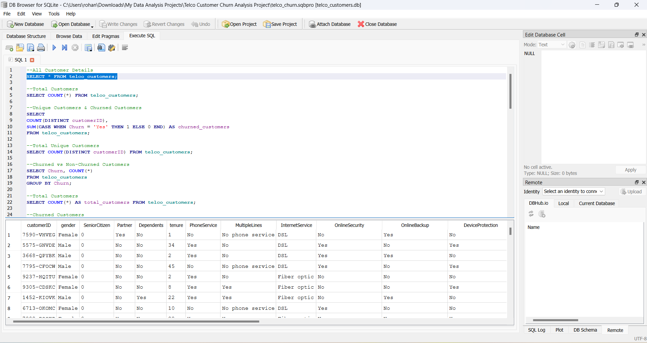
DB Browser for SQLite
DB Browser for SQLite
WRITING QUERIE

Slide 5



EXCEL
CONNECTING Excel To DB Browser for SQLite
DATA PROCESSING
DATA VISUALIZATION

Slide 6
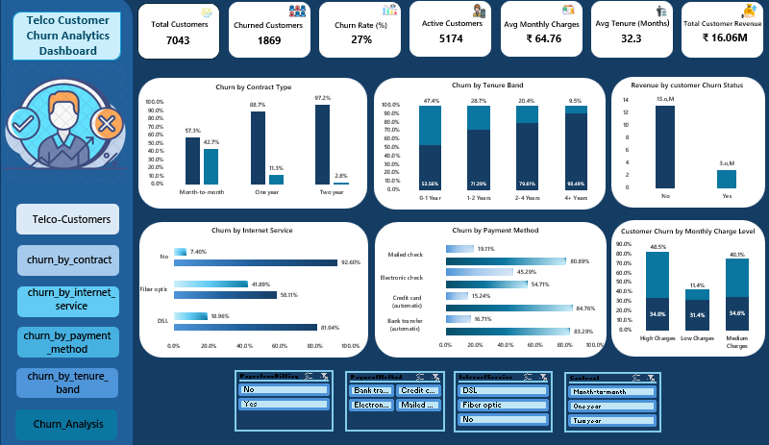
EXCEL

Slide 7
Executive Summary
Key Business Takeaways:
Overall churn rate stands at ~27%, indicating a significant retention challenge
Churn is not random — it is strongly influenced by pricing, contract type, and payment behavior
High-revenue customers are more likely to churn, increasing revenue risk
Several churn drivers are actionable, enabling targeted retention strategies

Slide 8
Pricing Impact on Churn
Insight: Avg Monthly Charges – Churned vs Active Customers
Churned customers have higher average monthly charges than active customers
Indicates price sensitivity, especially among premium users
High-paying customers may not perceive sufficient value
Business Implication:
Offer discounts for long-term contracts
Provide loyalty rewards for long-tenure customers
Promote auto-payment methods to reduce churn
Offer discounts for high monthly charge customers

Slide 9
Contract Type Drives Retention
Insight: Churn by Contract Type
Month-to-month contracts show the highest churn
Long-term contracts (1–2 years) show significantly lower churn
Commitment length directly improves retention
Business Implication:
Incentivize migration from month-to-month → long-term contracts
Offer discounts or bundles during renewal touchpoints

Slide 10
Tenure-Based Churn Behavior
Insight: Churn by Tenure Group
Churn is highest among early-tenure customers
Customers with longer tenure show higher loyalty and lower churn
Early experience is critical
Business Implication:
Strengthen onboarding & first 90-day experience
Trigger retention campaigns for customers in 0–12 month tenure

Slide 11
Payment Method Risk
Insight: Churn Distribution by Payment Method
Customers using Electronic Check exhibit the highest churn
Auto-payment methods (credit card, bank transfer) show lower churn
Business Implication:
Promote auto-pay adoption
Provide incentives for switching away from high-risk payment methods

Slide 12
Revenue Loss Concentration
Insight: Revenue Loss Due to Churn by Payment Method
A small number of payment methods account for disproportionately high revenue loss
Revenue churn is not evenly distributed
Business Implication:
Focus retention efforts where revenue impact is highest, not just churn count
Revenue-weighted churn tracking should guide decisions

Slide 13
Monthly Charge Band Risk
Insight: Churn Share by Monthly Charge Band
Customers in higher monthly charge bands contribute more to churn
Indicates dissatisfaction among premium segments
Business Implication:
Premium customers need priority support & personalized offers
Flat retention strategies may fail for high-value customers

Slide 14
Internet Service Type
Insight: Churn by Internet Service Type
Fiber optic customers show higher churn compared to DSL
Higher service cost may raise expectations
Business Implication:
Improve service reliability & support for fiber customers
Reassess fiber pricing vs perceived value

Slide 15
THANK YOU

