Slide 1
DATA-DRIVEN ANALYSIS OF
POLITICAL DISCLOSURE
DURING LOCAL ELECTIONS
A Case Study of the 2026 BMC Election — Borivali & Kandivali Wards
College Field Project — B.Sc. Data Science
Atharva University, Mumbai
Pratiksha Pawar – 70 . Srushti Patil – 69

Slide 2
Agenda
01
Introduction & Motivation
02
Objectives & Hypotheses
03
Methodology & Data Approach
04
Candidate Disclosure Analysis
05
Win-Prediction Model
06
Voter Perception Study
07
Discussion, Limitations & Conclusion
1

Slide 3
Introduction: The Problem
Indian election law requires every candidate to publicly disclose their criminal record, assets & liabilities, and education in a sworn affidavit.
This Project
2026 BMC Election
But two questions remain largely untested at the local body level:
Borivali + Kandivali
(Wards 8–28, 21 wards)
Does this disclosed information actually predict who wins?
Two linked studies:
Are voters even aware of it — and does awareness change their opinion?
Candidate disclosure → win prediction
Voter awareness → perception shift
2

Slide 4
Legal Background
Why candidates must disclose this information
2002
Since
Today
Supreme Court (Union of India v. ADR): voters' right to information includes candidate background
Election Commission & State Election Commissions mandate a standardized disclosure affidavit
Applies to local body elections too — including BMC 2026, verified directly from a real affidavit
3

Slide 5
Objectives
1
Build a structured candidate disclosure dataset for the ward cluster
2
Train & validate a model predicting electoral outcome from disclosure profile
3
Design a voter perception study measuring awareness and favorability shift
4
Test whether prior awareness moderates the impact of disclosure
5
Synthesize both studies into one coherent account
4

Slide 6
Hypotheses
H1
Disclosure profile (party, assets, education, criminal record) significantly predicts electoral outcome
H2
Criminal record disclosure has a negative association with winning, independent of party and wealth
H3
Exposure to disclosure information produces a significant shift in voter favorability
H4
Prior awareness moderates this shift — new information moves opinion more than confirming known facts
5

Slide 7
Research Design Overview
Component 1
Component 2
Candidate Disclosure Analysis
Voter Perception Study
Unit: 145 candidates, 21 wards
Method: Descriptive stats + logistic regression (cross-validated)
Output: Win-prediction model
Unit: 210 survey respondents
Method: Before/after design, t-test + OLS regression
Output: Favorability shift, awareness effect
Linked via: each respondent is matched to a real (simulated) candidate from their own ward
6

Slide 8
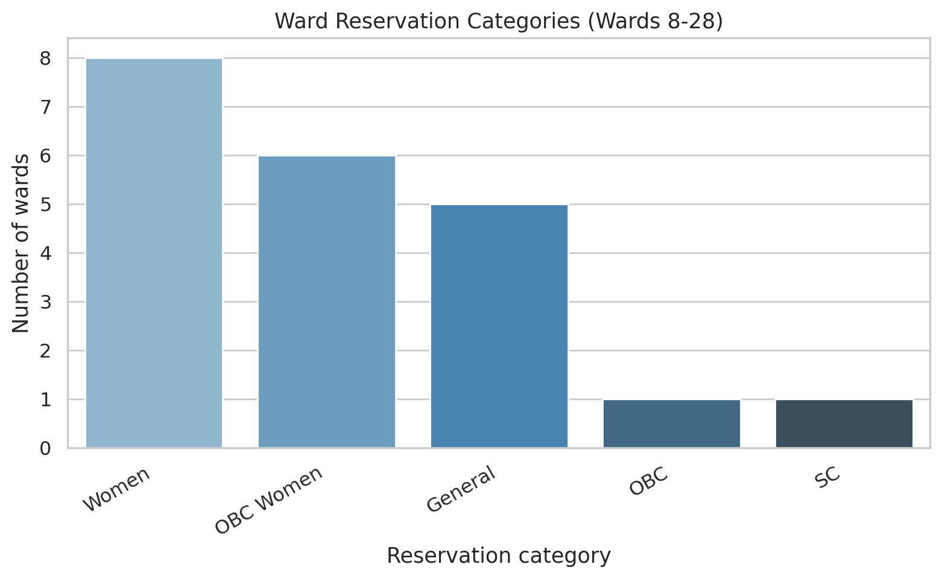
Methodology: Scope
21 Municipal Wards
R/Central (Borivali)
Wards 8–17
10 wards
R/South (Kandivali)
Wards 18–28
11 wards
Why this scope?
Feasible for a solo researcher, one semester
Direct local familiarity aids data verification
Real mix of gender/caste ward reservation categories
7

Slide 9
Methodology: Data Approach
Important: All candidate and respondent data in this project is SIMULATED — calibrated against real published statistics, and explicitly approved by the project guide.
1
2
3
Attempted
Constraint
Approved pivot
Real affidavit collection from Maharashtra SEC portal — confirmed genuine, machine-readable documents exist
Multi-step AJAX portal, partial affidavit availability (~50% in sampled ward) — not feasible at full scale in one semester
Simulated dataset, rigorously calibrated against real ADR statistics & real 2026 BMC seat shares
8

Slide 10
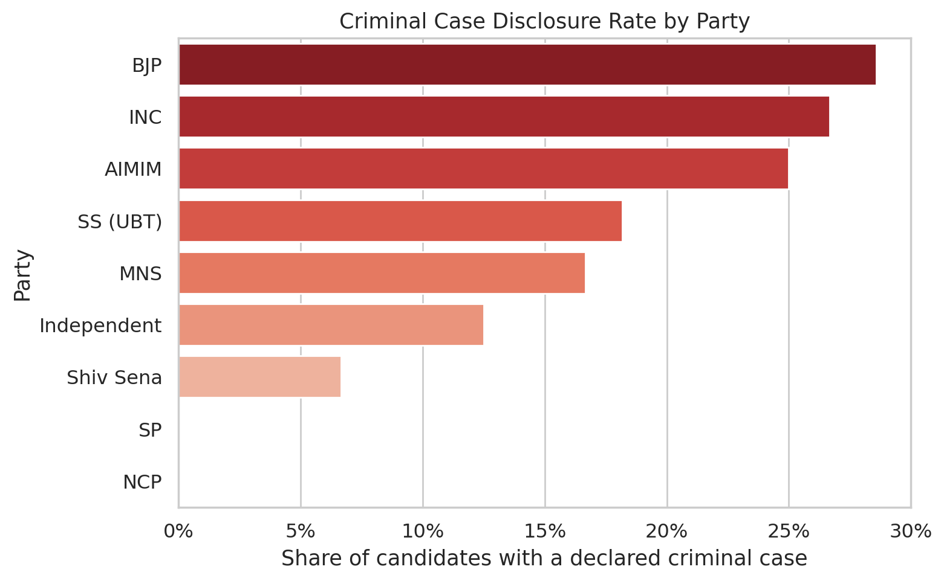
Candidate Disclosures: Overview
145 candidates across 21 wards
21.4%
have a declared
criminal case
79.3%
are crorepatis
(≥ ₹1 Cr assets)
Calibrated against ADR's real published BMC 2026 statistics (24% / 79%)
9

Slide 11
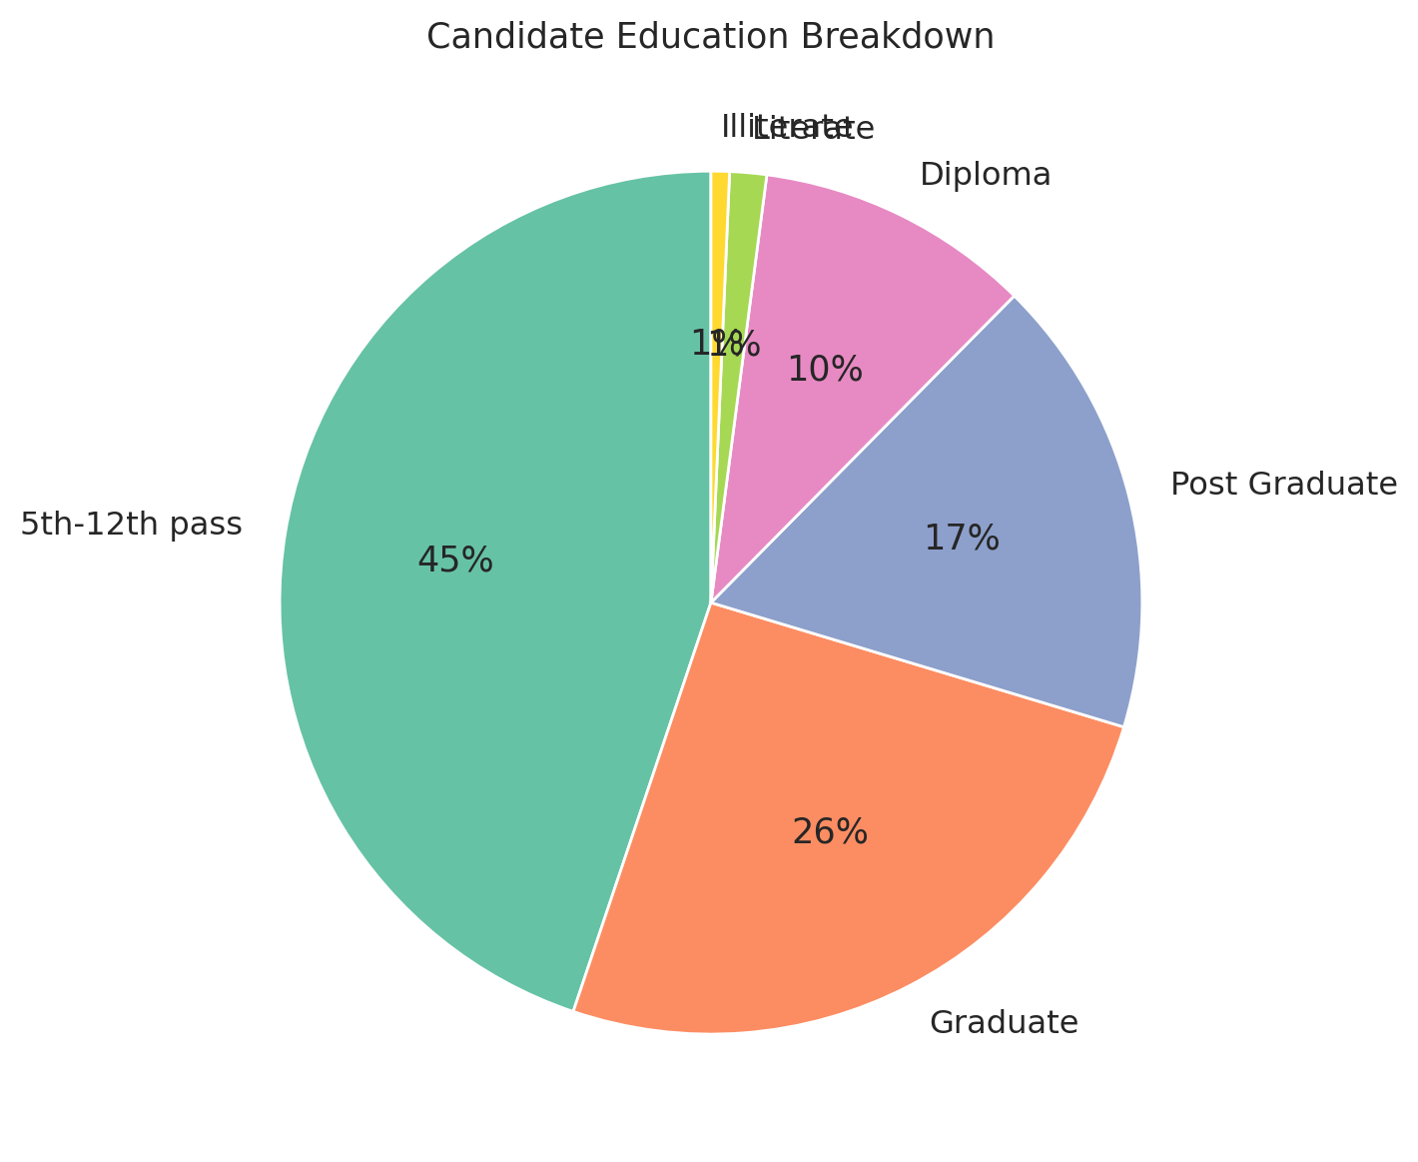
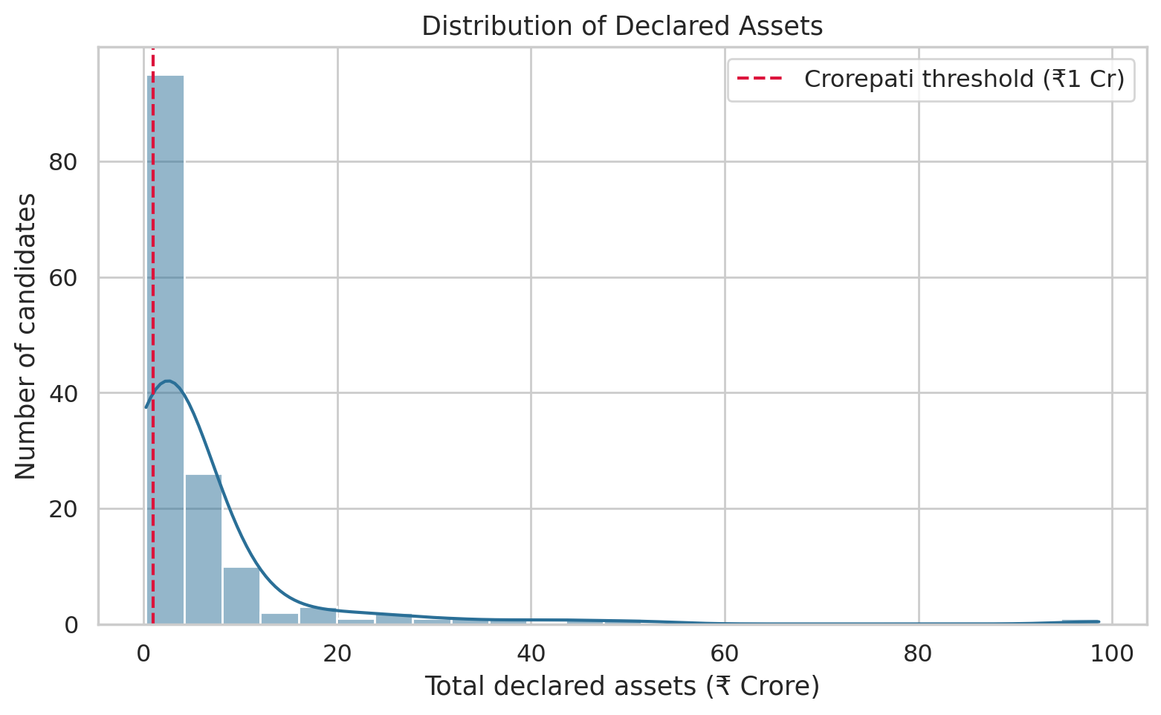
Candidate Disclosures: Education & Reservation
80% of candidates in this cluster are women — a genuine structural effect of ward reservation policy, not a data artifact.
10

Slide 12
Win-Prediction Model: Approach
Can disclosure alone predict who wins?
MODEL
FEATURES
VALIDATION
Logistic Regression
Party, assets, income,
education, criminal severity, age
Stratified 5-Fold
Cross-Validation
Chosen for interpretability — coefficients show direction & magnitude of each feature's effect
All derived from the affidavit's standardized "Summary" section
Small, imbalanced sample (~14.5% winners) needs robust, not single-split, evaluation
11

Slide 13
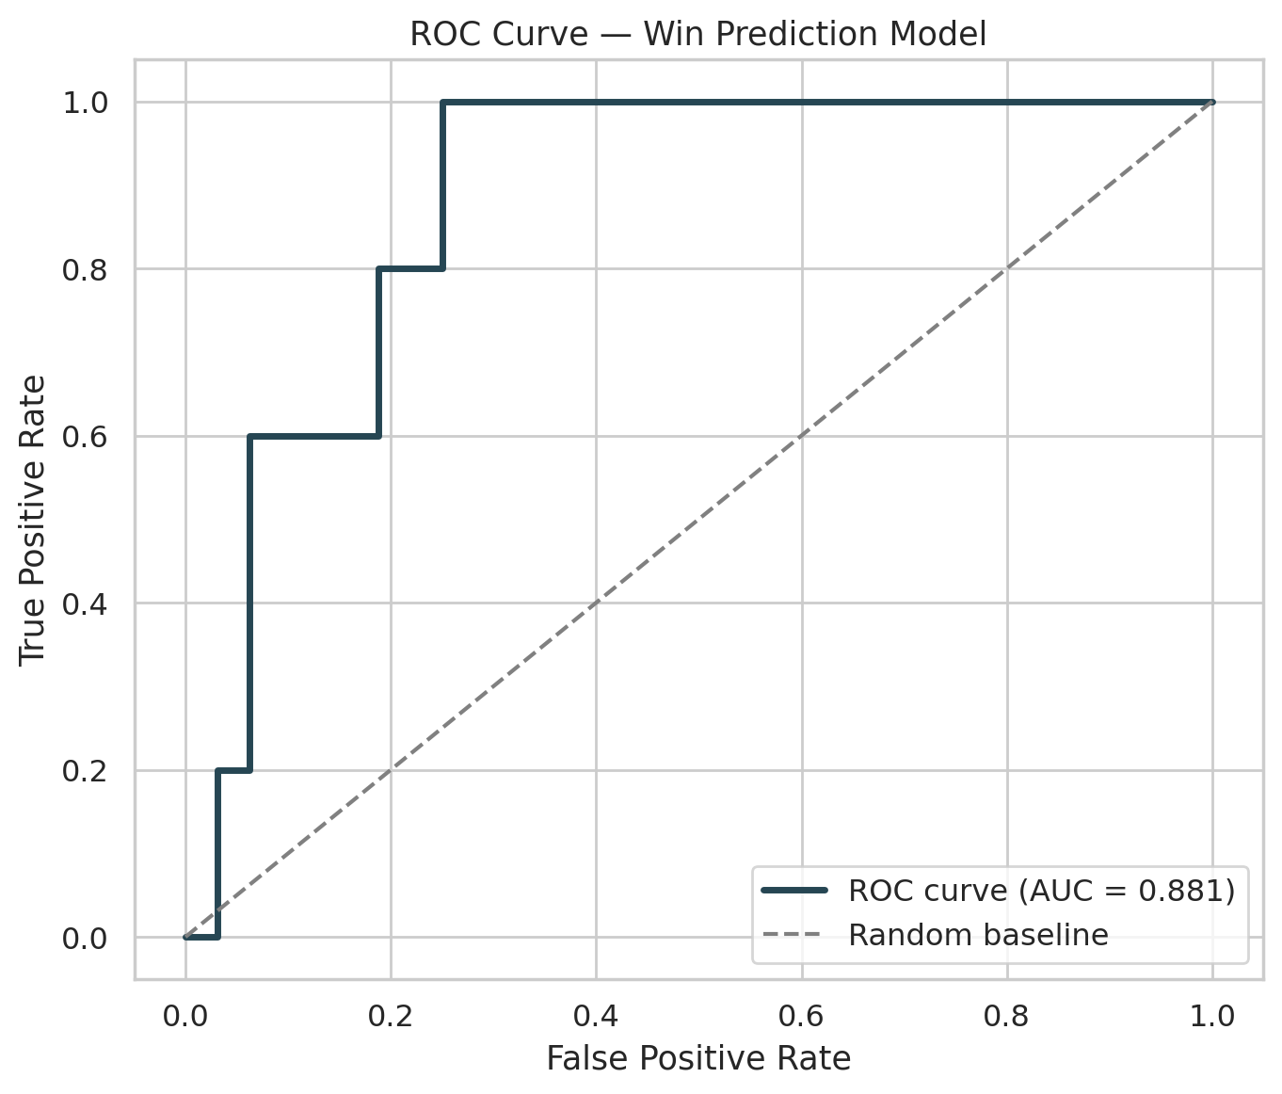
Win-Prediction Model: Results
0.81
Cross-Validated
ROC-AUC
Accuracy
0.738
Precision
0.341
Recall
0.810
F1-score
0.475
Recall prioritized over precision (class_weight='balanced') given only ~14.5% of candidates win.
12

Slide 14
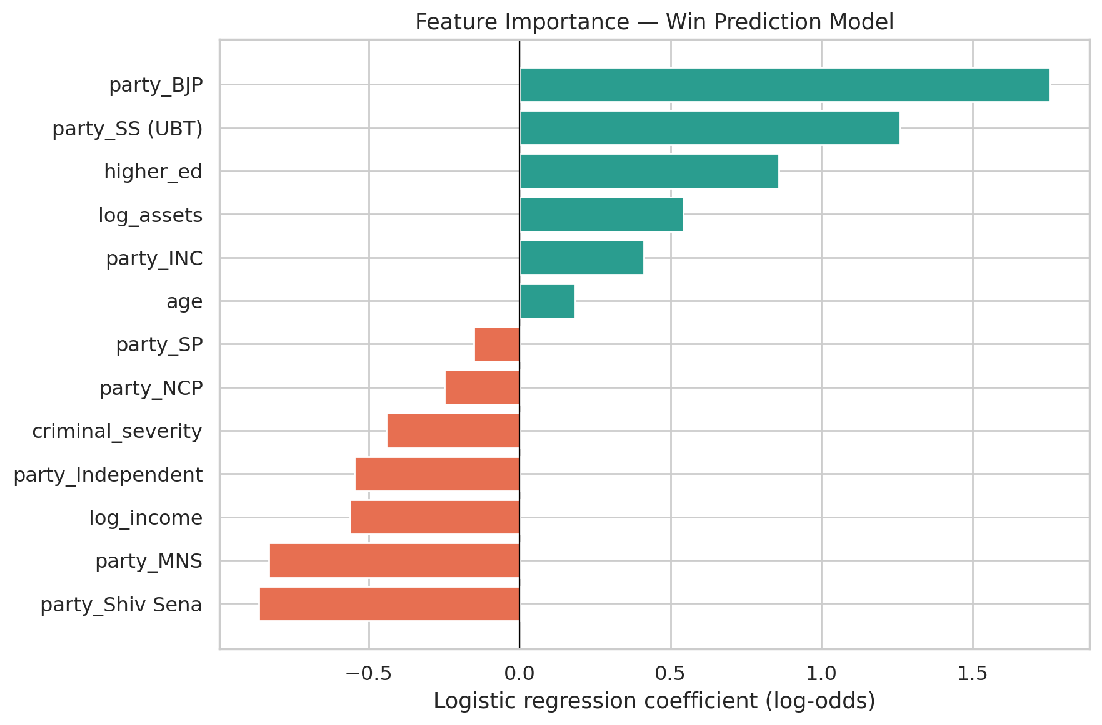
Win-Prediction Model: What Matters Most
Party affiliation dominates
Higher education & assets → higher win probability
Criminal severity → lower win probability
Supports H1 & H2
13

Slide 15
Voter Perception Study: Design
A before/after paired design, 210 respondents matched to real (simulated) candidates
Baseline
favorability
(1–10)
→
Awareness
check
(Yes/No)
→
Exposure to
disclosure
details
→
Post-exposure
favorability
(1–10)
Designed (not random) effects built into the simulation:
Serious criminal cases reduce favorability more than minor ones
The drop is larger when the respondent was NOT already aware (tests H4)
Wealth has a small, deliberately ambiguous effect
14

Slide 16
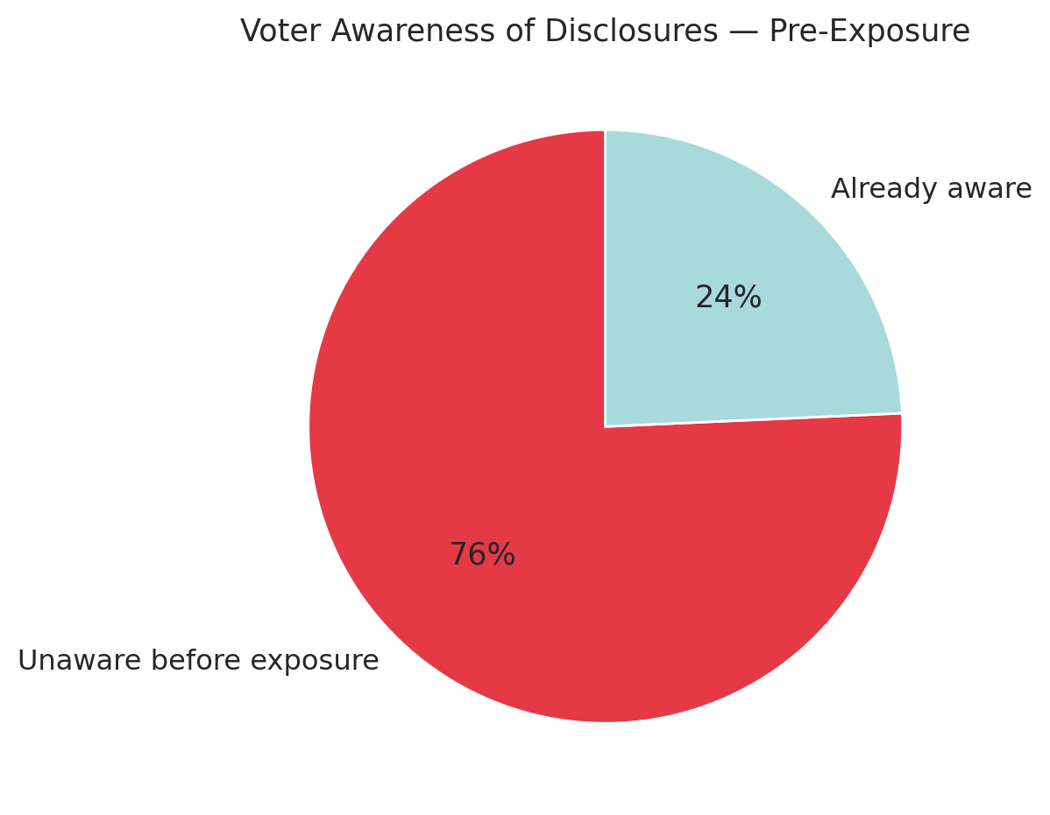
Voter Awareness: The Baseline Problem
75.7%
of voters were unaware of a candidate's disclosures before exposure
This gap is the core motivation for testing whether awareness itself changes disclosure's impact.
15

Slide 17
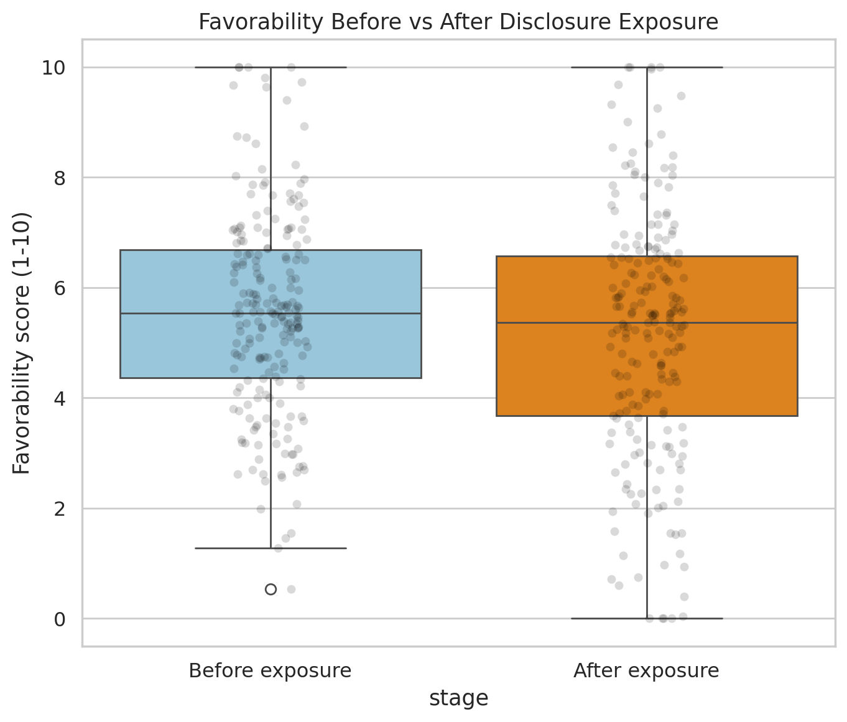
Does Exposure Change Favorability?
−0.39
mean favorability change (points)
Paired t-test:
t = −4.69, p < 0.0001
Statistically significant shift — supports H3
16

Slide 18
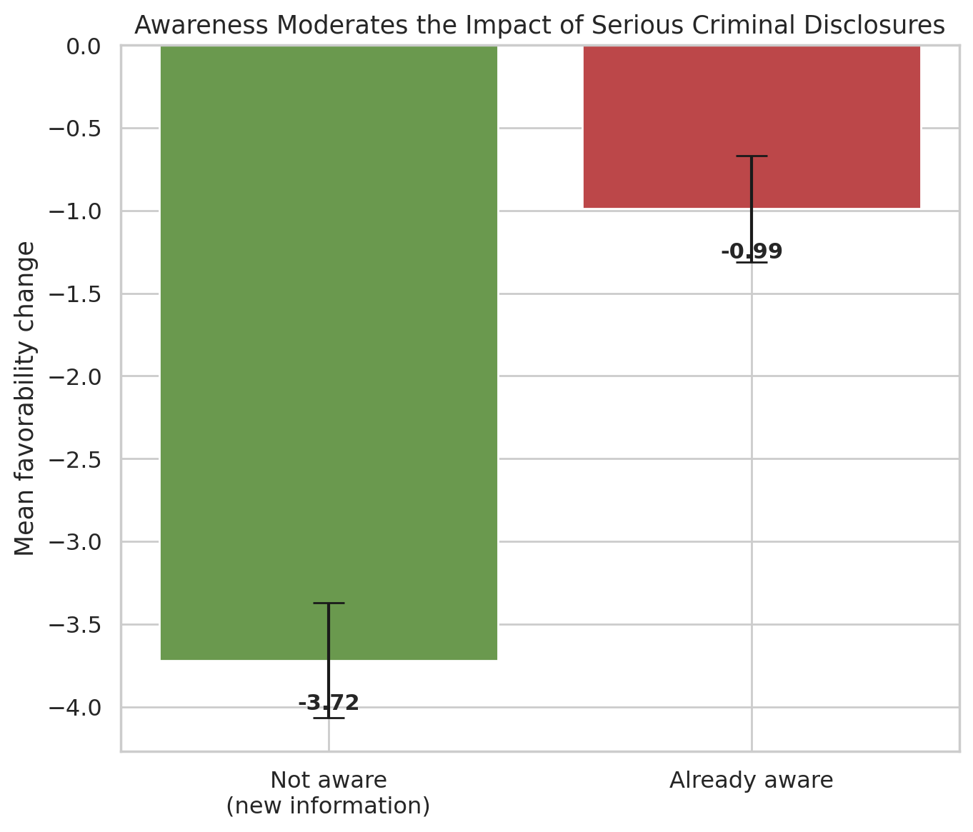
Key Finding: Awareness Moderates Impact
−3.72
favorability change — NOT already aware (new information)
−0.99
favorability change — already aware beforehand
Confirmed by regression (controlling for other factors): β = +0.494, p = 0.0015 — supports H4
17

Slide 19
Discussion: Putting It Together
Criminal record hurts win probability (Model) — but low awareness may explain why the penalty isn't larger in practice (Perception Study).
Legal transparency ≠ functional transparency — the disclosure requirement exists, but only works if voters actually see it
Disclosure regimes may need active voter-education, not just legal filing requirements, especially at the local body level
This is a hypothesis generated by this study's design — worth testing against real data, not an established fact
18

Slide 20
Limitations & Future Scope
Limitations
Future Scope
Simulated, not field-collected data
Modest sample sizes (145 / 210)
Expenditure data not incorporated
Awareness effect built into simulation design
Complete real-data collection via the SEC portal scraper
Run the actual Google Form survey with real residents
Extend model to all 227 BMC wards
Incorporate expenditure disclosure data
19

Slide 21
Conclusion
0.81
75.7%
3.7×
Win-prediction
ROC-AUC
Voters unaware
of disclosures
Larger favorability drop
when newly informed
A complete, extensible pipeline — calibrated simulation, cross-validated ML, and statistical perception analysis — ready to run on real affidavit and survey data once full-scale collection is feasible.
20

Slide 22
Thank You
Presented By:
Pratiksha Pawar – 70
Srushti Patil – 69

