Slide 1
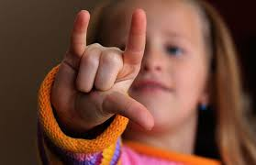
SIGN LANGUAGE CHARACTER RECOGNITION
ANKIT PRAJAPATI (1607713002)
PRATIKSHA YADAV(1607713005)
SHADMAN KHAN (1607713008)
SHAKTI ANAND SINGH (1607710073)

Slide 2
Introduction
A sign language is a language which uses gestures instead of sound to convey meaning combining hand-shapes, orientation and movement of the hands, arms or body, facial expressions and lip-patterns. Sign language is a complex visual-spatial language that is used by the deaf community in the various parts of the world and. It is linguistically complete, natural language. It is native language of many deaf men and women, as well as some hearing children born into deaf families. Some of the major problems faced by a person who are unable to speak is they cannot express their emotion as freely in this world so there is a need for such platforms for such kind of people.

Slide 3
Interaction point
The Problem
Project Requirements
Design Strategy
Working Modules
Result and Analysis
Advantages and disadvantages
Conclusion
Scope

Slide 4
The Problem
Communication Problem
Regional Sign Language
Sign Translation

Slide 5
Our aim………
our strategy involves implementing such an application which detects pre-defined Sign Language Character Recognition (SNCHAR) through hand gestures…

Slide 6
Project Requirements
Hardware Requirements Software Requirements
Intel Core i3-2100 2nd generation or later.
512 MB disk space.
512 MB RAM.
Any external or in-built camera with minimum pixel resolution 200 x 200 (300ppi or 150lpi) 4-megapixel cameras and up.
Microsoft Windows XP or later / Ubuntu 12.0 LTS or later /MAC OS 10.1 or later.
Python Interpreter (3.6).
TensorFlow framework, Keras API.
PyQT5, Tkinter module.
Python OpenCV2, Scipy, qimage2ndarray, winGuiAuto, pypiwin32, sys, keyboard, pyttsx3, pillow libraries.

Slide 7
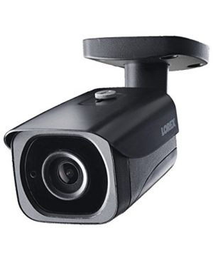
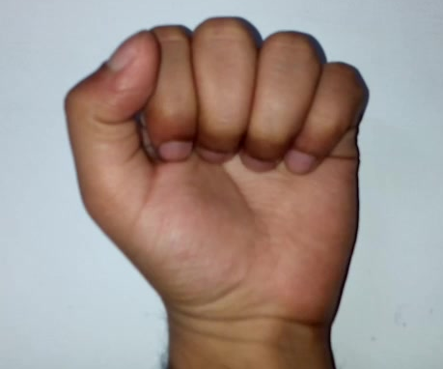
Design Strategy
Feature Extraction
Scanner Input Data Preprocessing Extraction
Output Classification
Pre-Processing
Pattern Recognition
Database

Slide 8

Working
Module

Slide 9
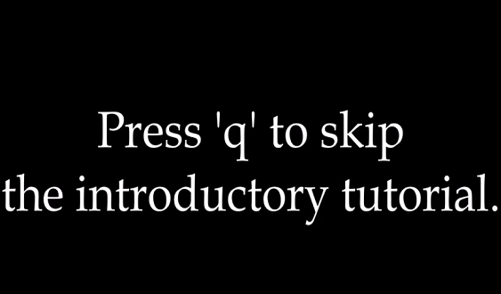
Skip video

Slide 10
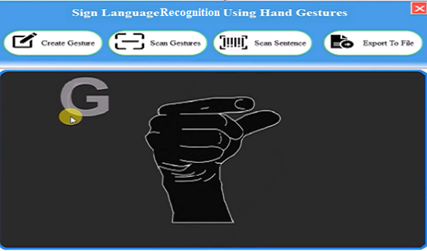
Dashboard with sample gesture animation

Slide 11
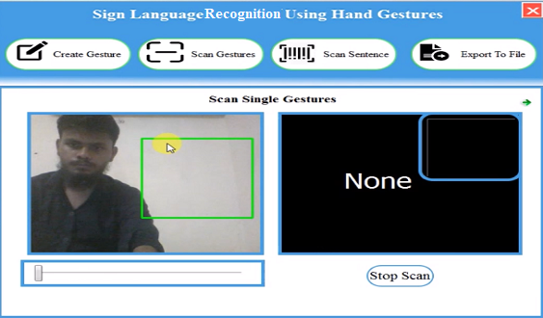
Single gesture

Slide 12
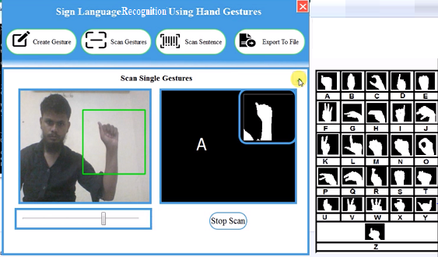
Placing hand inside rectangle box

Slide 13
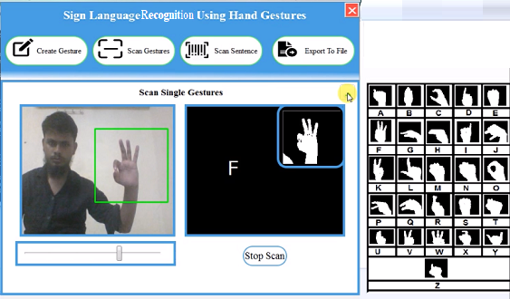
Single gesture output

Slide 14
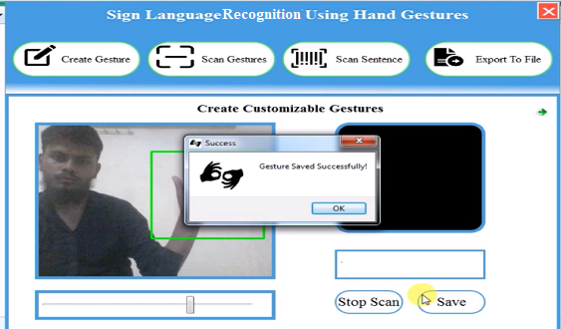
Gesture saved successfully

Slide 15
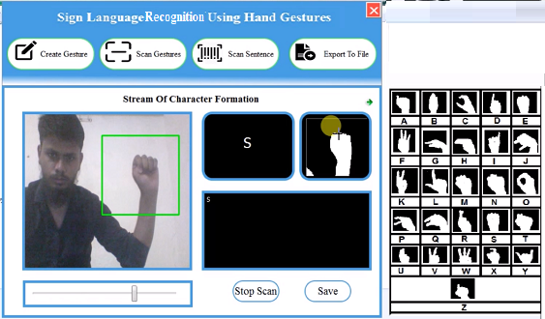
Sentence formation, focusing on the top right window pressing C to form sentence

Slide 16
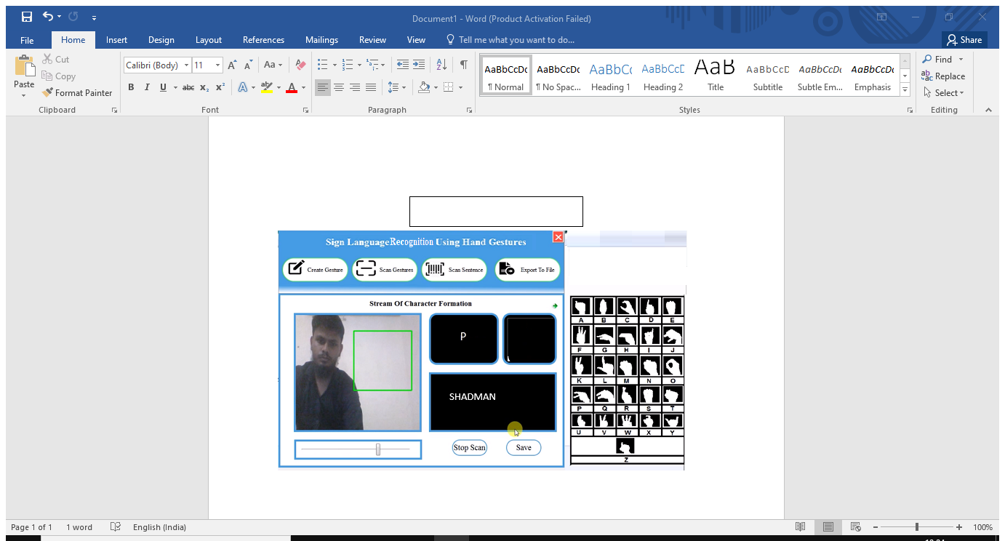
Sentence formed

Slide 17
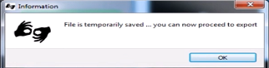
Sentence saved temporarily

Slide 18
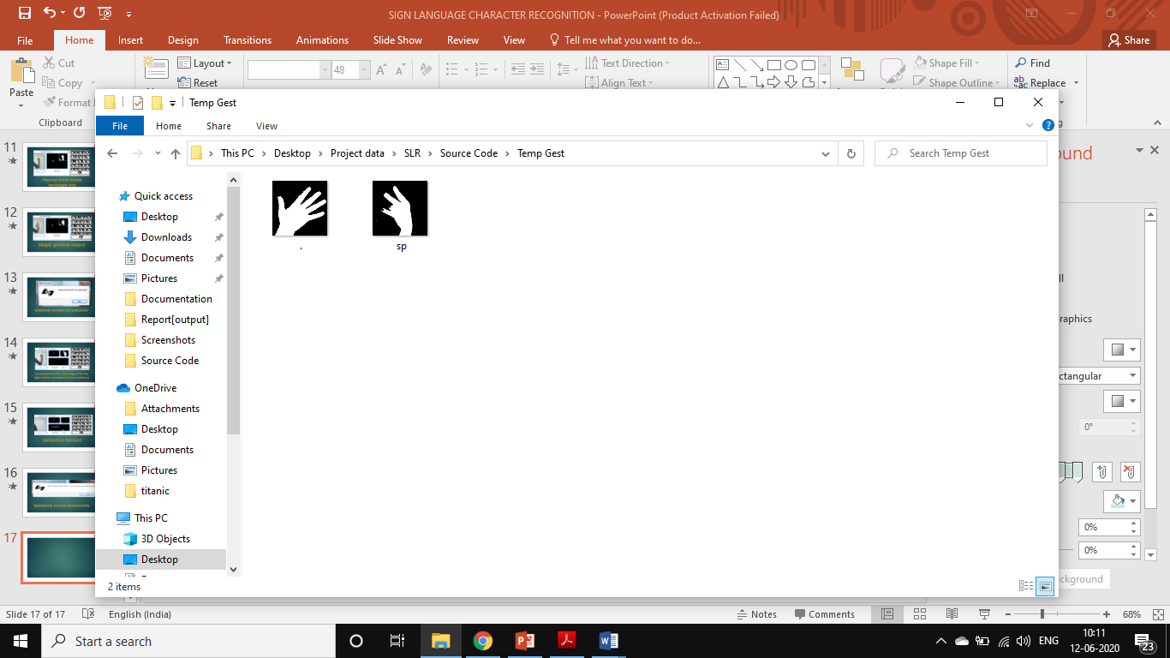
Content of Newly Generated Temp Gest Directory

Slide 19
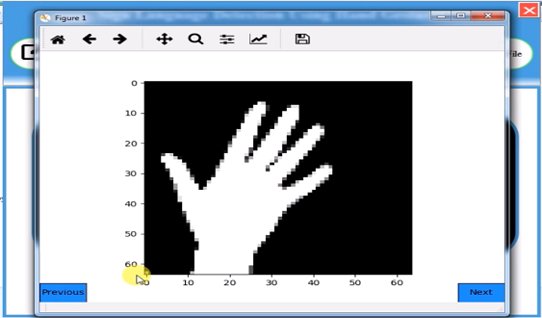
Gesture viewer sample

Slide 20
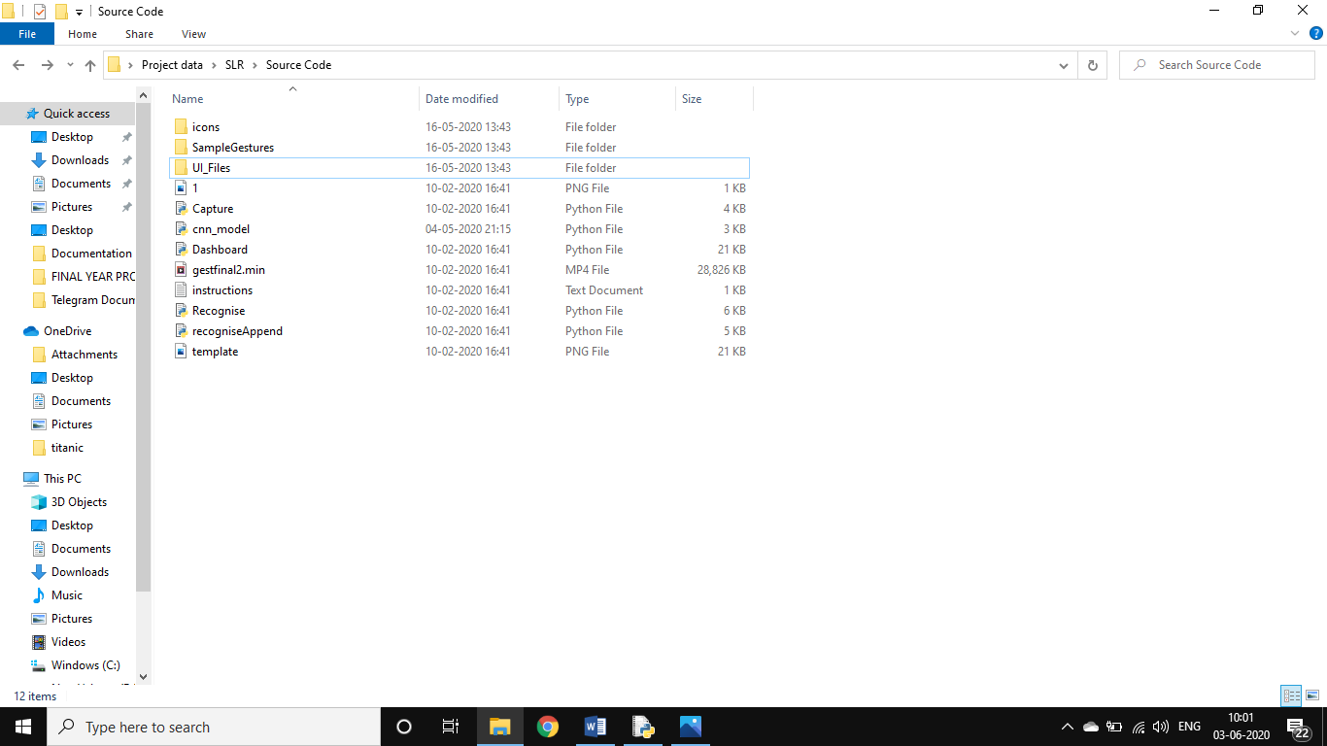
Exporting the file at desired location.

Slide 21
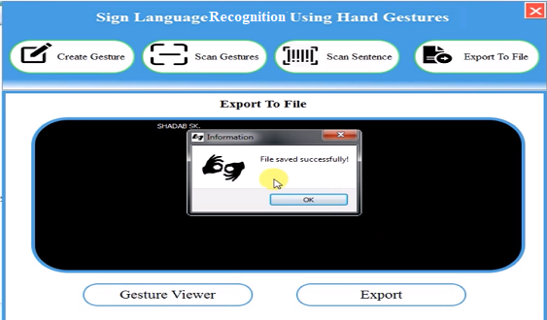
File saved successfully

Slide 22
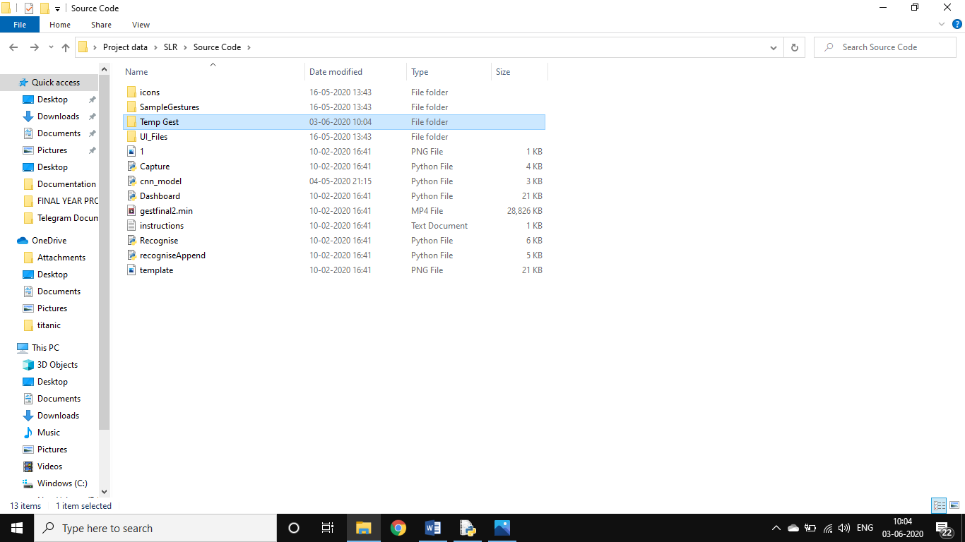
Temporary files deleted

Slide 23
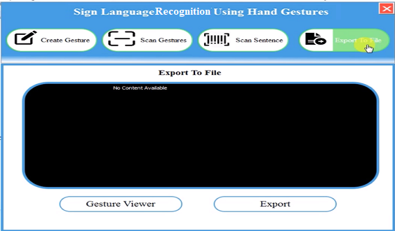
No content available

Slide 24
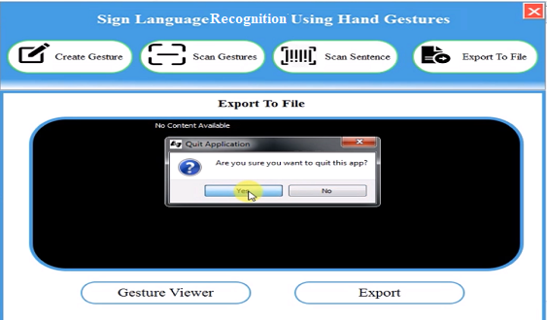
Quitting the application

Slide 25
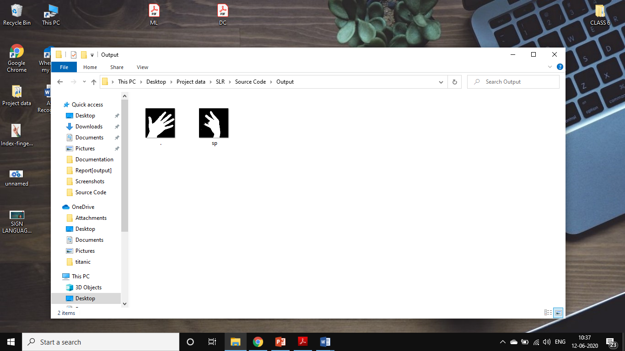
Result & Analysis
RECOGNITION RATE
Train Images-3700/3700 100%
Test Images-2503/2579 97.05%
TOTAL IMAGES-6203/6279 98.70%

Slide 26
ADVANTAGES
Not much of training is required.
it enables us to communicate easily with the persons who cannot hear or speak.
Simple, fast and easy to apply and can be applied on real system and play games.
It can be used in intelligence in future and hence can be kept under the category of man made potential resources .

Slide 27
DISADVANTAGES
It will not work until it gets all the required resources like camera to scan etc.
The inputs which are not stored in the database can not be recognised .
Performance decreases when the difference is more than 1.5m.
System limitation restricts the application
Only recognises Dynamic gestures .

Slide 28

conclusion………
We have used tensorflow framework, with keras API. And for the user feasibility complete front-end is designed using pyqt5. We developed a system for the purpose of recognition of a subset of the sign language with a recognition rate of 97.77%.

Slide 29

Future Scope….
Dynamic Gesture Recognition
Gesture with non uniform background
Multiple Sign Language Support
Virtual 3d simulation of gestures on screen

Slide 30
Thank You

