Slide 1

AstroSage Analysis
- Pratiksha Saraf

Slide 2
Problem Statement
AstroSage has received a 1 crore investment and aims to optimize its call center operations. The goal is to determine how to allocate this investment to maximize operational efficiency, customer satisfaction, and profitability. The analysis will consider historical call data, performance metrics, and market trends to make informed decisions.

Slide 3
Introduction
AstroSage operates a high-volume call and chat-based astrology service.
The company has received a ₹1 crore investment to improve its call center operations.
The project analyzes historical call center data to identify performance trends and improvement opportunities.
The analysis covers 8,513 calls across 34 days

Slide 4
Objectives
Analyze call volume and operational trends.
Evaluate guru performance and productivity.
Measure customer satisfaction and caller behavior.
Identify revenue-generating consultation categories.
Analyze operational costs and sales performance.
Identify areas where the ₹1 crore investment can create the highest business impact.
Recommend strategies to improve efficiency, customer satisfaction, and profitability

Slide 5
Data Overview
  I began with a single AstroSage dataset containing 35 attributes, covering 34 days from 01 Dec 2023 to 03 Jan 2024 of call and chat consultation data.
  The dataset contains key information on users, gurus, consultation types, call and chat status, call duration, ratings, sales, and earnings.
  Data cleaning was performed to handle missing values, inconsistent entries, extra spaces, unnecessary values, and incorrect data formats.
  Additional helper columns were created to support analysis, including Date, Day, Month, Year, Hour, and Time-related fields.
  After cleaning and preparation, the dataset contained 44 attributes and was analyzed using PivotTables and Pivot Charts.
  The final analysis was presented through an interactive dashboard with KPIs, charts, and slicers to evaluate call volume, agent performance, customer satisfaction, sales, and operational costs.

Slide 6
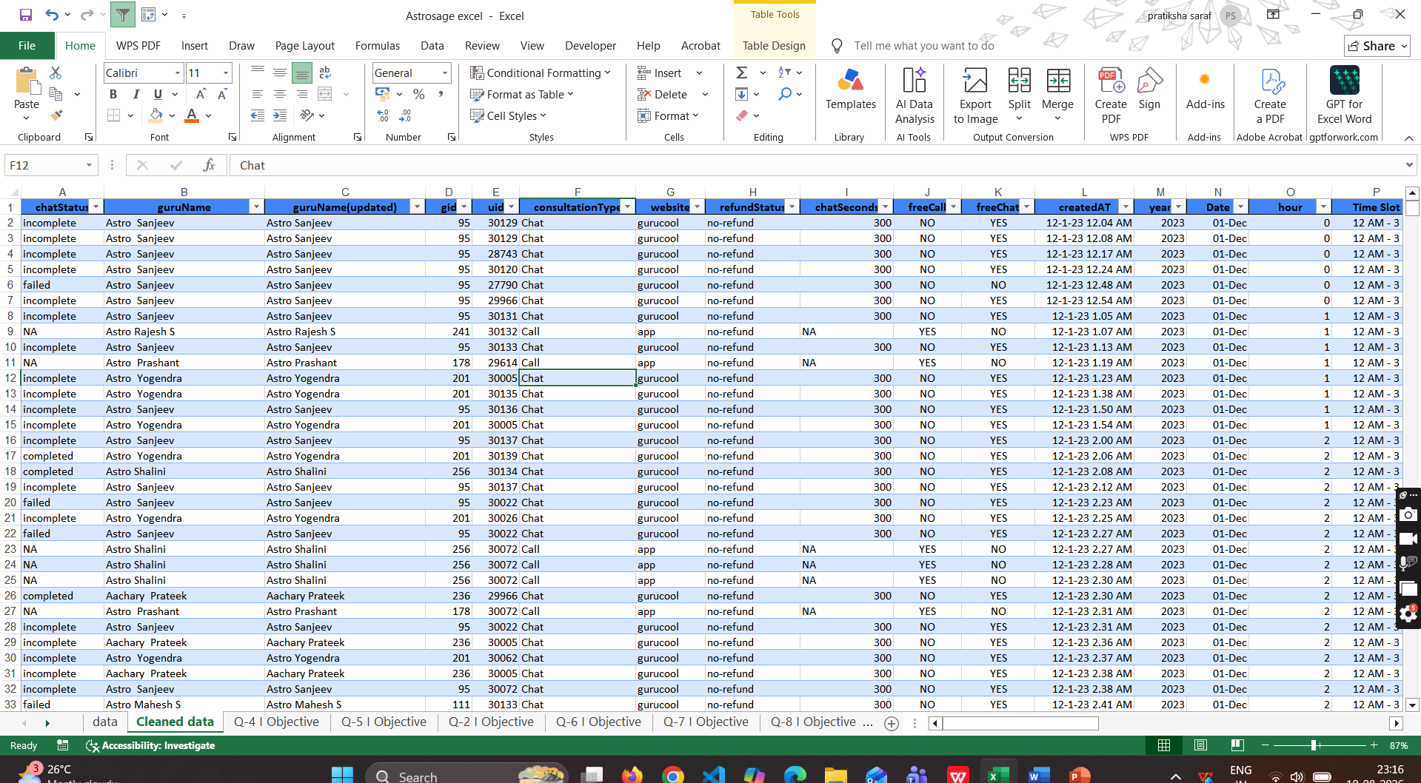
▪ Removed duplicate records no duplicates were found in the dataset.
▪ Applied filters to identify and handle missing and inconsistent values.
▪ Used TRIM to remove extra spaces from guru names.
▪ Replaced blank values in chat seconds and chat status with N/A where applicable.
▪ Removed unnecessary entries such as _v.
▪ boolean values by replacing TRUE as yes and FALSE as no.
▪ Converted rating, GID, UID, chat seconds, and astrologer call duration into the appropriate number format.
▪ Created additional helper columns such as date, day, month, year, hour, and time for further analysis.
DATA CLEANING

Slide 7
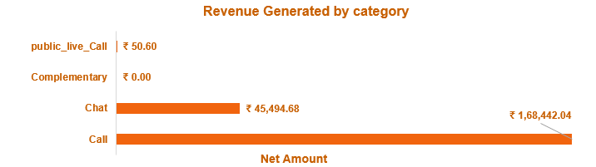
REVENUE GENERATED BY CATEGORY
Call is the primary revenue-generating category, contributing ₹1,68442.04
Chat generates ₹45,494.68 , making it the second-largest revenue source.
Public Live Call contributes only ₹50.60, showing minimal revenue impact
Complementary services generate no revenue, indicating an opportunity for improvement.
Overall Revenue is highly concentrated in Call and Chat services

Slide 8
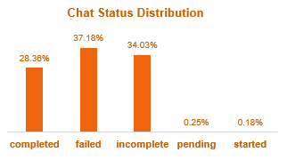
CHAT STATUS DISTRIBUTION
Failed chats are the highest at 37.18%.
Incomplete chats are also high at 34.03%, showing many chats are not finished.
Only 28.36% of chats are completed, which is lower than failed and incomplete chats.
Pending and started chats are very low, at less than 1% combined.
Overall the chart shows that chat completion needs improvement, as failed and incomplete chats make up most of the chats.

Slide 9
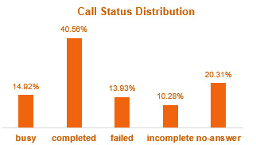
CALL STATUS DISTRIBUTION
Completed calls are the highest at 40.56%.
No-answer calls are 20.31%, showing that many calls are not being answered.
Busy calls account for 14.92%, which may indicate agents or users were unavailable.
Failed calls are 13.93%, while incomplete calls are 10.28%.
Overall 40.56% completion is positive, but there is still a large share of unsuccessful or unanswered calls.

Slide 10
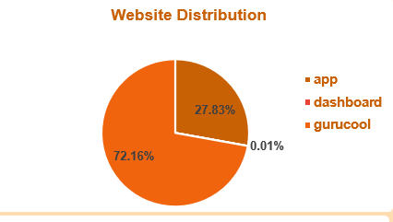
WEBSITE DISTRIBUTION
Gurucool has the highest share with 72.16% of total usage.
App accounts for 27.83%, making it the second most-used website.
Dashboard usage is almost zero, at only 0.01%.
Overall, Gurucool is the main platform used by customers, followed by the app.

Slide 11
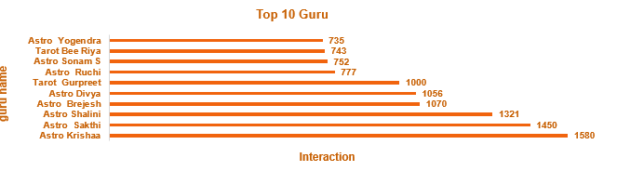
TOP 10 GURU
Astro Krishaa has the highest interactions with 1,580 calls.
Astro Sakthi is second with 1,450 interactions.
Astro Shalini has 1,321 interactions, also showing strong performance.
The lowest among the top 10 is Tarot Bee Riya with 735 interactions.
The top 3 gurus Astro Krishaa, Astro Sakthi, and Astro Shalini have the highest customer interactions.
.

Slide 12
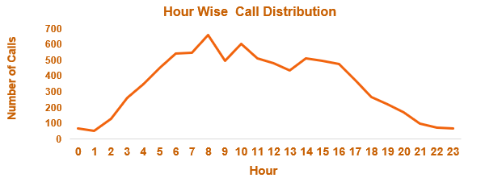
HOUR WISE CALL DISTRIBUTION
The highest workload occurs around 8 AM, with nearly 650 calls.
Call volume is high between 6 AM and 10 AM, showing a busy morning period.
Workload remains fairly high during the afternoon, around 13–16 hours.
After 17:00, the number of calls drops steadily.
The lowest workload is during the late night and early morning hours, around 0–2 AM and 21–23 PM.
.

Slide 13
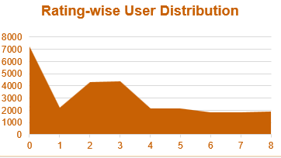
RATING-WISE USER DISTRIBUTION
Rating 0 has the highest number of users.
Ratings 2 and 3 also have a high number of users.
Rating 1 shows a significant drop compared with the other ratings.
Higher ratings have a relatively lower and stable user distribution.
.

Slide 14
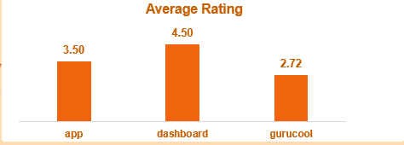
AVERAGE RATING
Dashboard has the highest average rating at 4.50.
App has an average rating of 3.50, showing moderate user satisfaction.
Gurucool has the lowest average rating at 2.72.
Overall Dashboard performs best in user ratings, while Gurucool needs improvement.
.

Slide 15
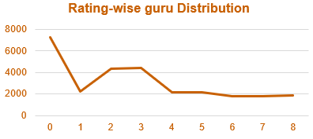
RATING-WISE GURU DISTRIBUTION
Rating 0 has the highest guru interactions, making it the largest category.
Ratings 2 and 3 also show a high distribution compared with most other ratings.
There is a sharp drop from rating 0 to rating 1.
From rating 4 onward, the distribution remains relatively low and stable.
.

Slide 16
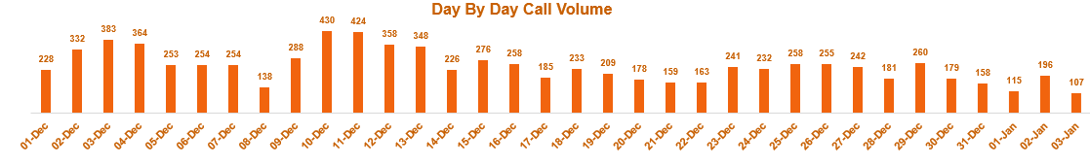
DAY BY DAY CALL VOLUME
Call volume increased from 228 on 01-Dec to 430 on 10-Dec, showing strong growth.
The highest call volume was 430 on 10-Dec.
Call volume dropped to 138 on 08-Dec, the lowest point in December.
After mid-December, call volume generally remained between 150–260 calls per day.
By early January, call volume fell further to 107 calls on 03-Jan.
.

Slide 17
AstroSage Performance Overview
Total Calls: AstroSage handled 8,513 calls, showing a strong overall customer interaction volume.
Total Agents: 149 agents were available to handle customer interactions.
Total Revenue: The platform generated ₹2,14,065.90 in total revenue.
Total Operational Cost: The total operational cost was ₹99,146.57, indicating significant spending on operations and service delivery.
Average Rating: The overall average rating was 2.93/5, suggesting that customer satisfaction has room for improvement.
Average Daily Call Volume: AstroSage received around 246 calls per day on average.
Average Calls per Agent/Day: Each agent handled approximately 5.53 calls per day on average.
Repeat Calls: 56.63% of calls were repeat calls, indicating that a large share of customers returned for additional interactions.

Slide 18
Strategic Recommendations
Agent Training – ₹40 Lakh ,Invest in communication, customer handling, and problem solving training, with additional focus on low-rated agents to improve customer satisfaction and reduce failed calls.
Technology Upgrade – ₹30 Lakh ,Implement Automatic Call Distribution, AI chatbot, and AI call analytics to distribute calls efficiently, handle routine queries, and identify service or agent-performance issues.
Peak-Hour Staffing – ₹20 Lakh , Use workforce management to increase agent availability during 6–9 AM and 3–6 PM, while offering callback options during busy periods to reduce customer waiting time.
Customer Experience – ₹10 Lakh ,Monitor ratings, customer feedback, complaints, and call quality across platforms and consultation types to identify areas requiring improvement.

Slide 19
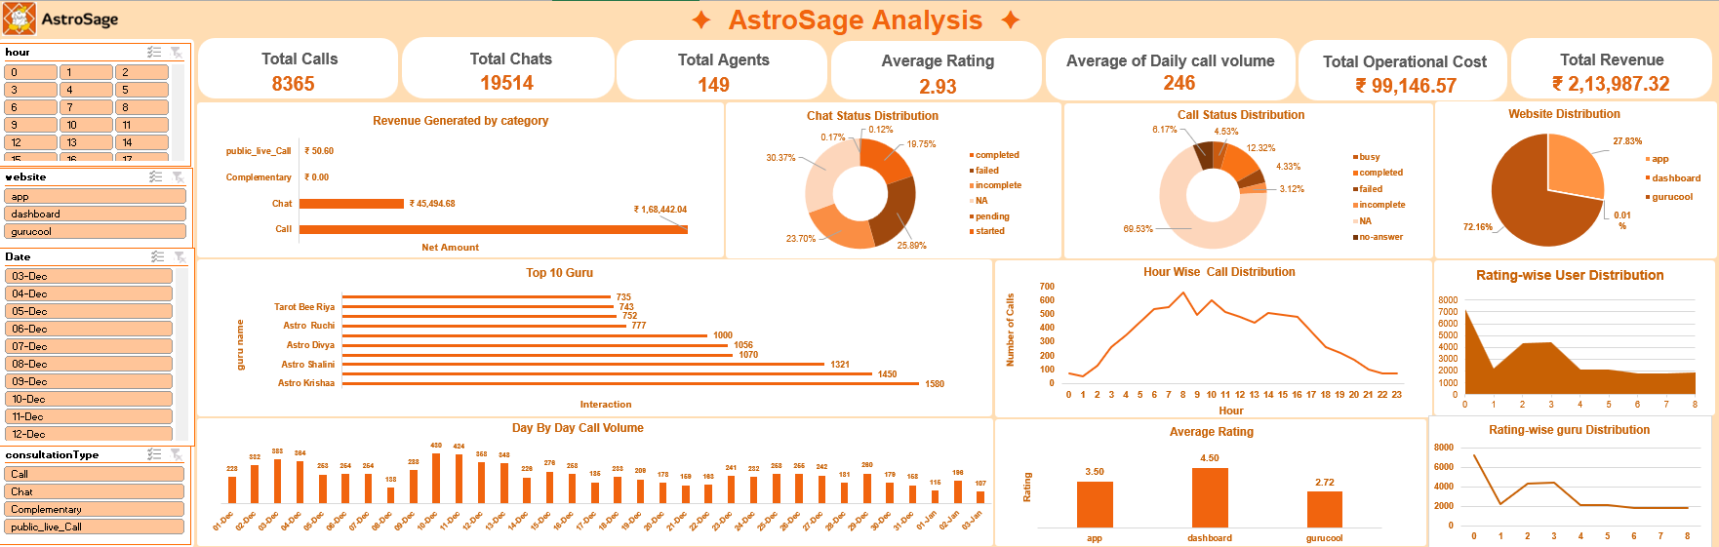

Slide 20
Conclusion
AstroSage has strong revenue potential, especially from call consultations.
The analysis shows operational gaps in call handling and service availability.
Workload should be distributed more evenly among gurus.
Guru training can help improve the overall customer rating.
Peak-hour staffing should be improved to handle high call demand.
Repeat customers should be retained through better service and follow-ups.
The ₹1 crore investment should be used for Agent Training , Technology Upgrade , Peak-Hour Staffing , Customer Experience .
These improvements can help AstroSage achieve better efficiency, customer satisfaction, and profitability.

Slide 21
THANK YOU
- Pratiksha Saraf

