Slide 1
SECTOR BASED TRADE RECOMMENDATION SYSTEM
CITI BRIDGE PROJECT #1
GROUP #10

Slide 2
WE ARE
PRATIKSHA BORLE
AVANI CHANDORKAR
AISHWARYA KOTKAR
AISHWARYA KAMBALE
SANIYA KHAIRATE

Slide 3
PROBLEM STATEMENT
To construct a trade recommendation system based on user-selected sector (from Nifty stocks).

Slide 4
TASK #1
User logs in to system with a user name and password. (Authenticated with predefined set of users in database)

Slide 5
SOLUTION AND TECHNOLOGY USED
UI using following:
HTML
CSS
JAVA SCRIPT
BOOTSTRAP
ORACLE DATABASE

Slide 6
TOOLS USED
Spring Framework
  Spring Boot Project
  Thyme Leaf

Slide 7
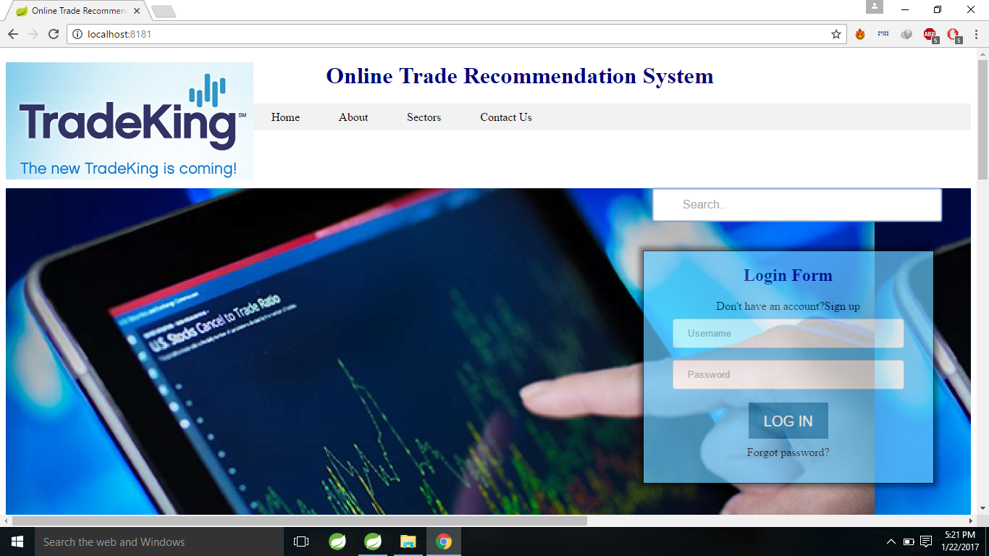
UI

Slide 8
TASK #2
User must select a market sector (Automotive, financial, health care, technology etc.) to get suggestions on securities.

Slide 9
SOLUTION
The user is first authenticated and if the password and username is wrong we get an alert message.

Slide 10
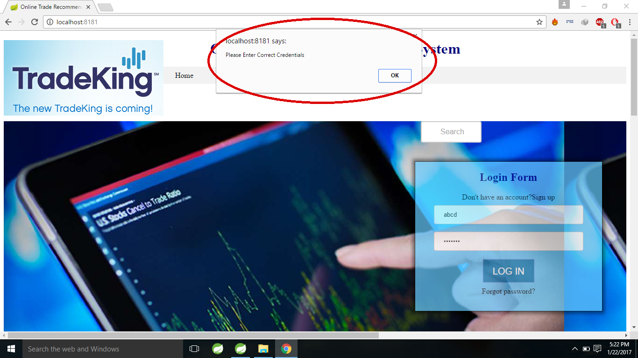
ALERT!!

Slide 11
If the user is authenticated we get the following page..

Slide 12
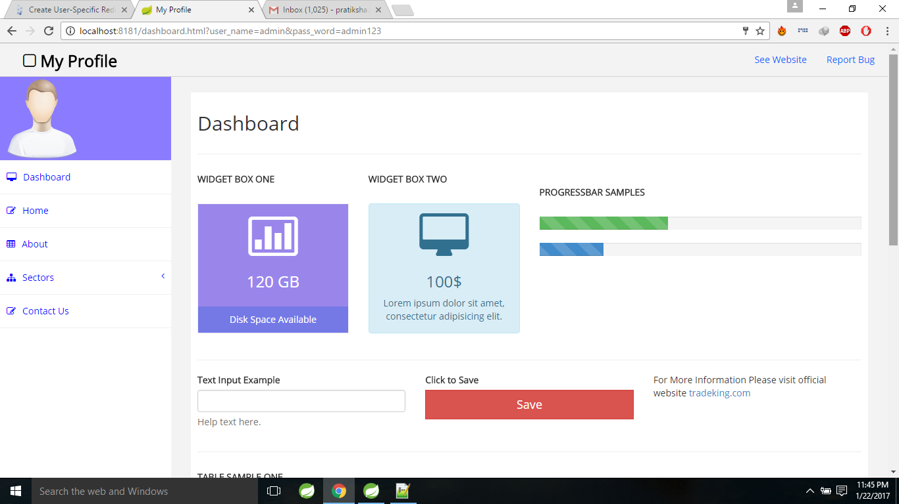

Slide 13
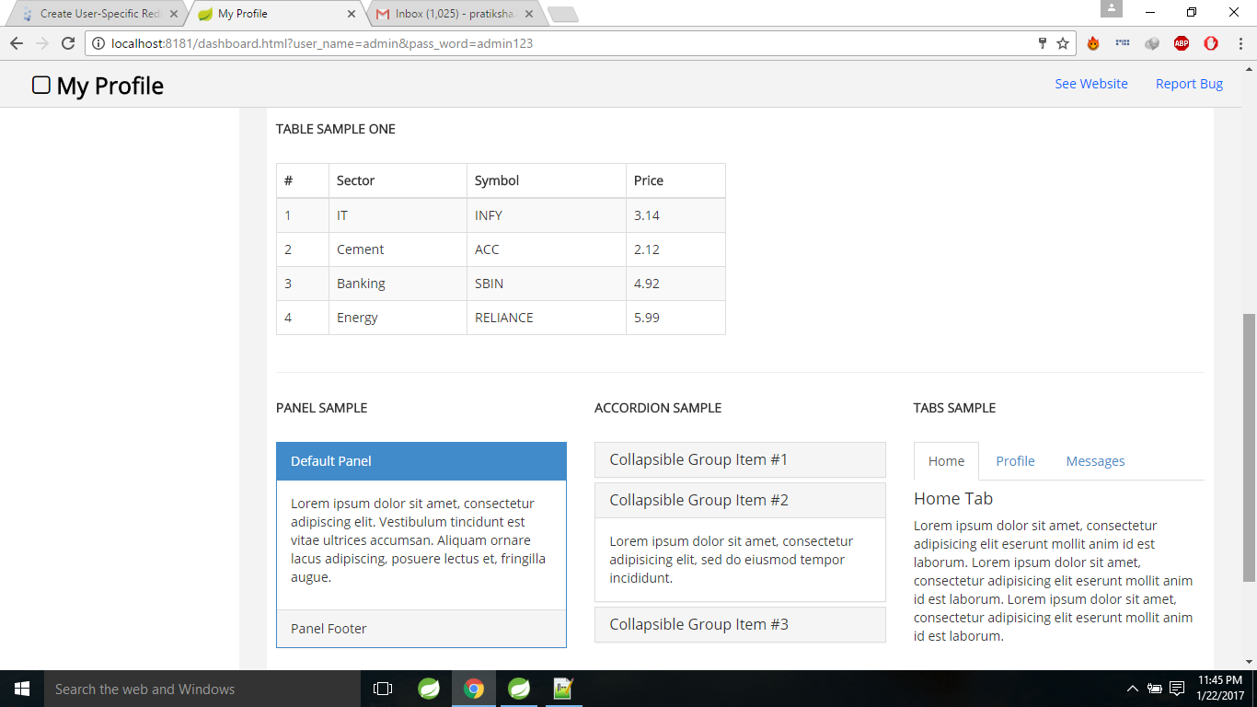

Slide 14
TASK #3
Once the user is logged the user selects a sector and the top five recommended securities must be displayed.

Slide 15
SOLUTION
We have used PRIORITY QUEUE to recommend the top five securities for the selected sector.
We recommend the stocks on the basis of the change in its value on that day.

Slide 16
Firstly, the change of every stock is stored in the priority queue in ascending order.
Then we display the top five priority queue contents in the reverse order.

Slide 17
We have used Thyme-leaf.
Thyme leaf is a modern server-side Java template engine for both web and standalone environments.
It brings elegant natural template to the development workflow.

Slide 18
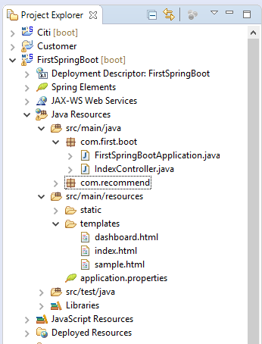
DIRECTORY STRUCTURE

Slide 19
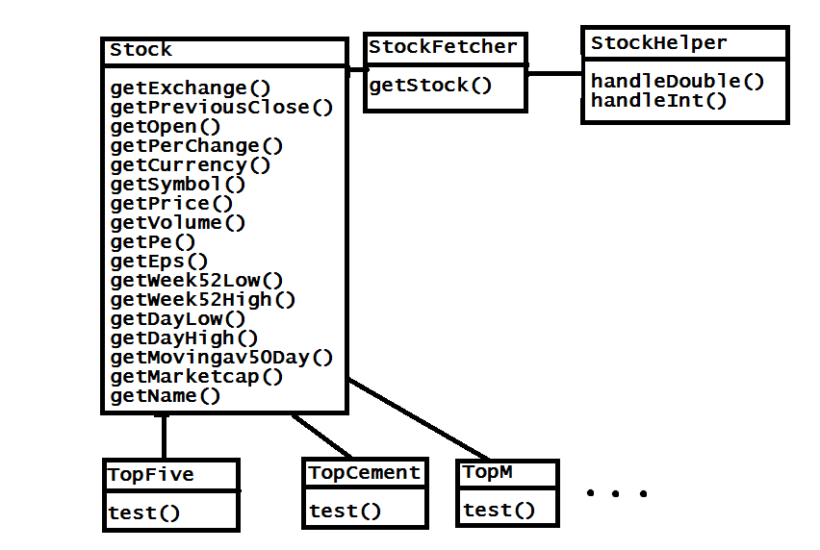
CLASS DIAGRAM

Slide 20
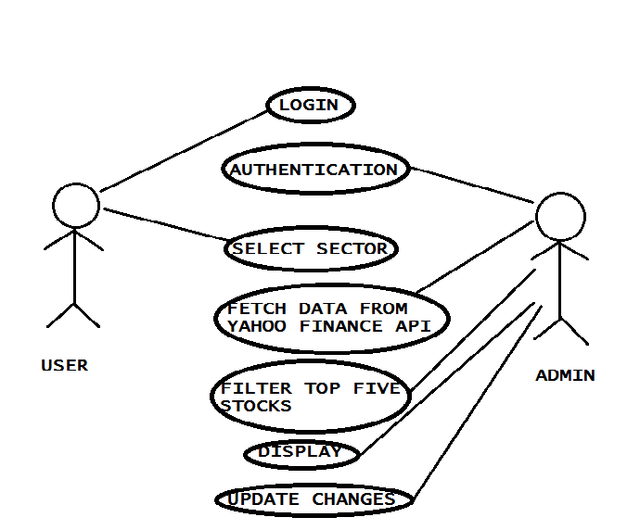
UML DIAGRAM

Slide 21
CONCLUSION
The trade recommender aids the user to select the stocks in which he/she wants to invest more effectively. And this project also helped us to learn and explore new things!!

Slide 22
THANK YOU!!

