Slide 1
Predictive Modeling on
Health Insurance Cost
Team:
Insurance Intelligence Squad
Poornima Yedidi
Pratiksha Gadhe
Yashi Agarwal

Slide 2
OUR PROCESS
Introduction
Modeling
Findings
Data Exploration
Model Selection
Model Evaluation
Future Scope
Objectives
Data Collection
Model Training

Slide 3
Introduction
The price of medical care is the single biggest factor behind U.S. healthcare costs, accounting for 90% of spending.
Healthcare spent in the United States is around $3 trillion a year, straining the budgets of families, businesses and taxpayers alike.

Slide 4
Objectives:
​
​
To find the best regression model
To predict health insurance costs based on people’s data

Slide 5
Data Collection
Source : Kaggle
https://www.kaggle.com/code/mariapushkareva/medical-insurance-cost-with-linear-regression/input
Book: Machine Learning with R by Brett Lantz
Dimensions :
observations: 1338
Variables: 7

Slide 6

Our Variables
Age
Sex
BMI
Charges
Children
Smoker
Region
Predictors
Response

Slide 7
age: age of primary beneficiary
sex: insurance contractor gender, female, male
bmi: Body mass index, providing an understanding of body, weights that are relatively high or low relative to height, objective index of body weight (kg / m ^ 2) using the ratio of height to weight, ideally 18.5 to 24.9
children: Number of children covered by health insurance / Number of dependents
smoker: Smoking
region: the beneficiary's residential area in the US, northeast, southeast, southwest, northwest.
charges: Individual medical costs billed by health insurance

Slide 8
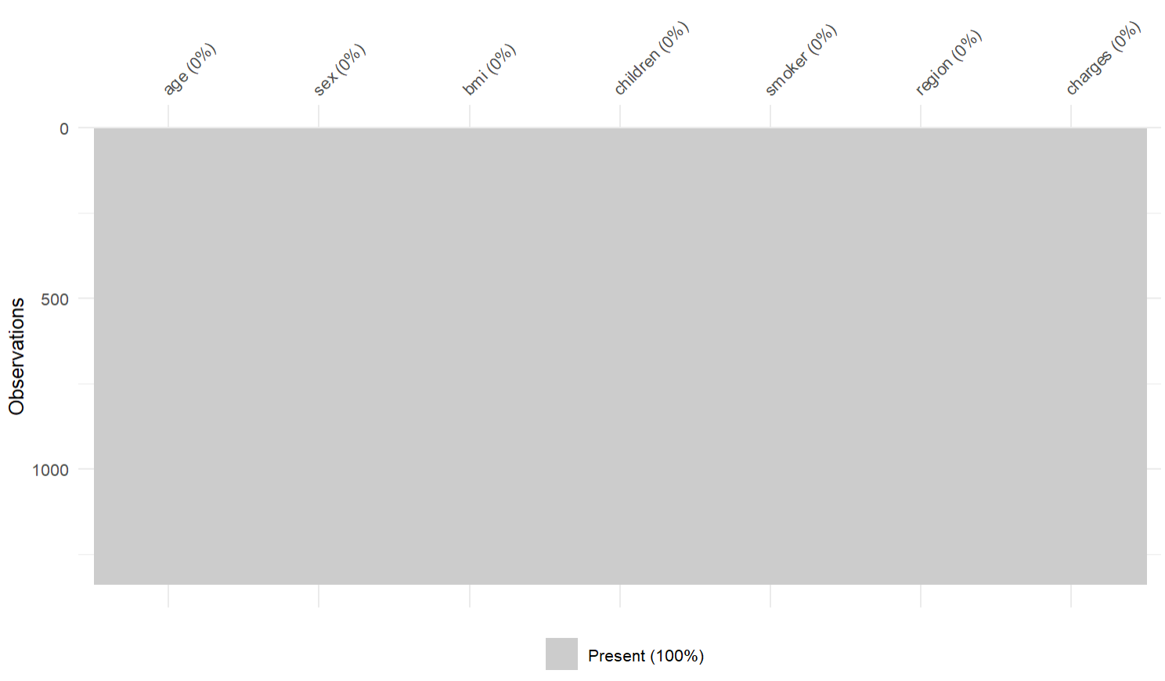
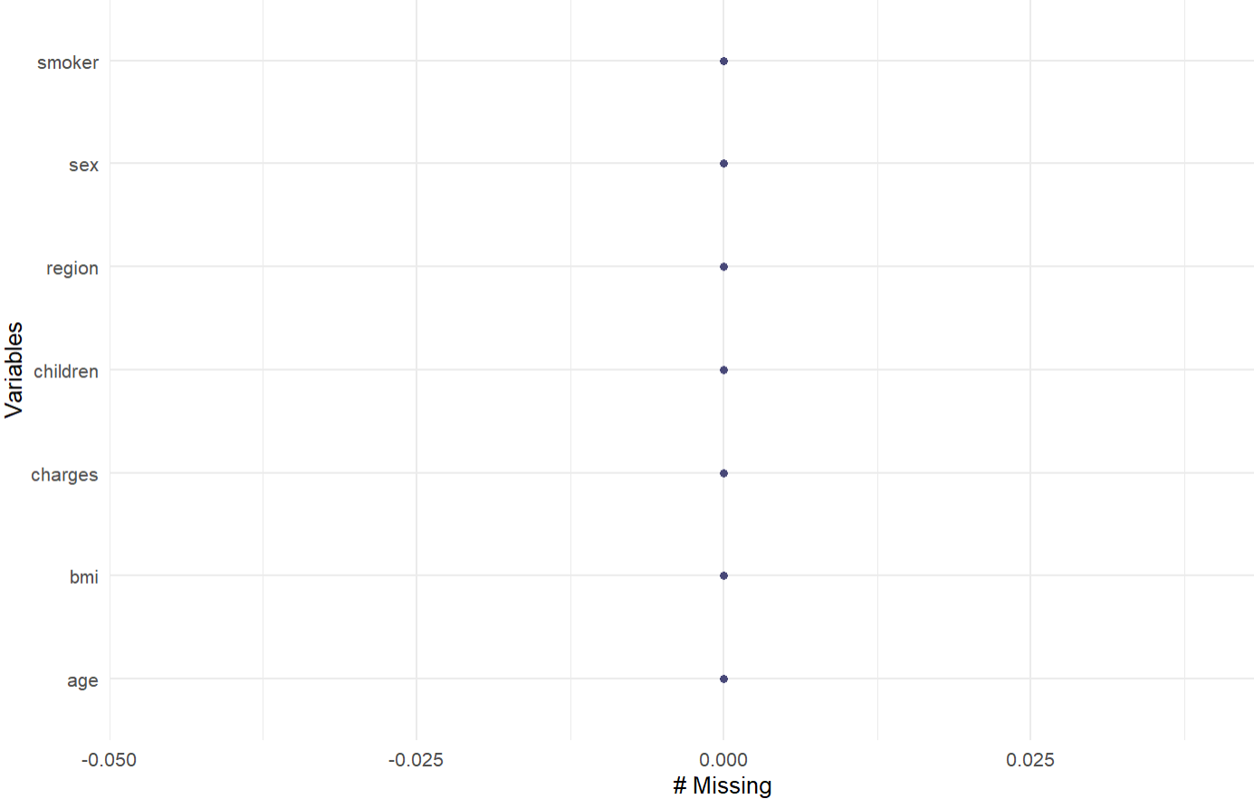
Missing Values

Slide 9
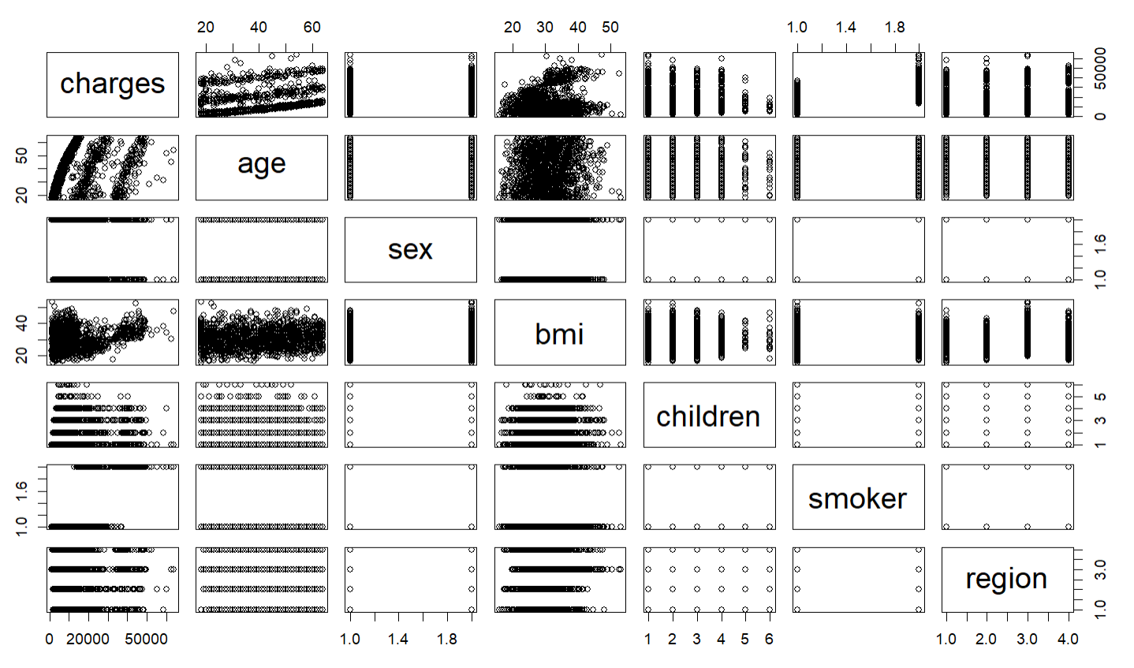
Data Exploration:
Notes:
For example, we can see from the scatter plot matrix that there is a positive correlation between charges and age, as we observed in the previous scatter plot. We can also see that there is a positive correlation between charges and bmi, as well as a slight positive correlation between charges and the number of children.
Additionally, we can see that smoker is a binary factor (with values of yes or no), and that there is a clear difference in charges between smokers and non-smokers. Similarly, we can see that region is a categorical factor with four levels, and that charges vary somewhat between the different regions.
Overall, the scatter plot matrix allows us to explore the relationships between all the factors in the dataset and to identify any interesting patterns or trends.

Slide 10
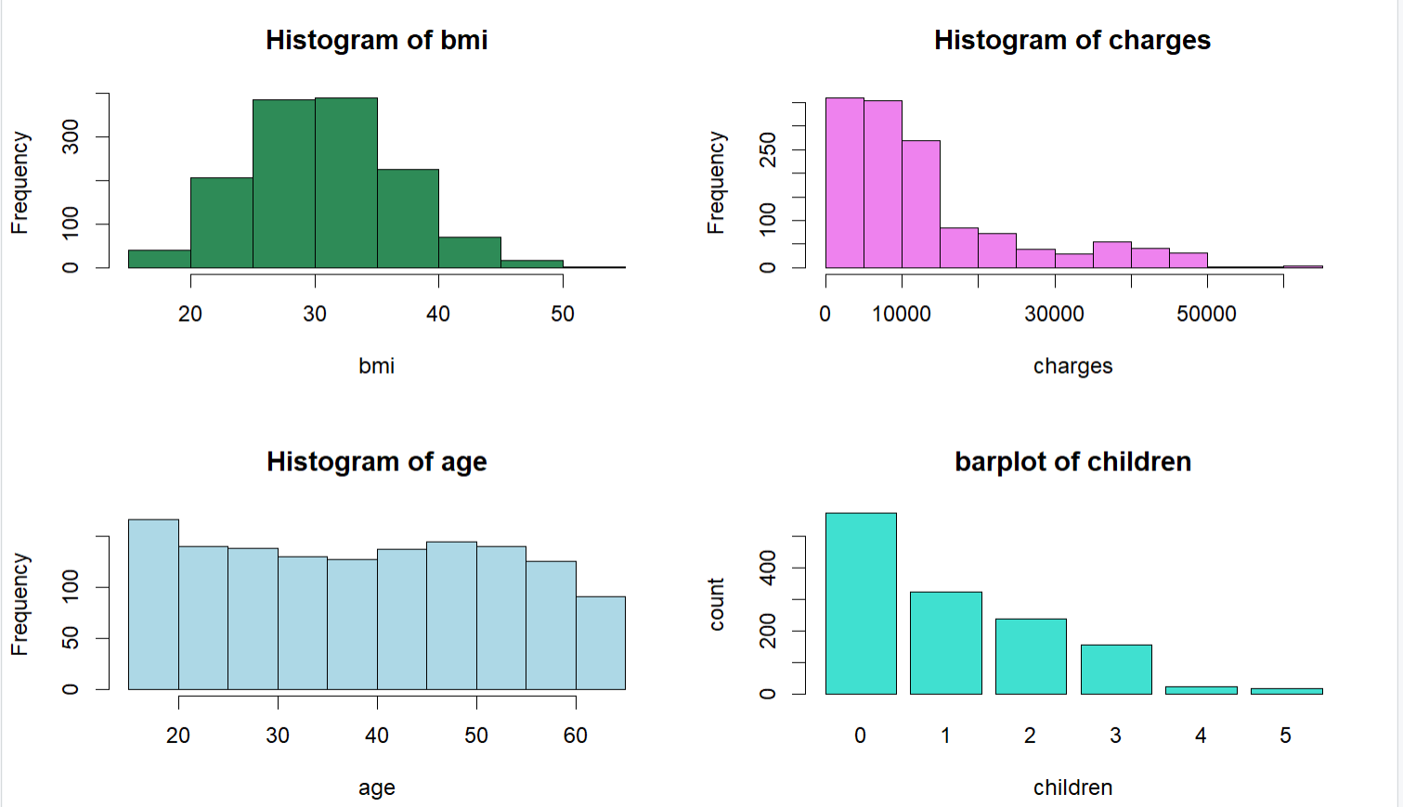

Slide 11
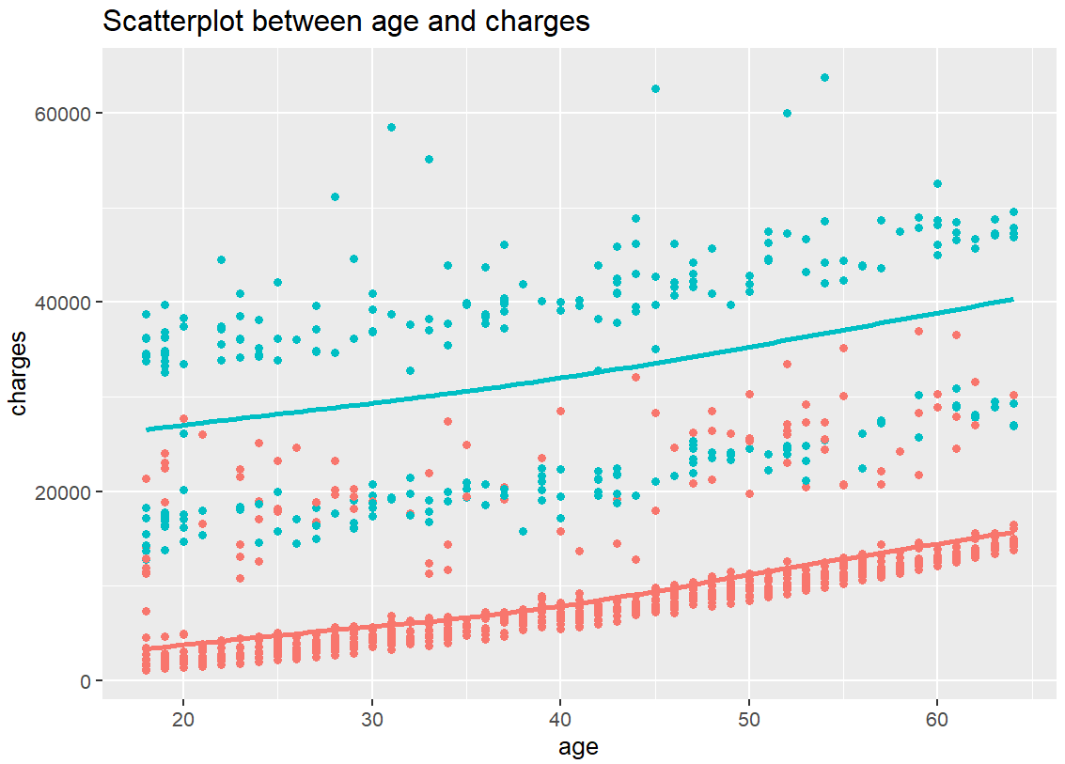
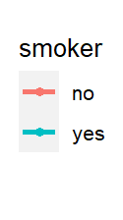
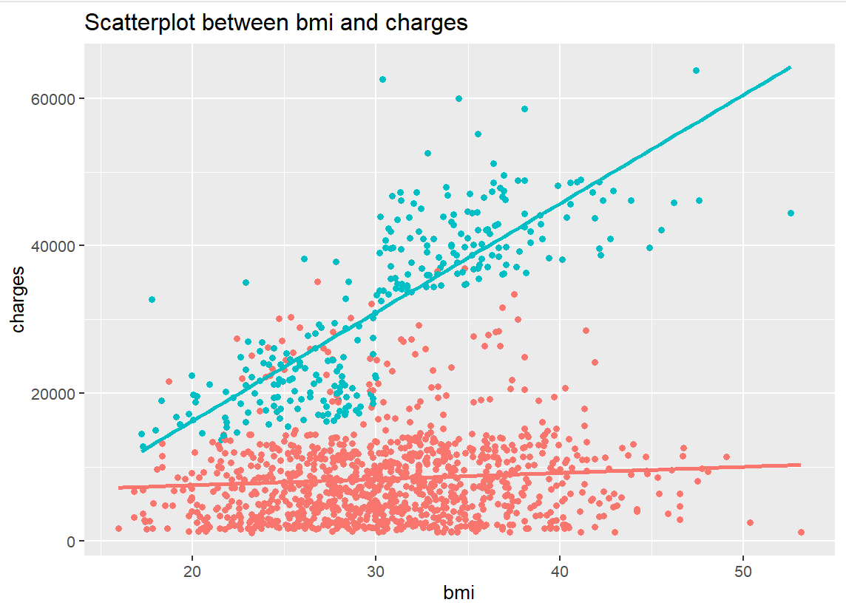

Slide 12
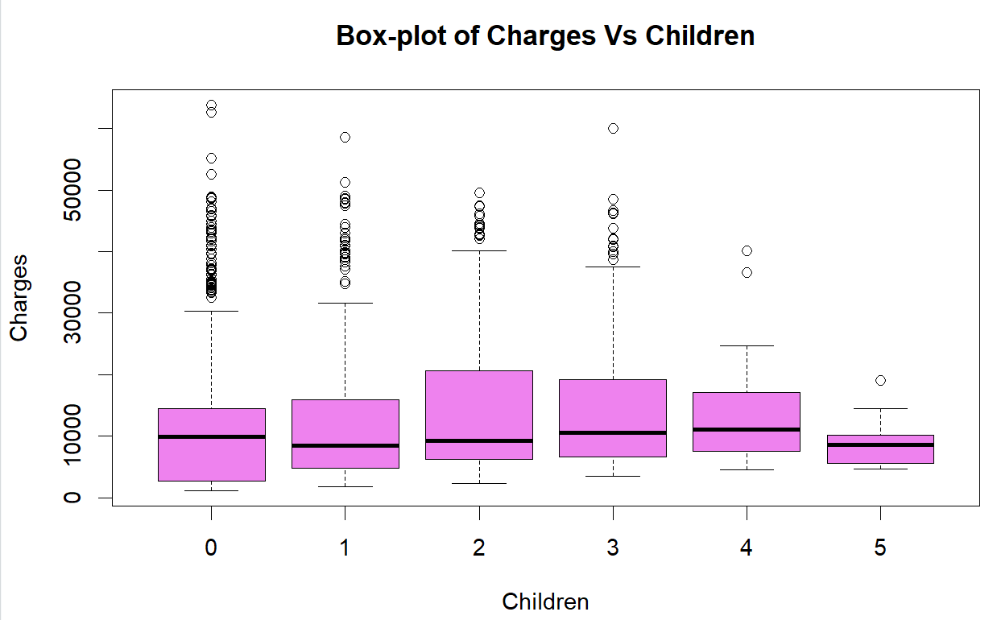
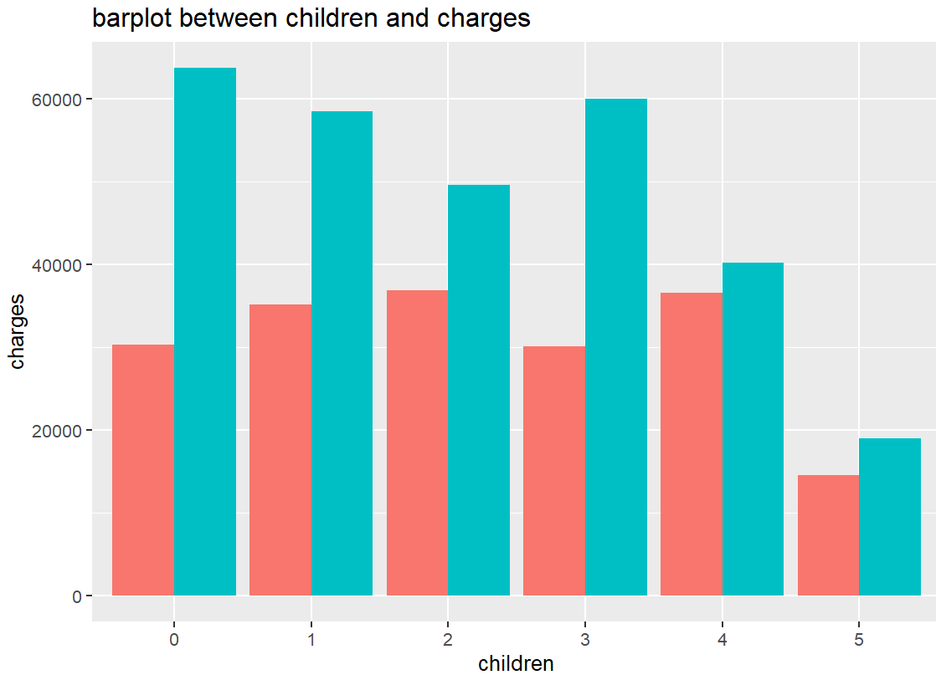
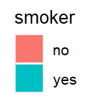

Slide 13
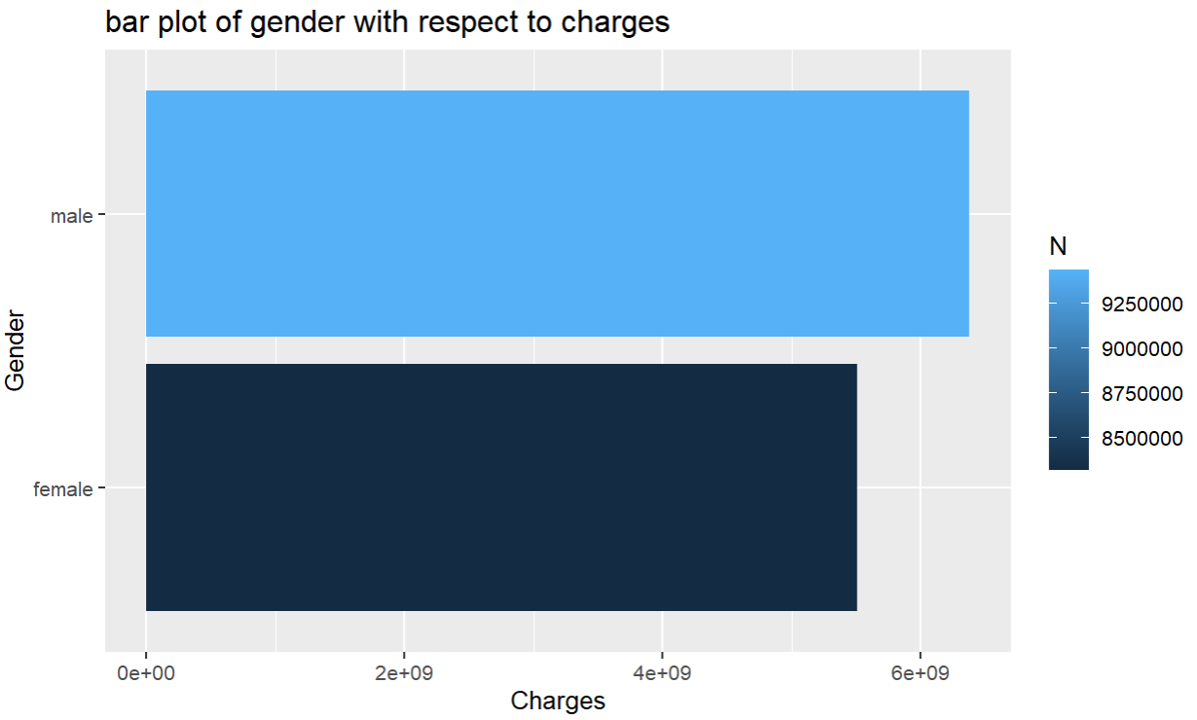
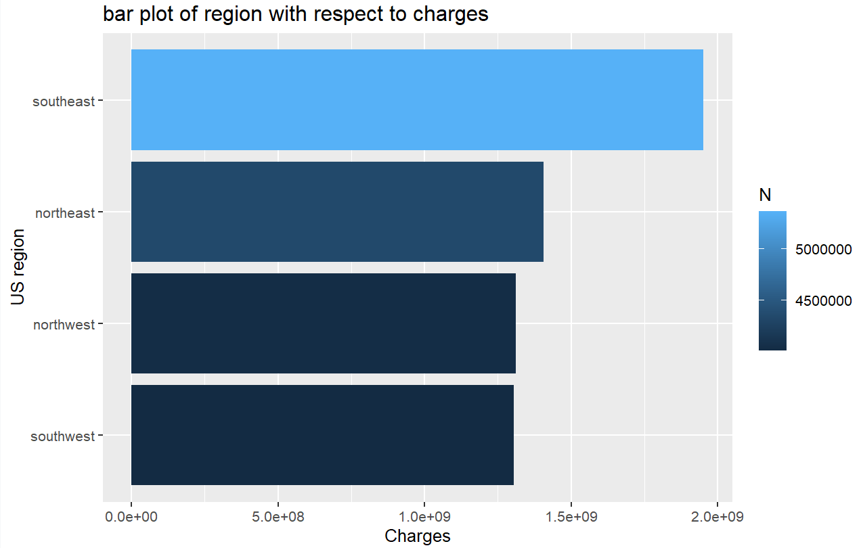

Slide 14
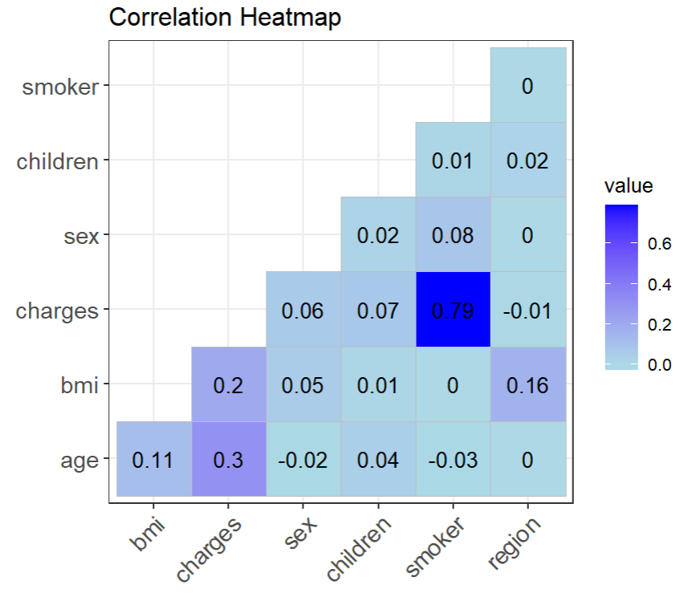
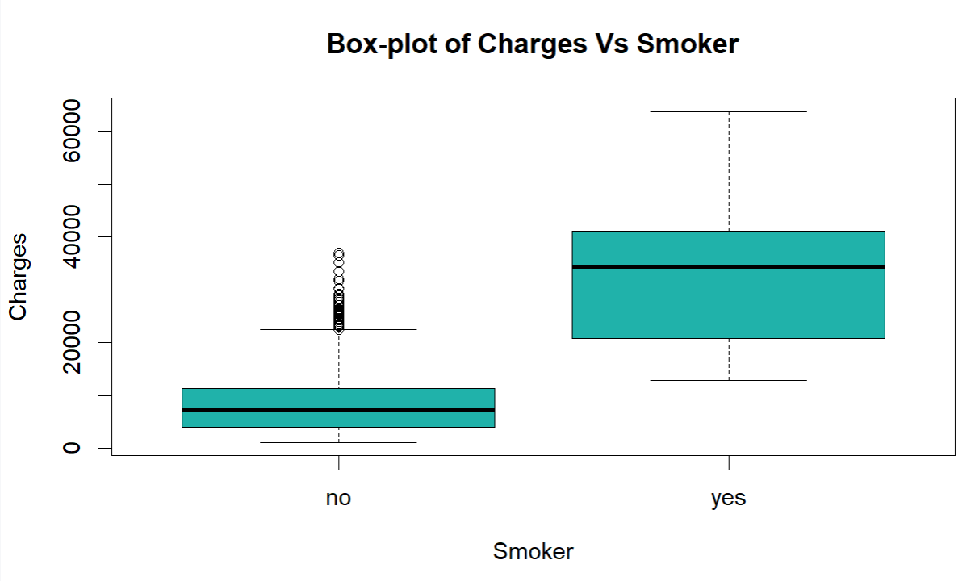
VIF
poly(age, 3) 1.20
sex 1.01
poly(bmi, 3) 1.14
children 1.21
smoker 1.02
region 1.13

Slide 15
Summary Statistics
Mean
SD
AGE | 39.2070 | 14.05
BMI | 30.6634 | 6.1
CHARGES | 13270.42 | 12110.01
sex
smoker
Female: 49.5%
Male: 50.5%
No: 79.5%
Yes:20.5%
Children
24.2%
Northeast
REGION
0
42.9%
1
24.2%
24.3%
Northwest
2
17.91%
3
14.2%
27.2%
Southeast
11.7%
4
1.9%
24.3%
Southwest
5
1.3%

Slide 16
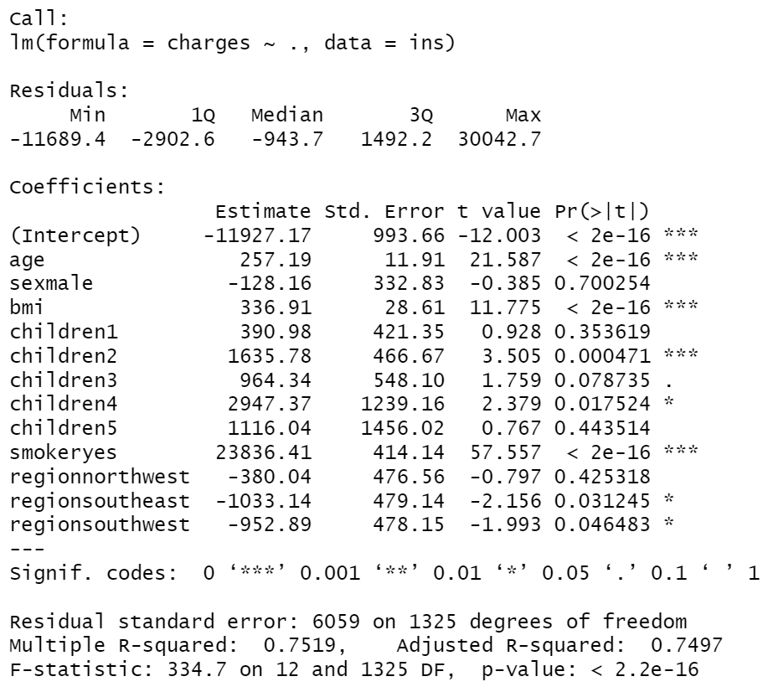
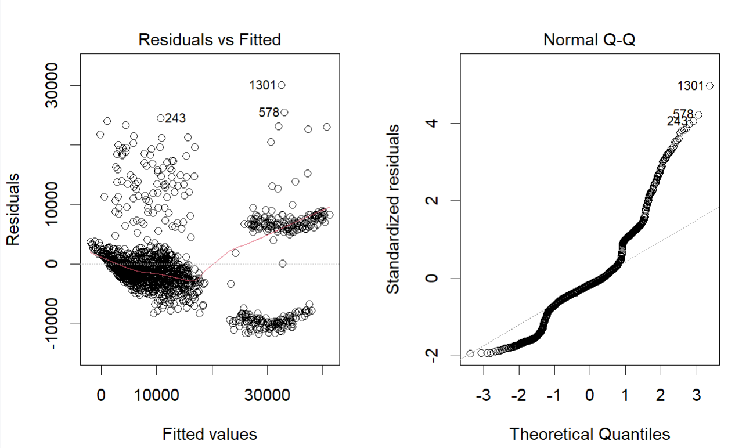
Modeling
Multiple Linear Regression:
Full model:

Slide 17
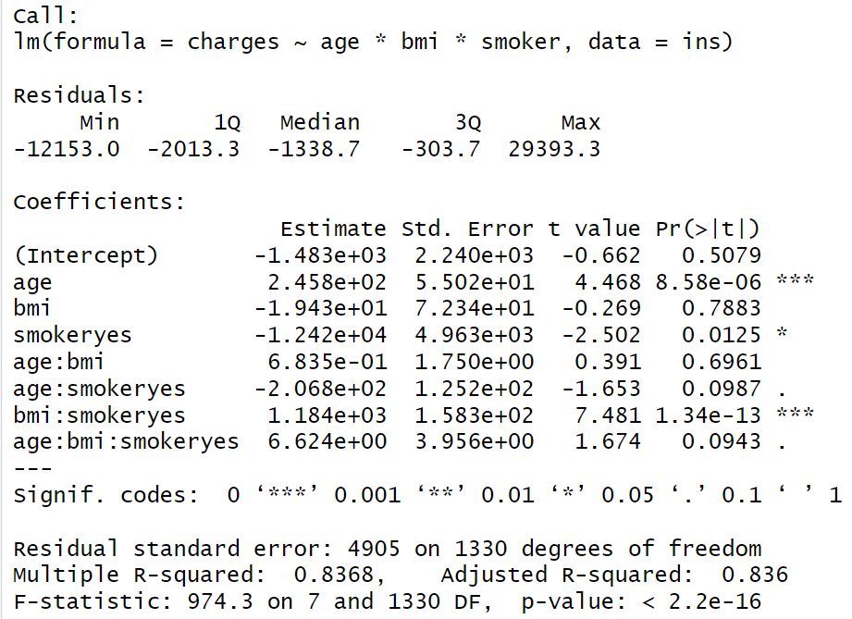
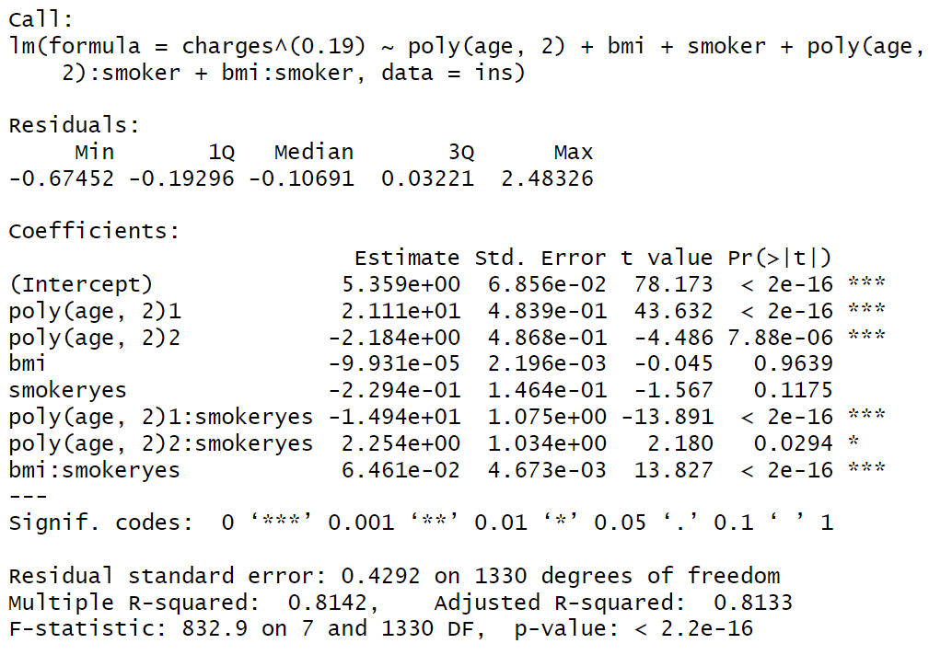
Using selected predictors
AIC: 26547.634
AIC: 1543.78

Slide 18
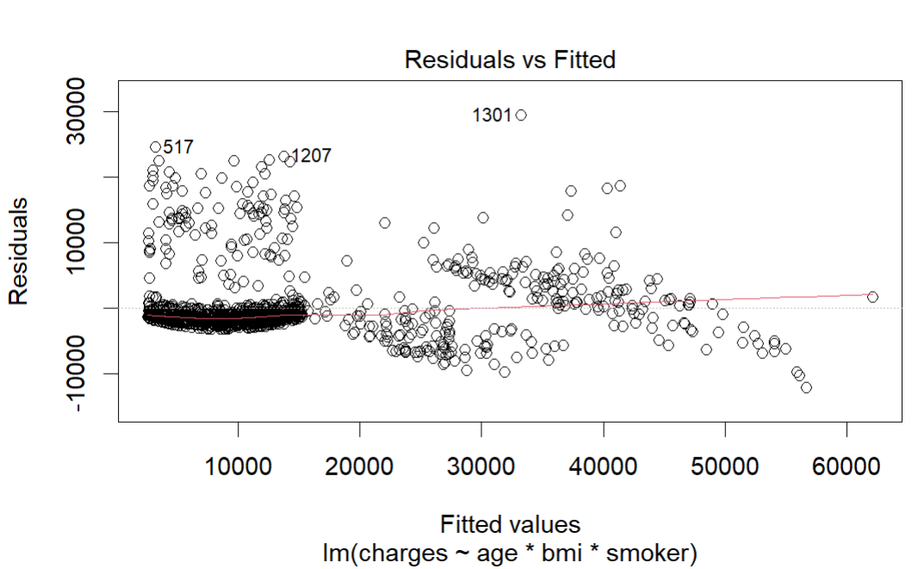
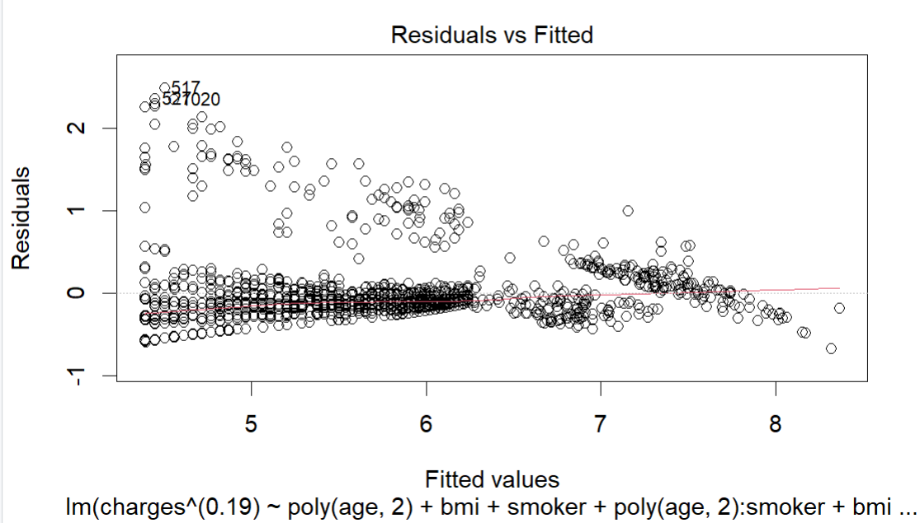
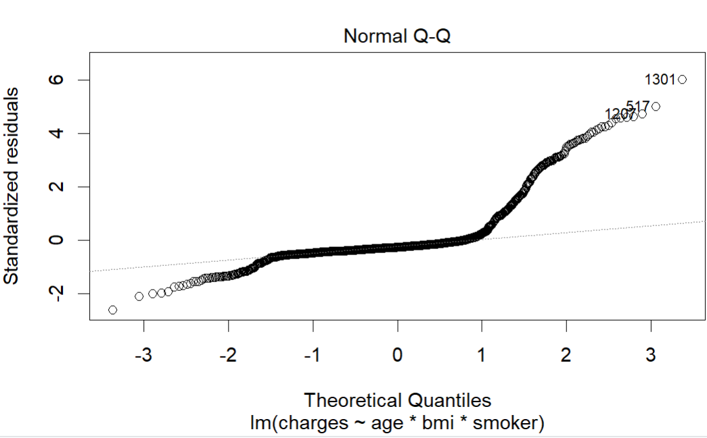
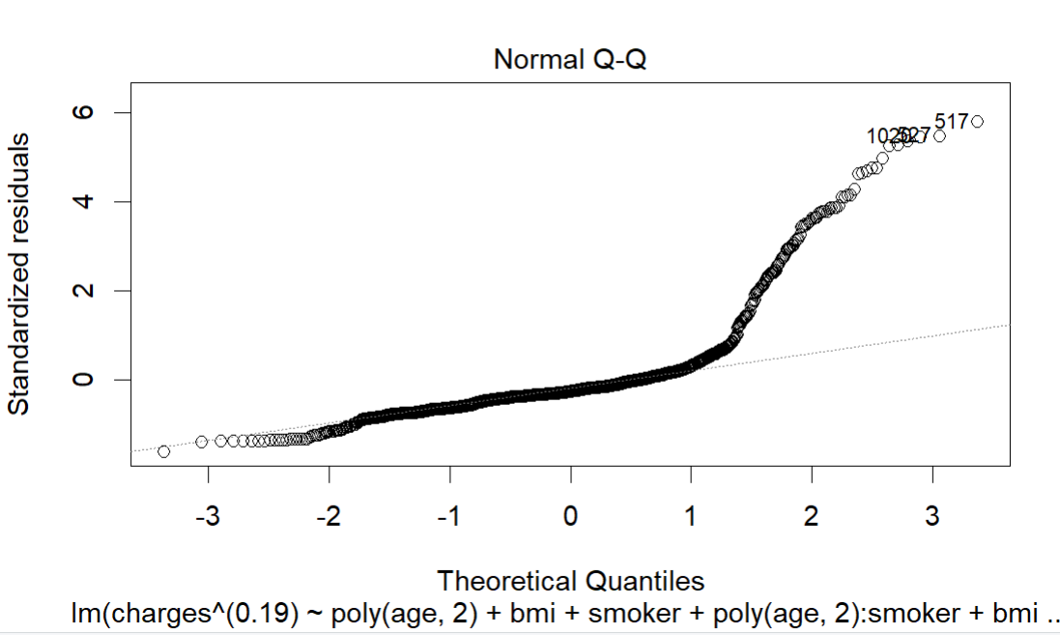
Plots for above models

Slide 19
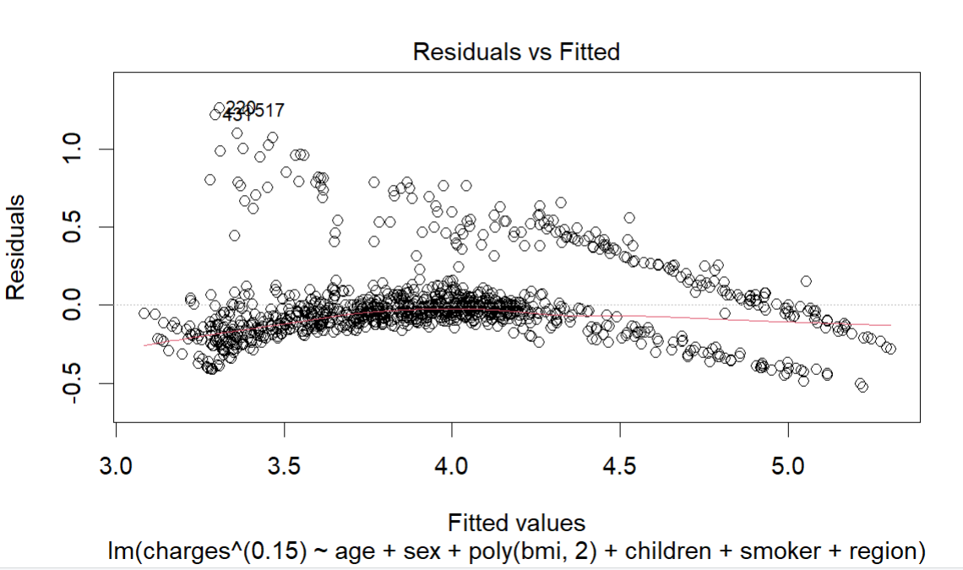
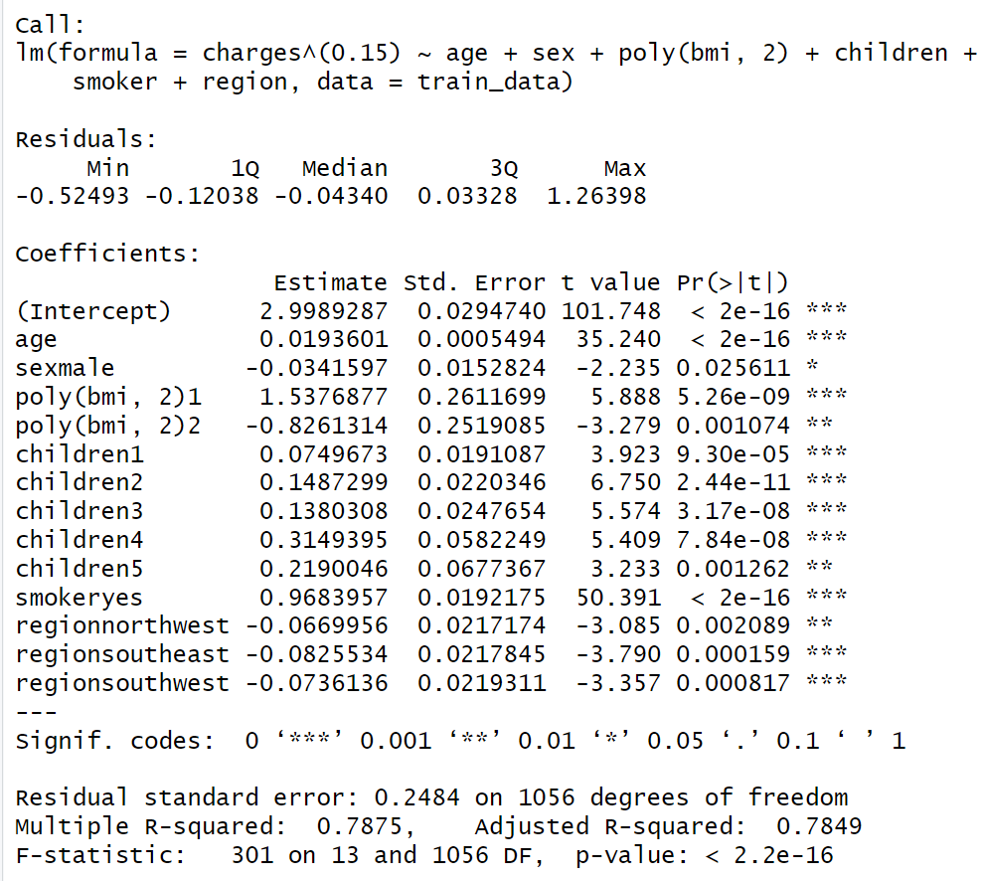
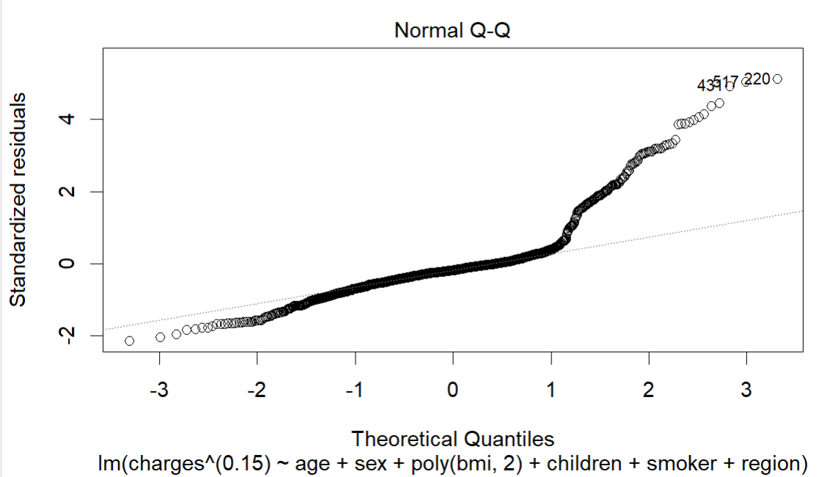
FinalModel: AIC-71.8

Slide 20
Supervised Regression models
Random Forest
Single Regress-ion tree
LASSO
Decision Trees
Bagging
Gradient Boosting

Slide 21

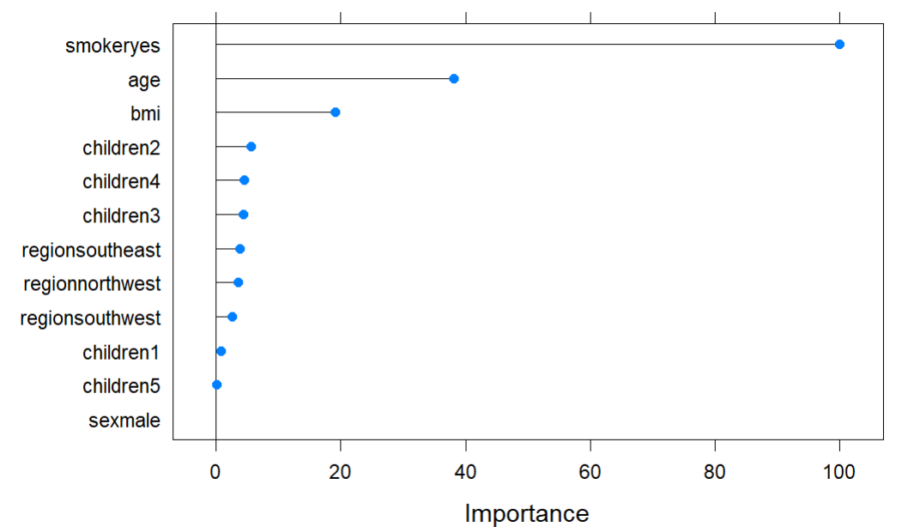
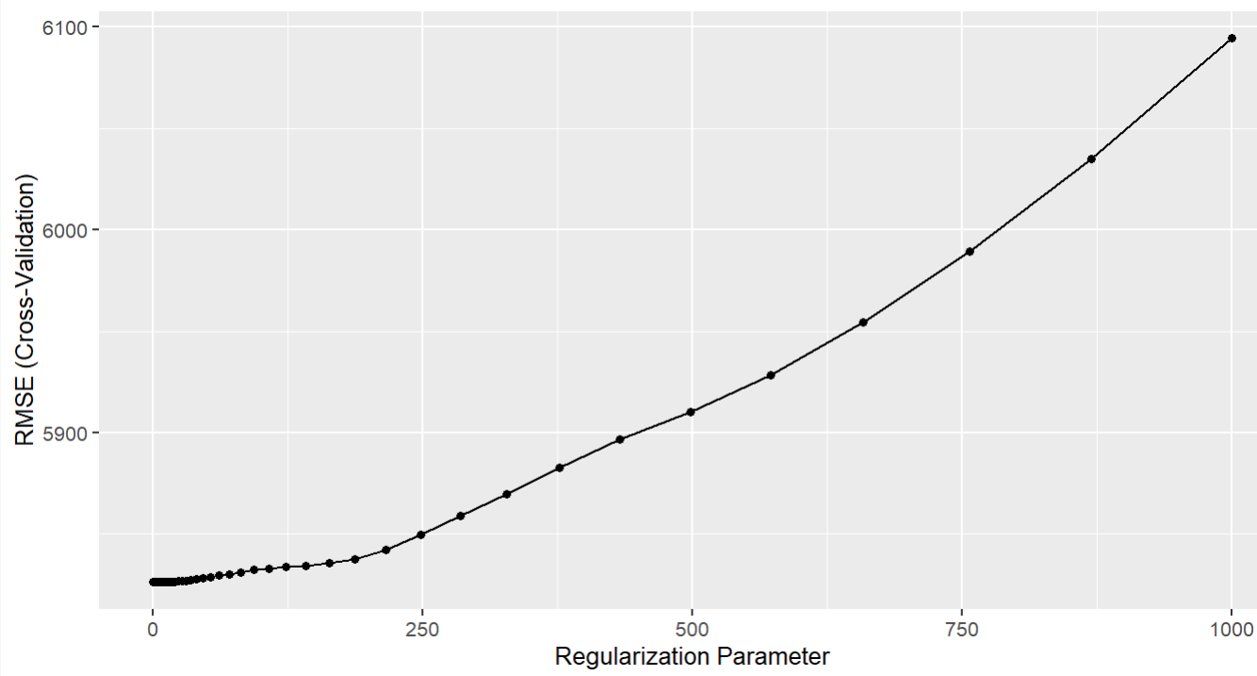
LASSO
Least Absolute Shrinkage and Selection Operator
Uses L1 regularization
Parameters used:
Method: glmnet
Alpha
lambda
Notes:
Least Absolute Shrinkage and Selection Operator ; regularisation of data models and feature selection;varImp() ranks the predictors by the absolute value of the coefficients in the tuned model.

Slide 22
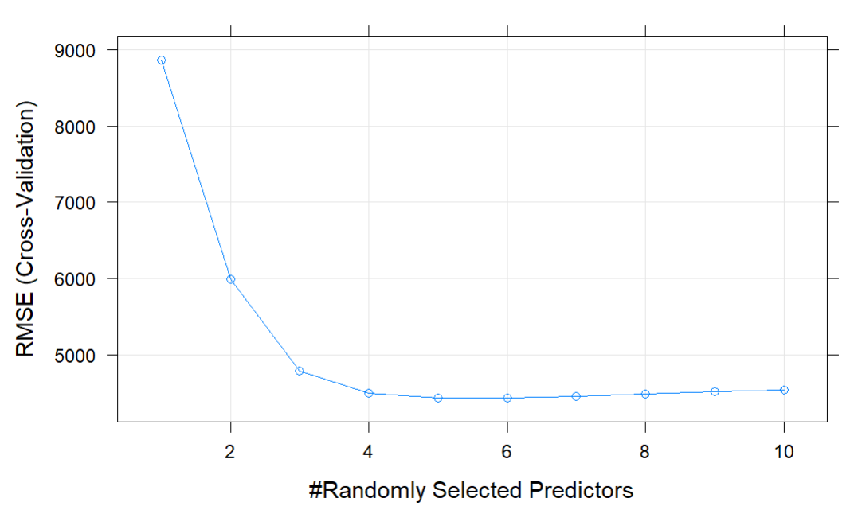
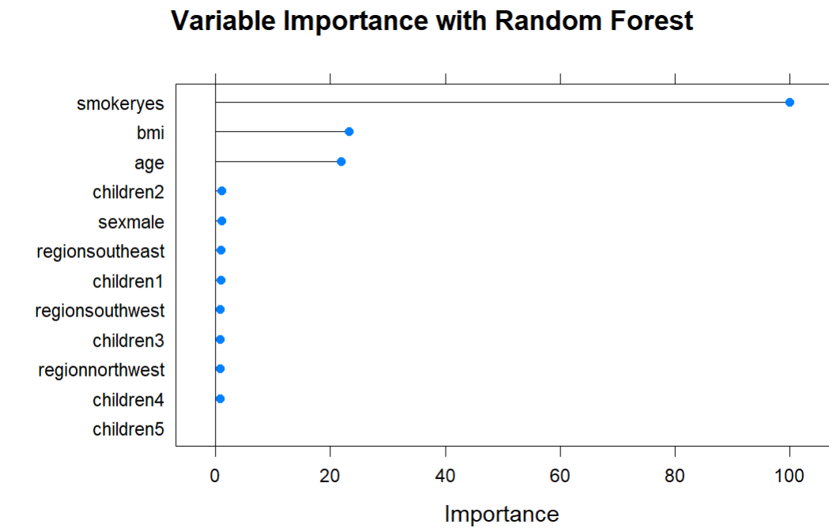
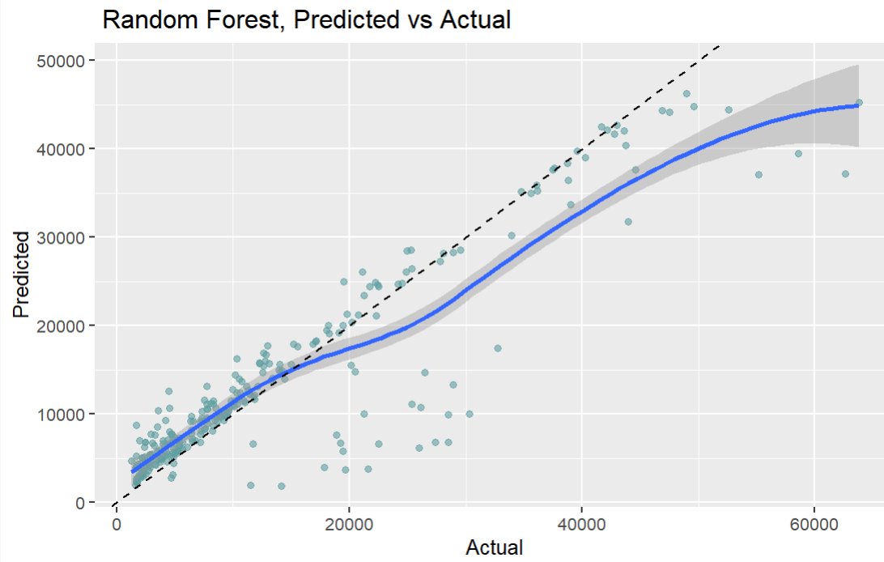
Random Forest
Parameters used:
Method: rf
ntree
mtry

Slide 23
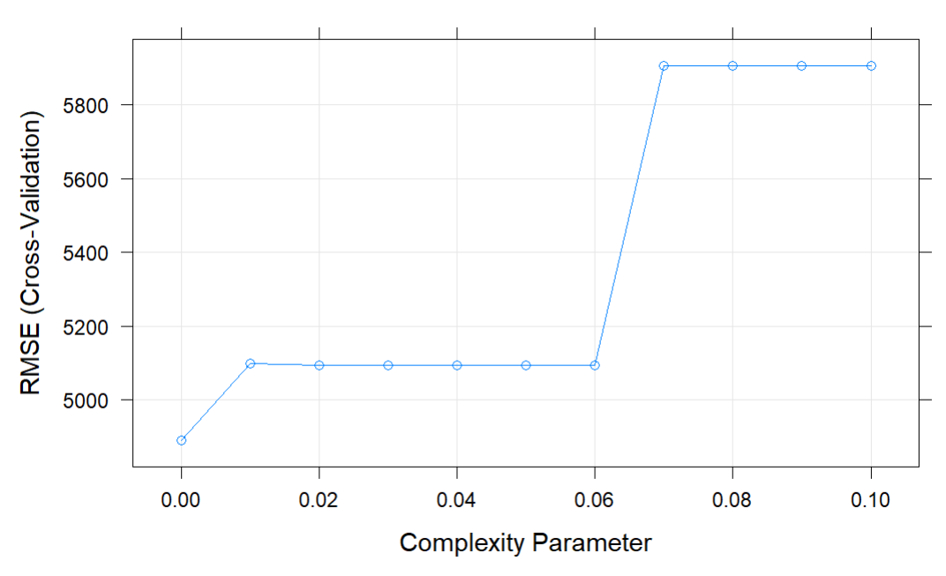
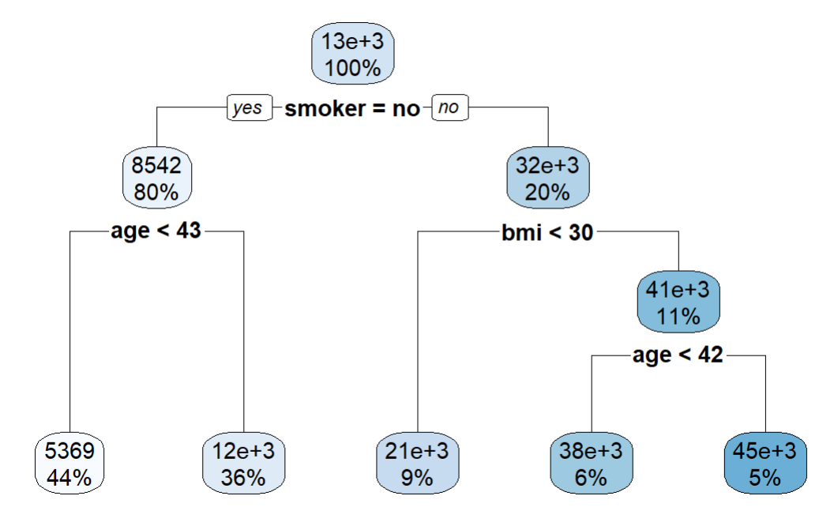
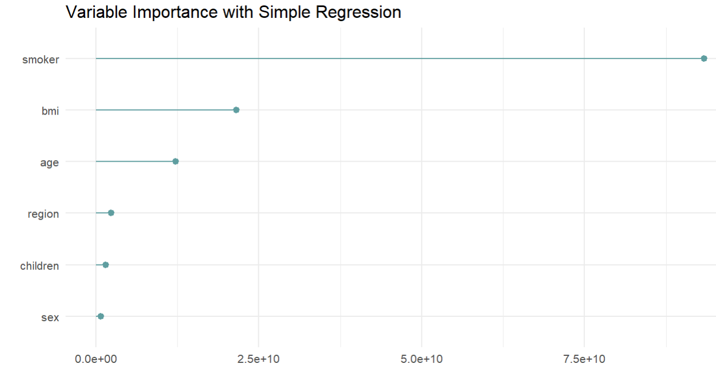
Single Tree
Parameters used:
Method: rpart
cp

Slide 24
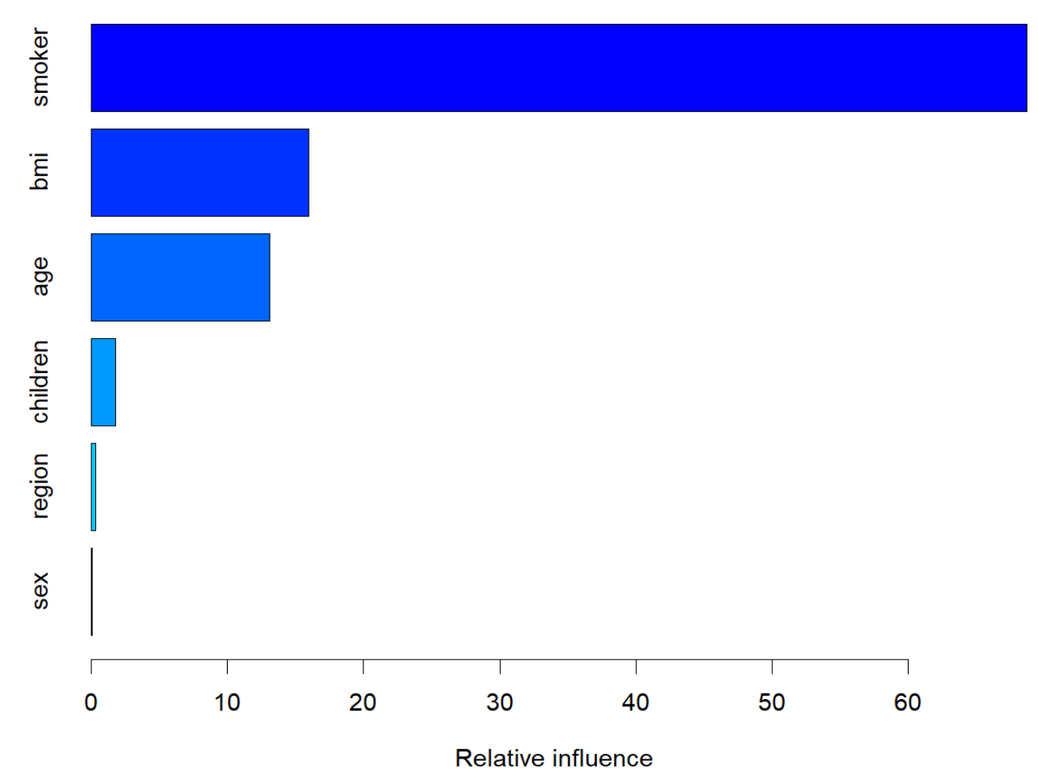
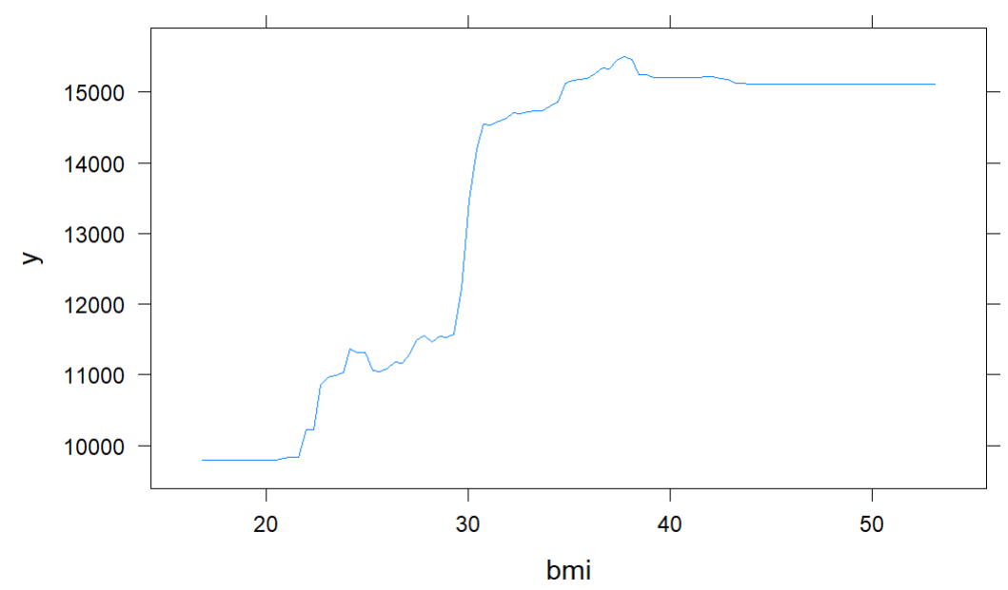
Gradient Boosting
Control interaction depths
View partial dependence

Slide 25
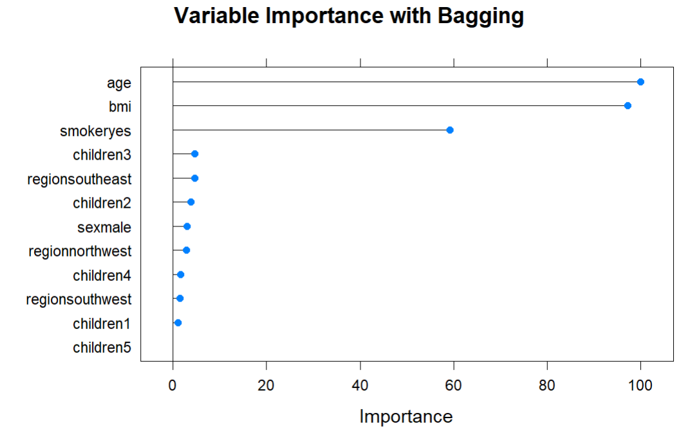
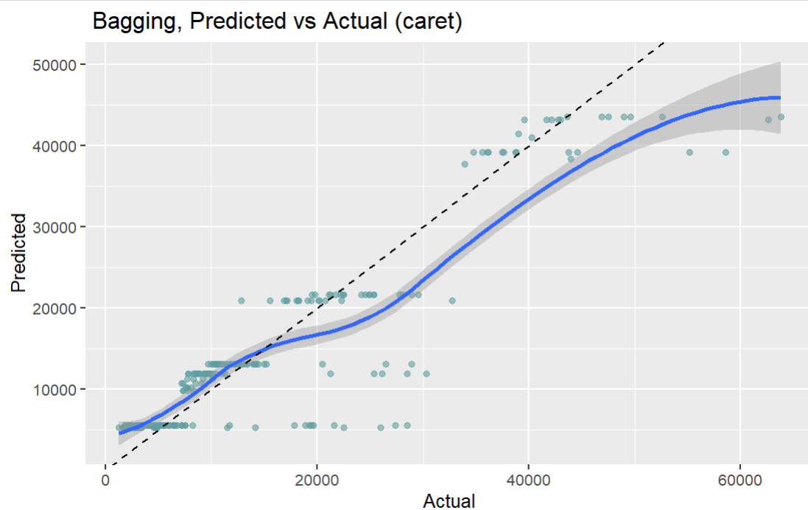
Bagging

Slide 26

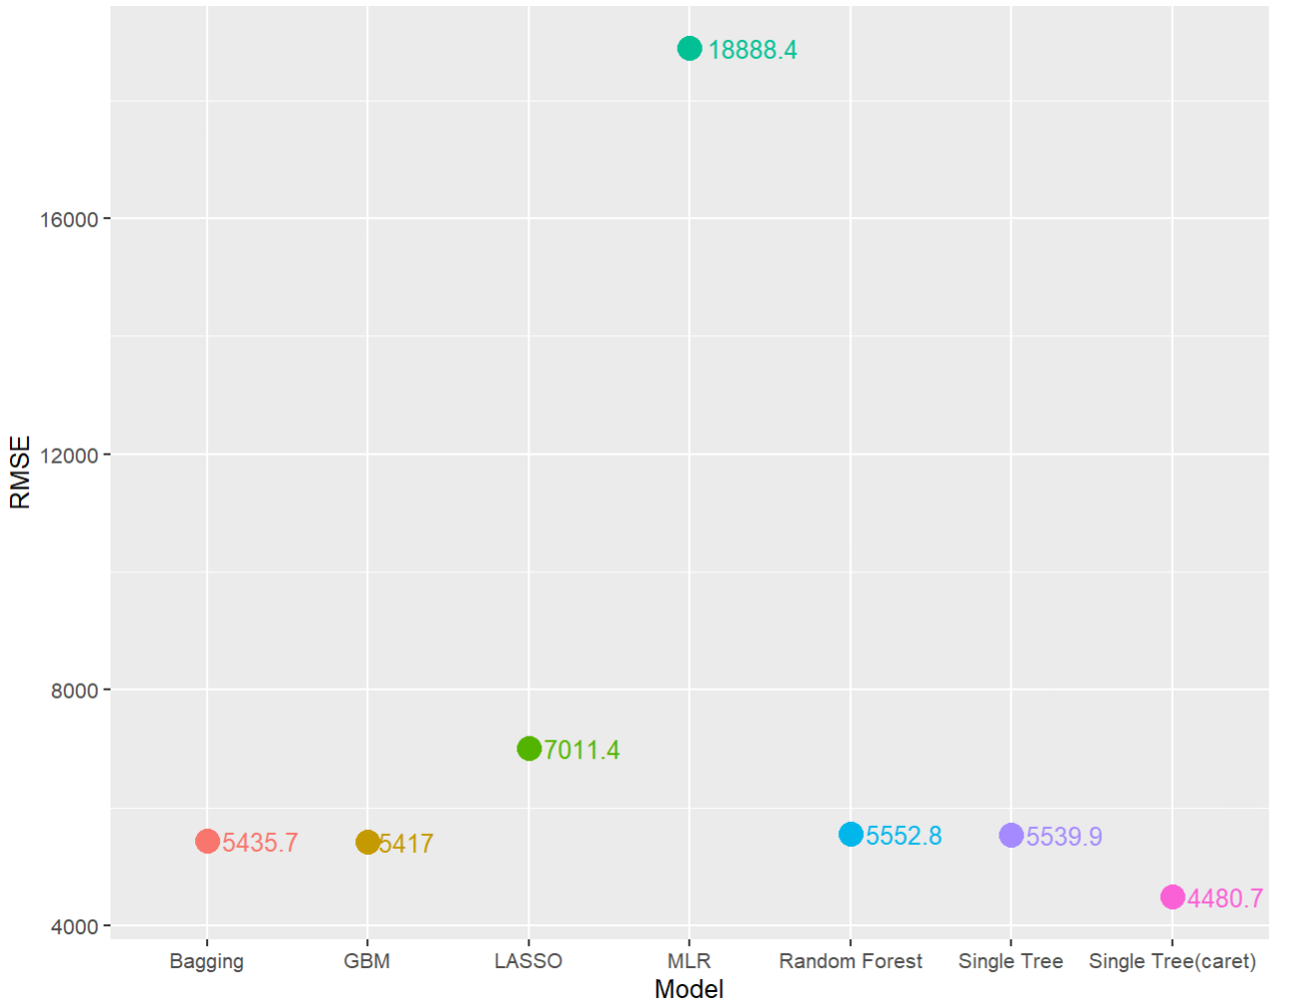
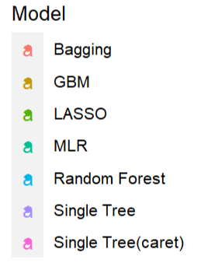
RMSE

Slide 27
Findings
Overall, from all the above models, we found out that age,bmi and smoking status plays a vital role in determining the health insurance charges.

Slide 28
Conclusion
Limitations | Future Scope
Confined to US region - can’t generalize results | Use of MARS-Multivariate Adaptive Regression Splines and other supervised learning models
Unbalanced data on factor levels | Collect more data
Limited variables may impact findings. | Include confounding variables such as food habits, financial history, drinking habits, insurance plan and so on

Slide 29
References:
https://www.researchgate.net/post/Akaike_information_criterion#:~:text=But%20to%20answer%20your%20question,above%20answer%2C%20comparing%20AICs).
https://mdsr-book.github.io/mdsr2e/ch-learningI.html#sec:tuning
https://www.kaggle.com/datasets/mirichoi0218/insurance
Machine Learning with R by Brett Lantz

Slide 30
Thank you!!!

Slide 31
Questions?
Please contact
Insurance Intelligence Squad

