Slide 1
E-Commerce Business Analysis Project Report (2022–2024)

Slide 2
Introduction
This project focuses on analyzing an E‑Commerce company’s sales and profit performance from the year 2022 to 2024. The analysis is done using Microsoft Excel with the help of Pivot Tables, Charts, Slicers, and an interactive Dashboard. The main objective of this project is to convert raw sales data into meaningful insights that can support business decision‑making.

Slide 3
Objectives of the Project
To analyze total sales and profit over multiple years (2022–2024).To compare sales performance by Product, Category, Region, and Day Name. To identify the most profitable regions and peak sales days. To present insights using a visually interactive Excel dashboard.

Slide 4
Tools and Techniques
Used Microsoft Excel Pivot Tables and Pivot Charts Slicers (Product, Category, Region, Day Name, Order Date)Charts: Column Chart, Bar Chart, Pie Chart, Line Chart Data Cleaning and Data Formatting

Slide 5
The dashboard titled “E‑Commerce Business Analysis (2022–2024)” provides a complete overview of sales and profit performance.
1.Sales by Product Name
This column chart shows sales generated by different products such as Laptop, Smartphone, Monitor, Mouse, Printer, Smartwatch, and Tablet. It helps identify top‑selling and low‑selling products.
2.Sales by Category
This horizontal bar chart displays sales distribution across categories like Electronics, Accessories, and Office. Electronics contributes the highest share of total sales.
Dashboard Description

Slide 6
3 Profit by Region
The pie chart represents profit contribution from different regions: North, South, East, and West. It clearly shows which region is the most profitable.
4.Profit by Day Name
This column chart analyzes profit based on days of the week. It helps understand which days generate higher profit, useful for planning promotions and offers.
5.Year‑wise Monthly Sales
Trend The line chart compares monthly sales trends for the years 2022, 2023, and 2024. It highlights seasonal patterns and growth trends over time.
6.KPI Cards
Sum of Sales: 10,667,381Sum of Profit: 1,844,565 These KPIs give a quick summary of overall business performance.

Slide 7
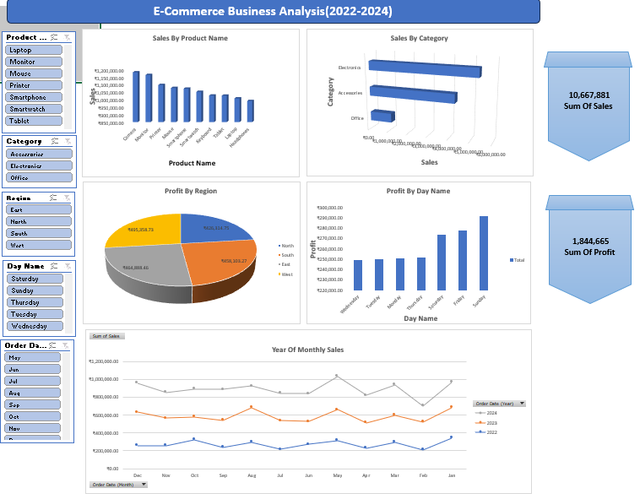

Slide 8
Key Insights
Electronics category generates the highest sales.Certain products like Laptops and Smartphones are top revenue contributors.One or two regions contribute the majority of profit.Profits are higher on specific days of the week.Sales show an increasing trend from 2022 to 2024.

Slide 9
Conclusion:-
The E‑Commerce Business Analysis Dashboard effectively transforms complex sales data into easy‑to‑understand visual insights. This project demonstrates the practical use of Excel for data analysis and business intelligence. It can help management make informed decisions related to sales strategy, inventory planning, and regional performance improvement.

Slide 10
Future
ScopeIntegration with Power BI for advanced analytics. Adding customer‑wise and payment‑mode analysis. Forecasting future sales using trend analysis.

