Slide 1



EcoGuard AI
AI-Powered Solution for LPG Safety Monitoring and Workforce Development
College Name: Parul University
Student names: Bhanu Kiran (team leader)
Aayushi Rajesh
Pratiksha Gohil
Jasmi Golani
Arjun Anjana
Date : 14-03-2026

Slide 2
Problem Statement
Brief Overview: LPG accidents cause significant injuries and property damage annually. Gas leaks, explosions, and fires pose serious threats to residential and industrial safety, requiring immediate detection and response systems . shortage of trained workforce with green skills in the energy sector. Traditional training methods are slow, expensive, and cannot scale to meet growing demand for sustainable energy professionals. Reactive maintenance leads to equipment failures and costly downtime. Without predictive capabilities, organizations cannot optimize maintenance schedules or prevent accidents before they occur. Inefficient energy consumption patterns increase costs and environmental impact. Users lack visibility into usage patterns and cannot make informed decisions to optimize consumption.
Key Objectives: 1. Real-Time LPG Leak Detection
2. AI-Powered Predictive Analytics
3. Green Skills Training Platform
4. Automated Safety Systems
Source :
www.freepik.com/

Slide 3
Dataset Overview
Dataset Description: Building Energy Consumption Dataset from Kaggle - A comprehensive dataset collected over 4.5 months using ZigBee wireless sensors in a low-energy building environment. Real sensor data collected from a low-energy building over about 4.5 months. It includes 19,735 observations and 29 features, with no missing values, making it suitable for machine learning analysis.
Before training the models, the data was preprocessed. Outliers were removed using the Interquartile Range (IQR) method, and new features such as hour, weekday, and month were extracted from timestamps. Correlation analysis was performed to remove less relevant features, improving model efficiency. The dataset was then divided into 70% training data and 30% testing data.
Important features in the dataset include temperature, humidity, occupancy data, timestamps, weather conditions, and energy consumption. Analysis showed that the hour of the day is one of the most important factors influencing energy consumption patterns. This insight helps the AI model make more accurate predictions and improve energy management.
Source :
www.freepik.com/

Slide 4
Methodology
Approach:
The overall methodology used to develop the EcoGuard AI system. The approach begins with collecting energy consumption and environmental data from IoT sensors and datasets. The collected data is then processed using several preprocessing techniques such as outlier removal, feature engineering, and correlation analysis to ensure accuracy and reliability.
After preprocessing, the dataset is divided into training and testing sets so that machine learning models can be trained and evaluated properly. Different algorithms are applied to analyze patterns in energy consumption and gas usage. These models help predict energy demand, detect anomalies, and improve LPG safety monitoring.
Finally, the trained model is integrated with IoT devices and a mobile application. This integration enables real-time monitoring, predictive analytics, and automated alerts to improve safety and energy efficiency.
Source :
www.freepik.com/

Slide 5
Algorithms Used:
Random Forest, XGBoost, and Support Vector Machine (SVM). Random Forest is an ensemble learning method that combines multiple decision trees to improve prediction accuracy and reduce overfitting. XGBoost is a gradient boosting algorithm that builds models sequentially and includes regularization techniques to improve performance and speed.
Support Vector Machine was used as a baseline model for comparison, but it showed lower accuracy on this dataset. The best performing model was the Extra Trees Regressor, which achieved an R² score of 74.41%. Tree-based models were selected because they handle complex and nonlinear relationships effectively and work well with large datasets without requiring extensive feature scaling.

Slide 6
Result
Model Performance:
Model performance was evaluated using several statistical metrics to measure prediction accuracy and error levels. The primary metric used was the R² score, which indicates how well the model explains the variance in the dataset. A higher R² value means the model can better predict energy consumption patterns.
In addition to R², error metrics such as Mean Absolute Error (MAE) and Root Mean Square Error (RMSE) were calculated. MAE measures the average magnitude of prediction errors, while RMSE penalizes larger errors more heavily.
Among all tested models, the Extra Trees Regressor delivered the best results with an R² score of 74.41%, an MAE of 8.82, and an RMSE of 11.75. These results indicate that the model can accurately predict energy consumption patterns and outperform previous approaches used in similar studies. This level of accuracy makes the model suitable for real-world monitoring and decision-making systems.
Graphs/Visualizations: (Include graphs or charts that display model performance, feature importance, or predictions)
Source :
www.freepik.com/

Slide 7
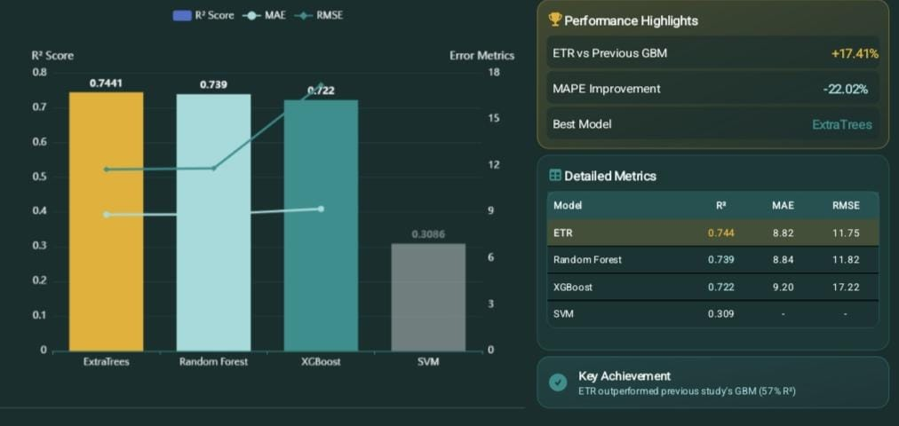
Graphs/Visualizations:

Slide 8

Conclusion
The EcoGuard AI system demonstrates how advanced technologies can be used to address multiple challenges in the energy sector. By integrating artificial intelligence, IoT sensors, and mobile applications, the system provides real-time monitoring and predictive analytics for LPG safety.
At the same time, the training platform helps develop a skilled workforce capable of supporting the transition to sustainable energy solutions. The project shows that combining safety technology with workforce development can improve operational efficiency, reduce risks, and promote environmental sustainability. Overall, EcoGuard AI represents a comprehensive approach to building a safer and greener future.
Future Work: Future improvements include expanding the dataset with diverse buildings, regions, and weather conditions to improve model accuracy. Integrating TinyML can enable faster on-device predictions. Adding sensors for gases like natural gas and carbon monoxide, along with thermal camera–based computer vision, can enhance leak detection and support large-scale industrial deployment.

Slide 9
Solution Impact
Sustainability Impact:
EcoGuard AI improves environmental sustainability by optimizing LPG usage and reducing fuel waste through AI-based monitoring. Real-time leak detection prevents harmful emissions and accidents. Predictive maintenance reduces equipment failures, while the green skills training platform promotes sustainable energy practices and prepares a workforce capable of supporting clean and efficient energy systems.
Practical Implementation: EcoGuard AI can be implemented in homes, industries, and commercial buildings using IoT sensors such as gas detectors, load cells, and temperature sensors. These devices send real-time data to a cloud platform where AI models analyze consumption patterns, detect leaks, and send alerts through a mobile application for safety monitoring.
Source :
www.freepik.com/

Slide 10
References
https://www.kaggle.com
https://www.nature.com/articles/s41597-020-00582-3
https://zenodo.org
https://data.mendeley.com
https://www.mdpi.com/1996-1073/13/7/1555

Slide 11
Thank You
Notes:
Thank You !!

