Slide 1

ALGORITHM VISUALIZER FOR AOA Rahul Chaurasia – 201042016 Pratiksha Kirolkar – 201042001 Minal More – 201042005 Abhishek Pawar - 201042007 Under the Guidance of Mr. A. R. Sonule Date:- 12/11/2021
Jawahar Education Society’s
A . C . Patil College of Engineering, Kharghar
Department of Computer Engineering

Slide 2

OUTLINE
Introduction
Motivation
Literature review
Analysis of Review
Objectives
Scope
Problem Statement
Proposed System
Result
Further Scope
Observations/Conclusion
References

Slide 3
INTRODUCTION
Algorithm visualization can be defined as the use of images to convey some useful information about algorithms.
Algorithms are the important concept in programming.
You can create a website that shows the people how does the actual algorithm work.
For Ex: Like array
They can input and it will show them how exactly the numbers getting interchange and how it is sorting the array.

Slide 4
MOTIVATION
We have learnt sorting algorithms like bubble sort, selection sort, insertion sort, quick sort.
But often we fail to understand the core idea of a particular algorithm maybe because we are unable to visualize how they work.
That’s why we are making this project to let everyone understand how these algorithms work.
One can get a deep understanding of such algorithms.
4

Slide 5
LITERATURE SURVEY
Sr. No | Title of Review Paper | Year | Review
1 | Visualization Tools of Data Structures Algorithms | 2014 | This study provides better understanding of visualization tool and provides knowledge to the beginners who want to work in visualization tools.
2 | Algorithm Visualizations as a Way of Increasing the Quality in Computer Science Education | 2016 | The group of students using algorithm visualizations within their exercises, could achieve better results in succeeding test than another group, not using them.
3 | Visualizing Sequence of Algorithms for Searching and Sorting | 2009 | In searching algorithms, the user has to give the total numbers of inputs, the set of data and the element to be searched. Then select the algorithm from the list and then the visualization of the selected algorithm is shown with the given inputs.

Slide 6
ANALYSIS OF REVIEW
In our system there are five Sorting algorithms and two Graph algorithms.
Sorting algorithms are namely
Bubble sort
Selection sort
Insertion sort
Quick sort
Radix sort
Graph algorithms includes
Breadth-first search
Depth-first search
6

Slide 7
There are two format for the user to visualize the algorithm :
Array layout
Bar graph
The users are free to select the array size as per their need or can add the array input value.
At end the proper step by step visualization will be displayed.

Slide 8
OBJECTIVES
It helps to realize the fundamental concept of algorithms.
Visualization gains more attention than theoretical study.
The main objective of this project is to help beginners :
To visualize the basic algorithms
Get a better understanding of the underlying operations.

Slide 9
SCOPE
VISUALIZATION of algorithm’s sequence is an important process to learn various hidden steps, which are involved dynamically.
The advantages of visualizing algorithms are:
Easy to learn with different set data,
Understand hidden steps of algorithms,
Memory usages,
Time management strategy
9

Slide 10
PROBLEM STATEMENT
It is difficult to understand algorithms due to its abstract nature.
Visualization tool makes algorithms easier and more interesting.
While using this tool they visually understand how algorithm works and how various operations executes.
Using this tool, we can improve traditional style of teaching and also increase the interaction between learner and educator
10

Slide 11
PROPOSED SYSTEM
It display information shortly.
It provide a visualization of step-by-step execution.
It gives deep understanding of algorithm.
It reduces the learning time.
It give detail and deep information about algorithm.
It provide easy way to learn a complex algorithms.
11

Slide 12
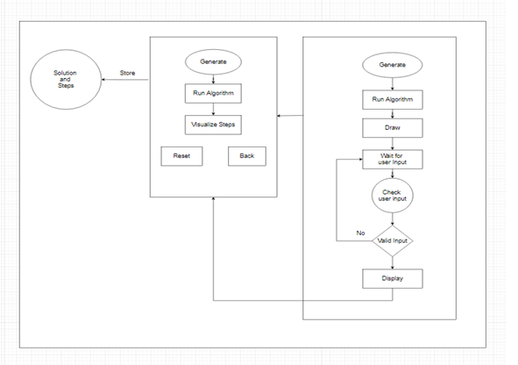
Flow Diagram :

Slide 13
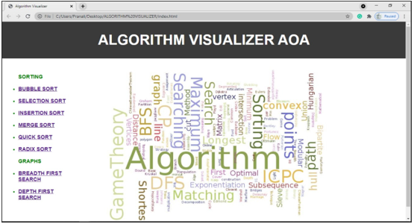
RESULT
13
13

Slide 14
FURTHER SCOPE
Project will be able to implement in future with better features after making some changes and modifications.
More Algorithms can be implemented
Problems and tutorials can be implemented
Simultaneous comparison of different algorithm
14
14

Slide 15
CONCLUSION
According to our findings, algorithm visualization can be seen as a valuable supporting tool, used in addition to standard ways of education in the field of computer science.
This system is implemented for visualizing algorithms.
This is a helpful tool for all kinds of learners/scholars to easily understand the implicit sequences of algorithm.
It helps to improve the quality of education in the field.
15
15

Slide 16
REFERENCES
https://algorithm-visualizer.org/
https://visualgo.net/en
https://www.geeksforgeeks.org/
https://sortvisualizer.com/
https://www.w3schools.com/
“Introduction to Algorithms” by Thomas
16
16

Slide 17
THANK
YOU!!!

