Slide 1
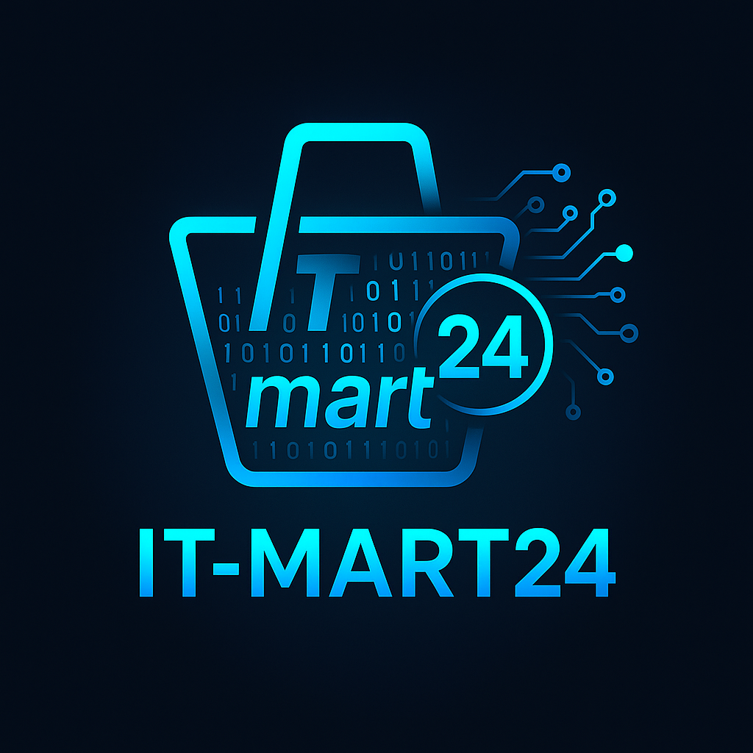
ITMart24
AI-Powered Digital Commerce Marketplace

Slide 2

1. Problem Statement
Individuals and businesses have powerful digital ideas but lack the technical clarity to choose the right software, hosting, AI tools, or IT services.
The market is flooded with overwhelming options, biased SEO content, and complex technical jargon, making decision-making confusing and risky.
Even tech-savvy professionals struggle with information overload, leading to inefficient, time-consuming, and often costly choices.

Slide 3
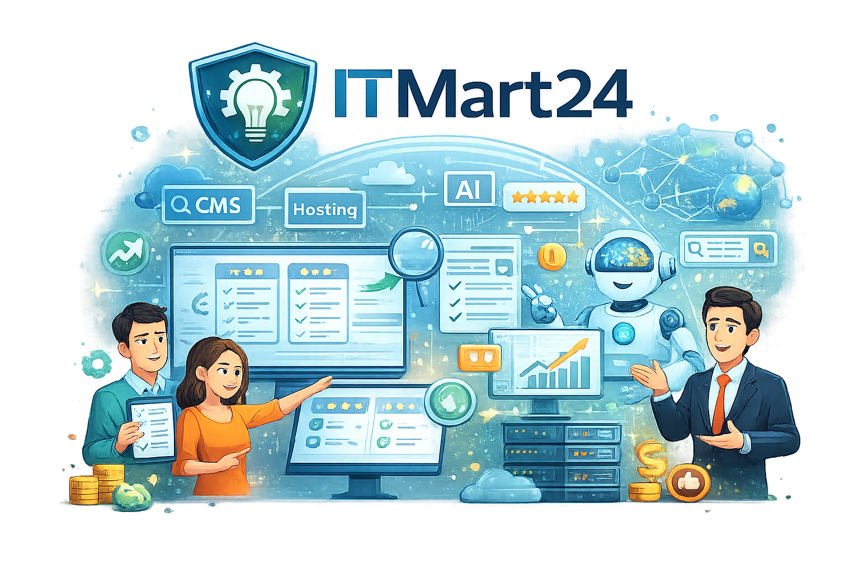
2. Clear Solution Definition – ITMart24
ITMart24 simplifies digital decision-making by helping users identify the right software, hosting, AI tools, and IT services based on their specific needs.
It provides structured comparisons, transparent reviews, and AI-powered recommendations to eliminate confusion and biased information.
ITMart24 acts as a one-stop IT discovery platform, enabling individuals and businesses to make confident, informed, and efficient technology choices.

Slide 4
Market Opportunity (2026 vs 2030 in USD Billion)

Slide 5

4. Business Model – Multi Revenue Engine
● Affiliate Programs:
Revenue through affiliate programs with registered Software, Hosting, AI, and Tutorial providers, earning
commissions on successful referrals.
Average affiliate commission 5% - 80% per successful sale
● Advertising Placements
Monetization through targeted advertising spaces for companies seeking visibility within the IT ecosystem.
Banner ads, featured placements, category sponsorships
Average Cost: ₹90,000 – ₹2,16,000 ($1000 – $2400) per month
High-intent audience ensures premium ad value

Slide 6
● SEO & PPC Visibility Campaigns
Businesses can pay for enhanced visibility via sponsored listings and performance-based click campaigns.
Average CPC: ₹80 – ₹150 ($1 – $2) per click
Ideal for vendors launching new products or scaling reach
● Premium Listings
Vendors can feature their products prominently on the homepage, top category sections, featured in blogs, top ten product pages etc.
Cost Range: ₹800 – ₹8,000 ($10 – $100)
Duration: 7 to 60 days
Drives immediate exposure and higher conversion probability
● Subscription-Based Dashboard (Recurring Revenue)
A premium dashboard for digital product owners to manage software, hosting, licenses, renewals, and performance tracking.
Includes profile page, predictive alerts for resource requirements
Centralized IT subscription management
Monthly Subscription: ₹2,500 – ₹9,500 ($30 – $115)
Builds predictable recurring revenue

Slide 7

5. Competitive Advantage
● Apart from features like Personalized AI Recommendations, a Structured Decision Framework, Multi-Category Coverage, and Transparent Comparison Tools, ITMart24 is fundamentally designed as a true digital marketplace.
● Just as Amazon operates as a marketplace for physical products, ITMart24 operates as a marketplace for digital products — including software, hosting, AI tools, digital tutorials and other digital products.
● Unlike Capterra - a software directory, There's An AI For That - a AI Tools directory, Trustpilot - product review platform, and other directory-style platforms that primarily focus on listings or reviews,
ITMart24:
Enables vendor onboarding and active participation
Supports promotional placements and performance campaigns
Facilitates discovery, comparison, and conversion within one ecosystem
Builds a transactional, scalable digital commerce environment
In short, others are directories or review platforms — ITMart24 is a structured digital commerce marketplace.

Slide 8

6. Traction
● Platform Live: ITMart24.com is fully operational with approximately 1,000 digital products listed across software, hosting, AI tools, and digital tutorials.
● Vendor Infrastructure Ready: A dedicated Vendor Panel has been fully developed and integrated, enabling vendor onboarding, product management, and promotional features — scheduled to go live soon.
● AI Recommendation Engine in Development: The AI-powered personalized recommendation system is currently under development, designed to enhance user decision-making and improve conversion efficiency

Slide 9

7. Growth Strategy
● Product Development Roadmap (Feb – Aug)
⦿ February 26 – August (6 Months):
• Complete full platform development including:
• Vendor marketplace activation
• AI recommendation engine
• Advanced comparison system
• Subscription dashboard
• Scalable backend & analytics integration
● Revenue Activation Begins: Sep 2026
Monetization starts while development continues toward full optimization by August.

Slide 10
● Subscription-Based Vendor Onboarding (Primary Growth Driver)
⦿ Phase 1: Initial Scale Sep Onwards)
• Target: 1,000 vendors onboarded
• Average Monthly Subscription: $30 (~₹2,700)
• Projected Monthly Revenue:
1,000 × $30 = $30,000 (~₹27,00,000/month)
⦿ Phase 2: 12-Month Expansion
• Target: 10,000 vendors
• Projected Monthly Revenue:
10,000 × $30 = $300,000/month (~₹2.7 Cr/month)
This builds predictable, recurring revenue and strengthens marketplace depth.
● Affiliate Program Revenue (Performance-Based Layer)
⦿ Average Commission per Sale: $30
⦿ Initial Target:
2 sales per vendor / month × 1,000 vendors = 2,000 sales/month
⦿ Revenue Projection:
2,000 × $30 = $60,000/month (~₹54,00,000)
Affiliate revenue scales proportionally with traffic growth and vendor expansion.

Slide 11
● Advertising Placements (Premium Regional Model)
• Max 10 premium ads per region per week
• Price: $150 (~₹13,500) per ad
• Targeting: 5 regions initially
• Monthly Potential Capacity:
$150 × 10 ads × 5 regions × 4 weeks
= $30,000/month (~ ₹27,00,000)
• Initial Conservative Target:
2 ads initially
Revenue: $6,000/month (~ ₹5,40,000)
This creates scarcity-driven premium positioning.
● Premium Listings
• Target: Minimum 100 premium listings
• Price: $25 per week
• Monthly Revenue:
100 × $25 × 4 weeks
= $10,000/month (~₹9,00,000)
This supports product visibility upgrades within the marketplace.

Slide 12

8. ITMart24 – Team Structure
1) Project Head (Founder / CEO)
2) Operations Head (COO)
3) UI/UX Team (2–3 Members)
4) Development Team (4–5 Members)
5) Digital Marketing Team (3–4 Members)
6) Content & Research (2 Members)
7) Finance & Administration (1–2 Members)
Team Size Summary
Core Team: 15 Members
Expanded Structure: 17–18 Members
Lean, scalable, and role-optimized for marketplace growth

Slide 13

Financial Ask: 3 Crore Runway
9.

Slide 14

10. Month Roadmap: 12-Month Roadmap – ITMart24
(Development Until August 2026 | Revenue After August 2026)
● February – April 2026 (Core Development Phase)
• Strengthen marketplace architecture
• Finalize vendor subscription infrastructure
• Build advanced comparison engine
• Begin AI recommendation system development
• Initial vendor pipeline building (pre-launch onboarding interest)
● May – June 2026 (System Integration Phase)
• Vendor panel integration & testing
• AI recommendation engine beta testing
• Payment gateway & subscription automation setup
• UX optimization & conversion-focused redesign
• SEO foundation & large-scale content addition

Slide 15
● July – August 2026 (Finalization & Pre-Launch Phase)
• Full platform testing (security, scalability, performance)
• AI engine deployment (Version 1)
• Vendor onboarding system ready for scale
• Marketing pre-launch campaigns
• Strategic vendor partnerships finalized
⦿ Platform Fully Developed by End of August 2026
⦿ Revenue Generation Begins: September 2026
● September – November 2026 (Revenue Activation Phase)
• Launch paid vendor subscriptions
• Activate affiliate monetization
• Enable premium listings & ad placements
• Target initial 1,000 vendor onboarding
• Begin performance marketing campaigns
● December 2026 – February 2027 (Scaling Phase)
• Expand vendor base aggressively
• Scale ad placements across regions
• Optimize affiliate conversion funnels
• Introduce dashboard subscription (Phase 2)
• Improve AI personalization accuracy

Slide 16
● 12-Month Objective
• Fully operational AI-powered digital marketplace
• Revenue-generating vendor ecosystem
• Strong recurring subscription foundation
• Positioned for rapid expansion & next funding stage

Slide 17

11. Risk & Mitigation
● SEO Dependency Risk
• Risk: Over-reliance on organic traffic may slow growth if search algorithms change.
• Mitigation: Diversify acquisition channels — PPC, vendor-driven traffic, email marketing, partnerships, and social distribution.
● Vendor Acquisition Risk
• Risk: Slower vendor onboarding could impact marketplace depth and revenue targets.
• Mitigation: Dedicated vendor acquisition team, competitive pricing, early adopter incentives, and performance-based value positioning.
● Competition from Established Platforms
• Risk: Platforms like Capterra or Trustpilot have strong brand recognition.
• Mitigation: Differentiate as a structured digital marketplace with AI-powered recommendations and subscription-based ecosystem, not just a review directory.
● Monetization Delay Risk
• Risk: Revenue may take time to scale post-launch.
• Mitigation: Multi-layered revenue model (subscriptions + affiliate + ads + premium listings) to reduce dependency on a single stream.
● Technology & AI Execution Risk
• Risk: AI recommendation system may face delays or performance gaps.
• Mitigation: Phased AI rollout (MVP → Optimization), continuous testing, and scalable infrastructure planning.

Slide 18
12. Investor Exit Possibility
Investors in ITMart24 gain value through equity appreciation and strategic exit opportunities.
• Strategic Acquisition: A larger tech media company or SaaS discovery platform may acquire ITMart24 to expand their marketplace ecosystem.
• Secondary Sale: Future investors (Series A/B) can buy early investors’ shares at a higher valuation as the company scales.
• Marketplace Consolidation: As vendor subscriptions and recurring affiliate revenue grow, ITMart24 becomes a valuable digital asset attractive for buyouts.
• High-Multiple Valuation: With strong recurring revenue (MRR/ARR model), the company can achieve 5x–10x revenue-based valuation, enabling investors to exit with significant capital gains.
In simple terms:
Investors enter at an early valuation and exit when ITMart24’s value multiplies.

