Slide 1
Image Compression under the course DIP
Under the guidance of:
Dr. Smriti Bhandari
Team members:
Puja Borude (2015BCS217)
Shivani Thorat (2014BEN030)
Pratiksha Patil (2014BCS064)

Slide 2
PROBLEM STATEMENT
Given a gray scale image. Perform Huffman coding to compress image. Find Compression Ratio. Carry out experimentation on minimum 10 images of various kinds

Slide 3
Compression
Definition
Reducing the size of data
(number of bits needed to represent data)
Benefits
Reduction in the storage needed
Reduction in the transmission cost / latency / bandwidth

Slide 4
Sources of Compressibility
Redundancy
Recognize repeating patterns
Exploit using
Dictionary
Variable length encoding
Human perception
Less sensitive to some information
Can discard less important data

Slide 5
Types of Compression
Lossless
Preserves all information
Exploits redundancy in data
Applied to general data
Lossy
May lose some information
Exploits redundancy & human perception
Applied to audio, image, video

Slide 6
Lossless Compression Techniques
LZW (Lempel-Ziv-Welch) compression
Build pattern dictionary
Replace patterns with index into dictionary
Run length encoding
Find & compress repetitive sequences
Huffman codes
Use variable length codes based on frequency

Slide 7
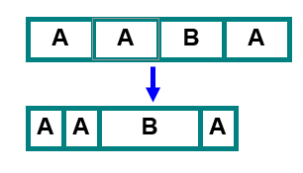
Huffman Code
Approach
Variable length encoding of symbols
Exploit statistical frequency of symbols
Efficient when symbol probabilities vary widely
Principle
Use fewer bits to represent frequent symbols
Use more bits to represent infrequent symbols

Slide 8
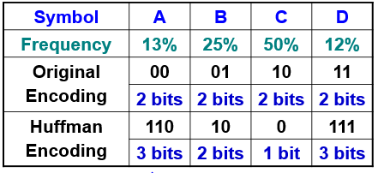
Huffman Code Example
Expected size
Original ⇒ 1/8×2 + 1/4×2 + 1/2×2 + 1/8×2 = 2 bits / symbol
Huffman ⇒ 1/8×3 + 1/4×2 + 1/2×1 + 1/8×3 = 1.75 bits / symbol

Slide 9
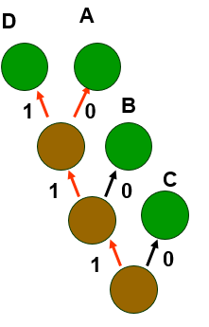
Huffman Code Data Structures
Binary (Huffman) tree
Represents Huffman code
Edge ⇒ code (0 or 1)
Leaf ⇒ symbol
Path to leaf ⇒ encoding
Example
A = “110”, B = “10”, C = “0”
Priority queue
To efficiently build binary tree

Slide 10
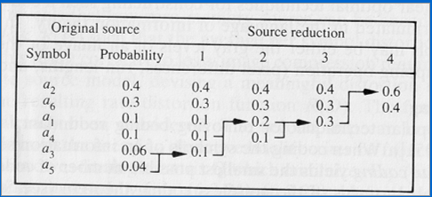
Huffman coding Algorithm
Forward Pass
1. Sort probabilities per symbol
2. Combine the lowest two probabilities
3. Repeat Step2 until only two probabilities remain.

Slide 11
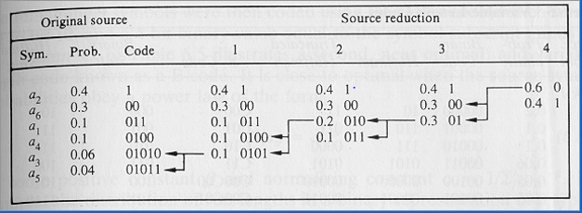
Huffman coding Algorithm(con.)
Backward Pass
Assign code symbols going backwards

Slide 12
Huffman Code Properties
Prefix code
No code is a prefix of another code
Example
Huffman(“I”) ⇒ 00
Huffman(“X”) ⇒ 001 // not legal prefix code
Can stop as soon as complete code found
No need for end-of-code marker
Nondeterministic
Multiple Huffman coding possible for same input
If more than two trees with same minimal weight

Slide 13
Huffman Code Properties
Greedy algorithm
Chooses best local solution at each step
Combines 2 trees with lowest frequency
Still yields overall best solution
Optimal prefix code
Based on statistical frequency
Better compression possible (depends on data)
Using other approaches (e.g., pattern dictionary)

Slide 14
THANK YOU!

