Slide 1

Mentor : Group no. 3 Group Members : 1. Munnanuri shiva Kumar 2. Pratiksha Manwatkar 3. D. Rohit Naidu 4. Nithyasri . A 5. Lokesh Kumar Patidar
BANK LOAN OF CUSTOMER| FINANCE

Slide 2
Project Objective
This is Bank loan of Customers project where we were provided with 2 datasets with .csv extension files having 39k rows each and the objective was to analyze the growth that bank got within given years in loans.
We used MS-Excel, MySQL for analyzing, cleaning and removing duplicates from dataset and prepared dashboard using Tableau and Power-BI tools where we did calculations, merging and prepared interactive dashboards.

Slide 3
Contents
KPI-1 : Year Wise Loan Amount Stats
KPI-2 : Grade And Sub-grade Wise revol_balance
KPI-3 : Total Payment For Verified Status And Non-verified Status
KPI-4 : State Wise Month Wise Loan Status
KPI-5 : Home Ownership VS Last Payment Date Stats

Slide 4
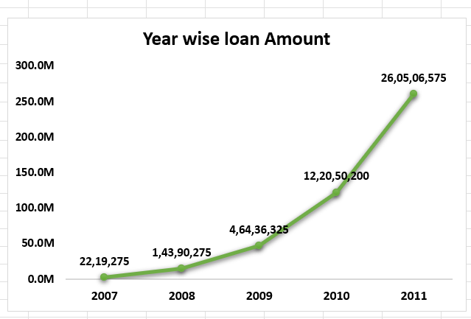
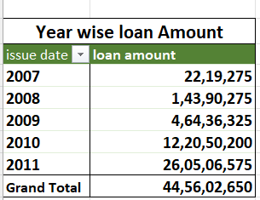
KPI - 1
Year wise loan Amount stats :
By observing the chart we can see how Loan Amount is increasing by year.
Starts from 2007 the loan amount is 22,19,275 and in the 2011 the loan amount is 26,05,06,575. We can subtract the new value to the old value to see the difference
26,05,06,575 - 22,19,275 = 258287300
258287300 increased in the duration of 5 years
And Grand Total of all years is 44,56,02,650.00

Slide 5
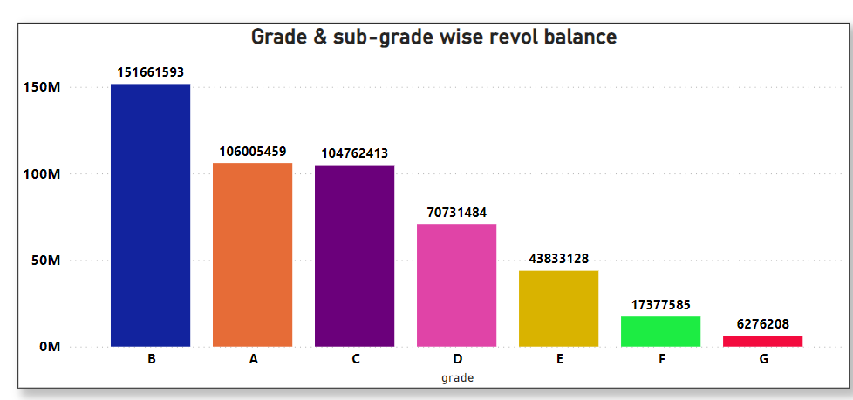
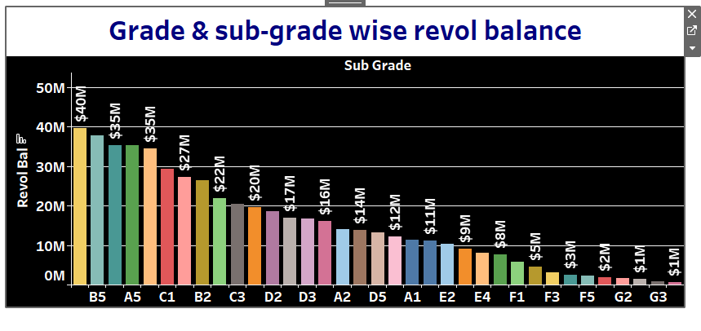
KPI – 2
Grade and sub-grade wise revol_balance :
In this Grade and subgrade wise revol balance we can notice Grade-B have more revol balance then any other grade & Grade-G have very low revol balance.
As we can see that Grade B customers has higher annual income for 10+ years of employment period, so higher the annual income lower the Debt to income ratio and hence, more number of customers took loan in Grade B .
Similarly, it goes for other grades also B>A>C>D>E>F>G order for revol bal as per annual income

Slide 6
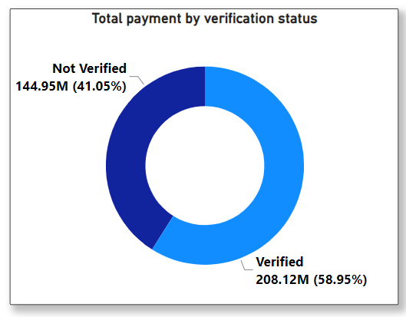
KPI - 3
Total payment for Verified & Non-verified status :
This is the first stage of the verification process. The bank needs a loan application to initiate the document collection and verification process
Looking at pie chart we can observe that verified status have 58.95% of total payment and 41.05% of total payment which are Not Verified for the Loan Amount

Slide 7
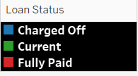
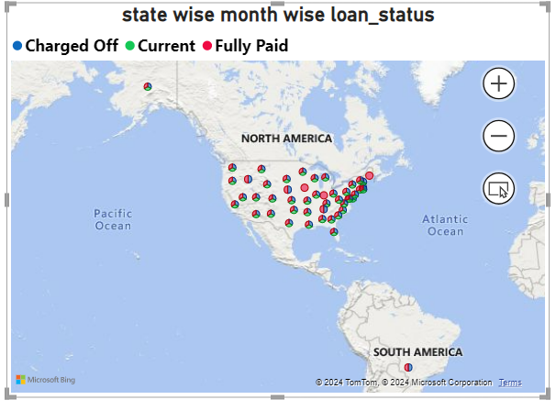
KPI - 4
State wise month wise loan status :
The right graph shows the count of Loan Status in each state of USA on particular last credit pull date.
As we know CA has given maximum customers who took Loan i.e >5000 is the count of loan status
This shows that 97% of bank customers have fully paid status for each state.

Slide 8
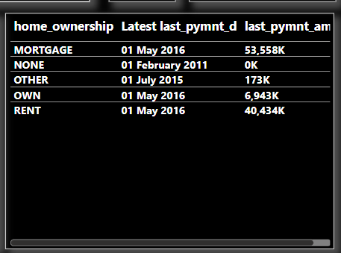
KPI – 5
Home ownership VS last payment date stats :
The right graph shows the Home ownership and the amount paid for each on last payment date.
Here, we can see that maximum latest amount paid by customers with MORTGAGE home ownership is Rs.53,558K.
It concludes that many of the customers are about to repay their loan amount for their particular home ownership.

Slide 9
CONCLUSION
On the basis of various techniques applied for financial analysis of bank loan we can arrive to the conclusion that the financial position and overall performance of bank is satisfactory and loan amount and the customers of bank has increased over the period of time and bank has maintaining the profitability position.
This analysis will provide valuable information to a wide range of stakeholders from banks and borrowers to investors, regulators, credit rating agency, economists and consumers.

Slide 10
THANK YOU !

