Slide 1

HOTEL RESERVATION ANALYSIS WITH SQL

Slide 2
OBJECTIVE
Analyzing a hotel reservation dataset using SQL to gain insights into guest preferences, booking trends, and other critical factors that influence hotel operations.
SCOPE
Using a provided dataset that includes various details about hotel reservations, the analysis will address key questions to inform decision-making and enhance guest experiences. The analysis aims to uncover patterns and trends related to bookings, guest demographics, and financial metrics.

Slide 3
DATA OVERVIEW
Booking_ID: A unique identifier for each hotel reservation.
no_of_adults: The number of adults in the reservation.
no_of_children: The number of children in the reservation.
no_of_week_nights: The number of nights in the reservation that fall on weekdays.
type_of_meal_plan: The meal plan chosen by the guests.
room_type_reserved: The type of room reserved by the guests.
lead_time: The number of days between booking and arrival.
arrival_date: The date of arrival.
market_segment_type: The market segment to which the reservation belongs.
avg_price_per_room: The average price per room in the reservation.
booking_status: The status of the booking.

Slide 4
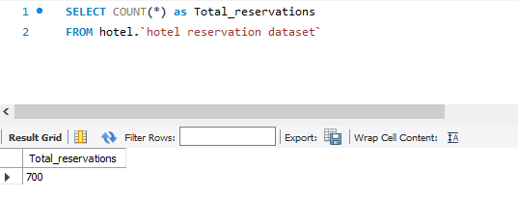
1. What is the total number of reservations in the dataset?

Slide 5
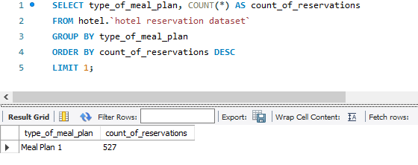
2. Which meal plan is the most popular among guests?

Slide 6
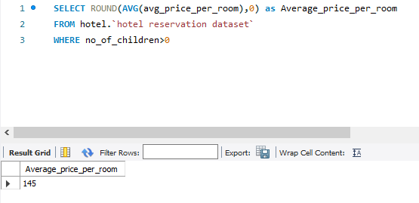
3. What is the average price per room for reservations involving children?

Slide 7
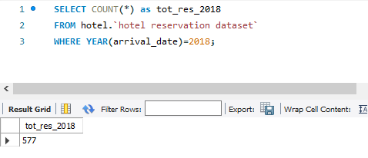
4. How many reservations were made for the year 20XX (replace XX with the desired year)?

Slide 8
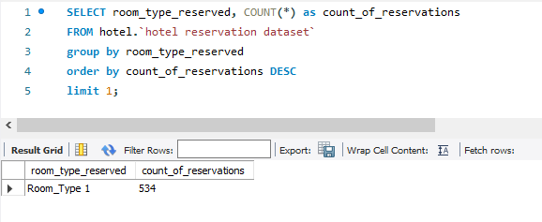
5. What is the most commonly booked room type?

Slide 9
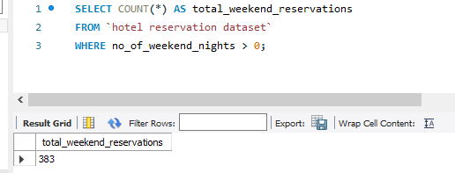
6. How many reservations fall on a weekend (no_of_weekend_nights > 0)?

Slide 10
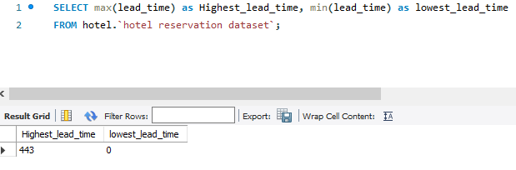
7. What is the highest and lowest lead time for reservations?

Slide 11
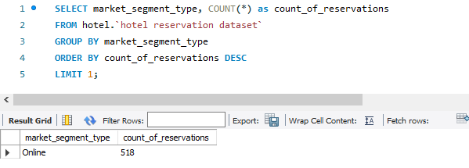
8. What is the most common market segment type for reservations?

Slide 12
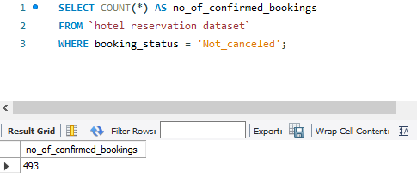
9. How many reservations have a booking status of "Confirmed"?

Slide 13
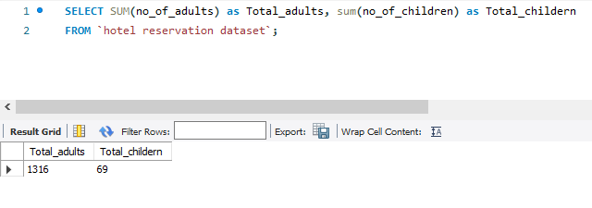
10. What is the total number of adults and children across all reservations?

Slide 14
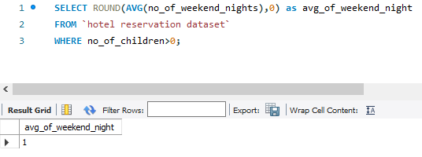
11. What is the average number of weekend nights for reservations involving children?

Slide 15
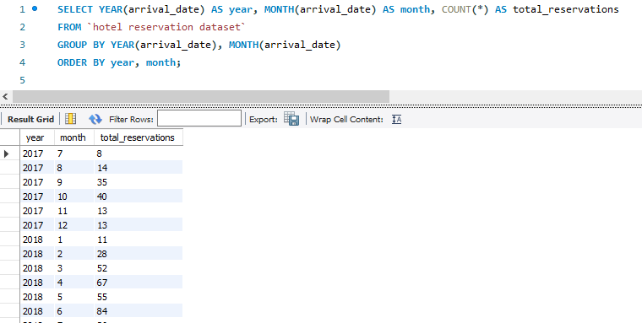
12. How many reservations were made in each month of the year?

Slide 16
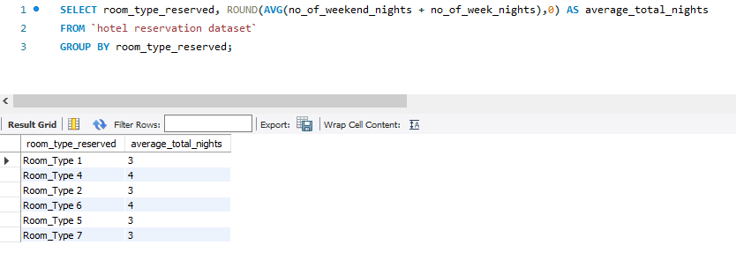
13. What is the average number of nights (both weekend and weekday) spent by guests for each room type?

Slide 17
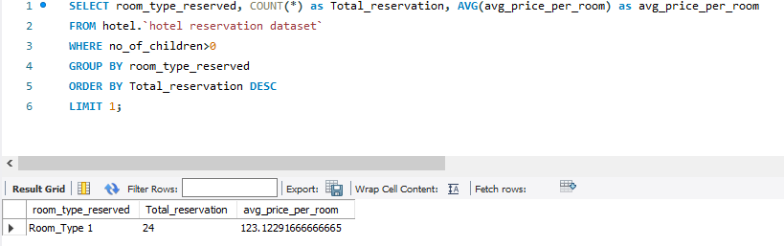
14. For reservations involving children, what is the most common room type, and what is the average price for that room type?

Slide 18
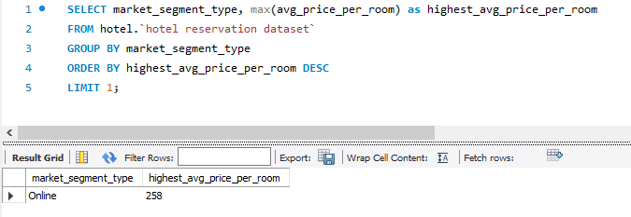
15. Find the market segment type that generates the highest average price per room.

Slide 19
Insights and Recommendations
Based on the analysis, Meal plan 1 is the most ordered among guests, indicating a strong preference for its offerings. Improving feedback collection, customizing the menu to suit guests' tastes, and adjusting prices strategically will make Meal plan 1 even more appealing.
Room type 1 is the most booked room type. Consider examining the specific attributes of room type 1 that make it popular, such as its price, amenities, layout, and location within the hotel. Applying similar successful elements to other room types can improve overall guest satisfaction.
The online market segment is the most common for reservations. Investing in and improving the online booking platform, making it mobile-friendly, and offering special online-only promotions can attract more guests.

