Slide 1

YOUTUBE SONGS ANALYSIS

Slide 2
OBJECTIVE
The goal is to utilize Power BI to create insightful visualizations and reports that provide a deeper understanding of YouTube song’s performance, popularity, and user engagement.

Slide 3
DATA OVERVIEW
1. video_id: Unique identifier for each YouTube video.
2. channelTitle: Title of the YouTube channel publishing the song.
3. title: Title of the YouTube song video.
4. description: Description provided for the YouTube song video.
5. tags: Tags associated with the YouTube song video.
6. publishedAt: Date and time when the YouTube song video was published.
7. viewCount: Number of views received by the YouTube song video.
8. likeCount: Number of likes received by the YouTube song video.
9. favoriteCount: Number of times the YouTube song video has been marked as a favorite.
10. commentCount: Number of comments posted on the YouTube song video.
11. duration: Duration of the YouTube song video.
12. definition: Video definition or quality (e.g., HD, SD).
13. caption: Availability of captions for the YouTube song video.

Slide 4
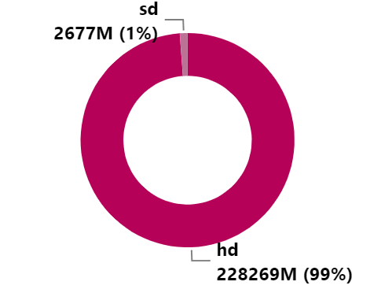
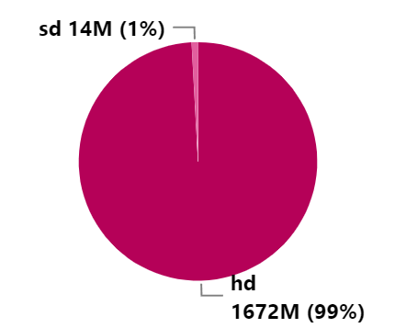
LIKES AND VIEWS BY VIDEO QUALITY
This section examines the correlation between video quality and the popularity metrics, specifically likes and views, of YouTube music videos. The analysis considers quality levels as hd and sd.
99% of people prefer high-definition (HD) quality when it comes to likes and views on YouTube.
LIKES BY VIDEO QUALITY VIEWS BY VIDEO QUALITY

Slide 5
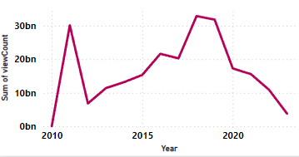
TOTAL VIEWS BY YEAR
This section presents the total number of views accumulated by YouTube music videos over different years. The analysis aims to identify trends and patterns in viewership over time.
In 2018, the total views reached 32.8 billion, which is the highest among all years.
In 2019, the total views reached 31 billion, which is the second highest among all years.

Slide 6
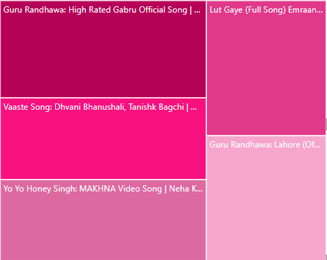
TOP SONGS BY COMMENTS
People gave the highest number of comments for the song 'High Rated Gabru' by Guru Randhawa, with a total of 420,375 comments.
This demonstrates the song's exceptional impact and the high level of engagement it generated among viewers.
The second highest number of comments was for 'Vaaste,' with 353,057 views.

Slide 7
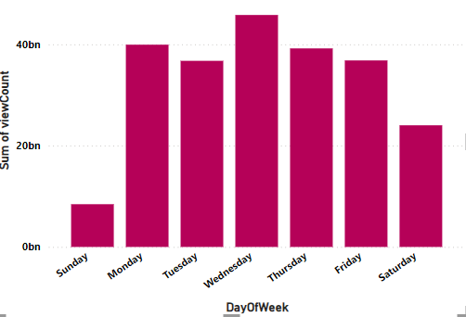
VIEWS BY DAY OF THE WEEK
On Wednesday, YouTube songs receive the highest number of views, with a total of 45.7 billion views.
On Thursday, YouTube songs receive the second highest number of views, with a total of 39 billion views.

Slide 8
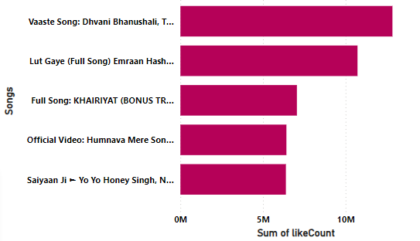
TOP SONGS BY LIKES
The song 'Vaaste' stands out as the most liked song on YouTube with 12.8 million likes, showcasing its widespread popularity and strong appeal to a diverse audience.
Following closely, 'Lut Gaye' holds the position for the second highest number of likes with 10.7 million, indicating its significant impact and widespread appreciation among viewers.

Slide 9
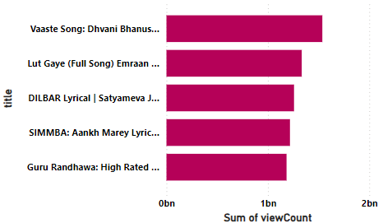
TOTAL SONGS BY VIEWS
The song 'Vaaste' stands out as the most viewed song on YouTube with 1.5 billion views, showcasing its widespread popularity and strong appeal to a diverse audience.
Following closely, 'Lut Gaye' holds the position for the second highest number of views with 1.3 billion, indicating its significant impact and widespread appreciation among viewers.

Slide 10
INSIGHTS
Viewers strongly prefer HD quality videos on YouTube, which consistently attract more likes and views compared to SD quality videos. YouTube music videos peaked in viewership with 32.8 billion views in 2018, followed closely by 31 billion views in 2019, reflecting significant engagement and content trends during those years.
'High Rated Gabru' by Guru Randhawa led with 420,375 comments, showing exceptional viewer engagement, followed closely by 'Vaaste' with 353,057 comments, indicating strong viewer interaction.
Wednesday has the highest YouTube song views at 45.7 billion, followed by Thursday at 39 billion, suggesting optimal days for release and promotion strategies.
'Vaaste' is the top-viewed song on YouTube with 1.5 billion views, demonstrating broad popularity. 'Lut Gaye' follows closely with 1.3 billion views, showing significant impact.
'Vaaste' is also the most liked song on YouTube with 12.8 million likes, reinforcing its popularity and positive reception among viewers. 'Lut Gaye' follows with 10.7 million likes, further indicating strong viewer appreciation.

